Slide 1




Transitioning Patients with Intellectual and Developmental Disabilities to Adult Care
Laurie J. Glader, MD
Professor of Pediatrics
The Ohio State University College of Medicine
Chief, Section of Complex Health Care
Medical Director, Comprehensive Cerebral Palsy Program
Nationwide Children’s Hospital
Carl V. Tyler, MD MSc
Professor of Family Medicine and Community Health
Cleveland Clinic Lerner College of Medicine
Case Western Reserve University School of Medicine
Director, Developmental Disabilities – Practice-Based Research Network

Slide 2
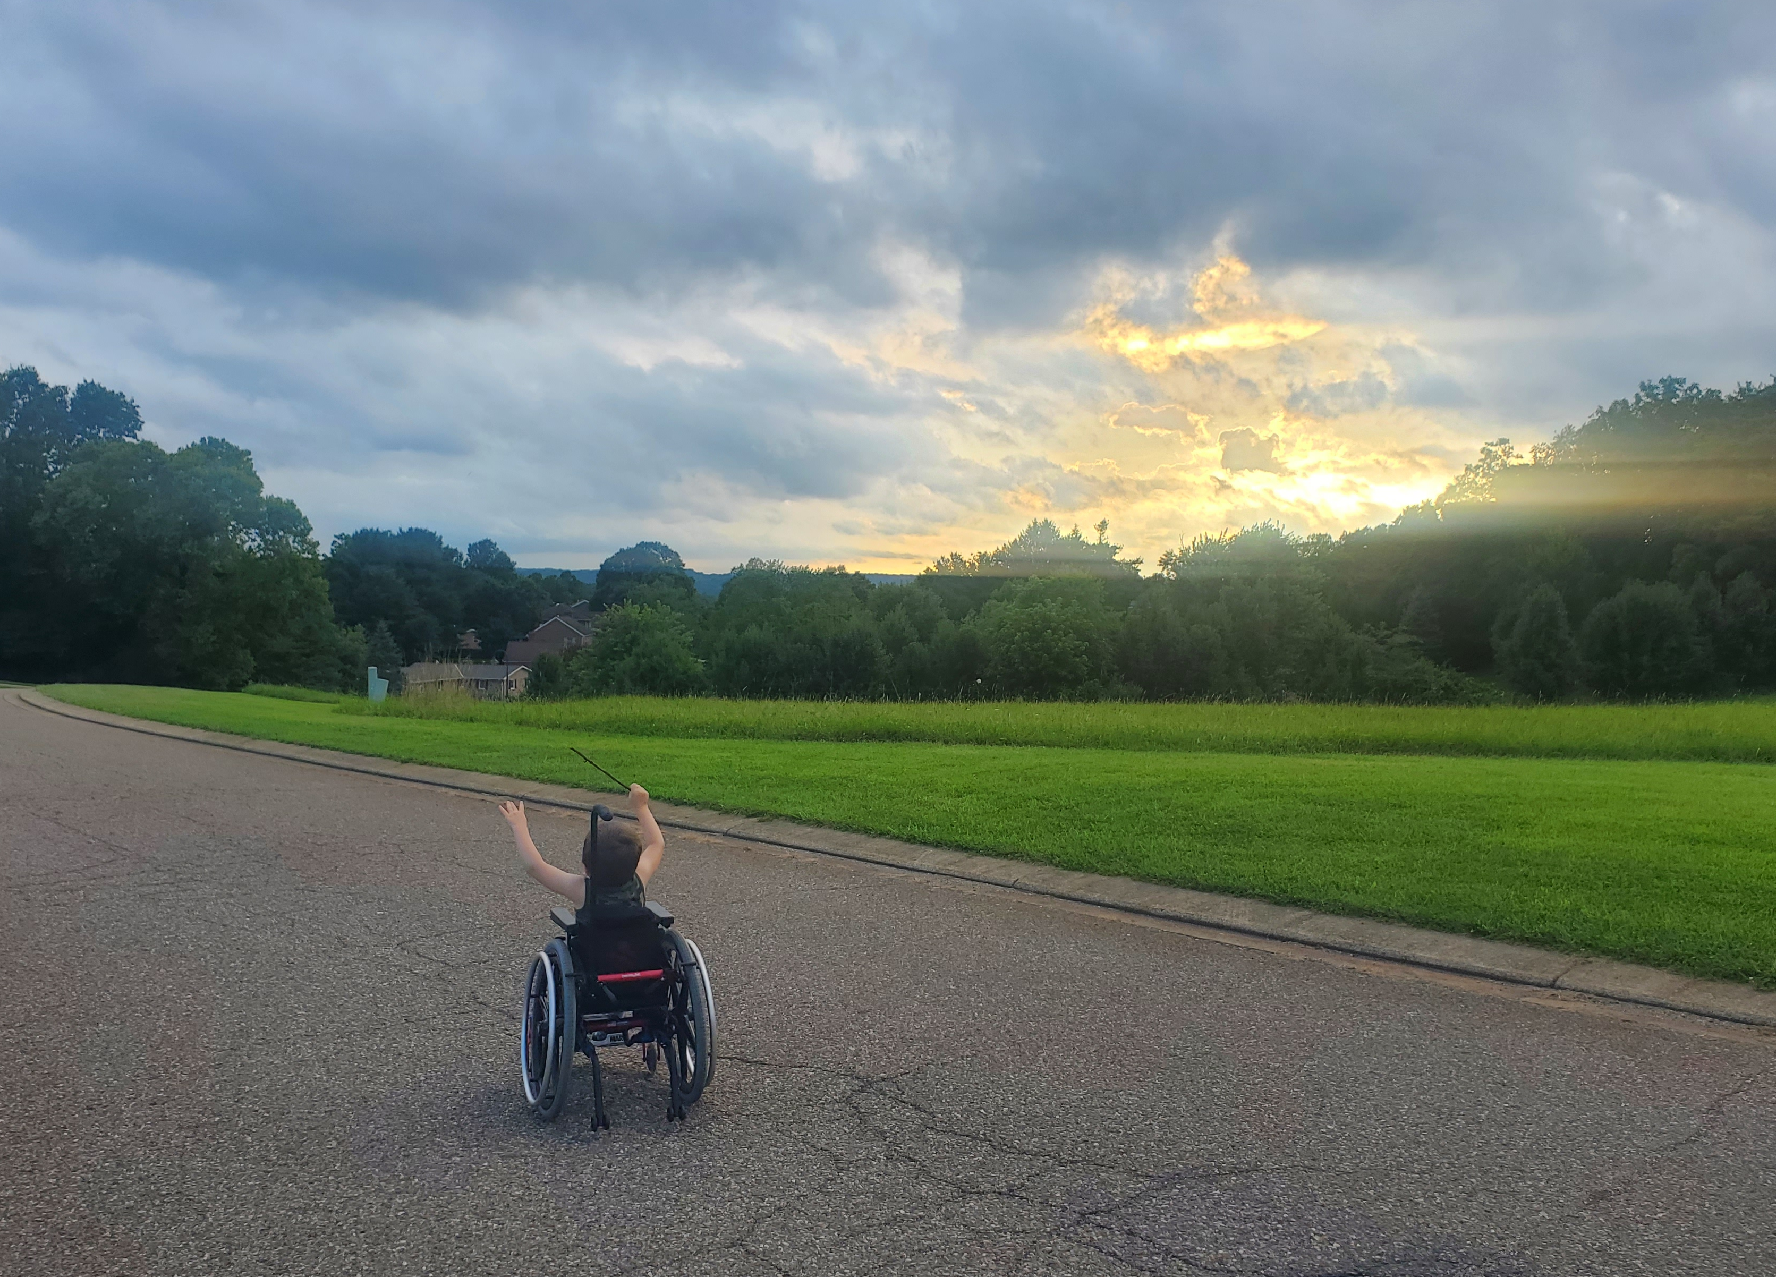
Transition agenda
Terminology
Core elements
Pediatric and adult perspectives
Challenges and opportunities
What is successful transition?

Slide 3

Transition defined
“…the purposeful and planned process of moving from pediatric to adult care services beginning in adolescence and continuing into early adulthood.”
Different from transfer: a one-time event when the responsibility of care shifts from a pediatric to adult provider

Slide 4
The facts
Lapses in healthcare access
Preventable ED visits and hospital admissions
Increased demand on pediatricians not trained in adult medicine
Approximately 14 million youth in the US ages 0-21yrs have special health care needs
Some are independent and some remain reliant on caregivers for medical decision making
86% do not benefit from fully functional medical systems, including support transitioning to adult care
Most children with chronic conditions survive into adulthood
  Failure to transition

Slide 5

Six core elements
Policy/Guide
Tracking and monitoring
Readiness
Planning
Transfer of care
Transition complete
Age 12-14
White P, Schmidt A, Shorr J, Ilango S, Beck D, McManus M. Six Core Elements of Health Care Transition™ 3.0. Washington, DC: Got Transition, The National Alliance to Advance Adolescent Health; July 2020.
Age 14-18
Preparation
Transfer from pediatric to adult care
Age 18-21
Integration into adult-based care
Age 18-23

Slide 6
Six core elements
Policy/Guide
Tracking and monitoring
Readiness
Planning
Transfer of care
Transition complete
TRANSITION
White P, Schmidt A, Shorr J, Ilango S, Beck D, McManus M. Six Core Elements of Health Care Transition™ 3.0. Washington, DC: Got Transition, The National Alliance to Advance Adolescent Health; July 2020.
TRANSFER

Slide 7

Preparation: Policy Guideline
Age 12-14
Start early!!
Transition policy
  Practice approach
  Guidelines about privacy, consent
  Anticipated age of transition
Display it

Slide 8

Preparation: Tracking and Monitoring
Age 14-18
Practice level: establish a mechanism for identifying transition age youth
Individual level: track progress in transition
  Readiness skill acquisition
  Development of a care plan
  Need for supported decision making
  Identification of an adult provider

Slide 9
Preparation: Transition Readiness
Age 14-18
Conduct transition readiness assessments
  Needs for self-care
  Health care decision making
  Self advocacy
Skill acquisition depends on a complex array of factors
Offer education/resources to address identified needs
This is a key factor and has been identified in diverse patient populations: cystic fibrosis, congenital heart disease, diabetes, asthma, mental health conditions, neuromuscular disease

Slide 10
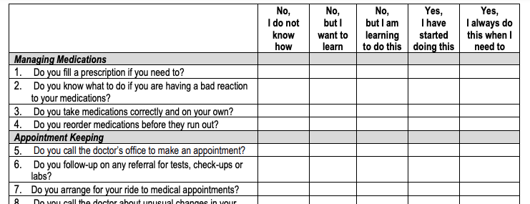
Transition Readiness Assessment Questionnaire
Sawicki G, et al. Measuring the Transition Readiness of Youth with Special Healthcare Needs: Validation of the TRAQ – Transition Readiness Assessment Questionnaire. J Peds Psychol. 36(2). 2009.

Slide 11
Preparation: Transition Planning
Age 14-18
Create and augment a plan of care
  Medical summary
  Emergency care plan
  Legal documents
  Condition fact sheet
  Readiness assessment findings
  Action items
Identify need for decision-making supports
Plan timing of transfer (primary/specialty)
Identify an adult clinician, community supports
Anticipate insurance shifts

Slide 12

Transfer of Care
Age 18-21
Transfer package + letter
Communicate with the adult provider
Transfer during a period of relative clinical stability
Continue to provide care up until the first appointment

Slide 13

Transition completion
Age 18-23
Outreach to confirm appointment completion
Offer consultation as needed to the adult practice
BUILD COLLABORATIONS WITH ADULT PRACTICES!!

Slide 14

Process influencers
Personal
Emotional and cognitive development
Individual and/or family supports
Social determinants
Practice
“Transition champion” or “It takes a village!”
Support ($$, time) for transition related activities
Knowledge/access to transition tools
Communication between pediatric and adult systems

Slide 15

Future challenges and direction
What defines successful transition?
What are patient-related outcome measures?
Does successful transition improve young adult outcomes?
How do we educate the provider work force?

Slide 16
Resources
https://www.gottransition.org
Sawicki GS, Lukens-Bull K, Yin X, Demars N, Huang IC, Livingood W, Reiss J, Wood D. Measuring the transition readiness of youth with special healthcare needs: validation of the TRAQ--Transition Readiness Assessment Questionnaire. J Pediatr Psychol. 2011 Mar;36(2):160-71. doi: 10.1093/jpepsy/jsp128. Epub 2009 Dec 29. PMID: 20040605; PMCID: PMC3415980.
White PH, Cooley WC; Transitions Clinical Report Authoring Group; American Academy of Pediatrics; American Academy of Family Physicians; American College of Physicians. Supporting the Health Care Transition From Adolescence to Adulthood in the Medical Home. Pediatrics. 2018;142(5):e20182587. Pediatrics. 2019 Feb;143(2):e20183610. doi: 10.1542/peds.2018-3610. Erratum for: Pediatrics. 2018 Nov;142(5): PMID: 30705144.
McLellan SE, Mann MY, Scott JA, Brown TW. A Blueprint for Change: Guiding Principles for a System of Services for Children and Youth With Special Health Care Needs and Their Families. Pediatrics. 2022 Jun 1;149(Suppl 7):e2021056150C. doi: 10.1542/peds.2021-056150C. PMID: 35642876.

Slide 17
Process Map for Primary Care of Adults with Developmental Disabilities

Slide 18

Stages of Transition
Preparation
1
Transfer from pediatric to adult care
2
Integration into adult-based care
3
Notes:
The goal of transition is
To improve the ability of youth and young adults with special health care needs to manage their own health care effectively and to use health services
To ensure an organized process in pediatric and adult health care practices to facilitate transition preparation, transer of care and integration into adult-based care

Slide 19
Practice Recommendations
Provide young people who have an intellectual or other developmental disabilities (IDD) with a defined, explicit process for making the transition into the adult health care system.
Conduct an annual comprehensive, systematic health assessment for patients who have IDD to improve detection of serious conditions and sensory impairments.
Encourage young people and adults with IDD to participate in regular physical activity to reduce psychosocial stressors and counteract metabolic syndromes.

Slide 20
Pre-Visit Questionnaire
Hello, my name is ___, a nurse/ medical assistant from X Family Health Center. I understand that (name) is coming to our office for an appointment on (date). I am calling to prepare our health care team to make this first appointment a successful one for you and (name).
How would (name) prefer to be called?
Who will be accompanying (name) to the appointment? What parts of the appointment will they remain for?
What are things that make (name) anxious or fearful that we might avoid doing? Are there certain topics we should avoid bringing up? Are there certain procedures we should avoid attempting to do the first appointment?
Does (name) have any particular sensitivities we should be aware of (light, sound, touch)?
What are things that help calm (name) that we might do? Are there some topics that put (name) at ease?
How does (name) best communicate?
Is there anything else the health care team might do to prepare for the appointment?
Does (name) need PPE equipment, wheelchair, oxygen, or other medical equipment upon their arrival? What would you want to happen that would make for a successful first appointment?
What strategies or techniques have care providers used in the past that have been helpful with (name) in making their healthcare visits successful?
Is there anything else you would like me to know that we didn't talk about?
Would it be helpful if I talked with (preferred name) now about their upcoming appointment?

Slide 21
Transition Essentials
Teach and practice disability etiquette
Conduct systematic health checks annually
Utilize etiologic diagnosis to tailor health care
Individualize preventive care according to risk profile, functional abilities, motivation and resources
Optimize chronic disease management
Screen for mental and behavioral health issues
Address weight management & physical inactivity
Apply holistic approach that acknowledges social, environmental, vocational, and spiritual impacts on health

Slide 22
Resources for Making the Health Care Transition in Patients with Intellectual and Developmental Disabilities (IDD)
Resources for making the health care transition in patients with intellectual and developmental disabilities (IDD)
Resource | Description | Location on the website
The Association for Driver Rehabilitation Specialists | Driving fact sheets for various disabilities, including information on finding a local driver rehabilitation specialist | www.aded.net/page/510
Association of University Centers on Disabilities | Resources on postsecondary education and relevant national policies | www.aucd.org/template/page.cfm?id=273
Employer Assistance and Resource Network on Disability Inclusion | State vocational rehabilitation agencies, including links | www.askearn.org/state-vocational-rehabilitation-agencies
Got Transition | Structured processes and resources surrounding health care transition geared toward patients and providers, including reimbursement strategies | https://gottransition.org
Medicaid Waivers | Links to state Medicaid waiver programs | http://medicaidwaiver.org
National Resource Center for Supported Decision-Making | Resource hub and states’ supported decision-making options | www.supporteddecisionmaking.org
Supplemental Security Income | Information on benefits of this program of the Social Security Administration | www.ssa.gov/benefits/ssi
The Arc | National advocacy organization that serves people with IDD and their families | www.thearc.org
Think College | Search and comparison tools for postsecondary education for students with an intellectual disability | https://thinkcollege.net/college-search
Ticket to Work | Federal program facilitating employment for those receiving disability benefits, including information on retaining Medicaid benefits while working | https://choosework.ssa.gov/index.html
TransCen, Inc. | National organization providing employment resources and support for people with disabilities | www.transcen.org

Slide 23

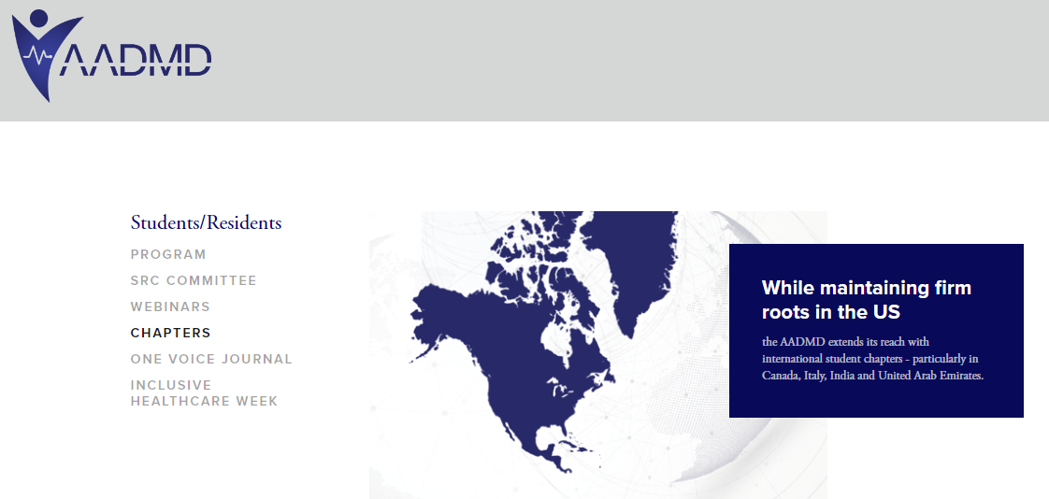
American Academy of Developmental Medicine and Dentistry
Purposes of AADMD Student/Resident Chapters
To create a forum in which training healthcare professionals may exchange experiences & ideas with regard to caring for patients with IDD.
To establish alliances between visionary advocacy & healthcare organizations for the primary purpose of achieving better healthcare.
To create a space for mentorship & exchange of knowledge/experience between seasoned IDD providers, entry-level clinicians, & future healthcare providers in training.
To promote awareness about the need of early professional training of caring for those with IDD.
American Academy of Developmental Medicine and Dentistry

Slide 24


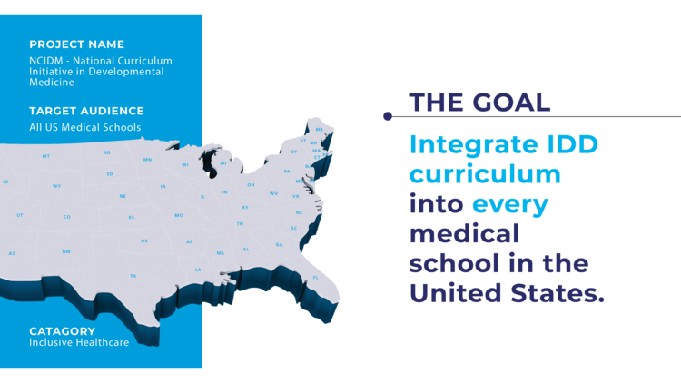
National Curriculum Initiative in Developmental Medicine
NCIDM was a 5-year CDC-funded initiative to enhance medical school curriculum about IDD
Participating medical school utilized consortium resources and expertise to refine their curricula

Slide 25
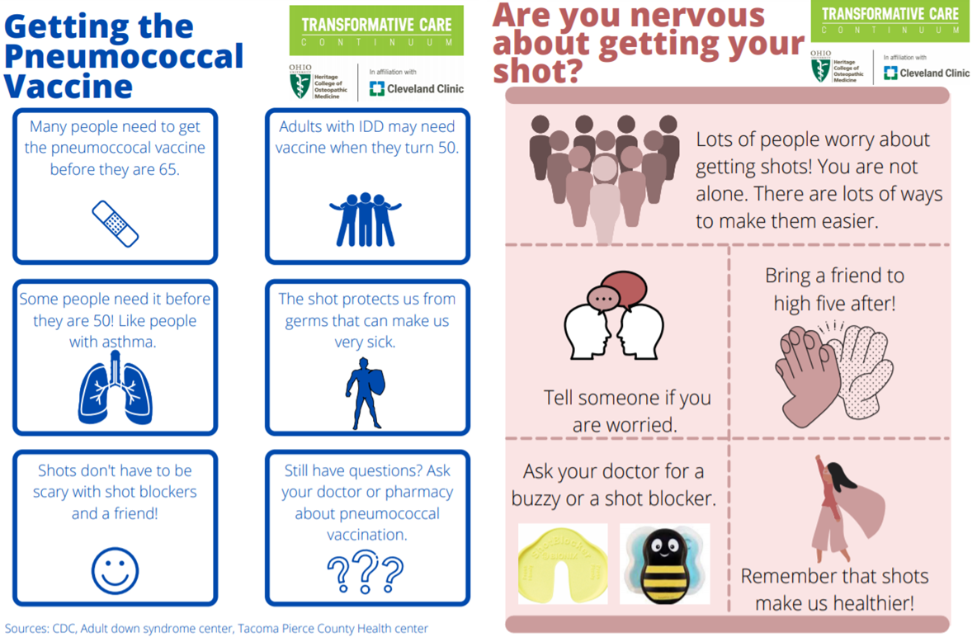

NCIDM at
OU-HCOM
  Down syndrome panel
  IDD-focused quality improvement project
  Assistive technology
  Osteopathic manipulative therapy (OMT)
  Health system-community partnership

Slide 26




Family Medicine Residency Training
Emphasize the role of community in promoting health for patients with IDD
Assistive technology
Employment services: Project SEARCH
Fitness: Special Olympics
Social integration: GiGi’s Playhouse

Slide 27
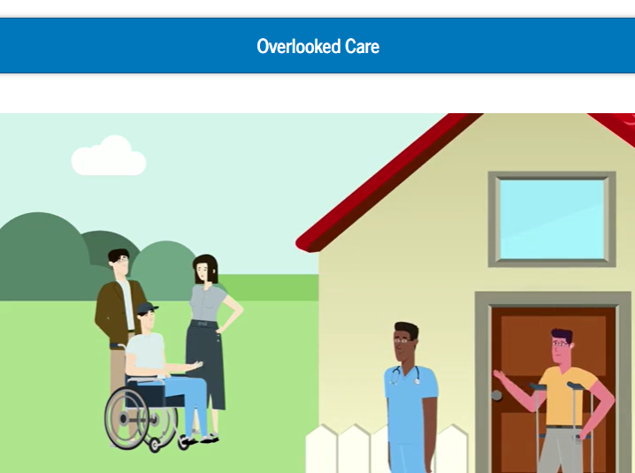
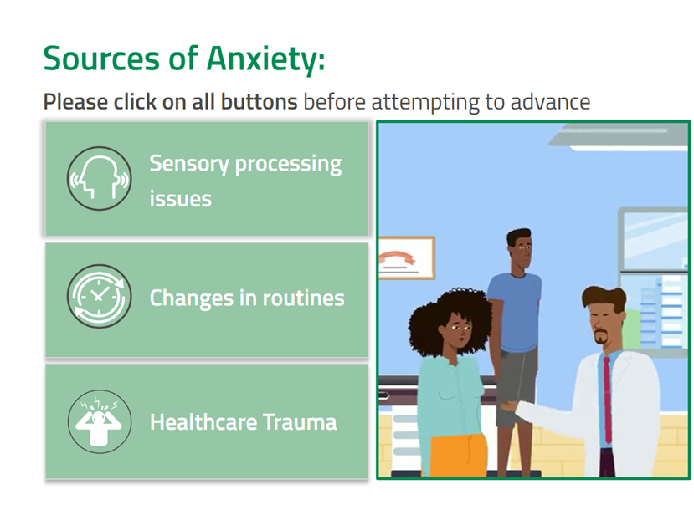
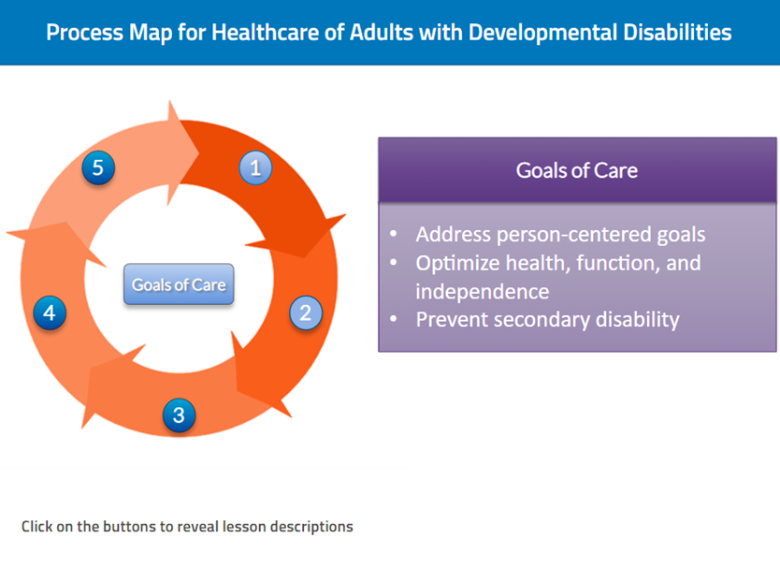
IDD Health Enterprise-Wide: e-Learning

Slide 28

Communicating with Adults who have IDD

Slide 29
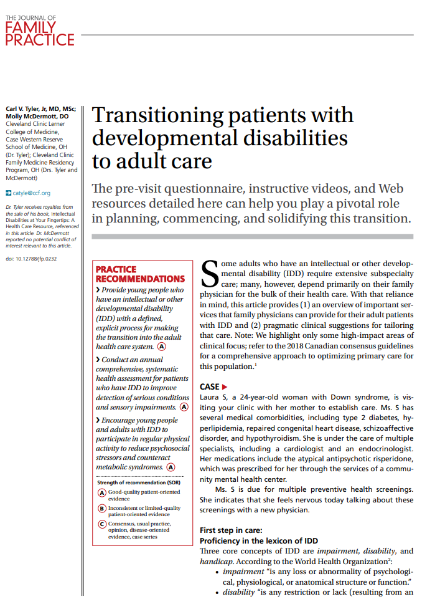

“Transitioning patients with developmental disabilities to adult care”
Carl V. Tyler Jr. MD, MSc & Molly McDermott DO, 2021
https://www.ohiof2f.org/wp-content/uploads/2021/11/Transitioning-patients-with-dd-to-adult-care-1.pdf

Slide 30
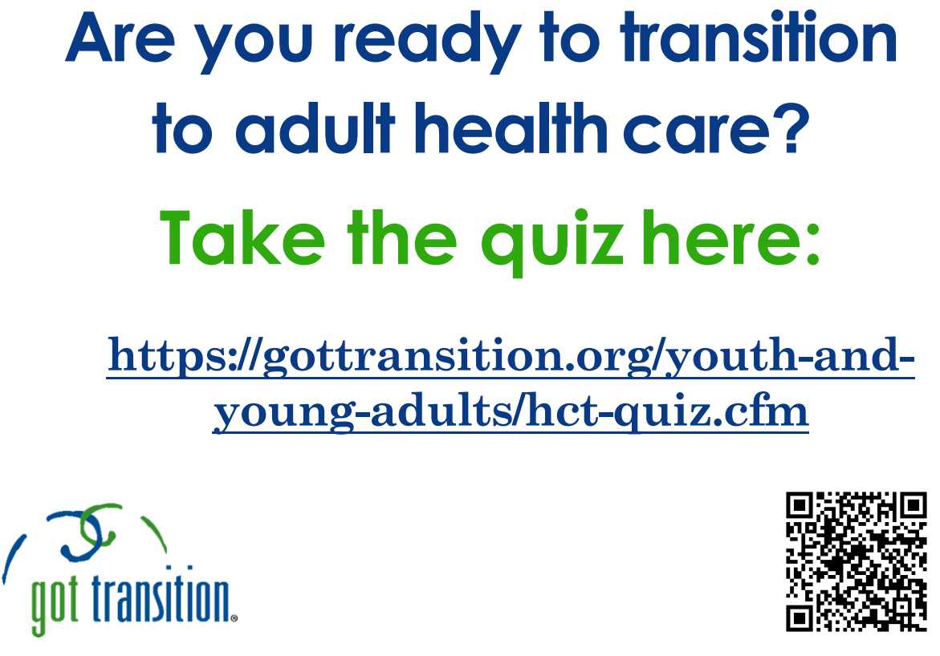
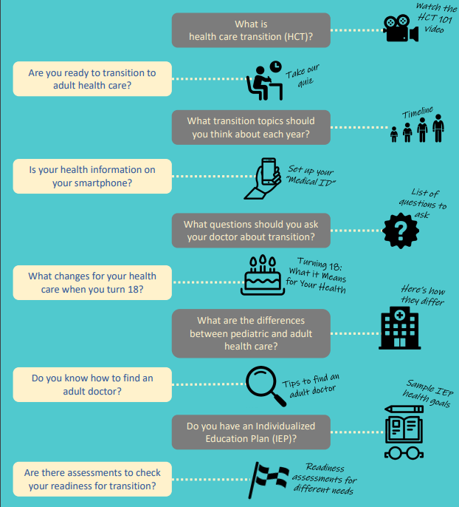
GotTransition.org

