Slide 1
Improving Outcomes for People with Disabilities
Health Care Professional Virtual Roundtables
Intervening Early
October 11, 2022

Slide 2
Today
Closed Captions & Interpreter
Chat or Raise Hand
Continuing Education
Introductions

Slide 3
Breaking the Ice
Use the chat box:
What was the first or most memorable concert you ever attended?

Slide 4
Today’s Presenter:
Dr. Laura Sorg is the Medical Director for the Ohio Department of Developmental Disabilities.
Dr. Laura is a family physician who has focused on care throughout the life span.
Her goal is to expand awareness of preventative care to the over 90,000 Ohioans with developmental disabilities, as well as education to the health care professionals serving them.
Raised on a farm in Southwest Ohio, her passion for caring for others started as a classroom assistant in fourth grade to children with disabilities.
Dr. Laura’s devotion to the field was cemented when her youngest son was diagnosed with autism at the age of two.

Slide 5
Today’s Learning Objectives:
After completing this training, attendees will:
Describe how intervening early can change a child’s developmental trajectory.
Discuss how intervening early can improve outcomes for children, families, and communities.
Identify barriers families experience in referral and follow up.
Demonstrate knowledge of validated screening tools and timelines for screening.
Describe the importance of parent-completed tools.
Compare and contrast available screening tools and the limitations and strengths of these tools.
Summarize providers federal obligations related to Early Intervention under the Individual with Disabilities Act, Part C (IDEA, Part C).
Demonstrate knowledge of how to make a referral to Ohio Early Intervention.
Identify ways to improve the likelihood of follow up.

Slide 6
Case Presentation
24-month-old male
Presents for Well Child Check
Mom concerned as speech has been “a bit delayed”.
Has about ten words and several sounds.
Likes lining up toys.
Loud noises bother him. Mom says her hair dryer makes him cry.

Slide 7
You Are The Clinician: What Do You Do?
You decide to administer an MCHAT.
The patient “fails” by two points.
You and mom discuss the MCHAT and formulate a plan.
Mom agrees to not “wait and see”. Referrals are placed to Early Intervention in your county.
You and mom also decide on a referral to speech given his delay.

Slide 8
Early Intervention: Why Should We Intervene Early?
Decades of rigorous research show that children’s earliest experiences play a critical role in brain development. The Center on the Developing Child at Harvard University has summarized this research:
Neural circuits, which create the foundation for learning, behavior, and health are most flexible or “plastic” during the first three years of life. Over time, they become increasingly difficult to change.
Persistent “toxic” stress, such as extreme poverty, abuse or neglect, or severe maternal depression can damage the developing brain, leading to lifelong problems in learning, behavior, and physical and mental health.
The brain is strengthened by positive early experiences, especially stable relationships with caring and responsive adults, safe and supportive environments, and appropriate nutrition.
Early social/emotional development and physical health provide the foundation upon which cognitive and language skills develop.
High quality early intervention services can change a child’s developmental trajectory and improve outcomes for children, families, and communities.
Intervention is likely to more effective and less costly when provided early in life rather than later.

Slide 9
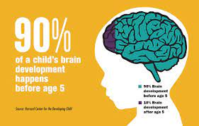
Why Intervene Early?
International Standard = Early Intervention
The skills that emerge in the early years are important prerequisites for success in school and later in the workplace and community.
The basic principles of neuroscience indicate that early preventive intervention will be more efficient and produce more favorable outcomes than remediation later in life.

Slide 10
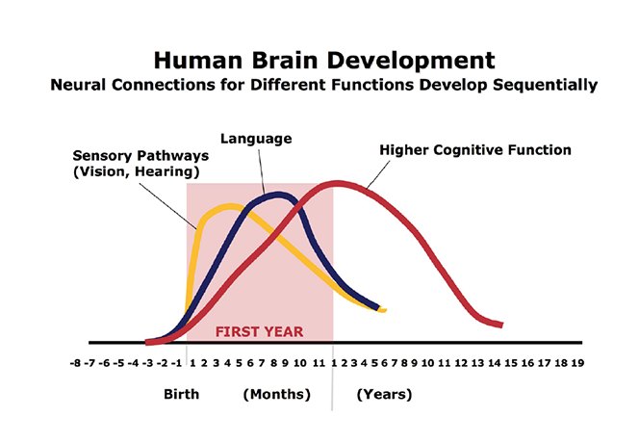
Center on the Developing Child (2007). The Science of Early Childhood Development (InBrief). From www.developingchild.harvard.edu

Slide 11
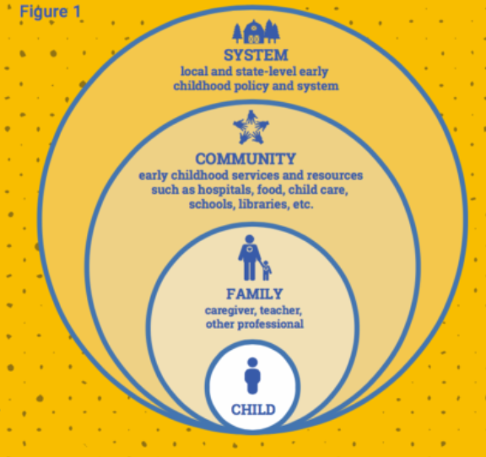
https://developingchild.harvard.edu/resources/brain-hero/

Slide 12
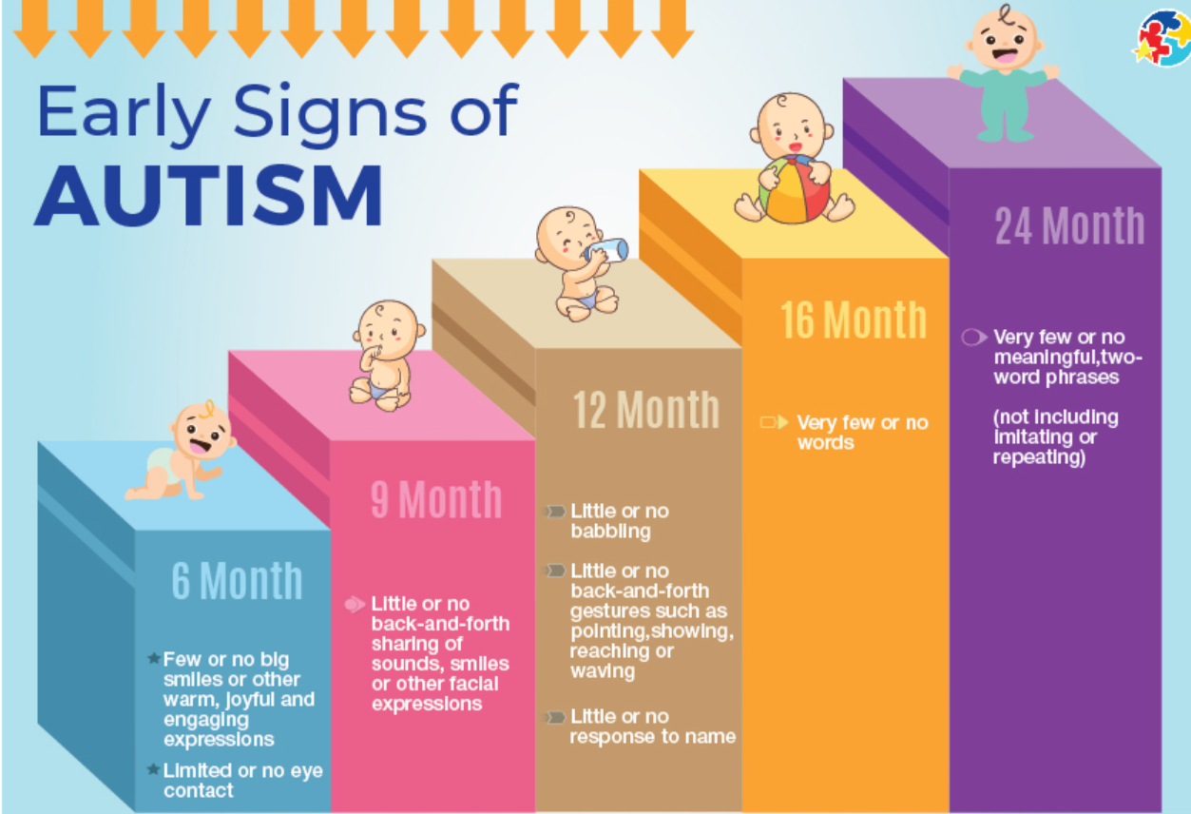

Slide 13
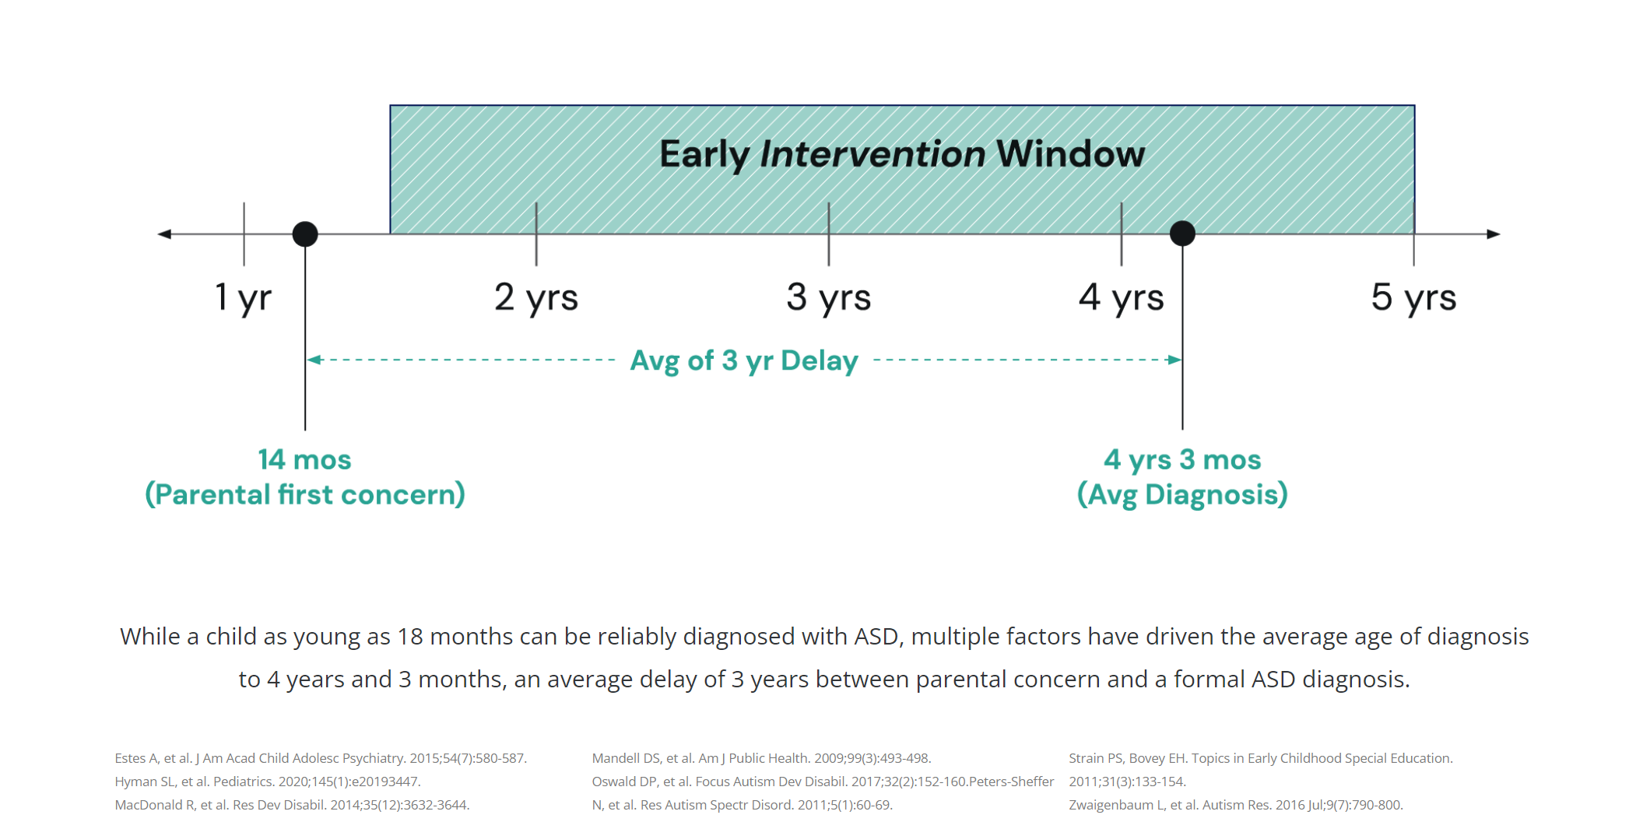

Slide 14
Screening Tools:
The evaluation process may include a variety of assessment tools, such as:
Childhood Autism Rating Scale (CARS)
The Modified Checklist for Autism in Toddlers (M-CHAT)
The Social Communication Questionnaire (SCQ)
The Autism Diagnostic Observation Schedule (ADOS)
The Autism Diagnostic Interview – Revised (ADI-R)
Gilliam Autism Rating Scale (GARS)
Psychoeducational Profile, 3rd Edition (PEP-III)
Parent Interviews for Autism (PIA)

Slide 16
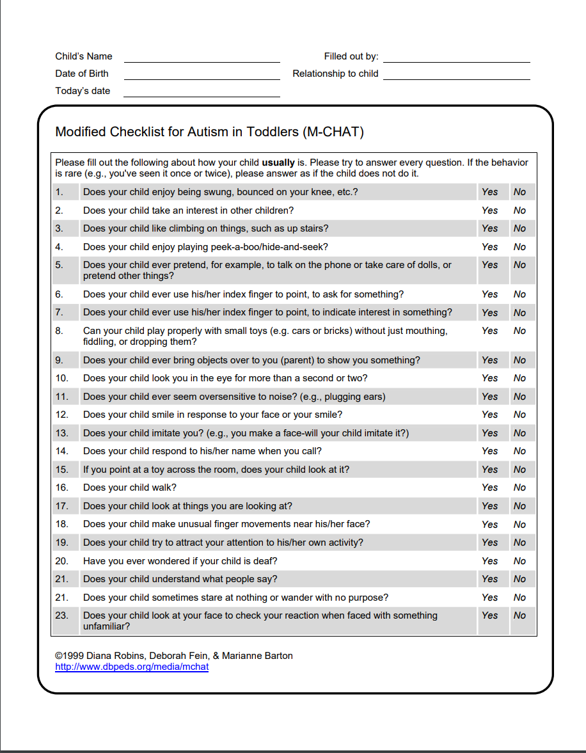
Parent Completed Screening Tools:
M-CHAT-R:
The Modified Checklist for Autism in Toddlers, Revised (M-CHAT-R) is a screener
Parent Completed
Asks a series of 20 questions about a child’s behavior.
Intended for toddlers between 16 and 30 months of age.

Slide 17
Parent Completed Screenings: ASQ-SE:
The ASQ:SE-2 is not an autism screener…
BUT, the questionnaires contain items designed to detect concerns that may point to autism.
Results from ASQ:SE-2 may assist programs in making decisions about referrals for autism spectrum disorder (ASD) testing.
Ongoing research is being conducted, but preliminary analyses suggest that ASQ:SE-2 should identify the majority of children with ASD.
The classification of children on ASQ:SE-2 was compared for 133 children between 18 and 60 months of age with a diagnosis of ASD. The overall agreement between a child’s ASQ:SE-2 classification and ASD classification was 83.5%.

Slide 18
Individual with Disabilities Act, Part C: (IDEA, Part C)
Both early intervention and school-aged services are available through our nation’s special education law—the Individuals with Disabilities Education Act (IDEA).
Part C of IDEA deals with early intervention services (birth through 36 months of age).
Part B applies to services for school-aged children (3 through 21 years of age).

Slide 19
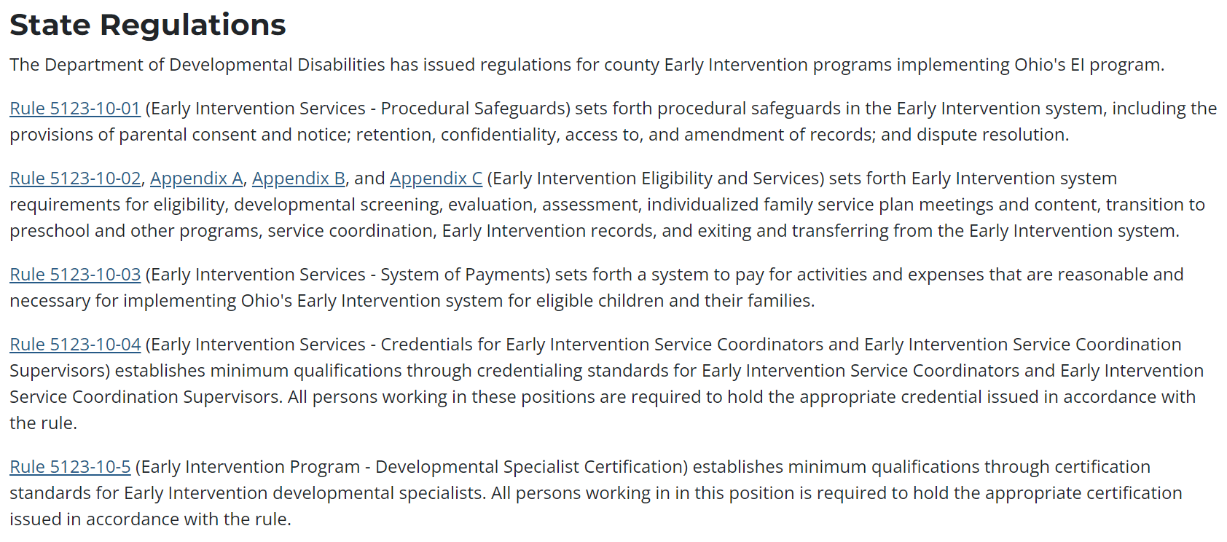

Slide 23
An Oregon Study Showed 2 out of 5 children referred to EI did not get evaluated
Some studies show that families decide on a referral in the first 48 hours
Phone follow-up (not necessarily contact) within two days of the referral significantly increased follow through

Slide 25
Question & Answers
Post in chat or “raise hand”

Slide 26
Closing
Atomic Chat:
Type your response in the chat box DON’T HIT SEND/RETURN!
When I say “go” hit send/return
Survey completion = CEUs
Upcoming sessions

