Slide 1
Improving Outcomes for People with Disabilities
Health Care Professional Virtual Roundtables
Core Competency #1: Conceptual and Contextual Frameworks on Disability
March 8, 2022
Kara Ayers, PhD

Slide 2
Today
Closed Captions & Interpreter
Chat or Raise Hand
Continuing Education
Introductions

Slide 3
Who’s here?
Introduce yourself in the chat
Name
Role
Where you’re joining us from
Poll!
PJs?
Amped up or barely awake?
Abelism?

Slide 4
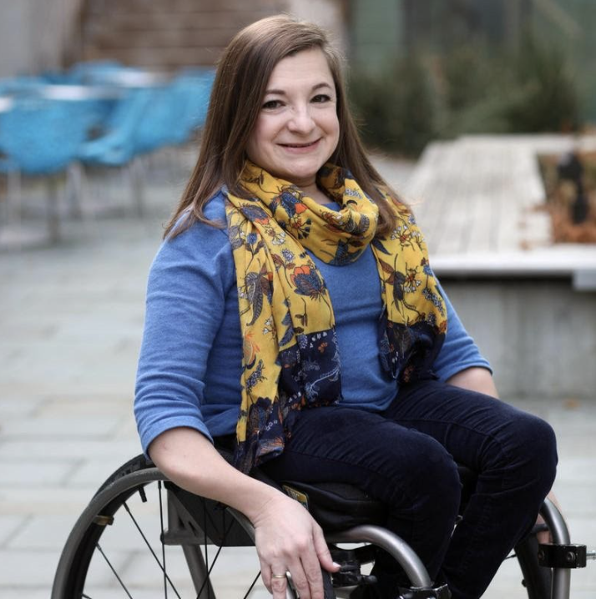
Kara Ayers, PhD
Assistant Professor, Department of Pediatrics, University of Cincinnati
Associate Director of University of Cincinnati UCEDD
Director of the Center for Dignity in Healthcare for People with Disabilities
Co-founder of the Disabled Parenting Project
On the boards of the Osteogenesis Imperfecta Foundation and The Association for Successful Parenting
Member of Board of Governors for PCORI (Patient Centered Outcomes Research Institute)

