Slide 1


“What Works for Work”
Session 3: Chaining and Prompting
Notes:
In this session you will begin to explore the Evidence Based Practices (EBP) of Chaining and Prompting. Chaining requires the user to also understand and complete a task analysis. All three of these components will be discussed during this session.

Slide 2
Complete Chaining Pre-Assessment First
See Chaining Mini Assessment Handout #1.
Answer the 6 questions in the pre-assessment column.
At the end of this session, the post assessment column of this handout will be completed. You will be prompted when to complete this.
This activity has two purposes:
  To become aware of your change in knowledge after engaging in the content of this section.
  An opportunity to reflect on the value of baseline information, progress monitoring and classroom practices.
Notes:
Chaining Mini Assessment. See handout #1.
At this point in the session, the facilitator should have the participants answer the 6 questions in the pre-assessment column of the handout #1. At the end of this session the post assessment column of this handout is to be completed.
This activity has two purposes: To assist the participants to become aware of a change in knowledge after engaging in the content of this section. It also allows an opportunity for the participants to reflect on the value of base line information, progress monitoring and classroom practices. The sessions will reinforce these ideas as the learner goes through the materials. The facilitator should reinforce this at the end of the session with the post assessment.

Slide 3
Chaining
Includes Task Analysis and Prompting
Chaining Strategies teach a sequence of defined steps in order for the learner to perform a larger task/skill.
  Task analysis. The job coach, teacher or trainer analyzes the task to be performed, identifying each defined step necessary to complete the task.
  Instruct. The teacher or trainer then guides the youth to learn each step.
  Goal. The youth successfully/accurately completes the entire activity.
Notes:
Begin to define what a “Chaining” strategy includes. Start to define this Evidence Based Practice (EBP) in connection to Prompting (another EBP) and the need for Task Analysis. Each of these items will be discussed in depth later in the session.

Slide 4
Using Chaining to Teach
Backwards Chaining Approach
  Support person completes all the steps identified except for the final step which the person learning completes and is reinforced.
  Then the next-to-last step or skill is introduced
Forward Chaining Approach
  Steps or skills taught in their naturally occurring order and reinforcement is delivered when the person completes the first step in the sequence
  Then the next time the skill is taught, the second step is reinforced
Notes:
Chaining can be approached several different ways. One can start with the first step (forward chaining) and work through each step systematically until the last step. This allows the learner to build skill in each step the way that it will occur when the skill is used.
However, there are some people and tasks that might best be taught and learned by viewing the entire task and focusing on learning to do the last step as the initial target. Learners that do well with seeing the whole task completed may find this the best way to learn. Or the learner that is motivated by closure might respond well to doing the last step and experiencing completion.

Slide 5
Example of a Task Analysis: Brushing Teeth(Matson et al., 1990)
Obtains materials
Takes cap off toothpaste
Puts paste on brush
Replaces toothpaste cap
Wets brush
Brushes left outer surfaces
Brushes front outer surfaces
Brushes right outer surfaces
Brushes lower right chewing surfaces
Brushes lower left chewing surfaces
Brushes upper left chewing surfaces
Brushes upper right chewing surfaces
Brushes upper right inside surfaces
Brushes upper front inside surfaces
Brushes upper left inside surfaces
16. Brush lower left inside surface
17. Brush lower front inside surface
18. Brush lower right inside surfaces
19. Rinse toothbrush
20. Wipe mouth and hands
21. Return materials
Notes:
This is an example of a complete task analysis, which shows groupings of sub steps needed to complete the entire task, e.g. as the slide is clicked, different groupings appear, steps 1-4 might be preparation for the task, steps 6-8 are all outer surfaces of teeth, steps 13-18 are all inside surfaces of teeth.
Some people can learn by chaining these ‘chunks’ together. Other people will need these chunks broken into discrete and individualized steps. This is why it is important to know the learner and adapt to the individual need and learning style.

Slide 6
Chaining Options -Forward
Forward chaining
  Teach only the first step of the task analysis and do all the other steps of the task analysis for the student.
  After the student masters step 1, then only teach step 2, while maintaining step 1.
  Reinforcement for the targeted step
Notes:
This slide details / reviews forward chaining again. Although it may seem repetitive, often the novice learner needs to review concepts several times.

Slide 7
Chaining Options- Backward
Backward chaining
  Teach only the last step of the task analysis.
  Do all the other steps of the task analysis for the student, until the student masters the last step.
  Then teach the second to last step only and expect the student to continue independently completing the last step of the task analysis.
  Reinforcement for the targeted step
Notes:
This slide details / reviews the backwards chaining . Although it may seem repetitive, often the novice learner needs to review concepts several times.

Slide 8
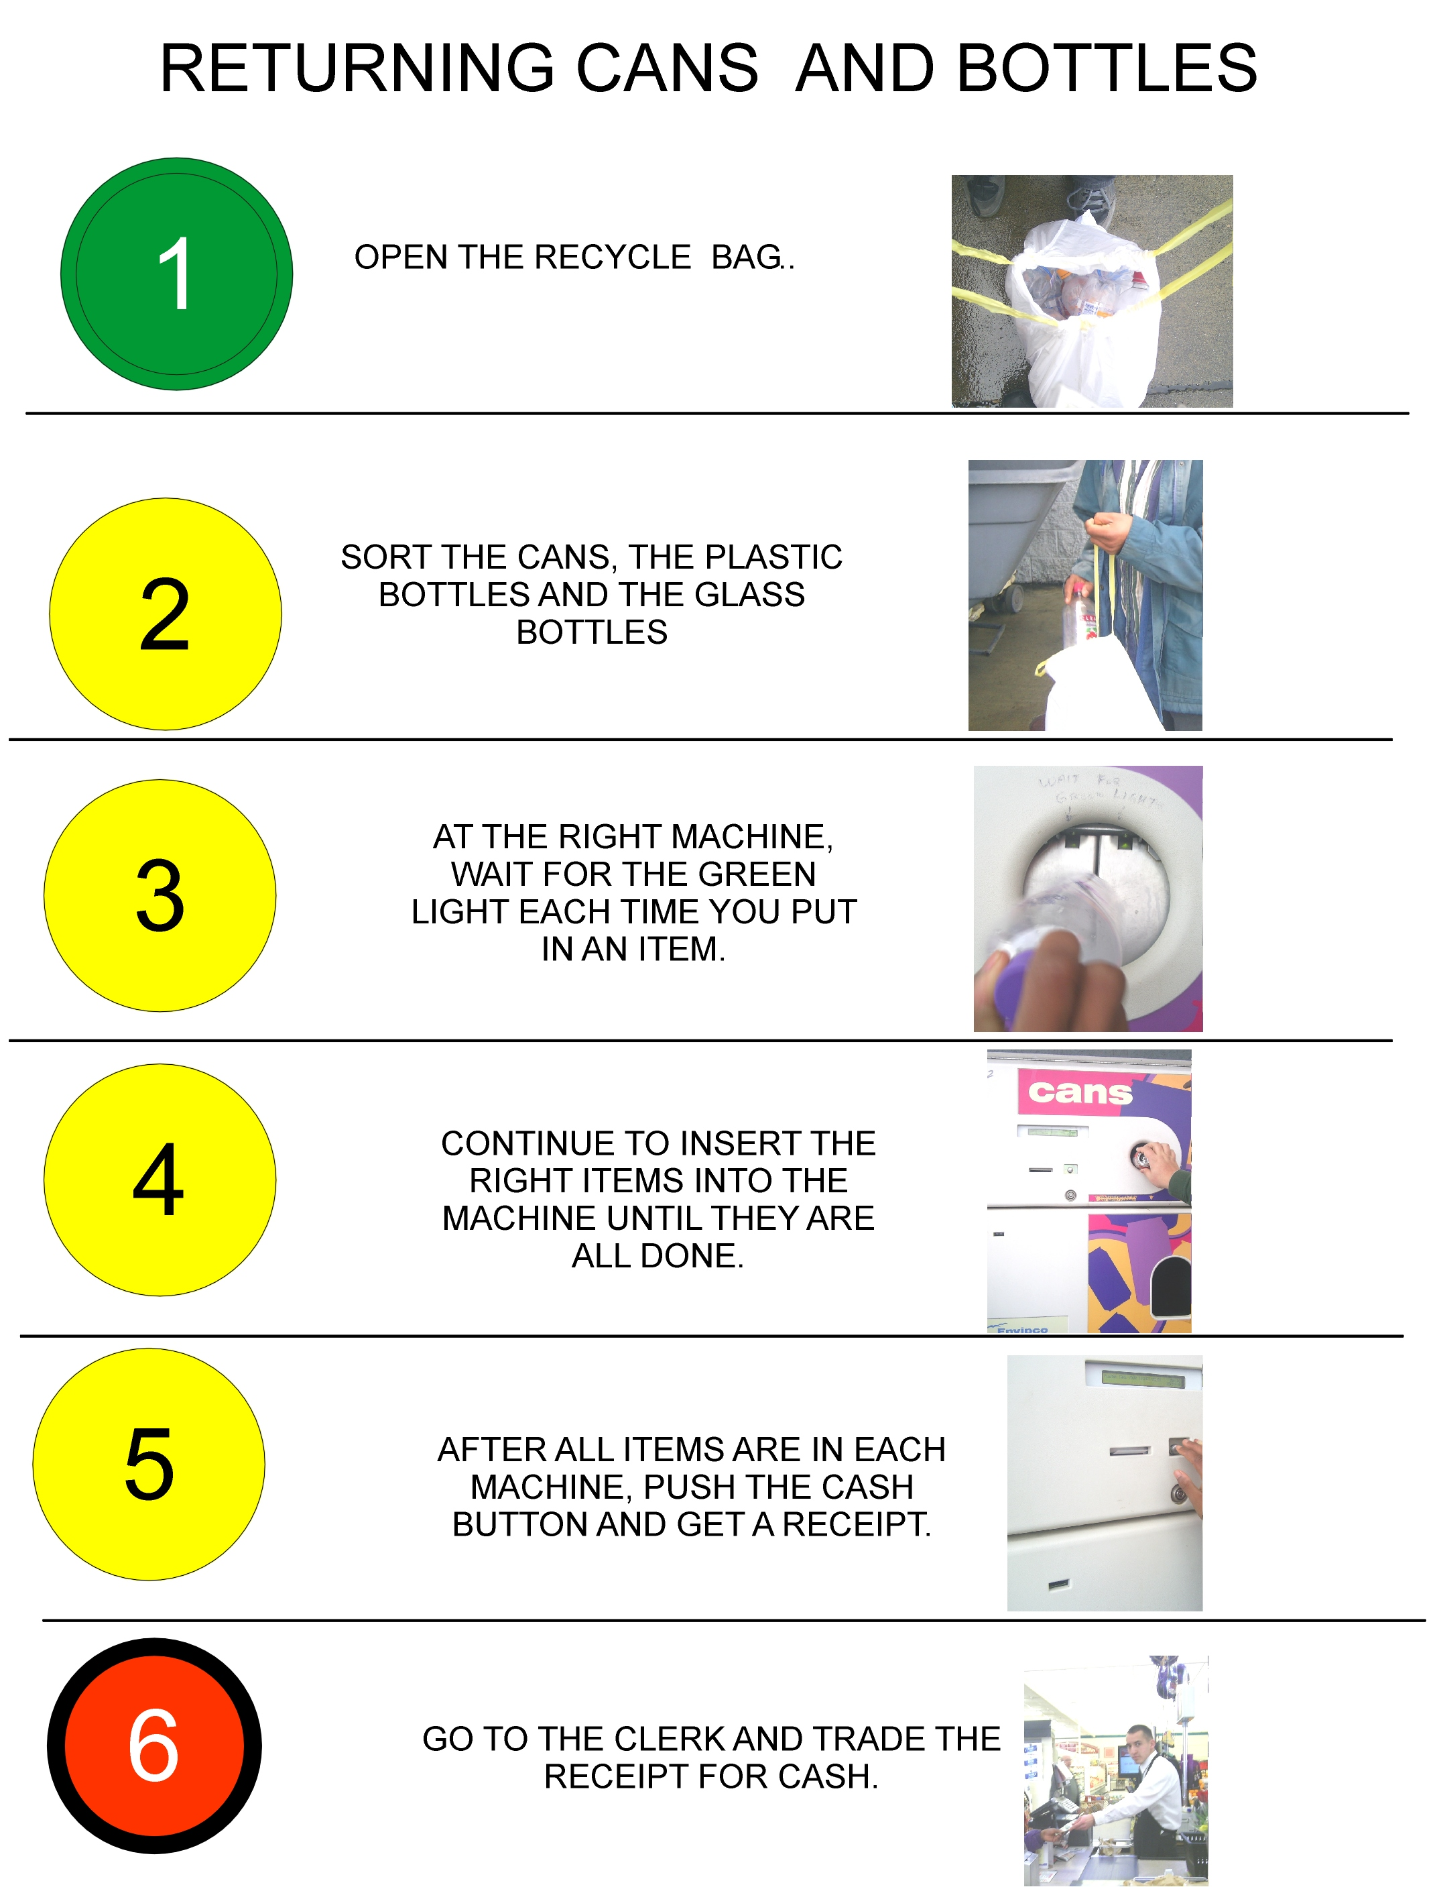
How to Use a Recycle Machine
Forward Chaining? Start with Step One
Backwards Chaining? Start with Last Step.
Notes:
This example demonstrates where to start in the task of using a recycle machine. Participants may consider and discuss which approach …forward or backwards chaining…. Would be best for teaching this task.

Slide 9
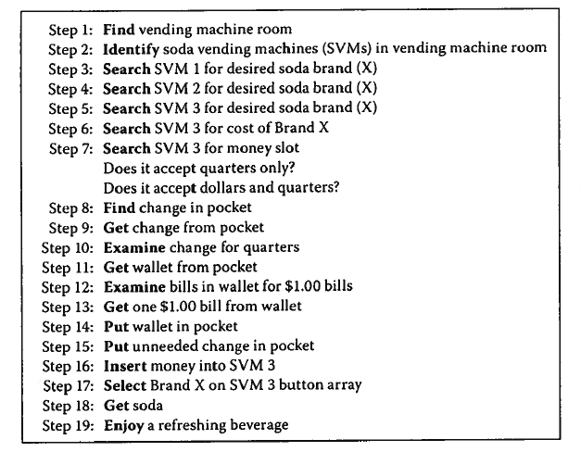
How to Use a Vending Machine
Notes:
This example details the steps involved in using a vending machine.
Participants may consider and discuss which approach …forward or backwards chaining…. would be best for teaching this task and why.

Slide 10
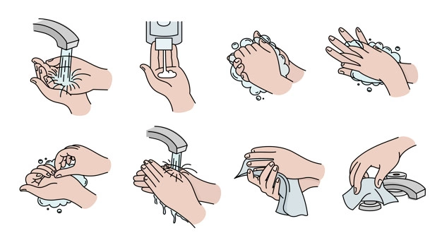
Visual Support: Chaining the Steps
Some students may find a visual support, similar to this example for handwashing, helpful in learning how to complete each step of the task in order

Slide 11
Chaining Options
Total Task Chaining
  Student is given opportunity to perform each step every time.
  For example: When putting on pants, the student has the opportunity to perform each step EVERY time he/she puts on pants.
  Reinforcement as needed
Notes:
Total Task may be the most common form of chaining used, although many would not realize they are using a specific type of process. Here, there is no specific step that is targeted for teaching or reinforcement. The student is given the opportunity to try each step.

Slide 12
Forward Chaining/Total Task Example (1)
Crystal needs to learn to do a car oil change. She has no prior experience in this area and even though she has watched videos and others do it, she is concerned she will make a mistake that will ruin the car.
The coach decides to use a combination of total task and forward chaining process to help Crystal be successful.
Initially, the job coach prompts Crystal through each specific step, pausing for her to complete the step. This helps assess how well Crystal is able to do each step.

Slide 13
Forward Chaining/Total Task Example (2)
Additionally, to motivate and build confidence, the coach praises her, provides an ‘elbow bump’, and other positive reinforcement for each step completed. Before she realizes it, Crystal has completed her first oil change and is ready to try again with fewer prompts.
On her next try, Crystal completed the first 2 steps of the oil change before being given praise. On the next try… the job coach waited for Crystal to complete 3 steps and then gave the thumbs up.

Slide 14
When to Choose Chaining
For tasks with an established, predictable sequence of steps that do not change.
For a person that learns best when presented with small chunks of information at one time to master a skill or concept.
For a person that desires structured learning environments.
After a Task Analysis is complete and the instructor/coach has tried it out herself.
Notes:
Not every person or task is best taught with chaining. Consider the learner and the type of task before choosing chaining as the EBP for the specific situation.

Slide 15
Backward Chaining
For a student who:
needs to see the big picture.
is anxious or gets flustered with a lot of steps.
you want to get comfortable and productive early on.
Backward chaining may be superior in developing speed, accuracy, fluency, and skill maintenance.
Learning takes place faster, learners develop greater confidence, and performance is generally better on the job.
Notes:
If chaining is selected, consider what type of chaining may be the best for the learner

Slide 16
Backward Chaining Example (1)
Connie is learning to make double-sided color copies on her job site.
A task analysis is completed that identifies multiple steps that include loading paper in the correct drawer, loading staples, and putting in a password to access the copier.
The job coach begins by showing Connie how to do all the steps of the task using a checklist.
The coach then completes each step until the last step, which is pushing the print button. The job coach prompts Connie to complete the chain by pointing to the print button, which she then pushes.

Slide 17
Backward Chaining Example (2)
The coach provides verbal praise for Connie’s success and then begins the process again, only this time, the coach does not do the last two steps.
Connie successful completes both and is again reinforced. The backwards-chaining process continues in this manner until Connie is completing all of the steps independently, accurately and consistently.

Slide 18
Backward Chaining Example: Shoe Tying
Watch the Backward chaining: Tying a shoe the video. (Note: there is no sound)
The steps shown on the video include:
  Cross Laces
  Put one lace under the other lace and pull tight
  Make a loop in one hand
  Using the opposite hand, wrap the free lace around the loop
  Using the index finger, push the lace through the hole
  Hold both loops and pull tight.
Notes:
Discussion: How are teachers using Task Analysis. How often? What about time constraints and task analysis?
Tying a shoe video url: (https://www.youtube.com/watch?v=FI1cu2u1eXk)

Slide 19

Start with the Task Analysis

Slide 20
Remember the Brushing Teeth Task Analysis?
Obtains materials
Takes cap off toothpaste
Puts paste on brush
Replaces toothpaste cap
Wets brush
Brushes left outer surfaces
Brushes front outer surfaces
Brushes right outer surfaces
Brushes lower right chewing surfaces
Brushes lower left chewing surfaces
11. Brushes upper left chewing surfaces
Brushes upper right chewing surfaces
Brushes upper right inside surfaces
Brushes upper front inside surfaces
Brushes upper left inside surfaces
Brushes lower left inside surfaces
Brushes lower front inside surfaces
Brushes lower right inside surfaces
Rinses toothbrush
Wipes mouth and hands
Returns materials
Notes:
Revisit the detailed task analysis of teeth brushing.
Some people can learn by chaining these ‘chunks’ together. Other people will need these chunks broken into discrete and individualized steps. This is why it is important to know the learner and adapt to the individual need and learning style. Illustrates that in complete task analysis, consider if student has the precursor skills (steps1-4) to complete the task. Take brief comments on the need for pre-cursor skills.

Slide 21
Considerations Beyond the Specific Steps
Steps for preparation. Example: gathering materials
Location. Does the location of the task change the steps?
Prerequisite Skills. Is there a set of precursor-skills/ knowledge that are required to be able to complete the target task/ activity? Examples:
  Oil Change. Do I know how to pick the correct oil?
  Greeting co-workers. Do I know who is my co-worker?
  Completing an Academic Assignment. Do I know how to remain focused on the assignment?
  What if things do not go as planned? Do I know how to ask for help when I find myself unsure about part of the process?
Notes:
In many cases there are specific and important prerequisite skills or knowledge that must be learned in order to attempt and complete the task. For some individuals these skills and knowledge do not come naturally and must be directly taught. In a complete task analysis, it will be important to identify these items or additional steps.

Slide 22
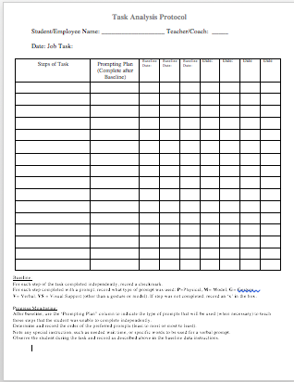
Task Analysis Recording Form
Use this form when conducting site visits and when observing potential job tasks
Make notes about the tasks that will need to be taught or supported for the students to complete
Use the same form to collect progress data. How much prompting needed and level of prompt needed to complete each step with complete independence.
Notes:
This form is available as a download from the Session 3 web page.

Slide 23
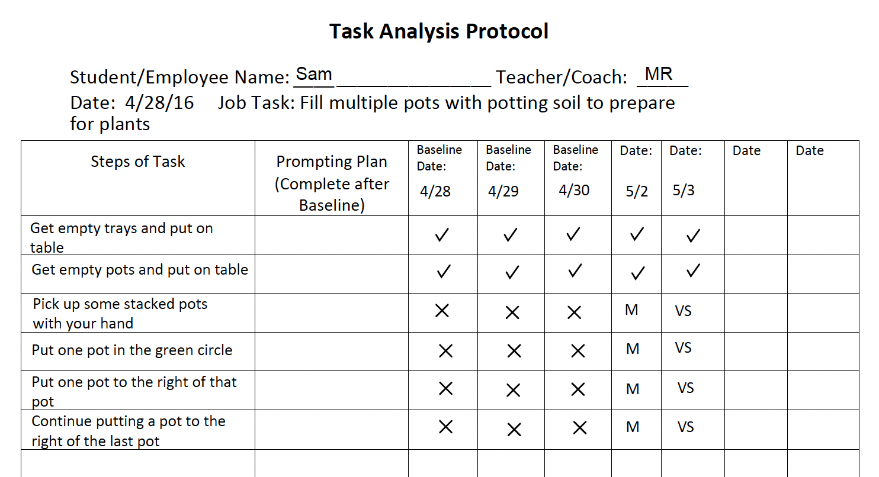
Example of Task Analysis
Student learning to prepare pots at a greenhouse
What other steps might you include?
Notes:
The facilitator of a group can use this time to generate small or whole group discussions. What precursor skills or knowledge might be important to consider? What additional or expanded steps might be important to specify or address within the example task analysis? What steps might be broken into two or more individual steps?

Slide 24
Activity: Hands on with Chaining
SELECT ONE OF THE FOLLOWING:
Cleaning table after a meal
Setting table
Academic-your choice or--Teach multiplication of 2 digit numbers (the process). Assume knowledge of multiplication tables
Packing/Bag groceries
Academic--Write sentence with an article, noun, action verb and punctuation
Do a Task Analysis for one of the five skills on this slide
  Use Handout #2, the task analysis form.
Choose Forward or Backward Chaining
Practice teaching with a partner on your team.
Notes:
Activity, hands-on with Chaining. 10-15 min. Use handout #2 Task Analysis Protocol.
This activity is time for the participants to experience how to do a task analysis and how to teach a skill using chaining. Although some in a group may have done this already, the value in this activity comes from working as a group. Different people will have different ideas how to teach these tasks. Some people will be extremely detail oriented and some may take a casual approach. Also, chaining may not be the best approach for teaching some of these skills. They were included intentionally. If chaining is found not to be the best approach, encourage the participants to explain why.
Facilitators ask each team to demonstrate their task analysis, with one member of the team being the teacher and one the student. With multiple teams, there will be different approaches and steps for the task analysis. Highlight that there will be different ways to do the task analysis based on the student’s needs and learning style. Adjustments can be made after the teacher observes the student doing the task. An important point is that all team members should be using the same chaining steps to teach a task and should discuss as a team the types of prompts that are used and when to combine steps or add new ones. Facilitators may want to observe what prompts were used when teaching the task for every demonstration. This will be an introduction to the next section on prompting and also show how chaining, task analysis and prompting are all woven together.

Slide 25
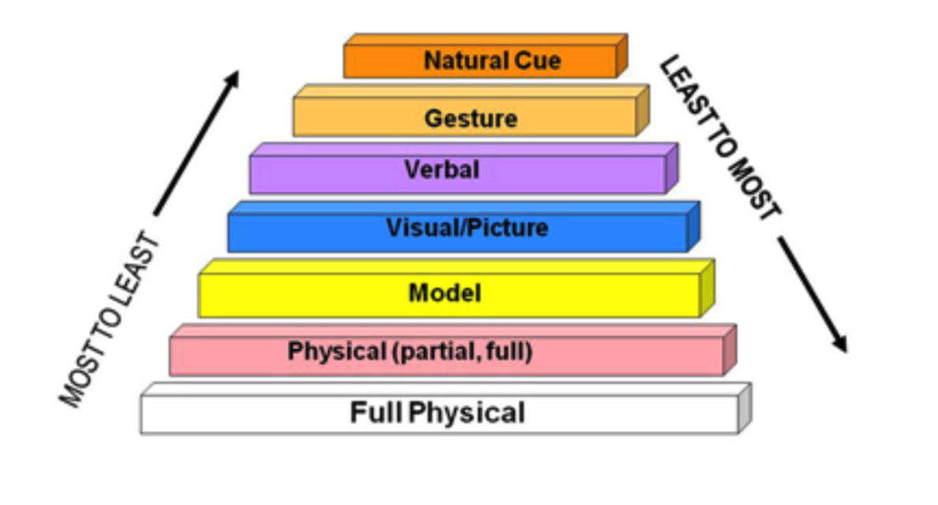
Prompting
Prompt Hierarchy
Most to Least
Least to Most
Types of Prompts
How to Use Prompts
Fading Prompts
Notes:
Divider slide. These are the topics covered in the remaining slides

Slide 26
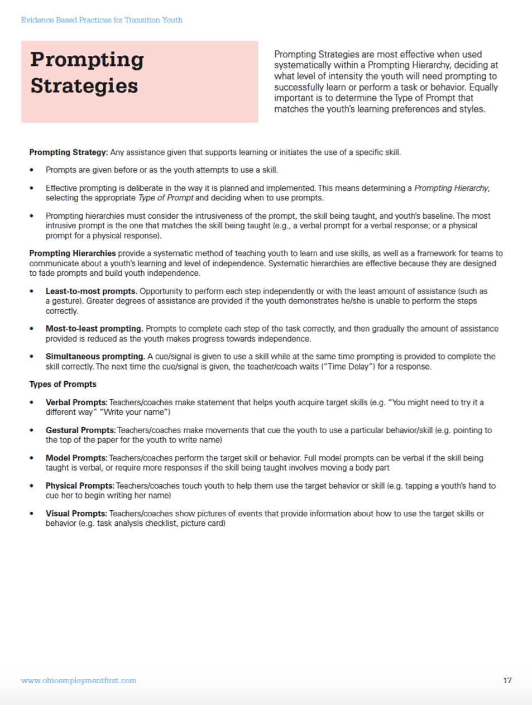
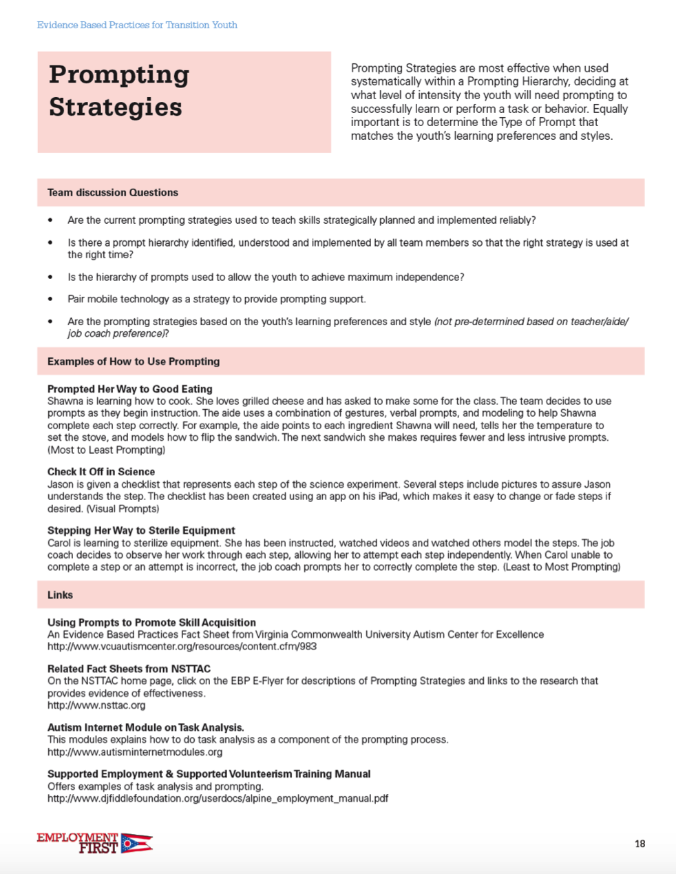
Prompting… An EBP
Notes:
Reference the Evidence Based Practices document that is being used throughout the session. Encourage participants to find the pages on Prompting.
PDF file: https://ohioemploymentfirst.org/up_doc/evidence_based_practices_for_transition_youth_-_accessible.pdf

Slide 27
Prompting is a Teaching Strategy
Prompting
Any assistance given that supports learning or initiates the use of a specific skill
Notes:
Ask for any comments on this statement. If there is any disagreement to the statement, ask the learner to explain what is confusing or misleading. Respond that there is more information in the next slides that may help clarify. At times, a learner may feel prompting is not specifically for instruction. Or may not quite agree that it initiates a skill. Some of this misunderstanding could be a difference in language that will be clarified with more information in the next several slides.

Slide 28
Prompting
Used by Everyone!
All the Time!
Very Effective!
But often issues or concerns arise.
What issue/concerns have you seen related to prompting?
Notes:
Ask for a few ‘shout-outs’ from the group in response to this question. If there is time, short discussions may be held and points from each discussion group de-briefed. In most sessions there is only time enough to take a few thoughts before moving to the next slide. See next slide for some common issues after participants have had a chance to raise their own concerns. These will include:
over prompting,
different prompts used by different staff may be confusing,
not needing the prompt and being used anyway,
prompts that don’t fit with the learning style of the student e.g. using an auditory prompt for a student who is an identified visual learner,
not fading prompt or using baseline data to determine the best type of prompt to use (gesture vs visual support) or when step has been completed independently so the prompt can be eliminated.

Slide 29
Prompting Errors
Over prompting… student does not try
Inconsistent prompting… team not on the same page
Lack of fading …..poor planning of the level of prompts to use and how to fade
Lack of data …..collected or reviewed
Notes:
Consider how the prompt will be shaped or faded before deciding to use a stimulus prompt.(Carnahan)
Pause after each line to allow for consideration by the group

Slide 30
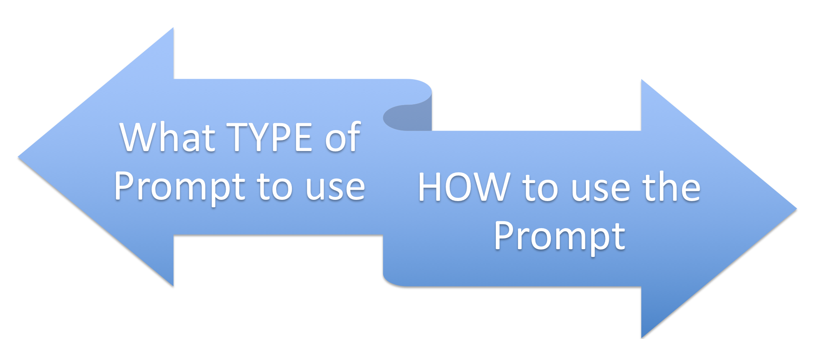
Two Considerations
Notes:
While there are many aspects of planning and using prompts effectively. Two that are important to consider are: 1) deciding what type of prompt or prompts should used for the individual and 2) determining how to use the prompts effectively to encourage independence with the skills.

Slide 31
What Type of Prompt?(1)
Verbal Prompts:
  Statements that help a person acquire target skills (e.g. “You might need to try it a different way” “Write your name”)
Physical Prompts:
  Coaches touch person to help them use the target behavior or skill (e.g. tapping a youth’s hand to cue her to begin writing her name)
Notes:
Review the types of prompts found on slides 31 and 32

Slide 32
What Type of Prompt?(2)
Gestural Prompts:
  Coaches make movements that cue the person to use a particular behavior/skill (e.g. pointing to the top of the paper for them to write name)
Model Prompts:
  Coaches perform the target skill or behavior.
Visual Prompts:
  Coaches show pictures of events that provide information about how to use the target skills or behavior (e.g. task analysis checklist, picture card)

Slide 33
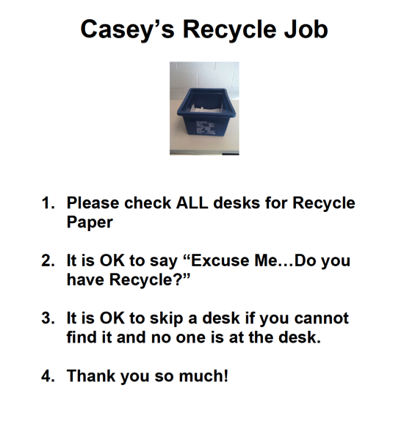
Visual Prompt
Use Visual Prompts Instead of a Person in order to increase independence
Notes:
Offer an example of a visual prompt. Many will call this a ‘visual support’. However, it is also a prompt.

Slide 34
Defining Verbal Prompt
Review the short verbal prompt video
Defines and provides video examples
Video modules available at the Autism Certification Center
Notes:
Short video from the Autism Certification center on verbal prompts. Comment on the source. Autism Certification Center. These are video based modules available free to anyone. These modules cover some evidence-based practices for youth with Autism Spectrum Disorder. https://autismcertificationcenter.org/
The video does have sound.

Slide 35
Which Prompt to Use and When
“How do I determine which prompt is the right prompt for the person?”
“Does the task make a difference on which prompt I should use?”
“When do I change prompts?”
Consider defining a ‘prompt hierarchy’ as you develop the instructional plan
Notes:
As you learn about prompts and the use of prompts to teach new skills, many of the questions on the slide may go through the learner’s thoughts. Use this slide to introduce the idea of a Prompt Hierarchy.

Slide 36
Prompt Hierarchy
Considerations
Identify which prompts are the most intrusive, obvious or require the most assistance from another person.
Identify which prompts are the least intrusive and provide the most opportunity for independence.
This will not be the same for everyone nor every situation.
Notes:
Lead a discussion about the difference in prompts and how some are considered ‘heavier’ prompts. These heavy or most intrusive prompts are generally the ones in the picture on the slide at the bottom of the pyramid. The prompts at the top of the pyramid are generally considered less intrusive and may lead to more independence. These less intrusive prompts can more likely be used in community settings and employment settings in a natural and subtle sense. Therefore, over time, the plan should focus on using the prompts near the top of the pyramid with the plan to fade the prompts totally if possible.
Discussion: Would anyone in the group change the order of the prompts on the slide? For example: Often the use of visual prompts could be considered LESS intrusive than verbal prompts. Any other thoughts from the group ? One must also consider the situation. For example, although verbal prompts can be rather intrusive, if the the task or activity requires a response to verbal prompting as part of the task, it may not be intrusive at all.

Slide 37
Using a Prompt Hierarchy
Least-to-Most
Most-to-Least
Person has opportunity to perform each step independently or with the least amount of assistance
Greater degrees of assistance are provided when the person is unable to perform the steps correctly
Use when person has already been taught skills
Prompts given to complete each step of the task correctly
Gradually the assistance provided is reduced as the person makes progress towards independence.
Used when teaching new skill

Slide 38
Teaching Skills and Promoting Independence
Most-to-Least
Least-to-Most
USE WHEN TEACHING THE NEW SKILL
USE WHEN GAINING INDEPENDENCE
Notes:
Emphasizes the time to use most to least vs. least to most

Slide 39
Examples of Hierarchy: Using a Copier
Most-to-Least
Least-to-Most
Promoting Independence to Gather Completed Copies
Gesture
  Nod head towards completed copies
Model
  Show how to remove completed copies from tray
Partial Physical
  Gentle pressure to elbow to pick up completed copies
Teaching Correct Button Usage
Partial Physical
  Gentle pressure to elbow to push hand to correct buttons
Model
  Show how to push correct button. No words.
Gesture
  Point or nod to correct button
Notes:
This slide offers an example of a hierarchy for the task of making copies in an office setting.
Hierarchy of Prompts selected for this task:
Gesture
Model
Partial Physical Prompt
The example shows:
When teaching the correct button to push on the copier you might use these steps that go from Partial Physical → Model → to Gesture
When promoting independence, the step related to picking up completed copies might flow from Gesture→ Model → Partial Physical

Slide 40
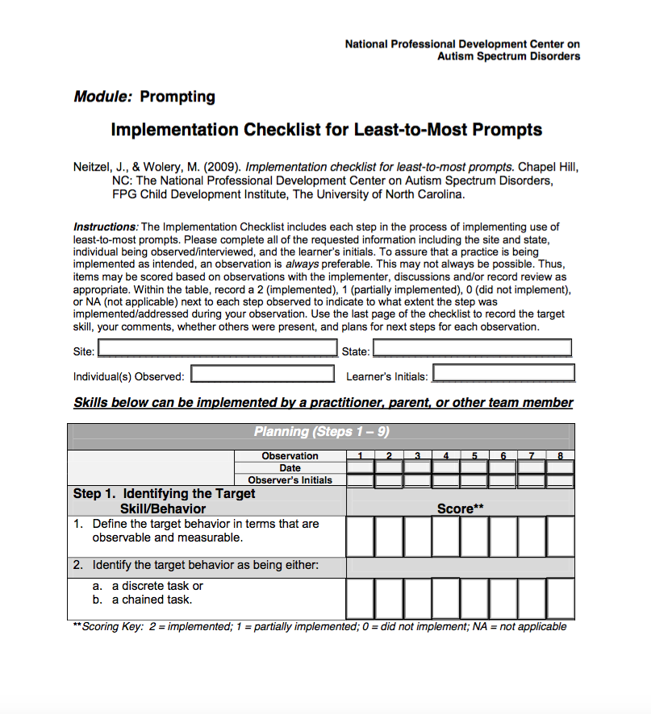
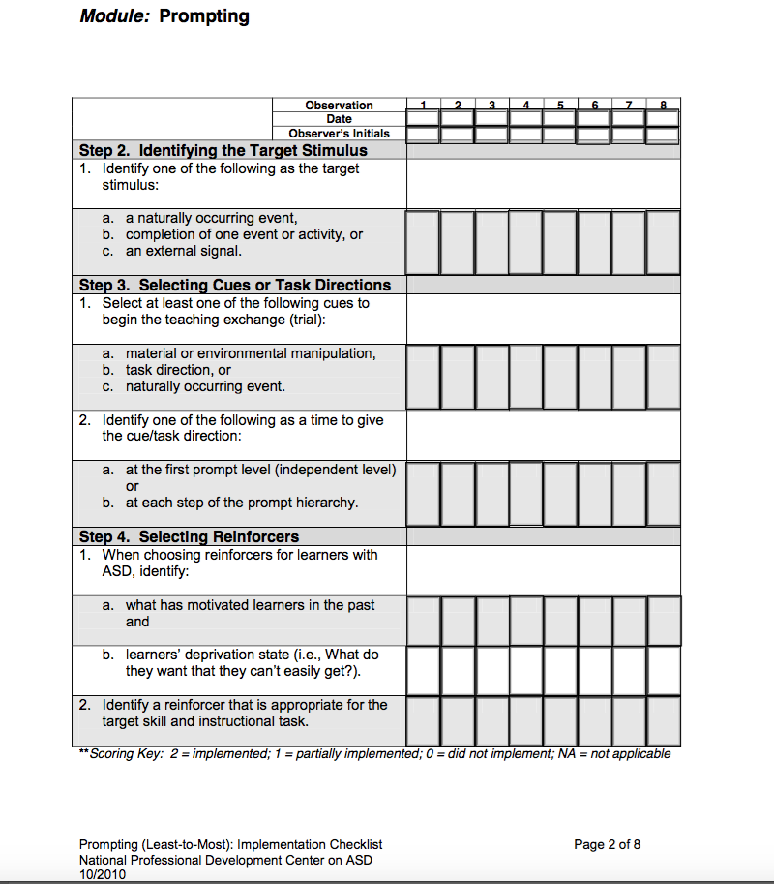
Handout #4:
Implementation Checklist from NPDC on Autism
Notes:
Handout #4 from National Professional Development Center for Autism on Checklist Least to Most Prompts.
Have the group review the implementation checklist to gain an awareness of the detail that may be needed when using least to most prompting. Ask for comments from the group.

Slide 41
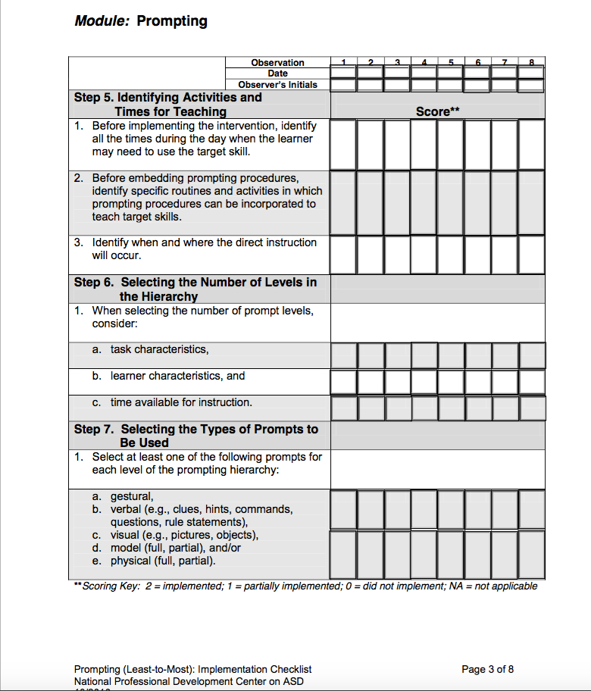
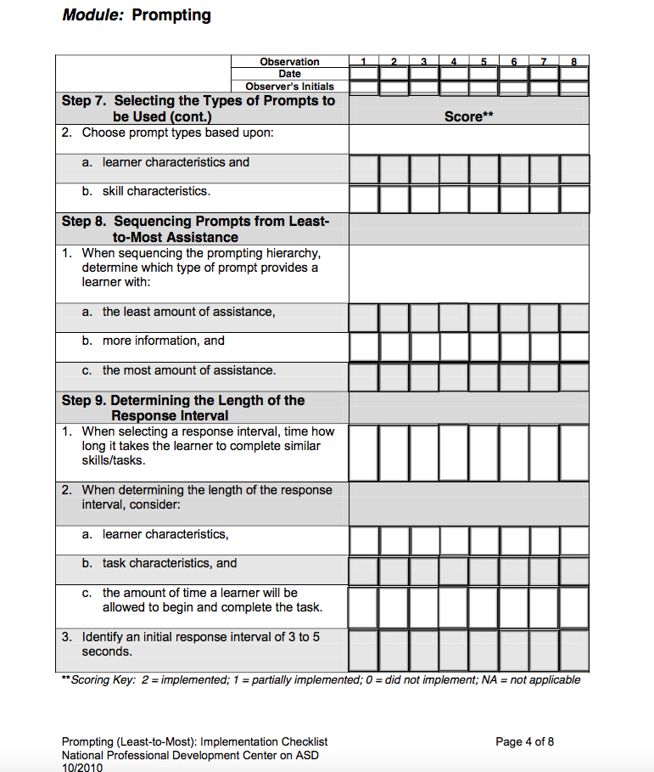
Handout #4:
Implementation Checklist from NPDC on Autism
Notes:
Pages 3 and 4.

Slide 42
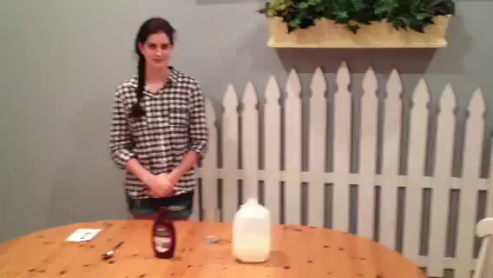
Example: Prompting Least to Most
Making Chocolate Milk with prompts
Notes:
This video has sound.
While this video is staged, the value of this video is to have the learners watch for the use of various prompts and how the ‘teacher’ is using a prompt hierarchy. Facilitate a brief discussion on how planful this must be in order to implement this in a daily routine. Ask for ideas about how the prompts could occur more naturally in the natural setting. Ask learners: For this task/skill (making chocolate milk), what 3 prompts would you select to make part of your prompt hierarchy and why?

Slide 43

Example: Prompting Most to Least
Hand washing with prompts
Notes:
This video has sound. Here is the direct link to the video https://www.youtube.com/watch?v=qBH0WfWTyUA&t=1s
While this video is staged, the value of this video is to have the learners watch for the use of various prompts and how the ‘teacher’ is using a prompt hierarchy. Facilitate a brief discussion on how planful this must be in order to implement this in a daily routine. Ask for ideas about how the prompts could occur more naturally in the natural setting. Ask learners: For this task/skill (washing hands), what 3 prompts would you select to make part of your prompt hierarchy and why?

Slide 44
Tips for Fading Prompts
PLAN. Create the fading plan early
GRADUAL. Fade prompts gradually
REINFORCE INDEPENDENCE
  Reinforce more independent responses during fading
  Provide heavier reinforcement for unprompted (independent) skill responses
REPLACE VERBAL. Verbal prompts are one of the most difficult prompts to fade. Replace verbal cues with a different type of prompt (visual, gestural, positional), so the verbal prompts can be removed more easily
Notes:
PLAN. Create the fading plan early. This implies that the team should review the prompt hierarchy and decide which prompts are the ones to use for teaching (‘heaviest’) and which are to be use as the person has some mastery of the step. A light prompt.
GRADUAL. Fade prompts gradually. This suggests that it is best to move gradually to a lesser prompt or a less frequent prompt. Keep the success level high and avoid extensive frustration when the task appears too hard to complete or the individual is making multiple mistakes.
REINFORCE INDEPENDENCE. In fading the focus becomes the independence and how well the individual is able to accurately complete the step with little or no prompts.
REPLACE VERBAL. This is generally very difficult for the job coach, aide or teacher. Help each other to remember to use other types of prompts and to give some wait time for the person to respond.

Slide 45
Activity: Selecting and Using Prompts
Review the hands on chaining activity completed earlier in this session
Consider
  the task analysis you developed in the activity
  a student you know
What three types of prompts would you use in the chaining activity with the selected student?
Where would you embed the prompts?
How would you fade these prompts over time for more independence?
Notes:
Use the forms available in the handout downloads to complete the activity
Have the groups or individuals select their own prompts for the task.
Another version of the activity would be to assign different prompts to each group and have them complete the activity with the assigned prompts. For example, assign verbal and visual to one group, physical and modeling to next group, and so on. Discussion: ask participants to give examples of specific prompts they might use and describe the type of students they were thinking of when using these prompts.

Slide 46
What if a Prompt is an Ongoing Need for a Person?
Notes:
Brief discussion based on participants’ experiences, then move on to the next two slides for examples of when a prompt may need to be an ongoing support.

Slide 47
Is it a Prompt or Support?
Prompt may be needed for student to learn and complete a task
Some prompts may eventually become a support to be independent as they are not able to be totally faded
Use the least intrusive prompt
  Example: verbal prompt replaced with a visual schedule as an ongoing support.

Slide 48
Compare: Prompts and Support.
Prompt
Support
Ongoing
Assists a person to be successful
Is not faded- always available
Use those that are least intrusive and allow for the most independence
For Instruction
When a person is learning or increasing independence
Are meant to be faded
Some “prompts” may eventually become “supports” for some people
Notes:
Ask the group for examples. Sometimes a visual prompt can become a visual support that the person uses independently to complete tasks and activities. Review Casey’s Recycle Prompt on slide 33 as an example.

Slide 49
Collecting and Recording Data
Components necessary when planning and implementing include a way to collect and record data on prompting, independence and progress
  Complete task analysis of skill to be taught
  Identify the prompts that will be used
  Create the prompt hierarchy
  Collect baseline data of current skills
  Identify which prompts are necessary and when
Notes:
This slide suggests that careful consideration of what to record and how to record is necessary. These issues prime the learners for the follow up slides that introduce the recording form for task analysis and data collection.

Slide 50
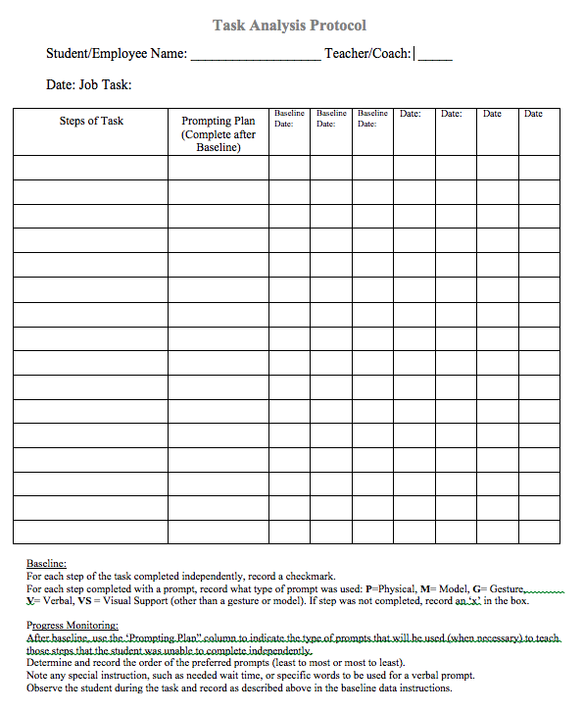
Explore the Task Analysis Protocol Form
Download this form from the Session 3 webpage
Review each element of the form on the following slides

Slide 51
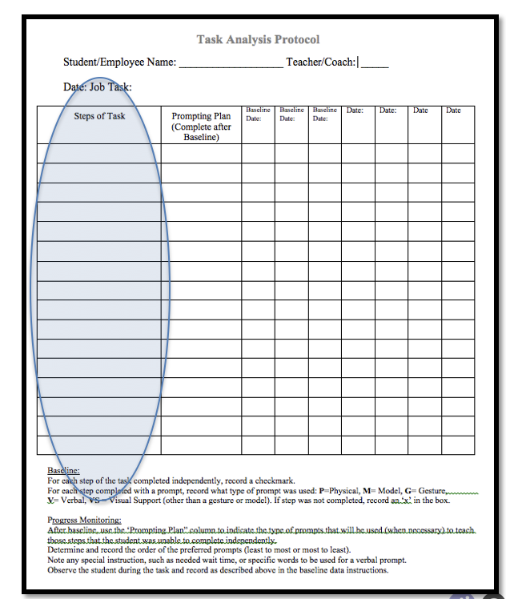
Record the Steps
Record the steps of the task analysis necessary to complete the targeted task
  Record steps in the far left hand column of the Task Analysis Protocol Form.

Slide 52
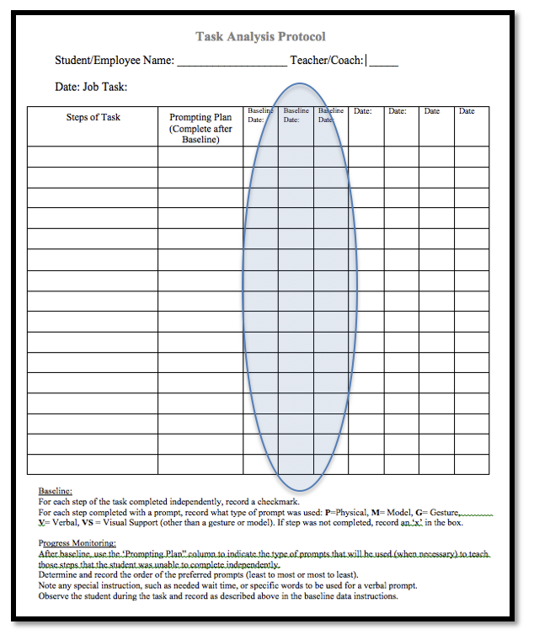
Collect the Data
Observe the student completing the task
Record level of success for each step and any prompting that was necessary in the columns labeled “Baseline”.
Review the coding for the type of prompts at the bottom of the page. Use these codes to indicate any prompts needed.

Slide 53
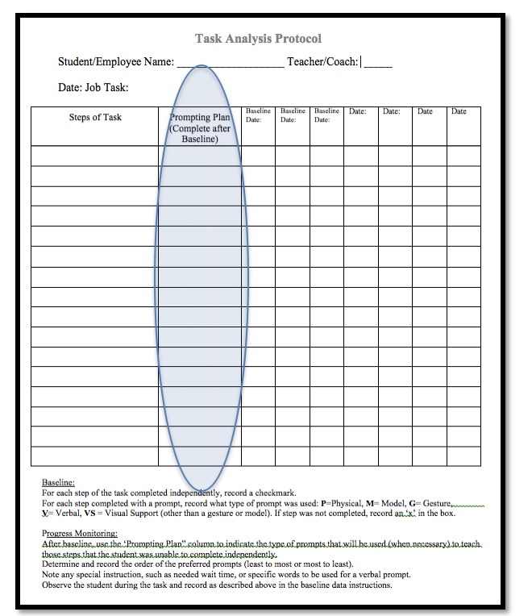
Prompting Plan
Based on the information that emerged from the observations for Baseline Data, identify the prompting plan.
For steps that required frequent prompting, determine which type of prompt from the prompting hierarchy should be used.
Record those in the column labeled “Prompting Plan”

Slide 54
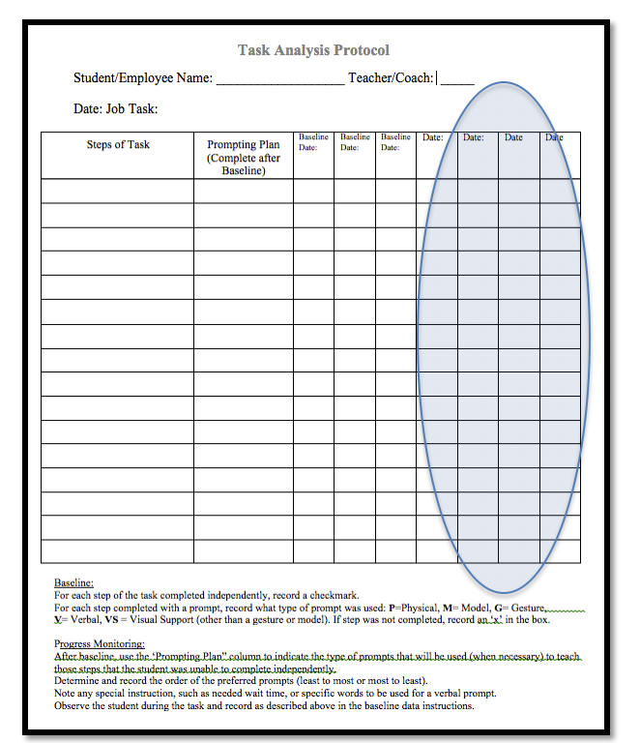
Teach the Skill
Using the outlined plan steps, begin teaching the skill
Use prompts as you have planned.
  Heavy prompts for teaching
  Minimal prompting for promoting independence
Implement plan and record progress at least 3 separate times
Review the student progress and refine plan as necessary

Slide 55
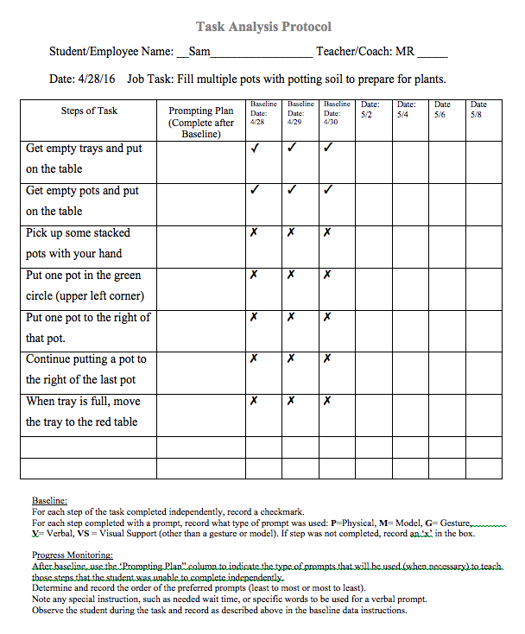
Example Task Analysis and Baseline Data
Notes:
This slide as well as the next several slides offer examples on using the task analysis form to collect baseline data, recording data for progress monitoring and modifying or fading prompts based on how the student completes the steps of the task. This slide shows very simple steps with very basic recording
One of the frequent comments participants make about using the task analysis and completing the form when instructing a student on a task, is the importance of the data in showing the student’s progress. This is not obvious without documentation. Also the importance of a record of what they have tried with students especially with prompts and what has been most effective. Finally this document is important so that all team members who work with the student are following the same protocol when teaching the student a task and following the same prompting plan. A system of rewards is often used to motivate students when they make progress.

Slide 56
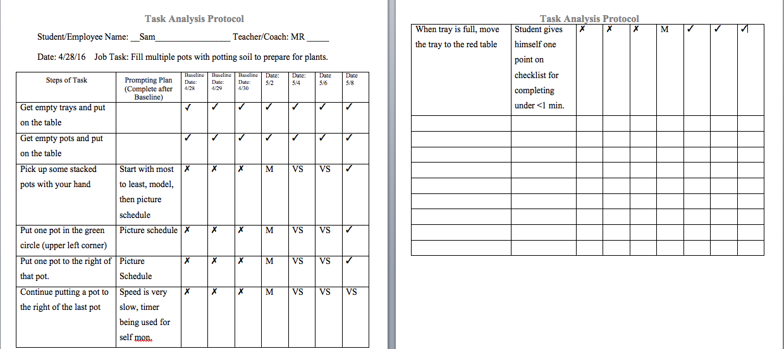
Example: Using Evidence Based Practices with Prompt Plan
Notes:
After baseline data was collected, the plan became more detailed

Slide 57
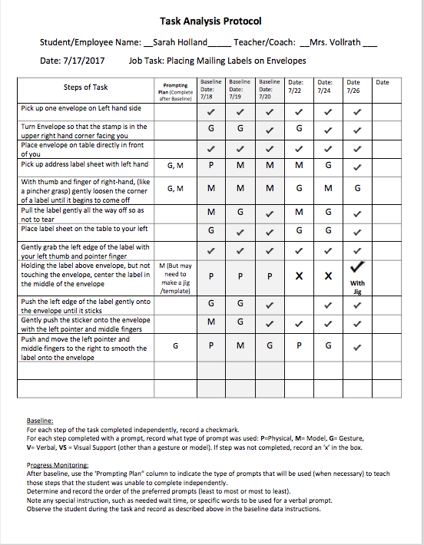
EXAMPLE
Uses baseline data for progress monitoring and modification of the prompting plan based on steps completed independently.
Notes:
Note that on the step that required centering the label, it was determined that the best way to complete this step was to have the individual use a jig or template to improve accuracy and independence. See next slide

Slide 58
PROMPT BECOMES SUPPORT
Note that on one step the student was unsuccessful without assistance.
A Jig was used to prompt the successful completion of the step.
This then became an ongoing support for the student to use to complete the task.

Slide 59
Participant Practice Activity (1)
Select Student. Choose two different students (with different profiles) who need instruction to introduce self and shake hands for a job interview.
Task Analysis. Do a step-by-step task analysis (TA) of the targeted task (Respond to a person introducing himself in an interview and engage in hand-shaking). Record the steps on the TA Form provided (Form Task Analysis Protocol).
Try It. After detailing the task analysis, try the steps with another person (friend or colleague) to assure that the steps are accurate and complete. Revise if needed.
Notes:
Give teams time to discuss assignment and do a little planning. All can do the same activity. Start Task Analysis in class on something like shaking hands.
Using chaining for this student—(remember one of your students will eventually be your target student for this project). Which are most effective and will move the student to the next level of independence?
Use the TA as a pre assessment to determine if steps need to be added or clarified and what the student’s level of independence is.
Record your observations on the task analysis sheet you just created for this activity. Is visual working? Verbal? What types of prompts need to change? You may need to do this more than once.
Record any thoughts on fading prompts.

Slide 60
Participant Practice Activity (2)
Student Baseline.
  Using the designated Form ‘TA Protocol’, observe the student in 3-4 natural situations where other students or adults introduce themselves and attempt to complete the intro and handshaking routine or TA.
  Identify the first 3-4 columns of data from TA Protocol as ‘Baseline Data”
  Observe and record the types of prompts being used. Identify how each each step was completed. ‘Independent’, or if prompted, record the type of prompt the student required to complete each step. If the student does not complete the step, use an “x” to signify that it was not completed.
  This form will be used later to continue the progress monitoring
Notes:
Give teams time to discuss assignment and do a little planning. All can do the same activity. Start task Analysis in class on something like shaking hands.
Using chaining for this student—(remember one of your students will eventually be your target student for this project). Which are most effective and will move the student to the next level of independence.
Use the TA as a pre assessment to determine if steps need to be added or clarified and what the student’s level of independence is.
Record your observations on the task analysis sheet you just created for this activity. Is visual working? Verbal? What types of prompts need to change? You may need to do this more than once.
Record any thoughts on fading prompts.

Slide 61
Participant Practice Activity (3)
Teach Using Chaining and Prompting.
  Using baseline data and task analysis (TA), create a prompting plan that will be used to chain the steps of the TA together to complete the task.
  Determine how the student will be taught each step of the task where he/she is not independent.
    What prompts will be used on which steps?
    Which prompts will be used first?
      Is this a new task? Is ‘most to least’ prompting needed?
      Or is the task familiar, however support to complete task using ‘least to most’ prompts is needed?
The goal is for the student to eventually complete the task independently, however you may not reach that goal depending on your time constraints
Notes:
Give teams time to discuss assignment and do a little planning. All can do the same activity. Start task Analysis in class on something like shaking hands.
Using chaining for this student—(remember one of your students will eventually be your target student for this project). Which are most effective and will move the student to the next level of independence.
Use the TA as a pre assessment to determine if steps need to be added or clarified and what the student’s level of independence is.
Record your observations on the task analysis sheet you just created for this activity. Is visual working? Verbal? What types of prompts need to change? You may need to do this more than once.
Record any thoughts on fading prompts.

Slide 62
Complete Chaining Post Assessment
Put your answers in the post assessment column of Handout #1.
Open handout #3 Chaining Pre and Post Answers. Correct your answers in the pre and post columns.
Did your scores improve from pre and post tests? Were you surprised by your results from either pre or post?
Any reflections on the value of this activity in terms of collecting baseline information, its role in progress monitoring and your practice in the classroom?
Notes:
Facilitators may wish to discuss the results and any connections with baseline data, progress monitoring and their classroom practices. Single viewers may want to reflect on some of the questions on this slide.

