Slide 1


“What Works for Work”
Session Nine
Visual Supports

Slide 2

Visual Supports

Slide 3

Handout
Evidence Based Practices for Transition Youth - Visual Supports Pages
  Download from Session 9 website
Notes:
Facilitators: Have the participants locate and review the visual supports pages in the document.
Link for Evidence Based Practices for Transition Youth: https://www.ocali.org/project/evp-adult-success

Slide 4
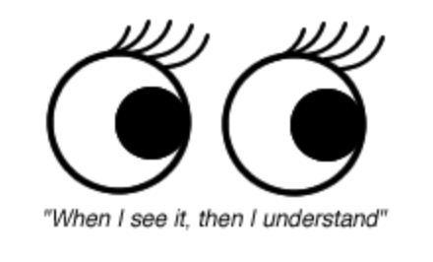
What are Visual Supports?
Visual supports are concrete items, pictures, photographs, symbols or printed words and/or a combination of these items that when used strategically can assist an individual to maintain attention, communicate, remember, organize thinking and complete tasks.

Slide 5
What Are Your Visual Supports?
Most everyone uses’ visual supports’
Individuals that have visual impairments often use similar strategies that have been translated to ‘tactile supports’.
Make a quick list of what you use to maintain attention, communicate, remember, organize thinking and complete tasks
My Visual/Tactile Supports
Notes:
Facilitator: Participants may Complete this activity by writing a list on the handout, blank paper, flip charts, etc. This may be completed individually or in small groups. When completed, have a quick share-out time to discover the diversity of visual supports used by the group. If the group includes learners that are visually impaired , highlight supports used by this participant that align with other types of supports used by a sighted person.

Slide 6
Characteristics of Effective Visual Supports
Visual Supports should be:
Clear and Accentuate Important Elements of the Support
Consistent and Predictable across environments
Constant and Unchanging (until necessary to change)
Available to the individual at any time
Matched to the individual’s learning style
Taught to the individual
Eventually managed by the individual (as much as possible)
Notes:
Discussing the characteristics of effective visual supports before looking at examples allows the group to understand the best visual supports are ones that are well matched to a person and reflect certain elements. When looking at examples, have the group continue to reflect on the ‘checklist’ of characteristics to emphasize the importance that a visual support may not be as simple as a list of words, nor will it be the same for everyone.

Slide 7
Visual Strategies Facilitate Receptive Communication
Assists Communication To the Person From Others
(Receptive Communication)
Example:
Explains and Prepares the person for ‘What is Happening’
  “Why”
  “Where”
  “When”
  “What Order”
  “How”
Explains the expectations for participation, action and behavior

Slide 8
Visual Strategies Facilitate Expressive Communication
Assists Communication From the Person To Others
(Expressive Communication)
Example:
Facilitates expressing ”How I feel” about what is happening
Supports the expression of choices about what is happening
Provides a way to clarify ”What I Want to Happen”

Slide 9
Visual Supports Improve Efficiency
Visual strategies and supports also assist the person to be able to function more efficiently and effectively:
  Complete a task or job more quickly
  Accuracy or correctness of job outcome is improved
  Consistency of task results increases
  Level of engagement and independence improves
Notes:
Additional Notes for facilitator and viewer.
The visual factor- Research supports that many persons with complex needs, especially those on the autism spectrum, learn best with visual and tactile supports.
Visual components for strategies remain constant, are available when the person needs them, and stay consistent across environments.
Strategies that include visual components are schedules, written picture directions, and video modeling.
If a strategy/intervention doesn’t have a visual/tactile component, this might be something to add in the revision if the individual responds well to this factor.
Source is NPDC (National Professional Development Center), 2010; Melching, 2007; Simpson, 2005.

Slide 10
Visual Strategies Support Learning
Visual strategies and supports also assist the person to learn and use information
  Organize thinking about the approach to a situation or task
  Recall academic instruction and information to support learning
  Problem solve and select solutions … including challenges in the social world

Slide 11
Visual Supports Work with Other EBP
Many other EBP will include visual supports as part of the teaching plan
Other sessions provide many examples of visual supports
  Social Emotional Supports such as Social Narratives- session five
  Mobile Technology offers visual support- session six
  Chaining steps can be represented in a visual format- session three
  Video Modeling is an effective visual strategy- session four

Slide 12
VCU ASD School to Work: Visual Supports
Employment preparation programs for youth with ASD recognize the value of visual supports on the job
Virginia Commonwealth University offers a short research brief of how supports are used on the job
Use the link above to access the article or download from Session Nine website. 06: VCU Visual Supports School to Work (Handout)
Notes:
Activity: If time permits, have participants review this 3 ½ page article briefly. A quick way to do this is to have the participants each take a different section, read it, identify 1 or 2 important points and share with the others in the group. Sections include: What are Visual Supports? What Does the Research Say about Visual Supports? How can Visual Supports be Used in Work Settings? What Supplies are Helpful to Have on Hand When Creating Visual Supports? Are There Other Considerations When Using Visual Supports at Work?
Link for research brief: https://worksupport.com/documents/Visual_Supports.pdf

Slide 13
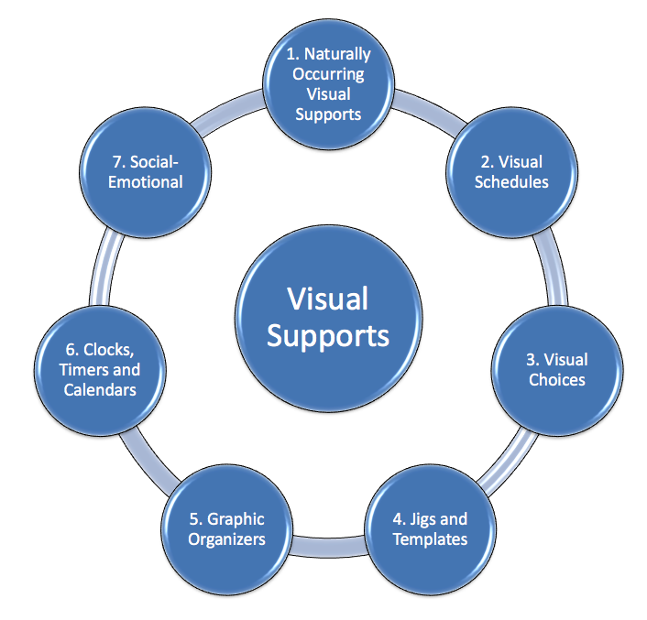
Types of
Visual Supports
There are many ways to categorize and review visual supports. In this session, the categories to the right are used and examples of each are provided in the following slides
Notes:
Naturally occurring visual supports
Visual Schedules
Visual Choices
Jigs and Templates
Graphic Organizers
Clocks, Timers and Calendars
Social-Emotional

Slide 14
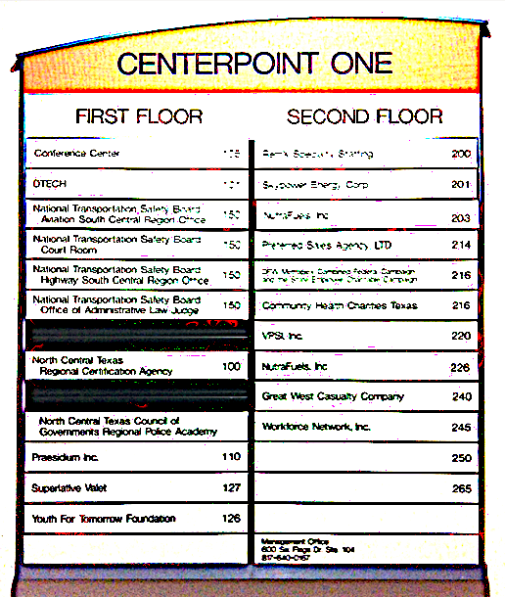
Natural Visual Supports
Natural visual supports are cues around a person that inform them what is happening and how to respond.
Draw attention to environmental labels and information and teach to use these cues for more independence.

Slide 15
Visual Environmental Cues
Use natural or create visual boundaries through furniture arrangement, labeling, color-coding, teaching relevance of walls/doors/carpets, use tape to indicate areas
Can help the individual know
  Where to stay
  How to transition
  What belongs to him/her
Notes:
For more information on environment and visuals, see the Visual Supports Modules at www.autisminternetmodules.org by logging in to AIM modules, free account, select View all modules, scroll through the list they are in alphabetical order.

Slide 16
Examples of Natural Visual Cues
Space/Distance
  Where chairs are placed
  Work area boundaries
Objects and Materials and When Used
  Coats
  Keys
  Lunch bags
Colors
  Stop lights
  Color-coded materials
  Recycle vs. Trash

Slide 17
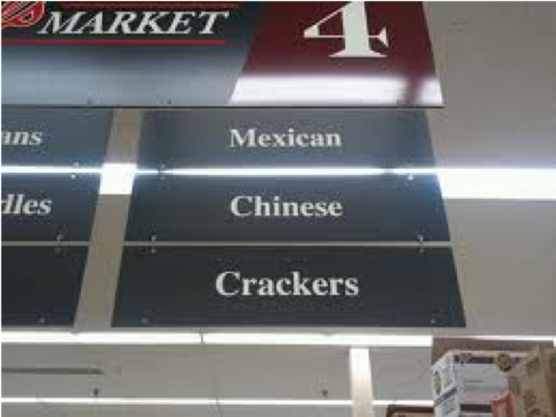
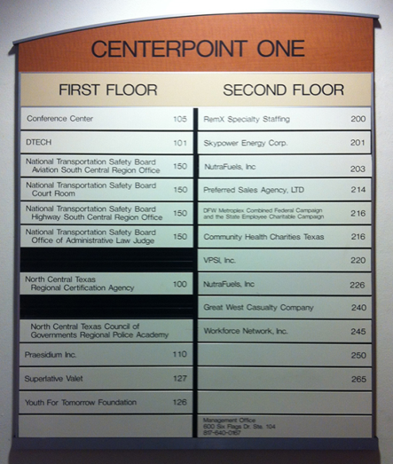
Teach to Use Natural Supports
Store Signs and Building Directories
Notes:
Do not assume everyone knows how to use the visual supports found in the community, on the job or around the school. Instead, take note of all the visual supports that are available to everyone. Determine which will help a person understand and be able to navigate the environment. Intentionally teach the supports, how to use them and where to find them.

Slide 18
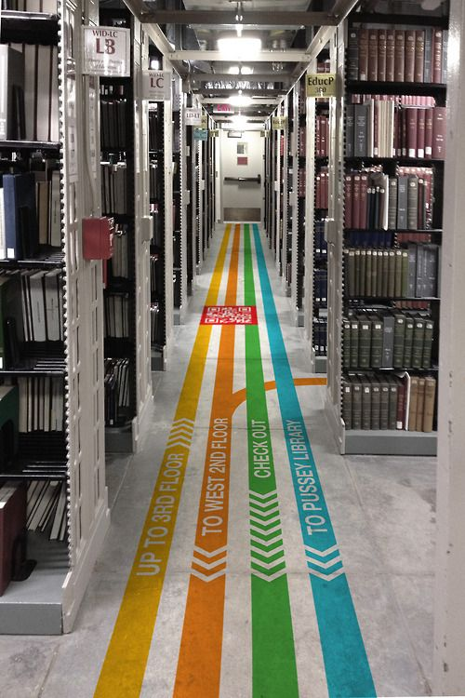
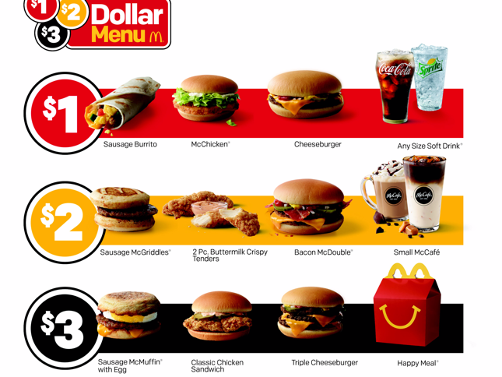
Teach to Use Natural Supports
Menus and Building Guides
Notes:
Do not assume everyone knows how to use the visual supports found in the community, on the job or around the school. Instead, take note of all the visual supports that are available to everyone. Determine which will help a person understand and be able to navigate the environment. Intentionally teach the supports, how to use them and where to find them.

Slide 19
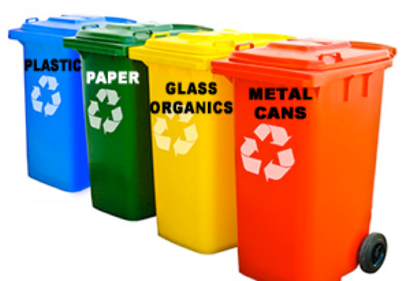
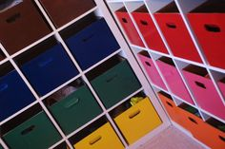
Use Color Coding as Environmental Cue
Notes:
The different color containers, recycle bins or shelf units, act as cues and guidance for remembering the types of materials that are stored in each. For example, items for a particular job task may be found in the same color bins. Or the same type of materials may be grouped in the same color bin, such as cleaning products, dishes, office supplies, etc.

Slide 20
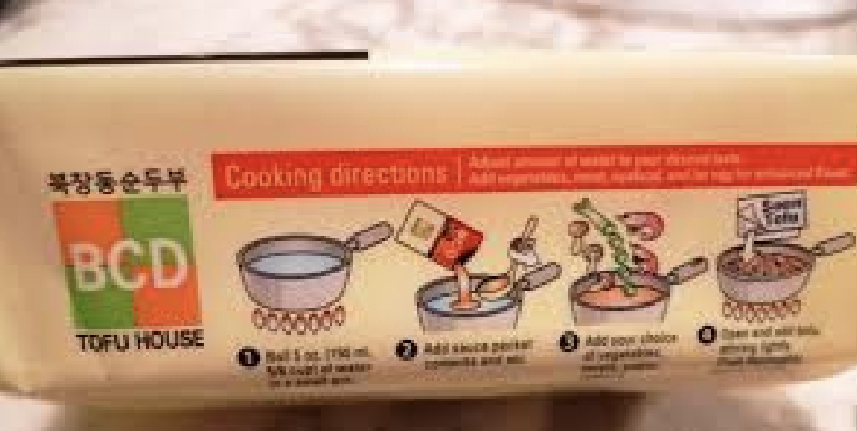
Recipe on Package
Recipe with words and picture drawings placed directly on the package by manufacturer

Slide 21
Visual Supports Work for Visually Impaired
Group Discussion
Review the previous slides 17-20:
  Store Signs and Building Directories
  Menus and Building Guides
  Color Coding
  Package Recipe/Instruction
How could these types of supports be adapted for the individual with a visual impairment?
Notes:
Facilitator: This can be a whole group or small group activity. Prompt the groups to discuss adaptations they have seen used, adaptations they may have developed, or potential adaptations. A Worksheet is available for download on the session 9 website- 05: Worksheet for Adapting Visual Supports Activity (Handout) to guide the group discussion if desired. Or the group may make notes on the handout, blank paper or flip charts if available.

Slide 22
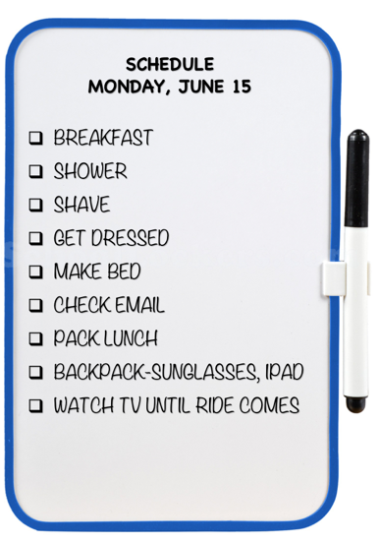
Visual Schedules
Tell what is to occur in the day, a portion of the day or only what will occur “next”.
Use objects, photographs, icons, words, or a combination.
Can be portable or fixed or both
Notes:
The visual schedule section is lengthy with examples. It includes approximately 25 slides The intent is to provide the learner with varied examples to meet different needs and different learning styles. Slides that review familiar types of schedules can be quickly reviewed. Slides with schedules that are unfamiliar can be discussed.

Slide 23
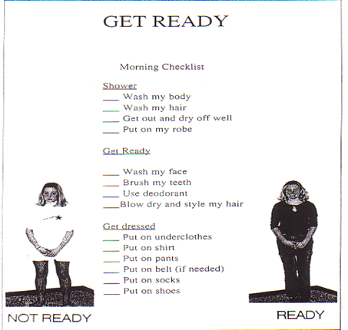
Visual Activity Schedules
Visual Activity Schedules are schedules that focus on a specific activity
The schedule breaks down and indicates each step of an activity
The daily schedule would indicate the activity (example: “Get Dressed”), and the activity schedule would then show the steps used to “Get Dressed”

Slide 24
Schedule Types
Objects
Photographs
Icon
Word
Combination
Dry Erase Board
First-Then
Let’s Look at a Few Examples

Slide 25
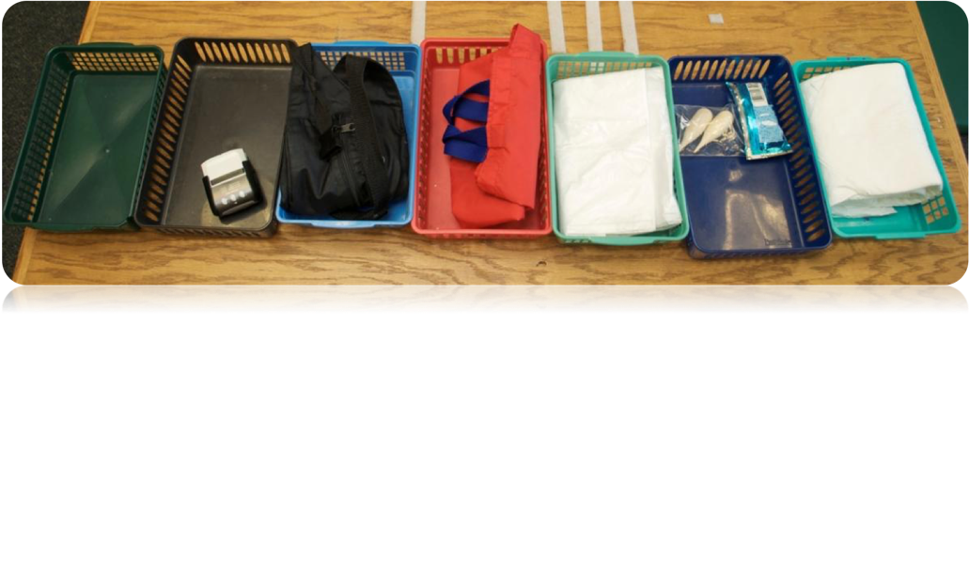
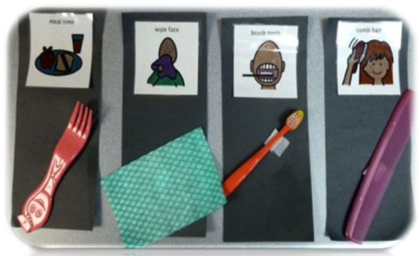
Object
Schedules
Notes:
The basket schedule uses the actual items involved in the task or activity as a cue for what is to occur.
The icon and object schedule used objects that represent and are similar to those used in the activity but may not be the actual items used in the activity. This schedule also provides the icon of the activity to teach the icon in order to transition the individual to an icon schedule in the future.
Object schedules are often used for those with visual impairments.

Slide 26
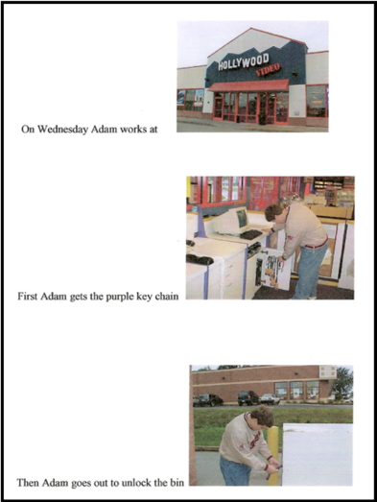
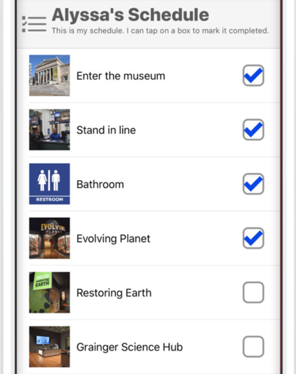
Photo Schedules
Notes:
The example on the left is an example of a schedule using photos of the person doing steps of a job task with simple text as a reminder to assist or support independent completion of the task.
Alyssa’s schedule on the right is an example of using an app to create a photo schedule and checking off the steps as they are complete.
Alyssa’s Schedule is an example from the app “Field Museum for All. An Inclusion & Accessibility Tool”
(https://itunes.apple.com/us/app/field-museum-for-all/id1171510231?mt=8). The Field for All app helps families and groups, including visitors with autism and disabilities, plan their visit with resources like exhibition previews, a customizable schedule, and a sensory-friendly map of the space. Features include visual schedules, social guides, and interactive games. This app is designed to help all visitors feel welcome and supported.

Slide 27
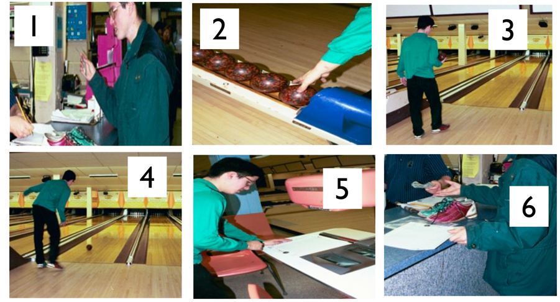
Photo Activity Schedule
Notes:
This example is a set of photos taken at the community bowling alley. The individual that will use the schedule is featured in each step. He is able to see himself walking through each step (where he was prompted by another person). Using the schedule he is able to predict each step and be more independent with the activity.

Slide 28
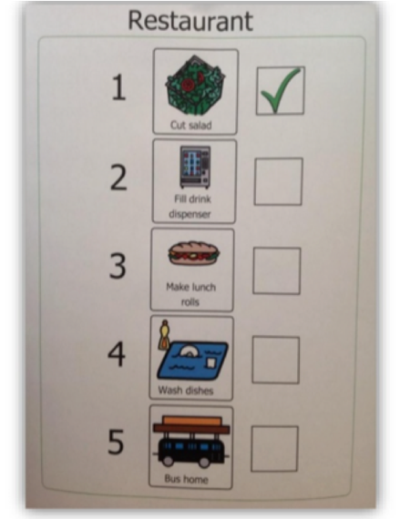
Icon Visual Schedule
Icon Schedules are frequently used as the individual is able to generalize from objects and photos to icons that represent the concepts

Slide 29
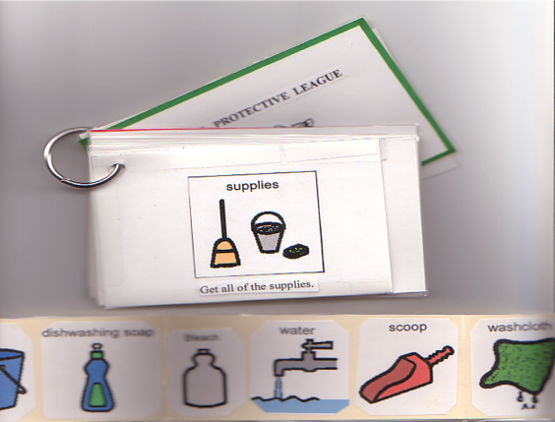
Icon Visual Activity Schedule
This activity schedule is embedded into a visual schedule on a ring.
At the step of gathering supplies, there is a visual checklist that is removeable to walk the individual through gathering the supplies.

Slide 30
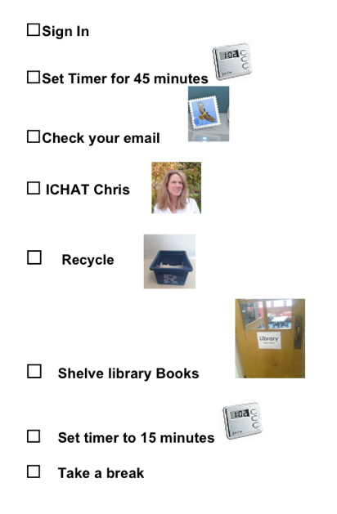
Word Schedules
Some schedules only include words and phrases to describe the event occurring
In order to transition to word schedules, the word may be paired with a picture and the picture gradually faded

Slide 31
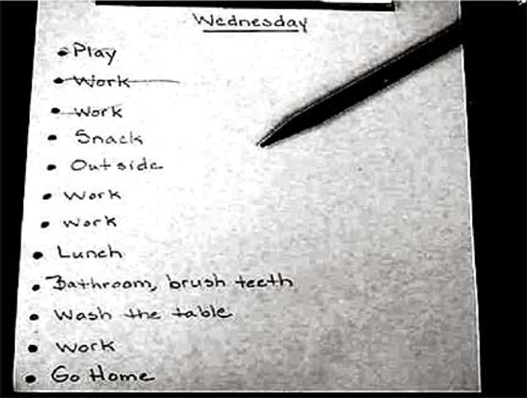
Word Checklist Schedule
A simple way to provide a schedule for the person that is a reader

Slide 32
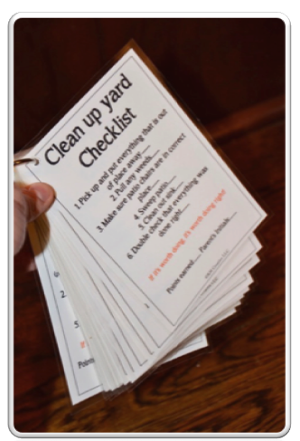
Visual Routine Word Checklist
Using a ring and laminated cards
The routine steps are explained with a location to check off the steps

Slide 33
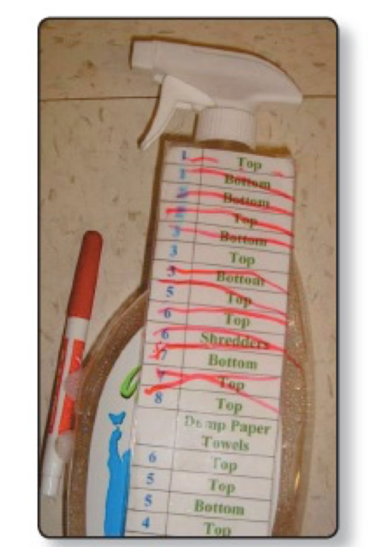
Visual Routine Embedded in Task Materials
Be creative!
Attached to the cleaning material are the steps of the task
Laminated routine allows steps to be crossed off as completed
Dry erase pen marks are erased, and schedule used for the next time or another person.
Notes:
This example came from Supported Employment & Supported Volunteerism Training Manual found at: https://www.alpinelearninggroup.org/images/newsletter/upload/pdf/1478275632-Alpine_Employment_Manual.pdf on page 12

Slide 34
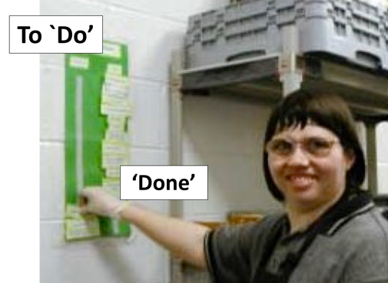
Word Work Schedule Using Velcro
Schedules can be created with Velcro.
Schedule items are placed in the order to be done (top to bottom)
The example shows the left Velcro strip of the schedule holds the ‘to do’ items. These are removed when completed and placed on the right-side Velcro strip of the schedule

Slide 35
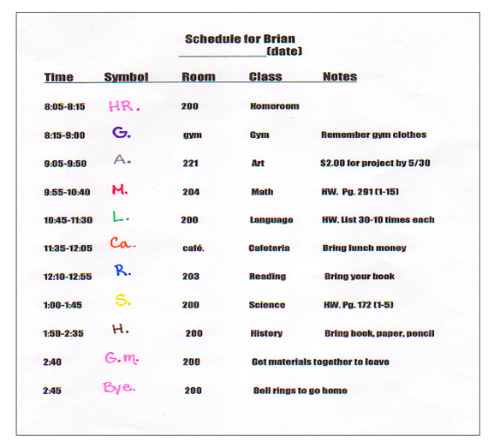
Word Schedule for School Day
This schedule was developed for a high school student that needed to know what would happen and when.
It provides additional information about the class or activity, as well.
All items for the class are color-coded to match schedule

Slide 36
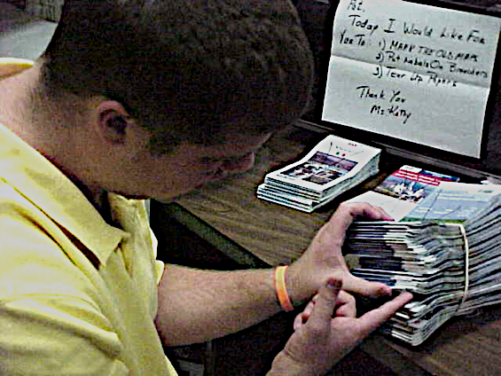
Very Simple Word Schedule
Some schedules are quite simple
Sometimes they are made quickly
Problem-solving when the primary support is not available may result in a plain, yet effective, strategy.
Notes:
When a more formal or prepared schedule is not available (perhaps forgotten or even lost), it is recommended that the support staff, supervisor or co-worker create a quick alternative. The individual may be prepared for this as a possibility.

Slide 37
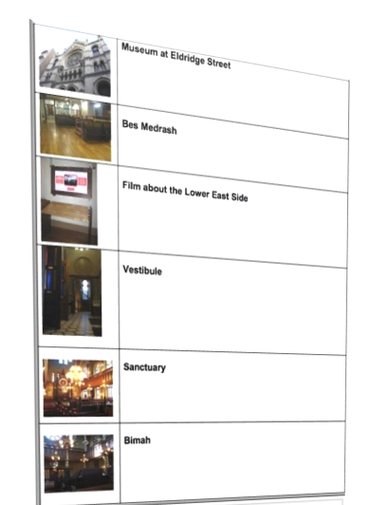
Combination Visual Schedules
Often Schedules are a combination of one or more types
This can give more information or may be used to transition the individual from one type of schedule to another

Slide 38
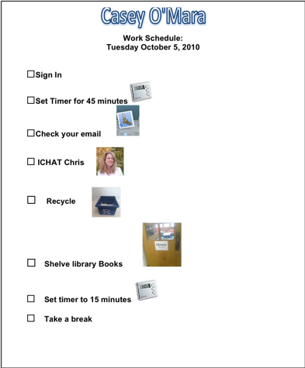
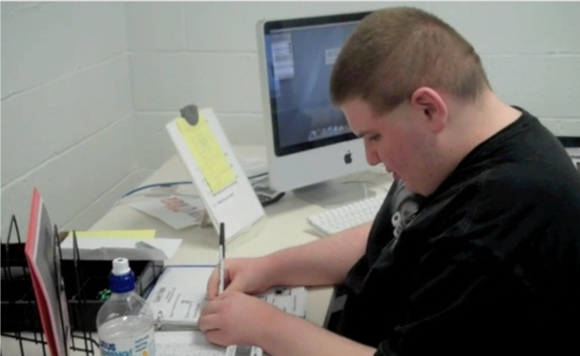
Combo Schedule
Notes:
This schedule is a combination of photos and words. The photograph shows the young man using the schedule as he independently works through the tasks of the work day. This schedule along with the pictures for each step and the picture on the right of Casey show how he is able to use the picture schedule to complete his work tasks. This schedule builds independence since he can use the pictures as a prompt or visual reminder to complete a task rather than having a job coach at his side telling him what to do for each step. As he becomes more familiar with the tasks he may choose not to use the checkbox and mark it off as he completes a task. Checklists can be designed without this box depending on the individual and what works best for them.

Slide 39
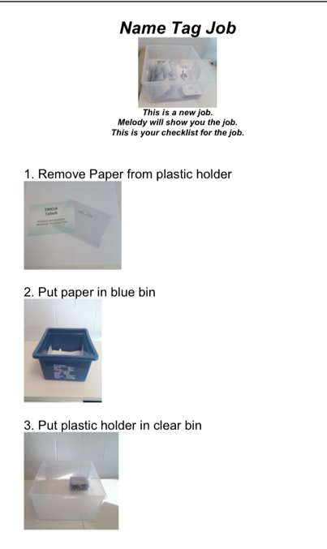
Picture Word Task List
This task schedule shows a work system with organizers
Bins were used in a school program and then were transferred to support task completion on the job
The different colored bins also serve as environmental cues so the worker knows where to put material
Notes:
This paper activity schedule includes three steps for the job. Includes words and photographs of each step. 1.Remove paper from plastic holder 2.Put paper in blue recycle bin 3.Put plastic holder in clear bin.

Slide 40
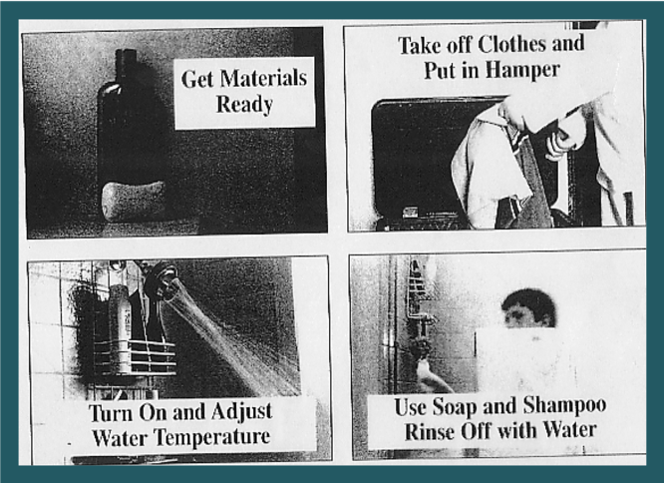
Simple Combo Schedule
Notes:
This paper activity schedule includes four steps for taking a shower. Includes words and photographs of each step. Top left- Get materials ready (shampoo container). Top right- take off cloth and put in hamper (clothes placed in bin). Bottom left- Turn on and adjust water temperature (shower faucet turned on). Bottom right- Use soap and shampoo rinse off with water (boy under the shower faucet- only head visible).

Slide 41
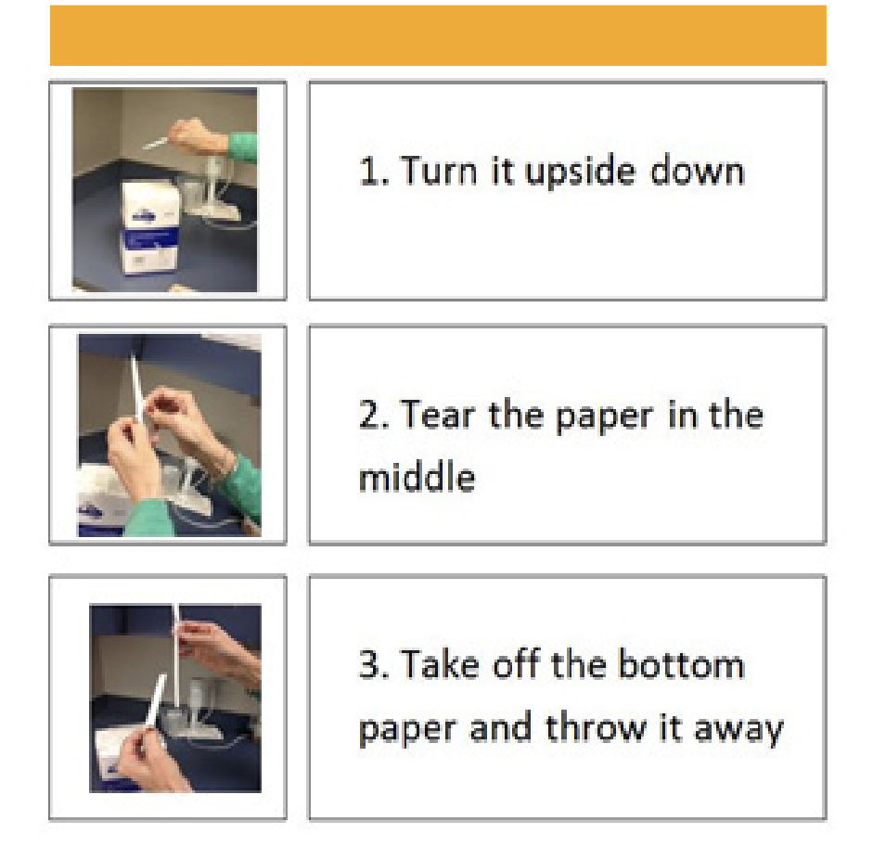
Simple Job Task Activity Schedule: Words and Photos

Slide 42
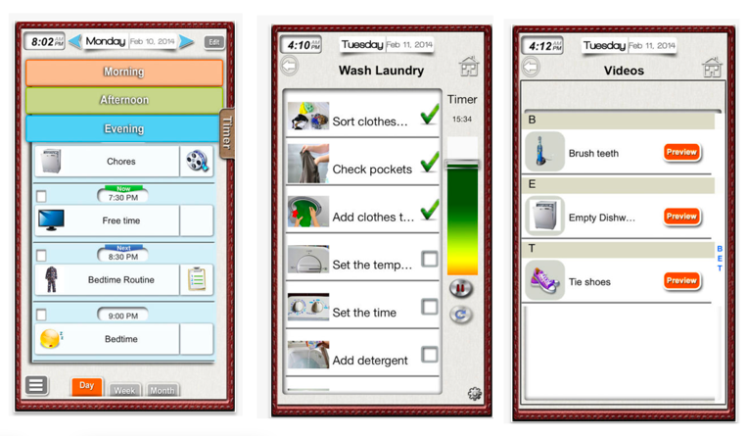
Apps for Creating Visual Schedules
This is the Visual Schedule Planner App
This offers different types of schedules
  Daily Schedule
  Activity Schedule
  Words, Photos, and Video
Notes:
The Visual Schedule Planner App (https://itunes.apple.com/us/app/visual-schedule-planner/id488646282?mt=8) offers the opportunity to set the time for activities throughout the day. Word labels can be added as well as photos and video examples. The daily schedule is entered into the app, as well as specific activity schedules that show each step needed to complete the activity. This is only one app that offers these types of options. Many apps offer similar types of visual schedule elements.

Slide 43
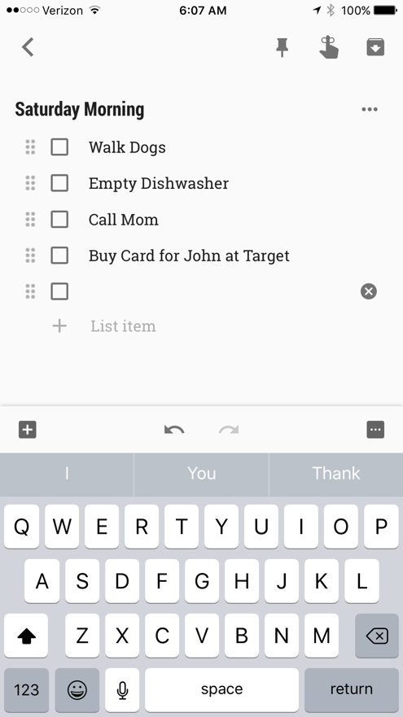
Google Keep
Google Keep is a free app that can create a variety of visual supports
  Schedule
  Lists
  Reminders
  To Dos
Uses words, pictures, videos and speech to text
Notes:
Hyperlink on slide goes to this video: https://youtu.be/MZUcFewFTQE
Other video tutorials on Google Keep:
https://www.youtube.com/watch?v=MKXC6nFA7z8,
https://www.youtube.com/watch?v=QU0FEOhzikM
Tutorial with video
https://www.controlaltachieve.com/2017/03/hipster-google.html

Slide 44
Group Discussion
Is anyone using an app that is effective to support an individual for scheduling or to understand routines?
Notes:
Facilitator may take a break from the slides and survey the group to see what apps participants have used with individuals they teach or support. The facilitator may also ask if anyone has used the apps highlighted in the slideshow.

Slide 45
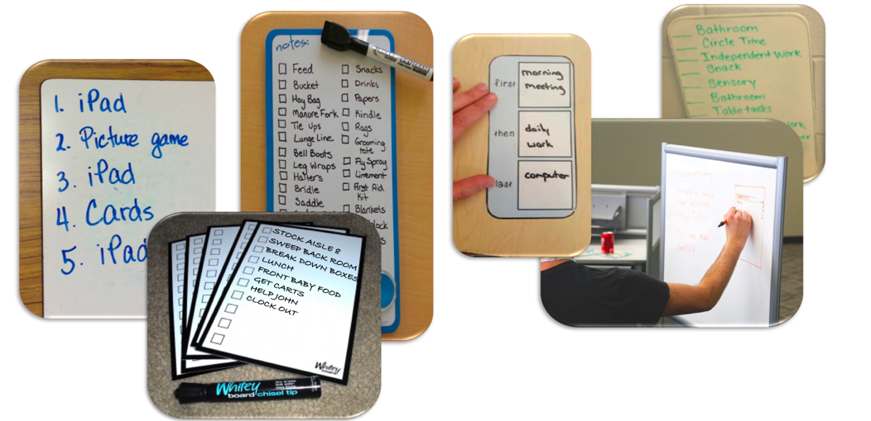
Quick and Easy: Dry Erase Boards
Notes:
These pictures demonstrate how dry erase boards can be used to write a schedule so a task can be accomplished, or list things or objects needed to accomplish a task. The dry erase board allow for quick writing of steps or lists or needed information to help with organization but can readily be erased and used again for a new set of tasks.

Slide 46
First-Then Schedules
What Happens NOW and WHAT’s NEXT?
Pictures and Words help focus on the needed information
This visual support shows what the individual will do first and then what to do next. A first-then board can be used with an individual who is not yet ready for a more complex visual schedule
Autism Center- Resource Gallery
Notes:
Autism Center Resource Gallery https://www.ocali.org/project/resource_gallery_of_interventions/page/first_then_board
First-then Schedules can be useful for many people. Some people only need this much information to be able to be successful. Some people need this type of schedule at particular moments. Sometimes the rest of the day is unclear and so it is best just to focus on what is a certainty.

Slide 47

Low Tech First-Then Schedule

Slide 48
Visual Directions: A Type of Activity Schedule
Directions break down what needs to be done into small steps
Visual directions use words, photos, objects, etc. to represent each step
Builds independence by removing the need for constant prompting

Slide 49
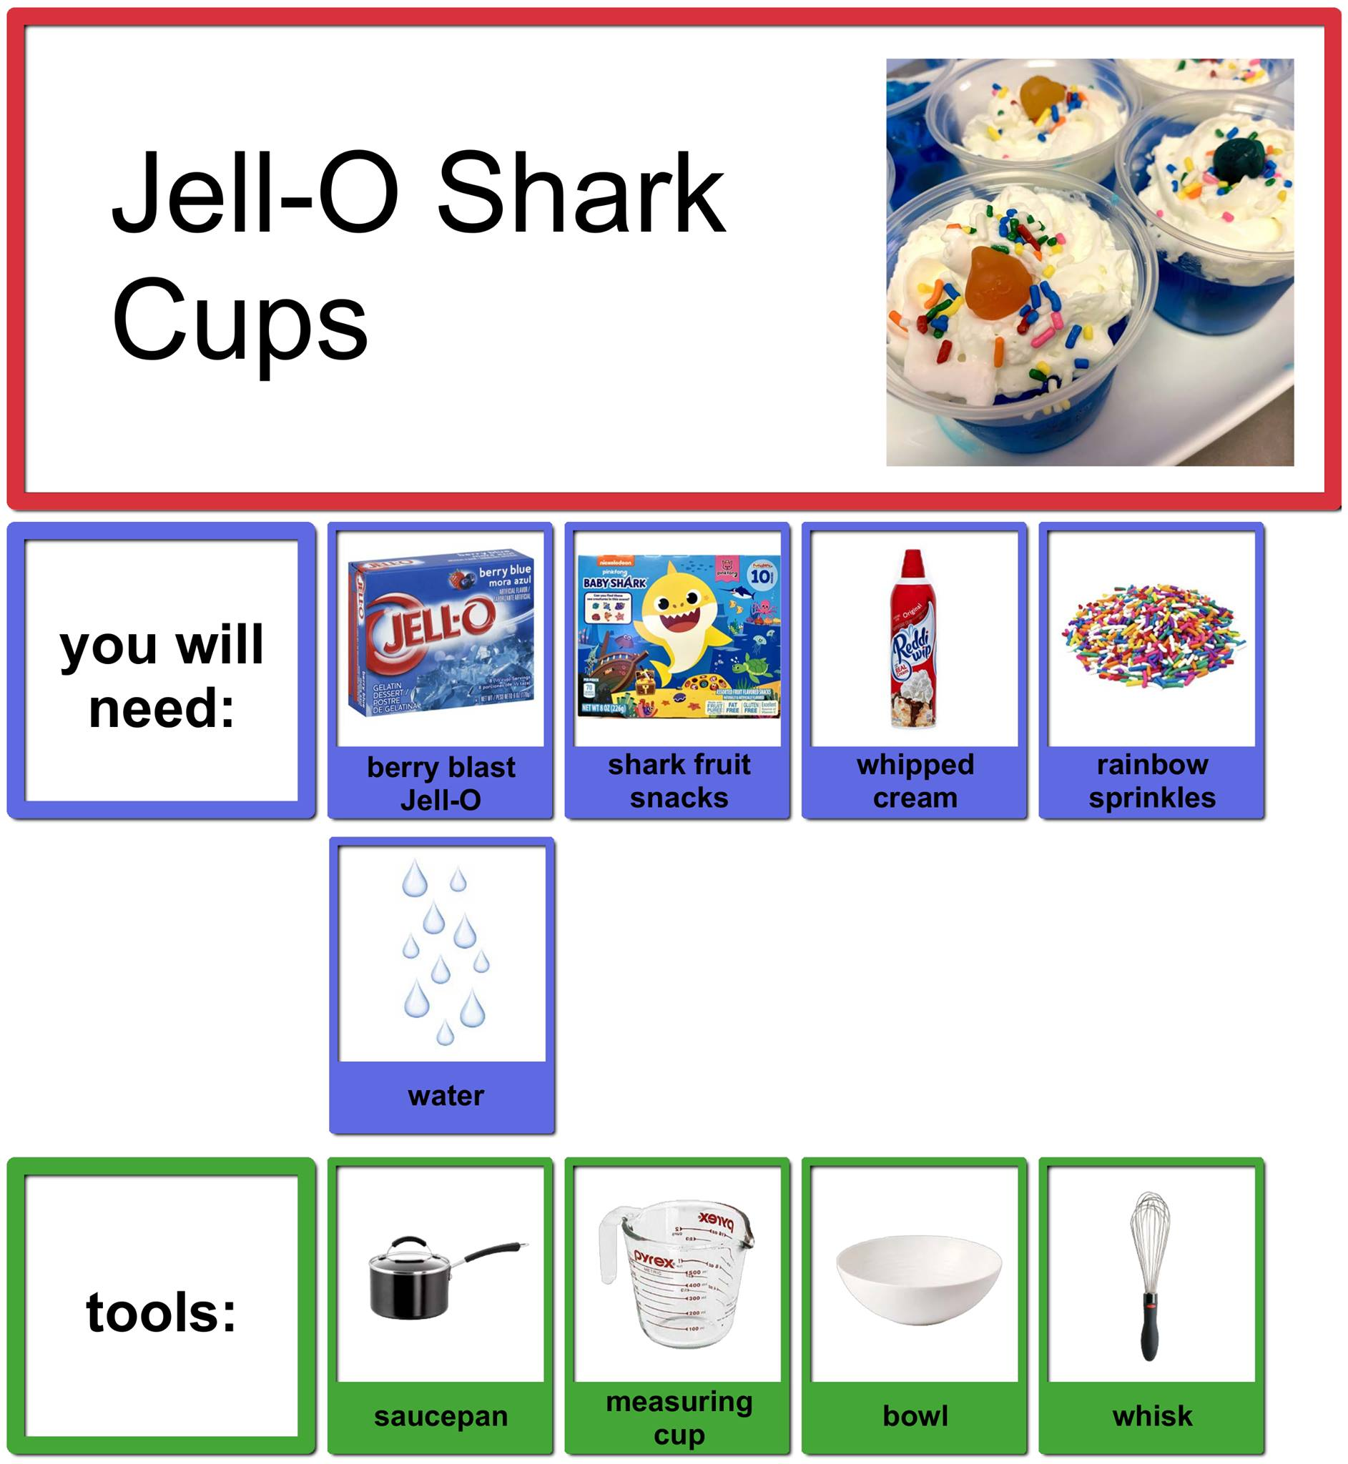
Accessible Chef
Recipes that provide photographs of the steps to prepare a variety of foods
Cost: Free
Notes:
Link for Recipes: https://accessiblechef.com/recipes/

Slide 50

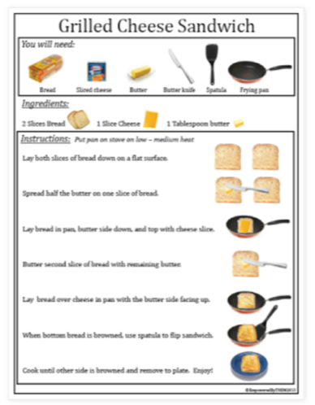
Visual Recipes Resource
Notes:
Available to borrow from the OCALI Lending Library. Feel free to connect with the OCALI lending library to set up an account, free of charge for you. The lending library can be reached at 614-410-0321

Slide 51
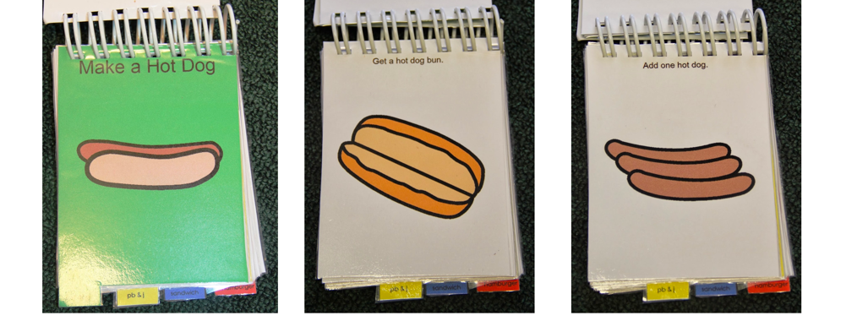
Visual Direction: Low Tech Version
Many Apps and other technology offers this type of support, but if there is a need for a ‘low tech’ option… consider this:
Notes:
Although low-tech, this might be the most effective visual support for an individual. Or, this could be a backup support for higher tech devices. Review the session six on mobile technology for examples of apps that help with visual schedules such as Can Plan and other resources on apps.

Slide 52
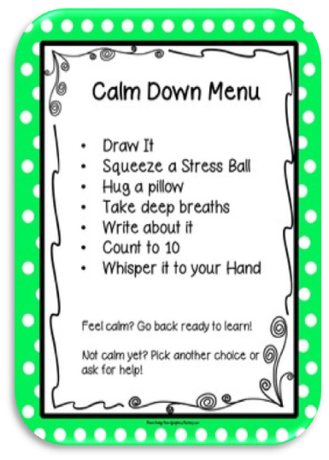
Visual Choices
Choices:
Empower communication
Provide control
Reduce behavioral outbursts
Can be paired with visual supports to increase effectiveness

Slide 53
Expressing Wants, Needs and Thoughts
Choice-making assists the individual to express desires
Many of the visual schedules and visual routines will support the development of vocabulary for choice
However, sometimes additional support may be needed

Slide 54
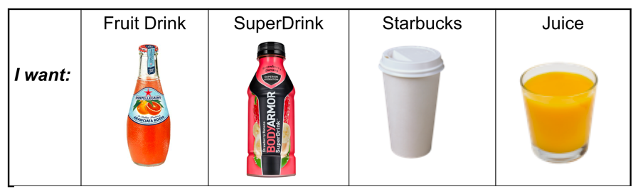
Choices Are Important
Choices in life are essential!
As we move into adulthood, we expect to make more choices that reflect adult options
Choices allow control in our life

Slide 55
Tips for Choice-Making
Start when the individual is calm/focused
  Don’t try to teach when the individual is upset/angry
Gain the individual’s attention then present the choice board
Don’t forget when it is not a choice
Provide highly motivating choices that complement the activities going on in the environment

Slide 56
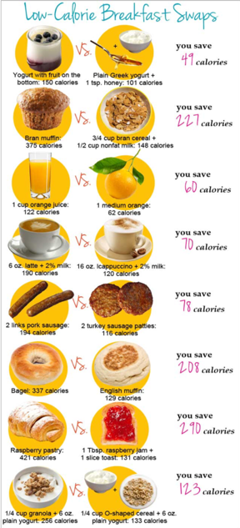
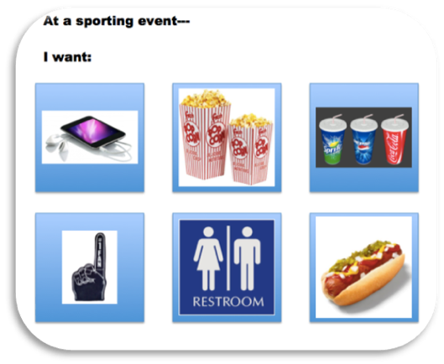
Two Additional Examples of Visual Choices
Notes:
The choices in the example on the left side of the slide are for a specific event. This might only be used at certain sporting events rather than as a general visual support. The choices in the example on the right side of the slide could be used on a daily basis to offer choices and also stay within low calorie options.

Slide 57
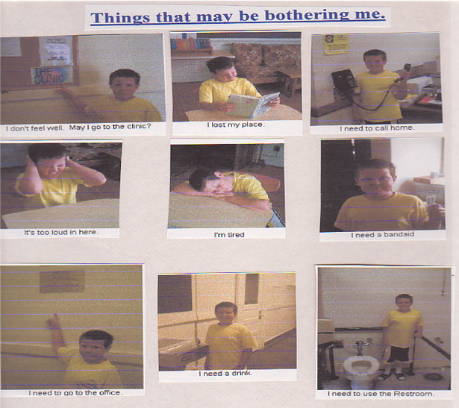
Visual Choices Help When Stressed
Sometimes when stressed making a verbal choice is difficult
The boy in the photos became frustrated at times of stress and often had behaviors
Preparing these photos of him while he was calm explaining stressors, allowed him to simply point to communicate during difficult times
Notes:
This example is very low tech and could be considered by some outdated. However, there are times when having this hard copy tool is an advantage or may be the only option that some schools, families or individuals are able to access.

Slide 58
Making Choices of What to Say and What Not to Say
Words I Can Use On the Job
Words I Can NOT Use On the Job
No thank you
Excuse me
Is it OK to take a Break now?
Please don’t do that
I Don’t Think So!
This is Stupid.
I am NOT doing this work now!
Knock It Off

Slide 59
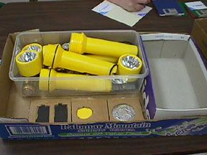
Jigs and Templates
A jig's primary purpose is to provide accuracy of task completion.
For example: A device with a predetermined number of openings to help the worker "count" the correct number of items.
Some ‘jigs’ may also be described as templates
Notes:
Another Example: A simple cardboard form, the “jig,” made it possible for a person with intellectual disability to properly fold jeans as a stock clerk in a retail store – cost $0.

Slide 60
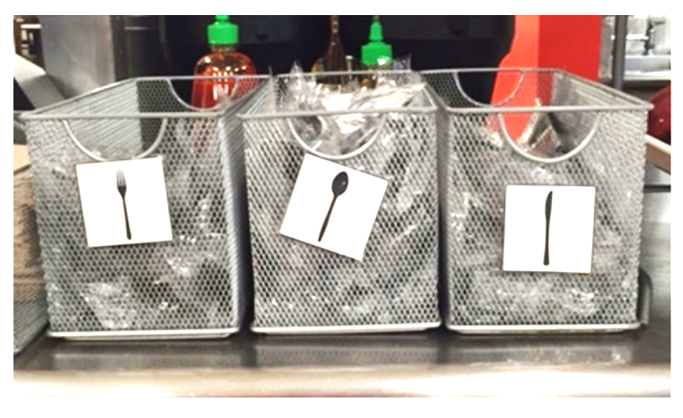
Jig: Where to Place the Utensils

Slide 61
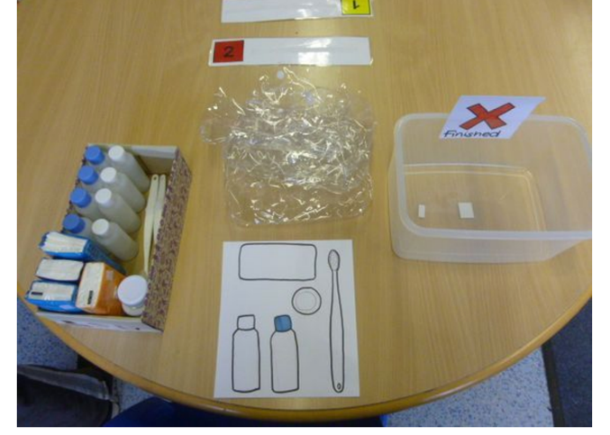
Jigs: Clear Beginning and End
Working left to right
Template or jig to understand what goes in each bag
A place to put the finished product

Slide 62
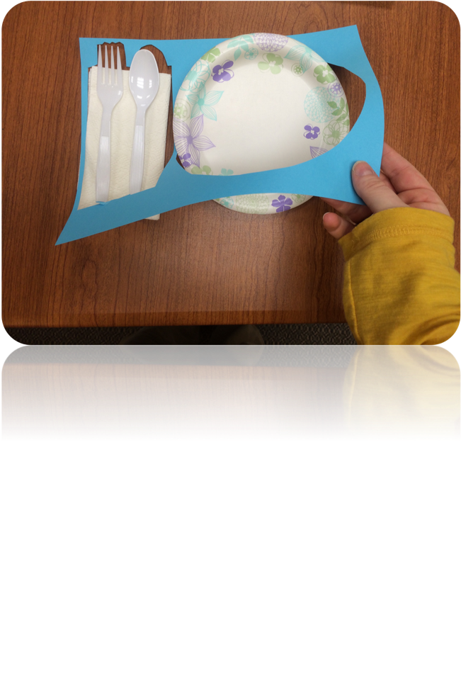

Example of Simple, Low-Cost Jigs

Slide 63
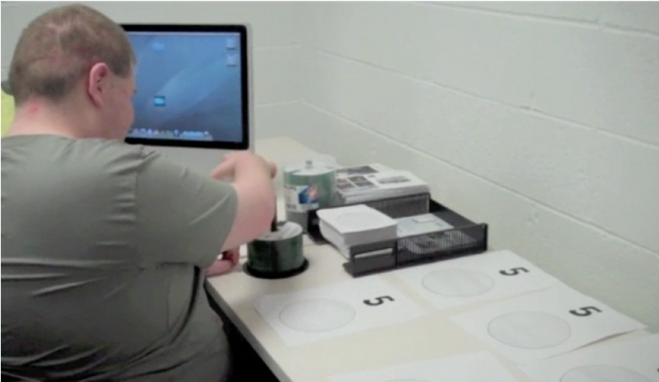
Quick and Easy Template
A circle template on a plain sheet of paper is used as a guide to independently complete a job task
Notes:
This shows how a template or jig assists with the job task of counting out and then grouping and packing groups of 25 discs. Five discs are placed on each sheet. These are then placed together in a stack and secured with rubber bands to create a 25-disc pack.

Slide 64
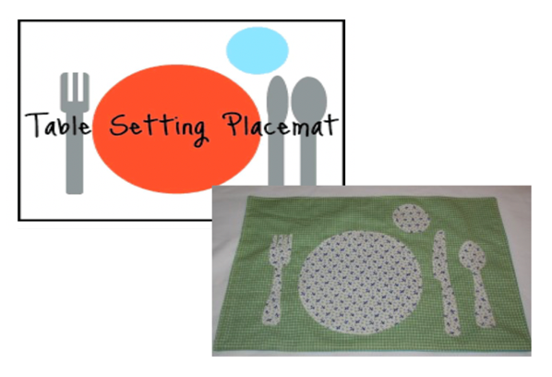
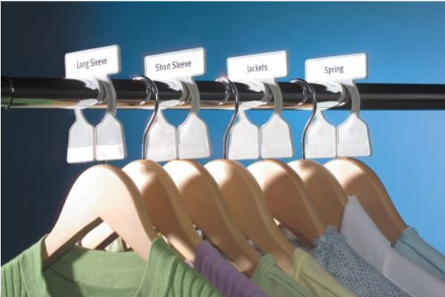
Visual Organizers for Kitchen and Closet
Notes:
The placemat and the clothing labels on the clothes rack both act as visual support templates for knowing where to find or place clothing or how to correctly set the table.

Slide 65

Graphic Organizers
A graphic organizer, may be referred to as a knowledge map, concept map, cognitive organizer, etc.
Graphic organizers are visual thinking tools that make pictures of thoughts. The pictures demonstrate relationships between facts, concepts, or ideas, to guide thinking.
Notes:
Websites where resources for graphic organizers may be found:
https://www.dailyteachingtools.com/free-graphic-organizers-w.html
https://www.controlaltachieve.com/2016/01/language-arts-graphic-organizers.html

Slide 66


Graphic Organizers for Academics

Slide 67

Graphic Organizer Apps
Online options of graphic organizers are available
Some offer free versions
Popplet is available in a free ‘lite’ version
YouTube video tutorial reviews the use of Popplet
Notes:
Video for popplet: https://www.youtube.com/watch?v=GkKg2qKnsRw
Popplet website: https://www.popplet.com/
Popplet Lite available at https://itunes.apple.com/us/app/id364738549

Slide 68

Graphic Organizer for Decision Making
Visually display a problem to help map the process of solving the problem
Map the decision to be made, the choices and the consequences
Brief video on types of graphic organizers
Notes:
Brief Video link in slide: https://www.youtube.com/watch?v=uU0v8eFO53g

Slide 69

Calendars, Clocks and Timers
Calendars, clocks and timers are visual tools and can overlap in their purposes:
Measure time
Tell when a person, event or activity occurs
Tell how long an activity or event lasts
  Beginning and/or end

Slide 70

Routine Clock
Although this version of the Routine Clock is design for a child, the same concept could be used for anyone that had difficulty telling time or remembering what happens at various hours of the day

Slide 71


Timers
Time Timer
Time Tracker
Notes:
The Timer on the left side if the slide is a ‘Time Timer” and comes in various size and also as a watch and an app. The red area is set to the amount of time that is available. As the red disappears it visual signals the passage of time. When the red is gone, the time is done. https://www.timetimer.com/
The Timer on the right side of the slide is the Time Tracker. This visual timer signals ‘green ‘ for time remaining, ‘yellow’ for time running out’ and ‘red’ for all done.
Available to borrow from the OCALI Lending Library in the Organization Kit. Feel free to connect with the OCALI lending library to set up an account, free of charge for you. The lending library can be reached at 614-410-0321

Slide 72

Visual Timer Also Supports Sensory Disabilities
For Visually/Hearing Impaired and Loud Environments
  Red Flasher
  Loud Beeper
  Vibration
Notes:
Available on Amazon for about $15.00 at the time of this PowerPoint development
General Tools TI150 3-in-1 Kitchen Timer - for Visually/Hearing Impaired, Loud Environments and Classrooms

Slide 73

Timer Board
Not sure of the exact length of time something will last?
You can still show time is passing.
Begin with all tokens on board and gradually remove as time passes to show the activity or wait is almost over
Notes:
Tokens do not equal a specific amount of time (example: minutes). Instead, they just show passage of time. This type of visual timer may be especially helpful in those situations where the amount of time is unsure, such as waiting for a ride. Waiting can be stressful. By taking off the first 2 or 3 tokens within a short time (example: a minute) the person sees the wait getting shorter and stress lowers. Slow the removal of the tokens at this point. If the ride comes around the corner and there are 2 tokens left, quickly remove one and then the other.

Slide 74
Calendar Apps
Use of calendars on smartphones, computers and tablets is essential for most adults.
Consider teaching the use of these same apps as the young person plans for transition to adulthood.
Google Calendar
Microsoft Outlook Email and Calendar
Tiny Calendar
Choiceworks Calendar
Notes:
Google Calendar link: https://www.google.com/calendar/about/
Microsoft Outlook Email and calendar link: https://www.microsoft.com/en-us/microsoft-365/outlook-mobile-for-android-and-ios
Tiny Calendar link: https://itunes.apple.com/us/app/tiny-calendar/id514917848?mt=8
Choiceworks calendar link: https://itunes.apple.com/us/app/choiceworks-calendar/id791053105?mt=8

Slide 75


Paper or Dry Erase Calendars
Monthly
Weekly

Slide 76

Example: Calendar Helps Predict When Mom Will Return
“Mom returns on December 11 and will Take Alex out to dinner.”
Each pretzel picture attached with Velcro to the calendar and story would be read with the calendar on a daily basis. Calendar was located in a central place in his apartment.

Slide 77

Social
Social-Emotional
Social-emotional learning is difficult
Visuals help to make abstract social and emotional situations make sense
Visual supports allow the individual to review the social/emotional reminders and cues
Independence increases as visuals replace prompting from people
Notes:
Note that many social-emotional visual supports were reviewed in session five on Self-monitoring and Self-management. Examples included here offer a reminder of those strategies. For more detailed information on social-emotional, review Session 5 materials.

Slide 78

Cartooning:
A Simple Way to Remember What to Say
“Speaking Bubbles” and “Thought Bubbles” visually demonstrate that what you might “think”, can be different than what you might “say”
Notes:
In this example the young man is somewhat irritated with what is being asked. He thinks the questions are really ‘stupid’ and he would like to change the conversation. Knowing that is not likely to happen, he chooses to take a break and tells the group that he’s “Gotta Go.”

Slide 79

Another Cartooning Example
What might be considered a compliment is not always perceived as such! Teach to use alternative comments an keep those other thoughts in your head until it is clear they will be welcome

Slide 80

5 Point Scale: A Social/Emotional Supports
A 5-point scale is developed to help an individual understand and learn when emotions and behavior may be getting out of control.
The scale offers a visual representation of the escalation of emotions or changes in a situation.
As the situation or emotion moves up the scale (from 1-5), the scale assists the person to remember how to respond effectively to reach the goal (usually the ‘1’ on the scale).
Notes:
Notes for facilitator or viewer: The Incredible 5 Point Scale, by Kari Dunn Buron and Mitzi Curtis shown in the self management, self monitoring session helps makes emotions more concrete with pictures and examples of feelings and also offers options for choices to make in emotional situations. For detailed information and more examples of the 5 Point Scale, review the Session 5 materials.
Available to borrow from the OCALI Lending Library. Feel free to connect with the OCALI Lending Library to set up an account, free of charge for you. The lending library can be reached at 614-410-0321
https://www.ocali.org/project/lending_library

Slide 81




Example of the 5 Point Scale
Notes:
Sometimes the description column and the What to do column are combined into one column

Slide 82

Stress Thermometer
Notes:
“This is what happens that stresses me out”.
When I’m introduced to new people
When the other guys don’t listen to me
Making Mistakes
“This is what I can do to help”
Use my scripts I learned
Think about the ocean. And take 5 deep breaths
Take a walk
Take Deep Breaths
Remind Myself it can be fixed!

Slide 83

Self-Monitoring Question Asking
Person tracks social behavior using the simple visual support
This is a reminder strategy and can be used to evaluate for progress and reinforcement

Slide 84
The Range of Visual Supports is Immense!
From: Generic and Intended to be used by all (labels for grocery isles, greeting card display markers, store signs, street signs, etc.)
To: Very specific for an individual and a task (communication device programmed for a specific task or environment).
What can you add to your current practice based on the information reviewed in this session?
Notes:
Provide time for a brief whole group or small group discussion to allow reflection on the range of materials covered. Ask for feedback and ideas from the group.

Slide 85

Planning the Use of Communication Supports (Handout 07) with a visual support
Download 07: Planning the Use of Communication Supports (Handout) from the Session Nine website
Use this checklist to help plan the elements or features of visual supports created
Review the checklist with an individual in mind that you support
How would the guidance from this document assist in planning?
Notes:
One more resource for the team to consider focuses on enhancing communication through visual support Planning the Use of Communication Supports (Handout 07). Format allows the educator to design and implement an effective visual support with a student that communicates clearly what to do, in what order or preparation and materials needed to do a task. This may also be an opportunity to rethink a visual support you have been using with a student and to make any necessary changes.

Slide 86
Additional Resources for Visual Supports
Resources to add- Create Visual Supports for your child
The visuals engine will help you build visual supports and sequences for youth.
Part 1: Planning Phase- Schedule & Task Management
Recorded Webinar from PACER Center
Learn about a variety of tools and strategies for managing schedules and tasks using calendars and task lists.
Notes:
Resources to add- Create Visual Supports for your child
https://connectability.ca/visuals-engine/
PART 1: PLANNING PHASE - SCHEDULE & TASK MANAGEMENT
https://www.pacer.org/livestream/?wksp=52EBA454-E817-4B1B-AC23-021658DBDFBB

Slide 87
Survey
Please take a few minutes to complete a short survey and provide feedback on the What Works for Work session information and resources.​
Need CEUs? Complete an eight-question survey with 75% accuracy to receive a certificate of attendance.​

