Slide 1
“What Works for Work”
Session One:
Introduction to Evidence Based Transition Practices
Notes:
In this session you will be become aware of the need to improve employment outcomes for individuals with disabilities. In addition, participants will be introduced to Evidence Based Practices (EBP) that have been associated with improved skill development for transition youth.

Slide 2
“What Works for Work”
Introduction to Evidence Based Transition Practices and Predictors
This series of materials, resources and guidance documents was developed by the Lifespan Transitions Center at the Ohio Center for Autism and Low Incidence (OCALI) through the support of the Ohio Developmental Disabilities Council.
Project Staff :
Chris Filler, Program Director of the Lifespan Transitions Center
Rachel McMahan Queen, PhD Outreach Director for the Center for Innovation in Transition and Employment and
Madeline Rosenshein, OCALI Consultant
Starr Dobush, OCALI Secondary Transition Consultant

Slide 3
Evidence Based Transition Practices: Improve Community Employment Outcomes
Learn about EBP
Hands on with EBP in team meetings
Use in planning process for target student back in district
Collect info about student
Collect data, baseline, progress monitoring
Use Task Analysis, prompts, reinforcement
Combine EBP and student info to implement plan
Write protocol for EBP
Test protocol with student-
What about Fidelity?
Notes:
This slide provides the learner with a very general overview of the process used in this series. It is intended to frame the learner’s understanding of how this series will unfold to build knowledge of processes, increase understanding of a variety of practices and access to resources.

Slide 4
What are the emerging employment realities for your students?
Centers for Medicare and Medicaid Services have directed states to move away from segregated services, including sheltered workshops. Priority is community employment.
Subminimum wages for individuals with disabilities is less permitted and requires specialized counseling for the individual
Still Room for Improvement: In November 2021, Employment rates for individuals WITH a disability was 34.6% and 73.8% for individuals with NO disability
Notes:
Why do we care about employment for your students. Figures released June 21, 2017 show that the jobless rate for those with disabilities hit 10.5 percent , general pop unemployment rate is 4.6%.
Speaker Anastasia Somoza article in Disability Scoop while speaking at the Democratic National Convention.
https://www.disabilityscoop.com/2016/07/28/democrats-republicans-subminimum/22548/
Since July 26, 1990, when President George H.W. Bush signed the Americans with Disabilities Act, it has become easier for people with disabilities to ride a bus, get into a building or use a computer. But advocates say employers’ perceptions have been slow to change.
While many physical barriers have fallen away, the workplace remains the next frontier. A movement is underway, for instance, to phase out sheltered workshops that segregate people with disabilities and pay subminimum wages in favor of integrating people into the larger workforce.
Aug. 12, 2016 Disability Scoop
The changes were set in motion with the 2014 passage of the Workforce Innovation and Opportunity Act, an update to federal labor law, but officially took effect July 22, 2016
Under a law dating to the 1930s, employers can obtain special certificates from the U.S. Department of Labor allowing them to pay workers with disabilities less than the federal minimum of $7.25 per hour. To qualify for such work, the earning potential or productivity of individuals with disabilities must be impaired and their pay must be commensurate with rates paid other workers for similar jobs.
Now, however, employers with the so-called 14(c) certificates will still be able to pay lower wages, but their pool of potential employees is likely to shrink.
Existing employees earning subminimum wage as of July 22 can remain in their jobs, but must receive career counseling and information about training opportunities once every six months during the first year and annually after that.
Meanwhile, the new law is designed to curtail the pipeline of young people with disabilities entering these types of work environments. Those age 24 or younger who don’t already have jobs earning less than minimum wage will not be able to start such employment without first showing that they have received transition services, pursued employment through vocational rehabilitation and have been provided information and referrals to other options in their area.
In cases where employers fail to ensure that workers meet the new requirements, the secretary of labor “may assess back pay and any other appropriate relief in the same manner as he would against any other employer who failed to pay the minimum wage,” according to a Labor Department bulletin about the rules.
In November 2021, Employment rates for individuals WITH a disability was 34.6% and 73.8% for individuals with NO disability retrieved on 12/18/21 from :https://www.dol.gov/agencies/odep/research-evaluation/statistics).

Slide 5
2014 Workforce Innovation and Opportunity Act Officially took Effect July 2016
Employees earning subminimum wage as of July 22, 2016 can remain in their jobs, but must receive ongoing career counseling and information
Those age 24 or younger not earning subminimum wage will not be able to allowed to earn subminimum wages unless completed transition services, accessed vocational rehabilitation services and considered other options.
If employers fail to ensure that workers meet the new requirements, secretary of labor “may assess back pay and any other appropriate relief…”
Labor Department bulletin about the rules.
Notes:
Existing employees earning subminimum wage as of July 22,2016 can remain in their jobs, but must receive career counseling and information about training opportunities once every six months during the first year and annually after that.
Those age 24 or younger who don’t already have jobs earning less than minimum wage will not be able to start such employment without first showing that they have received transition services, pursued employment through vocational rehabilitation and have been provided information and referrals to other options in their area.
In cases where employers fail to ensure that workers meet the new requirements, the secretary of labor “may assess back pay and any other appropriate relief in the same manner as he would against any other employer who failed to pay the minimum wage,” according to a Labor Department bulletin about the rules.

Slide 6
States With the Highest Employment Rate Among Disabled Workers
Reported February 2017
Ohio Rate: 35.2%
Notes:
What occurs in middle and high school can make a difference to the success of post school employment. Teachers and others that support student during the school years can impact and improve the current outcomes. Use of evidence-based instructional practices, authentic work experiences, and parental support are all critical.
See How Your State Ranks In Employment Among Workers with Disabilities
http://fortune.com/2017/02/28/disability-employment-rank/
Wyoming 57% and lowest is West VA with 25.4%

Slide 7
The IDEA of 2004 – Postschool Outcomes
All schools should conduct follow-up of IEP graduates and dropouts at least once every six years (>50,000 yearly)
This evaluation should identify work and education outcomes for IEP students
Schools should identify factors that promote post-school success and address these in school improvement efforts
The following slides reflect this follow up data from the Ohio Longitudinal Transition Study (OLTS) data.
Notes:
IDEA requires Longitudinal Studies of students following their exit from high school to evaluate the level of employment, education, and general engagement in adult life activities. This information should inform schools as to how well they are preparing students to be life-long learners, employees, and community members. This is Indicator 14.

Slide 8
Ohio Longitudinal Transition Study (OLTS) Trends of entire population 2010-2020
The chart shows that the Ohio Longitudinal Transition Study reflects a dip in employment rates for youth with disabilities from 2017-19 with a recovery in 2019-20
Notes:
The chart shows that the Ohio Longitudinal Transition Study reflects a slight decrease in both full and part time employment rates for youth with disabilities from 2010-2020

Slide 9
OLTS: Post-School Education Outcomes
The chart reflects that while many youth with disabilities planned to attend a 4-year college, many may have instead attended a 2-year college or had no post-secondary education.

Slide 10
OLTS: Post-School Employment Outcomes
The chart reflects that many youth with disabilities planned to work fulltime or part time after graduating high school however, many did not actually work those hours. Few youth indicated they planned to work less than 20 hours/week or in sheltered employment, however some did report working in both.
Notes:
The implication that many youth had a different vision for their employment future than the actual reality that occurred may indicate not only a lack of skill preparation, but a lack of planning in general. These youth and their teams may not have engaged in meaningful transition planning or may have begun later than was necessary.

Slide 11
Employment Outcomes Planned vs. Actual
Employment rates for students
SLD = 72.2
OHI = 67.8
ID = 55.9
Autism = 46.7
Outcome: More expected to work than actually worked.
SLD: ~7.0% less worked
OHI: ~8.5% less worked
ID: ~25.5% less worked
Autism: ~21.0% less worked
Notes:
Across all disability categories, more youth planned to work than actually worked a year after leaving high school. The largest discrepancies between planned and actual were for those with Autism and Intellectual Disabilities.

Slide 12
OLTS and Predictors of Post-School Success
OLTS surfaced several predictors for youth with disabilities
Participation in General Education over 80% of day increased the likelihood of attending post-secondary education
Successfully passing end-of-course or exit exams increases the likelihood of postschool employment
Participation in career and technical education was associated with the likelihood of paid employment after graduation
Students who were Black or African American were 1.3 times more likely than their peers who identify as White to enroll in 2- or 4- year colleges

Slide 13
Disability Category and Employment Outcomes
A year after leaving high school, the percentage of students working 20 or more hours per week:
SLD (69.6%)
OHI (53.9%)
ID (47.6%).
Autism (46.1)
Other (38.1)
Exiters with autism, other health impairment, and other disabilities were 60%, 10%, and 30% less likely to be competitively employed within the year since exiting school than students with SLD, respectively.

Slide 14
Steps to Improve Outcomes
How does a school-based team begin to improve post secondary outcomes for youth with disabilities?
How can educational programs be improved to prepare students for adult life?
How does a team decide the best ‘course of action’ for a student?
Notes:
This slide moves the learner into considering their own role in improving the outcomes. This slide moves to the next slide where the learner begins to consider their basis for decision making for students

Slide 15
How Do You Make Decisions About Strategies, Supports and Services?
Individual assessment
A record of student success for improved outcomes
Youth data collection and review
Availability of Service or Program
Strong/quality evidence of program success
Reports from peers as effective
Professional judgment
Based on rigorous research designs
Previous Experience
Parent Request
Guided by the pre-planned program design
Other?
Notes:
Pose the question in the title and then click through each of these items quickly. Learners may respond generally or ask for a volunteer. The purpose of this slide is to have the learner begin to consider their personal practice of decision making and how often it includes the use of data and research evidence.

Slide 16
So How Should We Decide?
Your experience and expertise does matter!
Respecting parents and team members’ opinions is part of the process
Access to a well-respected program is helpful
However, using individualized assessment and interventions that are proven to work is an important piece of the puzzle!

Slide 17
Not every method works well (1)
Notes:
Click through slides 17-21 to just highlight that by using practices that reflect evidence, research and data the outcomes can improve.

Slide 18
Not every method works well (2)
Notes:
Click through slides 17-21 to just highlight that by using practices that reflect evidence, research and data the outcomes can improve.

Slide 19
Not every method works well (3)
Notes:
Click through slides 17-21 to just highlight that by using practices that reflect evidence, research and data the outcomes can improve.

Slide 20
Not every method works well (4)
Notes:
Click through slides 17-21 to just highlight that by using practices that reflect evidence, research and data the outcomes can improve.

Slide 21
Some Methods are More Likely to be Successful
Notes:
Click through slides 17-21 to just highlight that by using practices that reflect evidence, research and data the outcomes can improve.

Slide 22
Evidence Based ‘Practices’ and ‘Predictors
Practices
Predictors
Activities, experiences, course of study, conditions
Provided in the school years
Correlates with improved post-school outcomes in education, employment, and/or independent living.
Proven with Research
Specific methods used to successfully teach or instruct specific skills/knowledge
Under specific conditions
To a defined group
Proven with Research
Notes:
This slide introduces and defines Evidence Based Practices and Predictors. While these terms are closely related, there is some difference. Predictors reflect what youth will engage in that research has shown improves the outcomes in adult life…including employment. Practices reflect the way that youth are taught and supported. How the team members teach and instruct the youth in those activities reflected in the Predictors. This series focuses primarily on the Practices.

Slide 23
Evidence Based Practices
Handout #1: Evidence Based Practices for Transition Youth

Slide 24
Evidence Based Practice
... “the conscientious, explicit and judicious use of current best evidence in making decisions about the care of the individual patient. It means integrating individual clinical expertise with the best available external clinical evidence from systematic research.” (Sackett D, 1996)
… a teaching method used to teach a specific skill that has been shown to be effective based on high-quality research
...is defined as an instructional strategy, intervention, or teaching program that has resulted in consistent positive results when experimentally tested (Mesibov & Shea, 2011; Simpson, 2005)
...are programs shown to be effective through rigorous research
…an approach, framework, collection of ideas or concepts, adopted principles and strategies supported by research
Notes:
Definitions of Evidence Based Practice.
Consider all these various ways that EBP have been defined. What are the common threads and frequent concepts reflected in these phrases? What stands out. Have the group shout out what they recognize and then summarize their thoughts and other ideas with slide 25.

Slide 25
Key Words
Shown to be effective…by research
…conscientious use of current best evidence in making decisions
…resulted in consistent, positive results…
…supported by research
….. teach a specific skill & shown to be effective
…been effective in helping students learn specific skills
Notes:
These are the key words and phrases pulled from the previous slide. Review quickly to emphasize that the practices that will be covered are powerful and have a research base.

Slide 26
EBP, Research, and Populations
No general conclusions should be drawn about the validity of an Evidence Based Practice for populations other than the ones cited in the research
Researchers indicate that additional research needs to be conducted with other populations in other settings
However, a practice selected for a youth:
because the practice matches the youth’s learning style
is validly implemented
is supported by individual youth data
is likely still ‘evidence based’ for that youth.
Notes:
The importance of this slide is to recognize that research studies are focused on situations with well-defined specific conditions. Generally, the group or population involved in the study is also well-defined. Therefore, the outcomes of the study are only assigned to the population used. Of course, this does NOT mean that a practice would not also be effective with a population outside of the study, however, it cannot be assumed. Therefore, individual data must be collected and reviewed as the EBP is implemented to determine effectiveness.

Slide 27
NTACT:C Website
The National Technical Assistance Center on Transition: The Collaborative (NTACT:C) provides multiple resources and information regarding Evidence Based Practices. This information was one source used to develop the Ohio Employment First Evidence Based Practices Tool.
Notes:
Click on image to go directly to NTACT link.
May wish to ask learners if they are familiar with this site. If so, how do they use it? If not, recommend that the user explore the site.

Slide 28
NTACT:C Effective Practices in Secondary Transition
Notes:
This PDF document from NTACT:C is available for download at https://transitionta.org/wp-content/uploads/docs/Description-of-EBPs_2020_02-02.pdf
Create a free NTACT account to access additional information about the latest evidence based, research based, and promising practices in the area of transition.

Slide 29
National Professional Development Center on Autism (NPDC)
Notes:
Additional Evidence Based practices were identified by the National Professional Development Center on Autism (NPDC). Many were the same practices as those identified by NTACT (previous slide). Some of those practices that were identified as evidence based for transition youth and adults were included in this series. Encourage learners to explore this website as well as the NTACT website to identify those practices that appear in both locations.
The website for the NPDC is https://autismpdc.fpg.unc.edu/evidence-based-practices
Screenshot on slide is hyperlinked to the site

Slide 30
Frequently Identified EBP
The National Professional Development Center on Autism (NPDC on Autism) and the National Technical Assistance Center on Transition (NTACT) identify similar EBP. Some are included in this series.
Video Modeling
Prompting
Scripting
Self-Management
Social Skills Training
Computer Aided Instruction
Visual Supports
Notes:
Note that in some cases the specific name used by NTACT documents may not be the identical match to the title of the EBP in this series. However, the descriptions of the EBP are similar and include the same critical components.

Slide 31
Review of Ohio Employment First Evidence Based Practices for Transition Youth Tool
Review Handout #1: Evidence Based Practices for Transition Youth
Notes:
Download this handout from the What Works for Work session one web page. Or click on the image of the document cover to go to the Ohio Employment First
webpage where the document may be downloaded. If the facilitator is making hard copies available, please distribute at this point in the session.

Slide 32
Evidence Based Practices
Notes:
This colorful list of all Evidence based Practices is from the document that was highlighted in the previous slide. These will be the practices that will be the focus of this series. Chaining, community based instruction, computer assisted instruction, mnemonics, self-monitoring and self management, video modeling, prompting, self advocacy and self determination, visual supports, mobile technology, simulation.
Potential Discussion for the group: “Which of these practices do you use? Are there certain practices that they use more often, less often? Which ones are they least familiar with?” This discussion allows the facilitator to get a sense if the content may need to be reviewed carefully or if there are certain elements that could be presented as more of a group discussion.

Slide 33
Template for EBP Tool
Each evidence based practice (EBP) included in the tool is organized using the same template
Two pages for each EBP
Large Block on each page with the name of the EBP
Brief definition of the EBP on each page
Page one: Overview of the EBP and Team Discussion Questions
Page Two: Examples of how to use the EBP and Resource Links
Notes:
Have the group scan the booklet while describing the template.

Slide 34
Chaining Strategies
Notes:
Images of a few pages of the booklet to help with the review of the booklet and the format.

Slide 35
Video Modeling
Notes:
Images of a few pages of the booklet to help with the review of the booklet and the format.

Slide 36
Self-Monitoring & Self-Management
Notes:
Images of a few pages of the booklet to help with the review of the booklet and the format.

Slide 37
Your Turn: Explore the Practices
Notes:
This is the divider slide indicating that is is time for the group to explore the practices

Slide 38
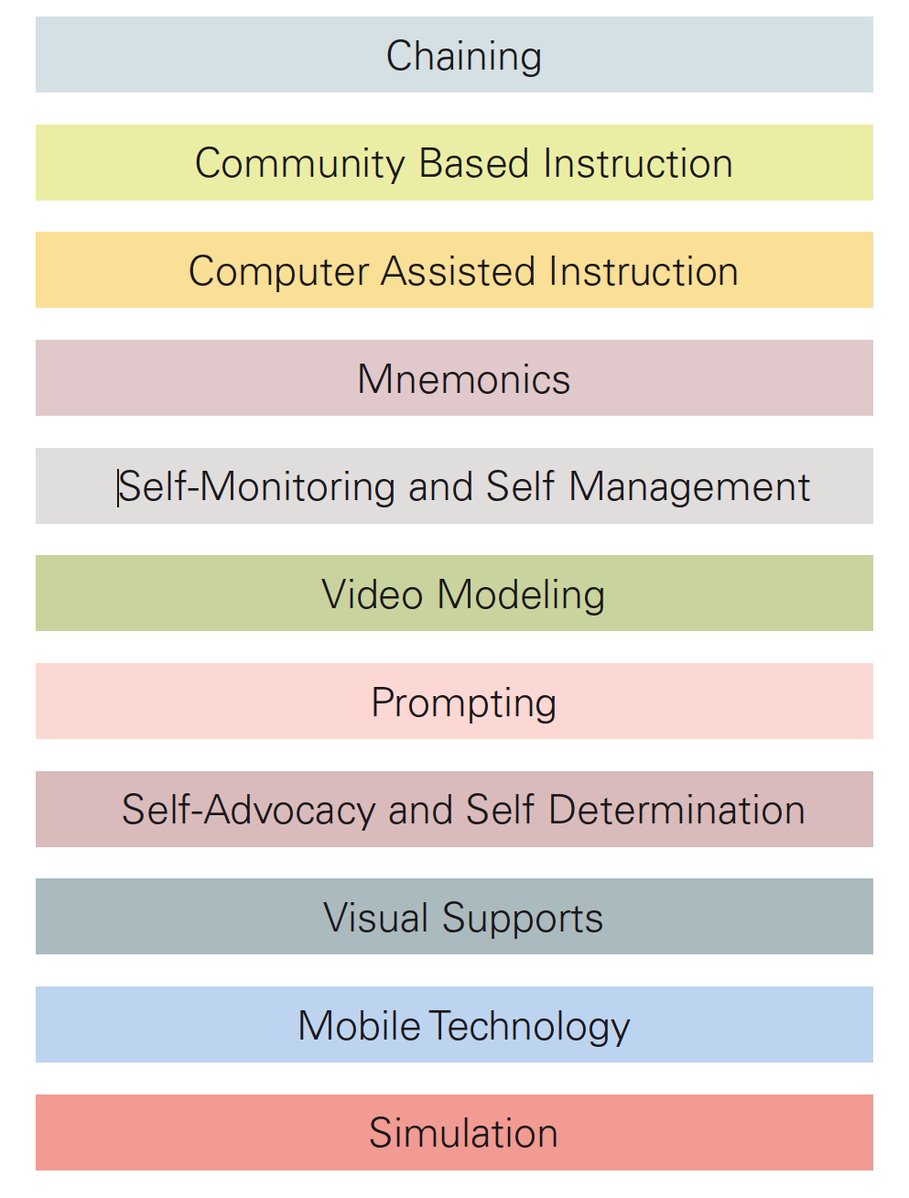
Explore the practices: GROUP ACTIVITY
Group Numbers | 1
 | 2
 | 3
 | 4
 | 5
 | 6
 | 7
 | 8
 | 9
 | 10
 | 11
Write on the Flip Chart:
Define your assigned practice in one or two sentences.
Summarize what you found at two web sites or resources for each practice.
Have you used this, seen it used? Give an example.
Notes:
This activity should take approximately 30 minutes.
1. Give each team specific practices to review from the document. For example self directed IEP, self determination, video modeling, computer assisted instruction, mobile technology.
2. Ask each team to write on a flip chart the directions on this slide. A spokesperson from each team can then report on their findings and example . Alternatively a spokesperson from each group can be part of a Gallery Walk and use flip chart notes to talk about their findings.
3. Groups will rotate to each “station”. Facilitators will call time—about 5 minutes to get groups to move to another station and hear that report on the practice.
4. When answering #3, “ Have you used this practice or seen it used?”, ask the group to name a specific skill that is taught when using the practice. Example--For self determination choice-making might be a specific skill used to teach this practice.

Slide 39
Transition Review Tool
Transition Review Tool is available on pages 27-33 of the Evidence Based Practices booklet. This tool assists the user to better select the appropriate practices for an individual youth.
Notes:
Learners may wish to look over the review tool found on pages 27-33. No specific activity is assigned to this slide or section.

Slide 40
Using the Review Tool
Understanding the Practices. Review the information in the Employment First Evidence Based Practices Transition Review Tool.
Select a rating or action for each of the practices in relation to the specific student.
“YES. Included and Individualized.” This means that the practice is being used and the student data indicates that the implementation is effective. Current implementation continues as planned
“Needs REVISING or Need MORE INFORMATION.” This means that the student data indicates a need for review and revision of the practice and implementation. OR the team needs more information about the practice or implementation in order to determine an action.
Notes:
This tool allows the user to select the rating or action for each of the practices in relation to the specific student.
The ratings included are:
*. Yes. The practice is included in the student plan and individualized for the student.
* Needs REVISING or Need MORE INFORMATION. Student data indicates a need for revision of the practice OR the team needs more information in order to determine an action.

Slide 41
Using the Review Tool Continued
“Consider Adding to Plan.” This means that the team review of the practices and the youth’s plan and profile indicate the likelihood that this practice would be useful to teach skills and knowledge important for future success. The team would like to add this to the youth’s plan.
“Not a priority strategy to include at this time.” This means that the team review of the practices and the youth’s learning profile and plan indicate that this practice would not be as effective as other practices or strategies. The team does not recommend implementation at this time.
Notes:
This tool allows the user to select the rating or action for each of the practices in relation to the specific student.
The ratings included are:
* Consider adding to plan. Data indicates this practice would be beneficial to add this to the youth’s plan.
* Not a priority strategy to include at this time. The team does not recommend implementation of this practice at this time.

Slide 42
Summary Worksheet This final page is helpful for organizing ideas, gathering new information, revising current plans, and adding new Evidence Based Practices (EBP) to the youth’s plan.
What EBP did you find?
What EBP need to be revised and refined
What EBP do you want to know more about?
What EBP need to be added to the plan?
How will we assess effectiveness of the EBP for this student?
Notes:
This is a basic planning tool for using the practices with students. In future sessions, there will be opportunities to learn about a more detailed planning method that addresses assessment, PINS information, task analysis, baseline data and progress monitoring.

Slide 43
Certificate of Completion
Please take a few minutes to complete a short eight-question survey.
Response to the survey with 75% accuracy allows the learner to download a certificate of completion for the session.

