Slide 1


“What Works for Work”
Session 7: Creating a Plan for Teaching Skills Using Evidence Based Practices

Slide 2

Introduction and Overview of Plan to Teach Skills Using EBP
Listen to a brief introduction to Session Seven
A download of the audio script is available on the Session Seven website (Handout #10).
Notes:
It is highly recommended that participants either read the script or listen to the audio file on this slide to better understand the focus and flow of this session

Slide 3
Key Points for Plan to Teach Skills with EBP
It takes more than just knowledge of the evidence based practice to plan for their use with a student.
For the purposes of learning, it helps to break down and think through each aspect of a plan, which includes selecting, implementing and evaluating.
In daily practice…. after becoming familiar with practices, and planning processes …a formal, written plan will not be necessary for every youth and every skill.
When learning how to incorporate new ideas and strategies, it is helpful to slow it down and examine each step.
Notes:
Note: These key points assist participants to frame this session and the process as a learning method to enhance professional practice and NOT as additional paperwork or procedural requirements.

Slide 4

Teaching Skills Using EBP: A Planning Guide
Version One (Handout#4)
Table Format
Version Two (Handout#5)
Text and Tables Best for Screen Readers
Notes:
This is the introductory page for Teaching Skills Using Evidence Based Practices (EBP): A Planning Guide.
There are 2 versions. Version One is formatted completely in a continuous table. Version Two is a combination of text and table. Both versions contain the same information and guidance. Version two is recommended for screen readers. Have participants review and select a version to use as they work through the session. It is highly recommended that the participants use a copy of the plan during the session and not rely entirely on the slides in the PowerPoint. Download both copies from Session Seven website. Handouts #4 and #5 https://www.ocali.org/project/creating_a_plan_for_teaching_skills_using_evidence_based_practices

Slide 5
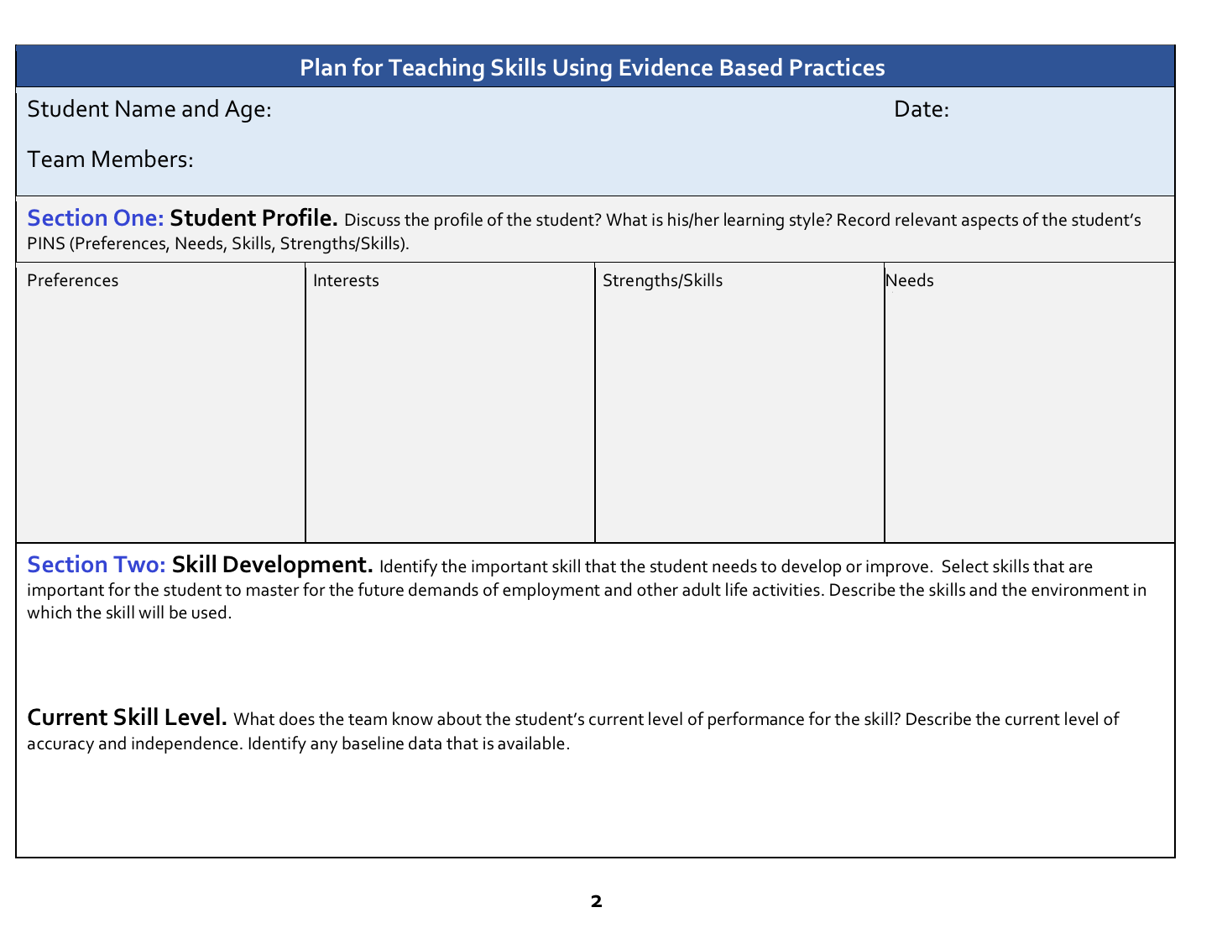
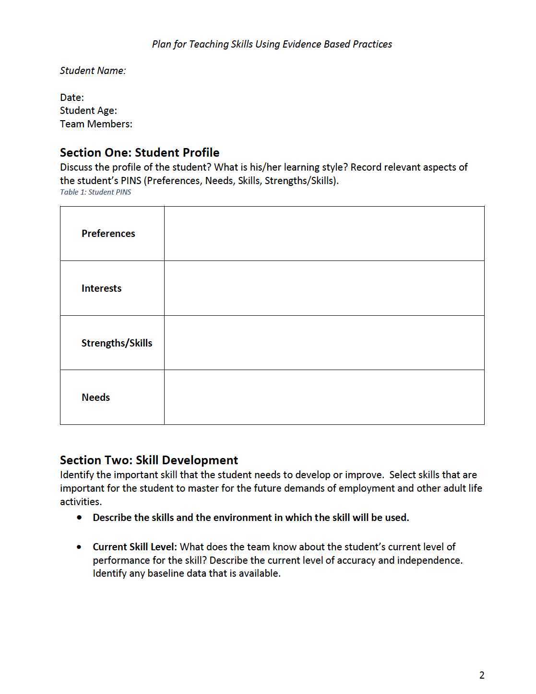
Plan for Teaching: Section One and Two
Version One
Version Two
Notes:
This is a page of the Plan for Teaching form. As a reminder, there are 2 versions. Participants should have selected, downloaded or printed a copy to use during the session.

Slide 6
Section One: Student Profile
The plan begins with a focus on the person.
Teams review, discuss and record the student information available and discuss the youth’s PINS
  Preferences
  Interests
  Needs
  Skills/Strengths
Teams will select EBPs that match the youth’s profile
Notes:
Facilitators may wish to survey the participant teams to determine how familiar they are with the term ‘PINS’. A brief discussion may be helpful before moving to section two and completing these sections.

Slide 7
Example: Paul Section One
Preferences : Prefers routine in his schedule. Responds well to hands-on activities and learning instead of a lecture style classroom instruction
Interests: Very interested in machine operation. Shows intense interest in use of the computer
Strengths/Skills: Great with technology. Works well on the computer and attends to computer. Academic strength is math and geography. Demonstrates basic social skills in familiar environments
Needs: Reading skills are well below grade level. Struggles with unstructured settings and requires 1:1 monitoring and assistance in all unstructured situations as he is prone to becoming upset and will try to lash out verbally at others or run from the building. Paul is unsure how to deal with unpredictable social interactions and how to comfortably get out of the situation when he feels himself getting upset.
Notes:
Download and/or print the example plan for Paul (Handouts #8 and #9). Paul’s plan is provided as a download in both versions of the Planning Form. Use whichever version is preferred as the same information is included in both versions. The information about Paul is also included on the PowerPoint Slide.

Slide 8
Section Two: Skill Development
After discussing the profile in section one, the focus moves to skill development needed.
Teams identify a skill that the youth needs to learn or master that will improve outcomes in adult life, including employment outcomes.
Some targeted skills may be vocational; however, other important skills are social and emotional regulation.
Notes:
The facilitator may wish to survey the team members to bring to the surface the variety of skills that they have found to be critical for adult life, especially employment. This can help individual teams think more broadly about the skills they may wish to focus on in the plan they will develop.

Slide 9
Section Two: Current Ability
When targeting the skills needed, the team discusses what is known about the youth’s current ability to perform the targeted skill.
Baseline will be collected in Step Five, however an early discussion helps the team consider the extent of instruction and practice that may be necessary
If no reasonable estimate of current skill is available, the team should note that in section two.

Slide 10
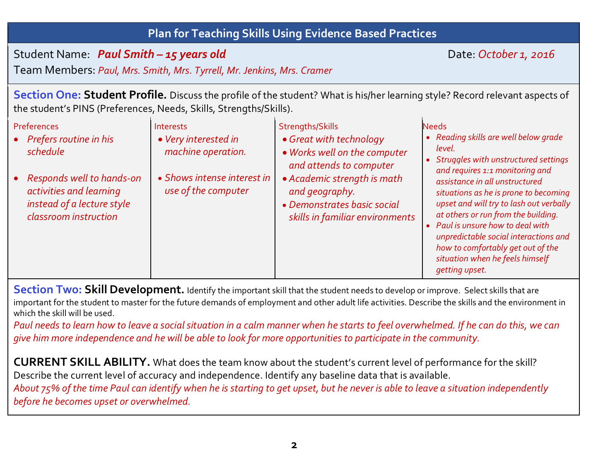
Example: Paul Section Two
Section Two
Paul needs to learn how to leave a social situation in a calm manner when he starts to feel overwhelmed. If he can do this, we can give him more independence and he will be able to look for more opportunities to participate in the community.
About 75% of the time Paul can identify when he is starting to get upset, but he never is able to leave a situation independently before he becomes upset or overwhelmed.
Notes:
Download the example plan for Paul (Handouts #8 and #9). Paul’s plan is provided as a download in both versions of the form. Use whichever version is preferred as the same information is included in both versions. The information about Paul is also included on the PowerPoint Slide.

Slide 11
Team Time!
Review Sections One and Two, in the previous example of Paul
Complete the student profile for the target student selected.
Complete the PINS (preferences, interests, needs and strengths) information (the team may wish to collect additional information and to expand the profile
Complete the skill development area based on the team knowledge of the student’s needs.
In Section Two, also add available information on the youth’s current ability to perform the needed skills. Baseline data about the target skill will be collected and added in section five.
Notes:
At this point, the teams are more than ready to get started on the process! Use this summary slide as a reminder of the tasks at hand. Encourage them to review the Paul Example if they need additional reminders of how to use these sections to begin the plan.

Slide 12
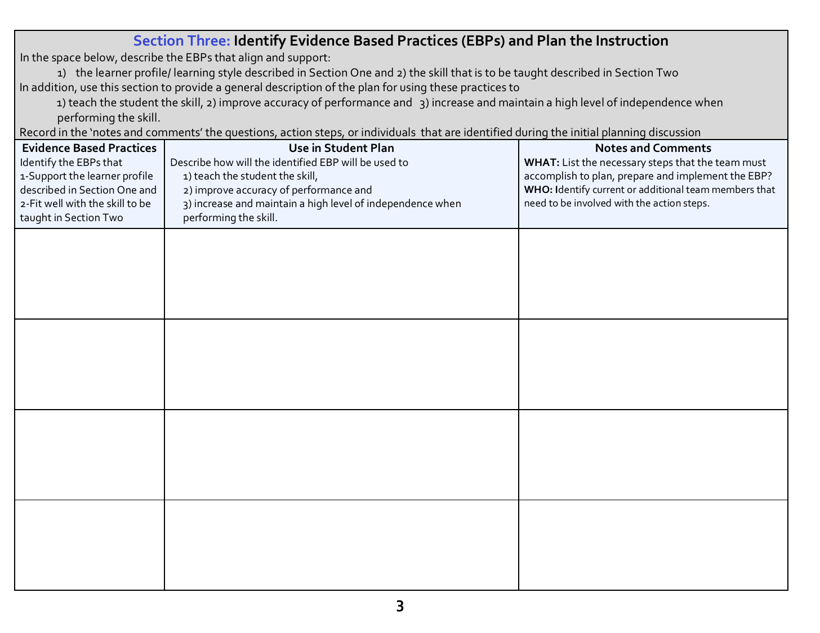
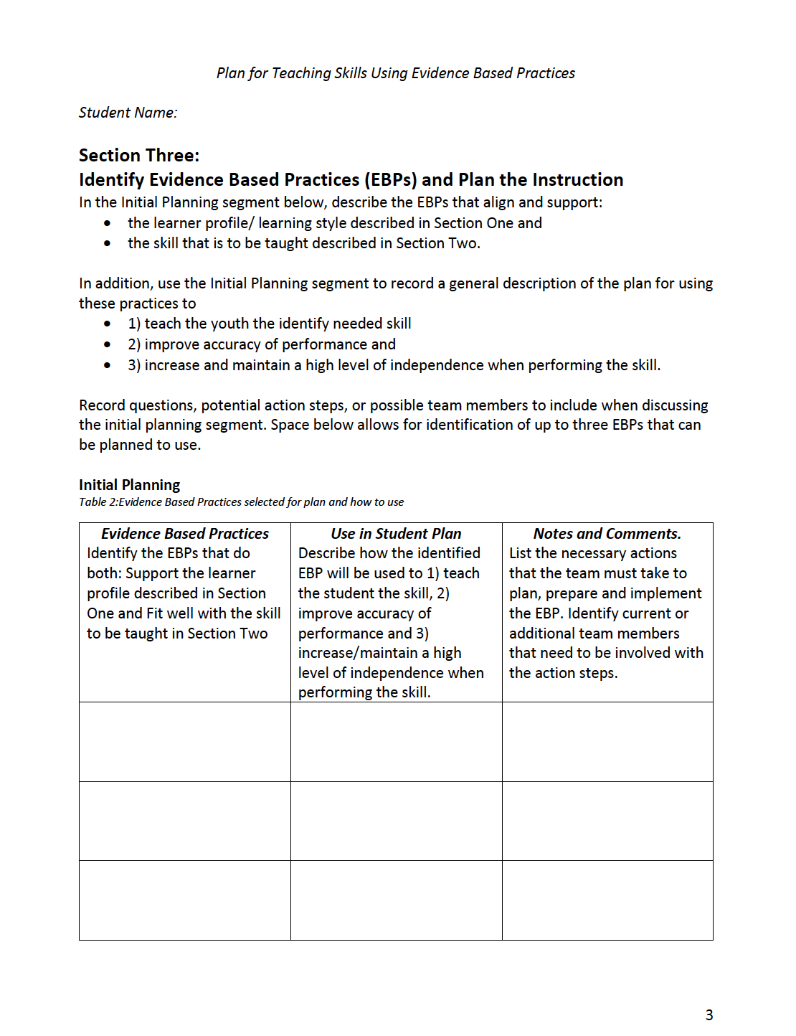
Section Three
Version One (Handout #4)
Version Two (Handout #5)
Notes:
Have the participants find these sections in the version of the plan they have selected to use.

Slide 13
Section Three: Evidence Based Practices
This section is the opportunity for the team to begin selection of specific EBPs to be used in the plan
Reflect on Sections One and Two and decide:
  What EBPs are a good match to the learning style and the PINS of the youth described in Section One?
  What EBPs would be useful to teach the needed skill(s) identified in Section Two?
Notes:
The facilitator should emphasize that this section is more than just a random selection of an EBP. Encourage the teams to look through the EBP materials from previous sessions. Discuss what types of EBPs are a good match for the target skill. Is it an academic skill that would be easily taught using a mnemonic? Or is it more likely the type of skill that needs Simulation and community based instruction? What types of prompts will be used? The selection of the EBP also needs to match with the student. Is this a student that learns best through a visual presentation? Would video modeling work? Or is this a student that needs small chunks of information provided at one time? If so, is Chaining the right choice? Do not rush the discussion. Encourage the teams to discuss multiple options.

Slide 14
Section Three Discussion
Use this portion of the process as a pre-planning opportunity
  Go beyond the selection of EBP and discuss how the practices will be used in a complete plan
  Brainstorm what will need to be done to put the plan in motion and who might need to be involved
Begin organizing the people, materials and information needed.
Before implementation, the team will review and finalize details
Notes:
Facilitator should emphasize that this is a discussion to determine how the EBPs will be used and identify important steps to consider in order that the plan can be implemented with fidelity. Encourage the teams to capture the discussion in the notes and comments section. Do not rush through this section as it lays the groundwork for a comprehensive plan.

Slide 15
Review Section Three Example
Review Section 3 of Paul’s example
Use the downloaded example of Paul (either version) in combination with the next several slides to review the EBPs Paul’s team selected for his plan, why they seemed to be the best choice and the type of pre-planning the team noted in this section

Slide 16
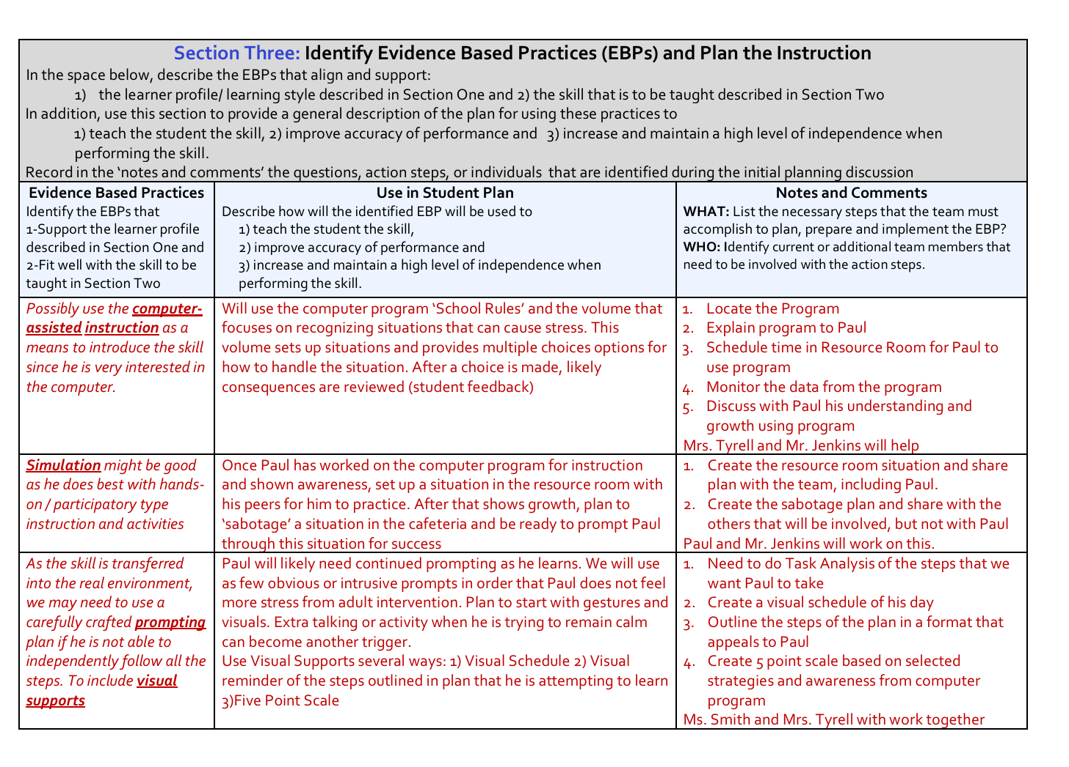
Example Paul: Section Three
Section Three of the completed example
For ease of reading, the next three slides will review the information shown in the picture to the left
Notes:
Often more than one EBP is used to teach a skill, e.g. self management and visual supports and prompting.

Slide 17
Example Paul: Section Three (1)
Select EBP: Possibly use the computer assisted instruction as a means to introduce the skill since he is very interested in the computer.
How Used: Will use the computer program ‘School Rules’ and the volume that focuses on recognizing situations that can cause stress. This volume sets up situations and provides multiple choices options for how to handle the situation. After a choice is made, likely consequences are reviewed (student feedback)
Additional Notes: 1.Locate the Program 2. Explain program to Paul 3. Schedule time in Resource Room for Paul to use program 4. Monitor the data from the program 5. Discuss with Paul his understanding and growth using program Mrs. Tyrell and Mr. Jenkins will help

Slide 18
Example Paul: Section Three (2)
Select EBP: Simulation might be good as he does best with hands on/ participatory type instruction and activities
How Used: Once Paul has worked on the computer program for instruction and shown awareness, set up a situation in the resource room with his peers for him to practice. After that shows growth, plan to ‘sabotage’ a situation in the cafeteria and be ready to prompt Paul through this situation for success
Additional Notes: 1. Create the resource room situation and share plan with the team, including Paul. 2. Create the sabotage plan and share with the others that will be involved, but not with Paul. Paul and Mr. Jenkins will work on this

Slide 19
Example Paul: Section Three (3)
Select EBP: May need to use a carefully crafted prompting plan if he is not able to independently follow all the steps. To include visual supports
How Used: Paul will likely need continued prompting as he learns. Use few obvious or intrusive prompts in order that Paul does not feel more stress from adult intervention. Plan to start with gestures and visuals to eliminate extra talking or activity Use Visual Supports several ways: 1) Visual Schedule 2) Visual reminder of the steps outlined in plan 3)Five Point Scale
Additional Notes: 1. Need to do Task Analysis of the steps for Paul to learn 2. Create visual schedule of his day 3. Outline steps of the plan in a format that appeals to Paul 4. Create 5-point scale based on selected strategies and awareness from computer program. Ms. Smith and Mrs. Tyrell with work together

Slide 20
Complete Section Three
Complete the first column of Section 3 by identifying the Evidence Based Practices (EBP) that will be used to teach the skill identified previously and one that aligns with the student’s preferences and interests and strengths.
Next, brainstorm how the team might use each EBP to teach this skill, improve the student performance and increase independence. Put this information in the second column.
Finally, record notes on what else is needed to complete this plan and who will be involved with the plan in column three.

Slide 21
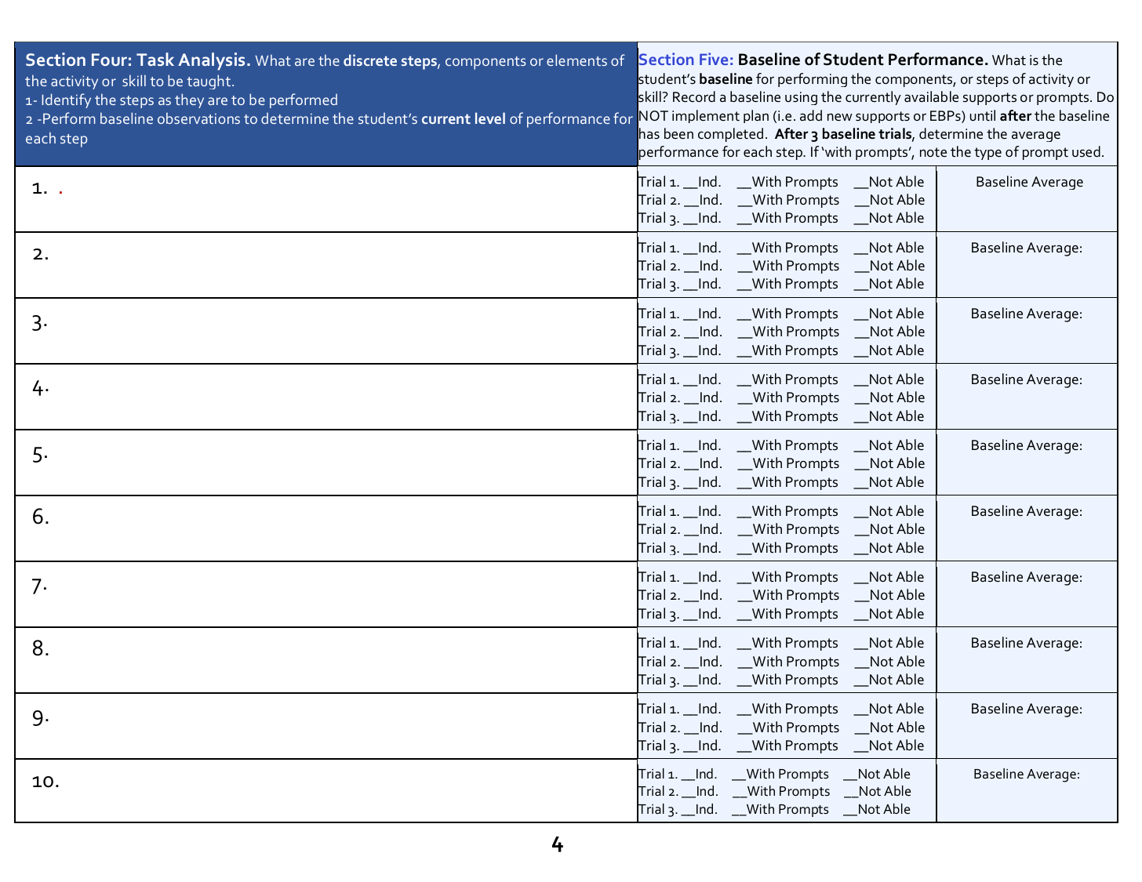
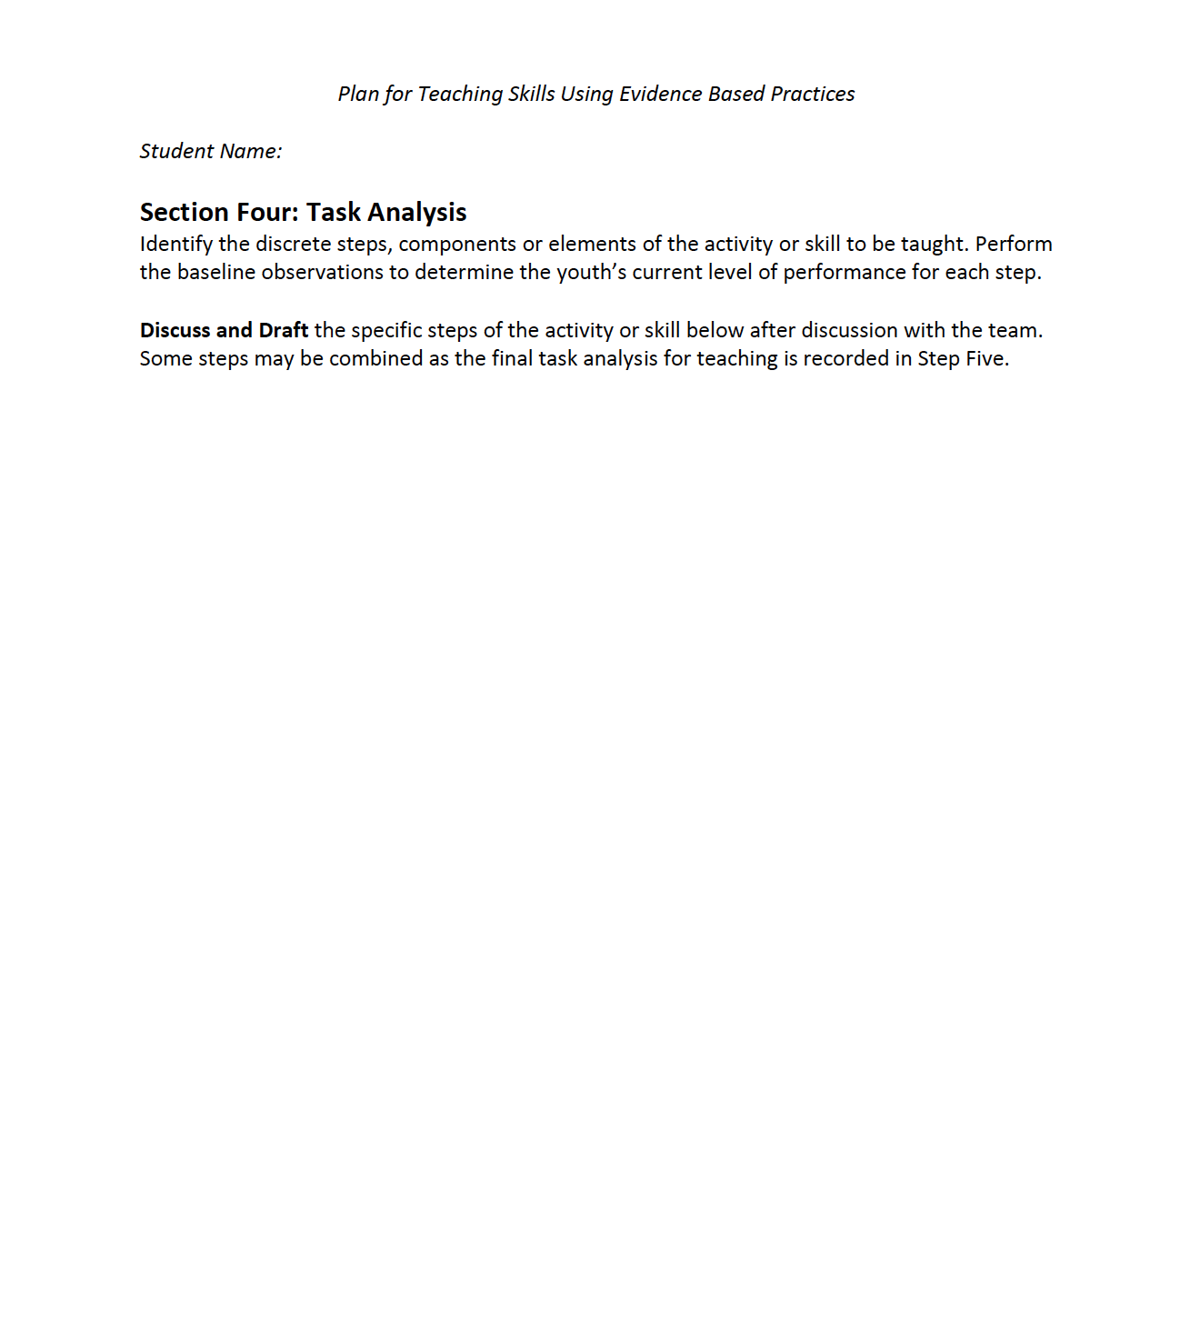
Section Four: Task Analysis
Version One
Version Two
Section 4
Section 4
Notes:
Section 4. Task Analysis, a list of steps to complete a task. Note that in Version One, Section Four and Five are on the same page. Direct participants to only focus on Section Four at this time.

Slide 22
Section Four Considerations
As a team, discuss the steps that must be accomplished in order to successfully complete the entire targeted task.
If needed, review the session on “Chaining” for a refresher on Task Analysis.
Consider all aspects of the task. Some steps may be discrete, such as pushing a button or counting 10 items. Other steps may incorporate more than one small step that the person is able to perform
Notes:
The facilitator should survey the participants to determine that they understand what is included in a Task Analysis . If teams are hesitant to ask for more information, but there is a concern that this is new information for some participants, the facilitator should briefly review the process of task analysis. One method would be to have the teams each write a definition of task analysis on poster paper and post it on the wall. The facilitator can then summarize the main points from the teams as a way to assure there is common understanding among the group.

Slide 23
Example: “Gather Supplies”
Walk to cabinet
Open cabinet
Pick up: Pens, Paper, Stapler, Post-It Notes, Large Paper Clips and Folders
Place supplies in rolling cart
Close Cabinet
Place hands on cart to push
Walk pushing cart to the meeting room
These seven actions are the steps that could be included in a single step (“Gather Supplies”) of a task analysis for a job to prepare a meeting room.
One person may be able to do each of these steps and will only need the instructions to indicate “gather supplies”
Others may need each of the seven individual steps included and taught specifically.
Notes:
Use this slide to emphasize that a task analysis can be very detailed. A single step could actually need it’s own task analysis (i.e. ‘gather supplies’). “Gather Supplies” may be the first step of a task analysis for the task of “Preparing a Meeting Room”. If a person is unable to do this first step independently, they will never be able to complete the entire task independently. In other situations, a person may be able to gather supplies with a single direction, “Gather supplies”, but may have no idea how to actually prepare the room with the supplies. It is best to err on the side of being too detailed in the task analysis. Break down the steps at this point. Then after the baseline data has been collected, the team can decide to group the small steps together that the youth is able to complete and focus instruction on steps that are difficult for the student to accomplish.

Slide 24
Review Section Four Example
Use the following slide or the downloaded documents to review the task analysis draft for Paul’s plan
Note: In Version One, the Task Analysis steps are placed within a table alongside Section 5 . Version Two allows separate space to draft steps during team discussions. The steps are then moved to the table for Step 5.
Teams use whichever version is preferred.

Slide 25
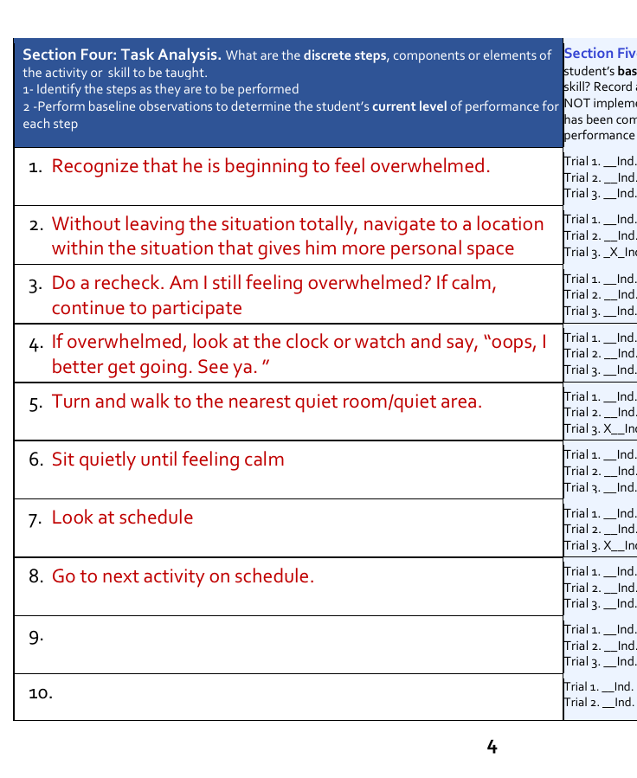
Example: Section Four
Steps Identified for Paul’s Plan
Recognize he is beginning to feel overwhelmed
Without leaving the situation, navigate to a location within the situation with more personal space
Do a recheck. Am I still feeling overwhelmed? If calm, continue to participate
If overwhelmed, look at the clock or watch and say ’Oops, I better get going. See ya”
Turn and walk to the nearest quiet room/area
Sit quietly until feeling calm
Look at schedule
Go to next activity
Notes:
Completed example of sections 4 and 5

Slide 26
Complete Section Four: Task Analysis
Identify the steps for the targeted task or skill by completing a task analysis. Draft and refine the list of steps needed to complete the targeted task for the youth.
Consider which small steps can be combined to one step and which need to be taught separately.
Consider the youth’s learning style, skills and experience when chunking together or separating steps

Slide 27
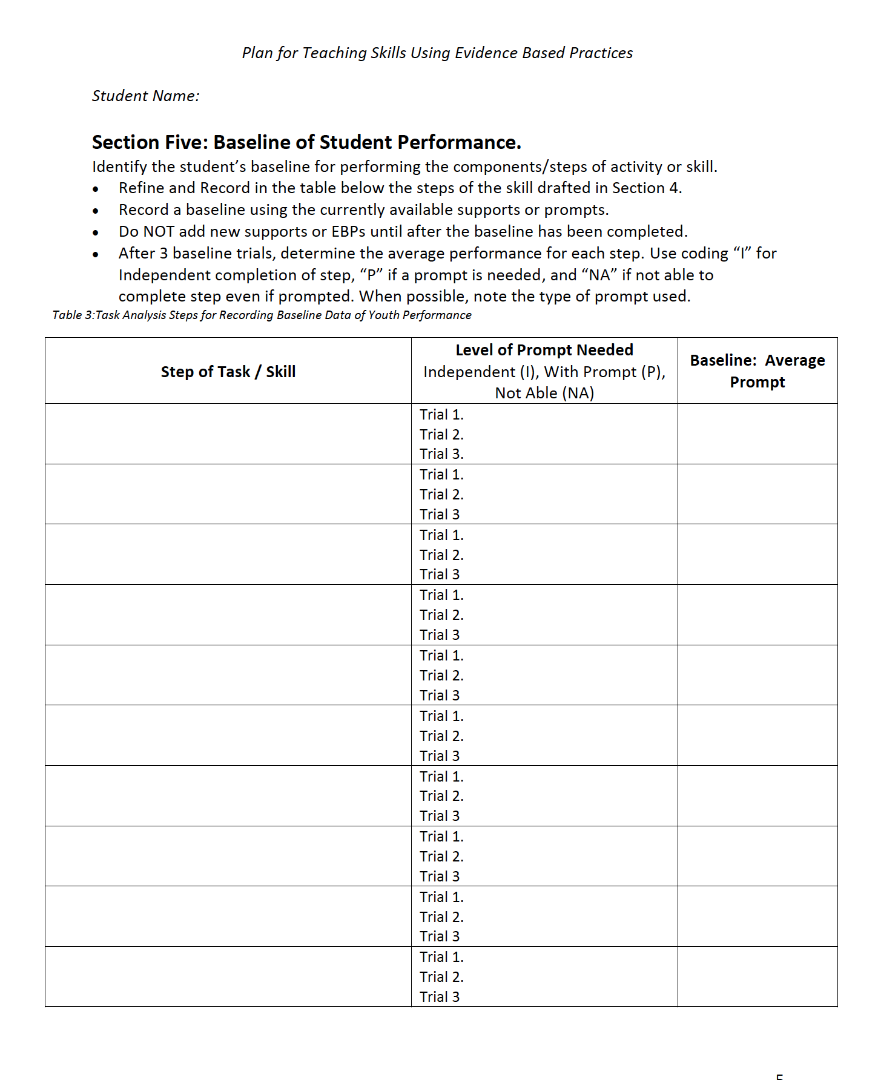
Section 5: Baseline Data
Version Two
Version One
Section 5
Section 5
Notes:
Section 5. Baseline of Student Performance with results of trials and prompts.
This section cannot be completed during a training. However a brief review of what needs to be done is recommended

Slide 28
Baseline Data Overview (1)
Defines a beginning point
Purpose
  To provide measurable data that can be compared to ongoing data to determine progress towards skill mastery
Notes:
Baseline data is important if a team wishes to accurately measure success.
Facilitator may engage the group in a brief discussion using this question. “Have you ever been part of a situation where there is disagreement about student progress? Was baseline data available in those situations? If not, how might baseline data have helped there be a common understanding?”

Slide 29
Baseline Data Overview (2)
Baseline data
  Measures level of success on each step of the task or skill
    Independently Completed? Completed With currently available Prompts? Unable to Complete with available support?
  Collected PRIOR to intervention
  Includes only currently available supports or prompts
    New supports or EBPs are NOT to be added during baseline
  Should be the average of 3-5 observations
Notes:
Emphasize that baseline is what is happening with no plan, no new supports, and no new instruction. Basically it is when the person is provided the opportunity to demonstrate the targeted task or skill before the plan is implemented. In many cases the baseline may show the person is not able to begin or complete the skill or task because there is no support. This only emphasizes the need for the intervention.

Slide 30
Review Section Five Example
Use the following slide and the downloaded documents to review Section Five of Paul’s plan.
The baseline data is coded as:
  I = Independent
  P= Prompted
  NA= Not Able to Complete
The final baseline is the average of the three opportunities observed

Slide 31
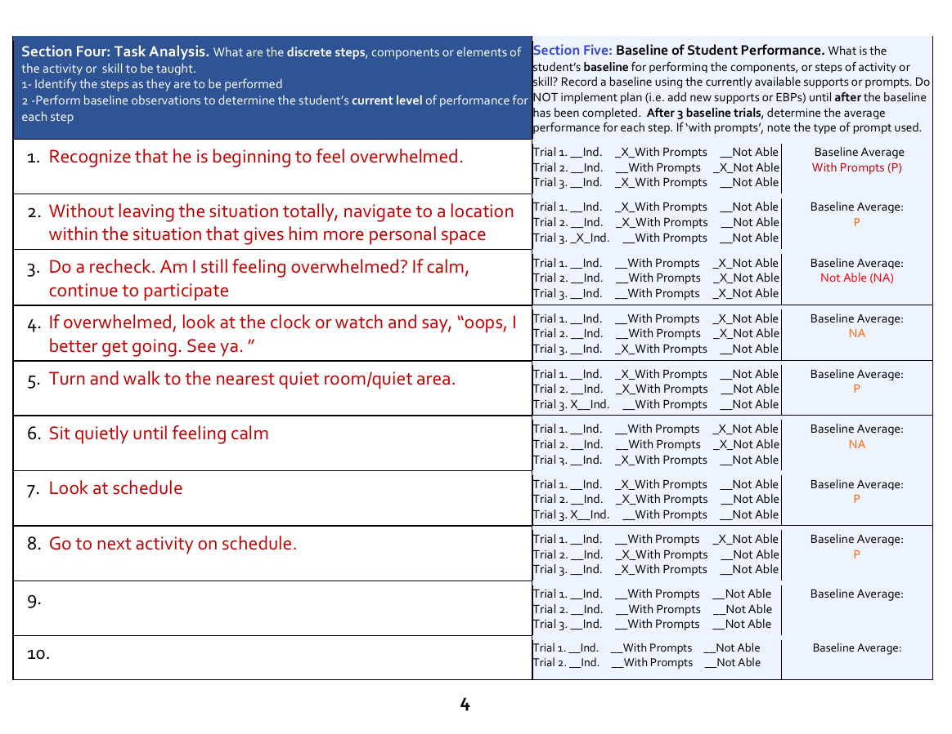
Example: Section 5
Steps | Level of Prompt | Baseline
1. Recognize that he is beginning to feel overwhelmed. | Trial 1. P Trial 2. NA Trial 3. P | P
2. Without leaving the situation totally, navigate to a location within the situation that gives him more personal space | Trial 1. P Trial 2. P Trial 3. I | P
3. Do a recheck. Am I still feeling overwhelmed? If calm, continue to participate | Trial 1. NA Trial 2. NA Trial 3. NA | NA
4. If overwhelmed, look at the clock or watch and say, “oops, I better get going. See ya. ” | Trial 1. NA Trial 2. NA Trial 3. NA | NA
5. Turn and walk to the nearest quiet room/quiet area. | Trial 1. NA Trial 2. NA Trial 3. P | P
6. Sit quietly until feeling calm | Trial 1. NA Trial 2. NA Trial 3. P | NA
7. Look at schedule | Trial 1. P Trial 2. P Trial 3. I | P
8. Go to next activity on schedule. | Trial 1. NA Trial 2. P Trial 3. P | P
Notes:
Both images include the same information. The larger image is included for ease of reading.

Slide 32
Complete Section Five: Baseline Data
Review, and if necessary, make final edits to the steps of the task or skill
Complete Section five by observing the student in the target environment.
Plan at least three opportunities for the youth to engage in the target task in the target environment.
Record the success of each step of task in Section Five (independent, with prompts or not able)
Add the type of prompt used in prompts were necessary. Average the results of the three opportunities or trial.
This is the baseline
Notes:
Have teams review and refine the Steps in the Task Analysis section. They will not be able to complete Section five until observation opportunities for the specific skill/task are available. Emphasize again that they are NOT to implement the plan, new instruction or new supports until AFTER baseline data is completed.

Slide 33
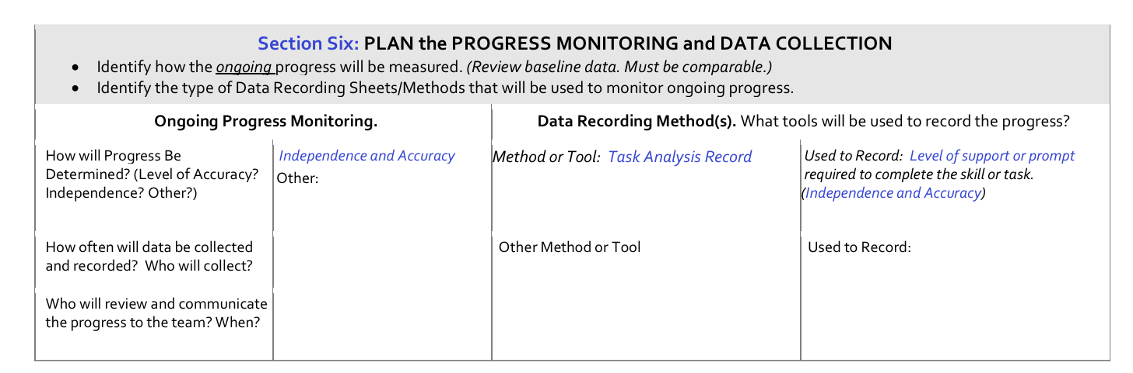
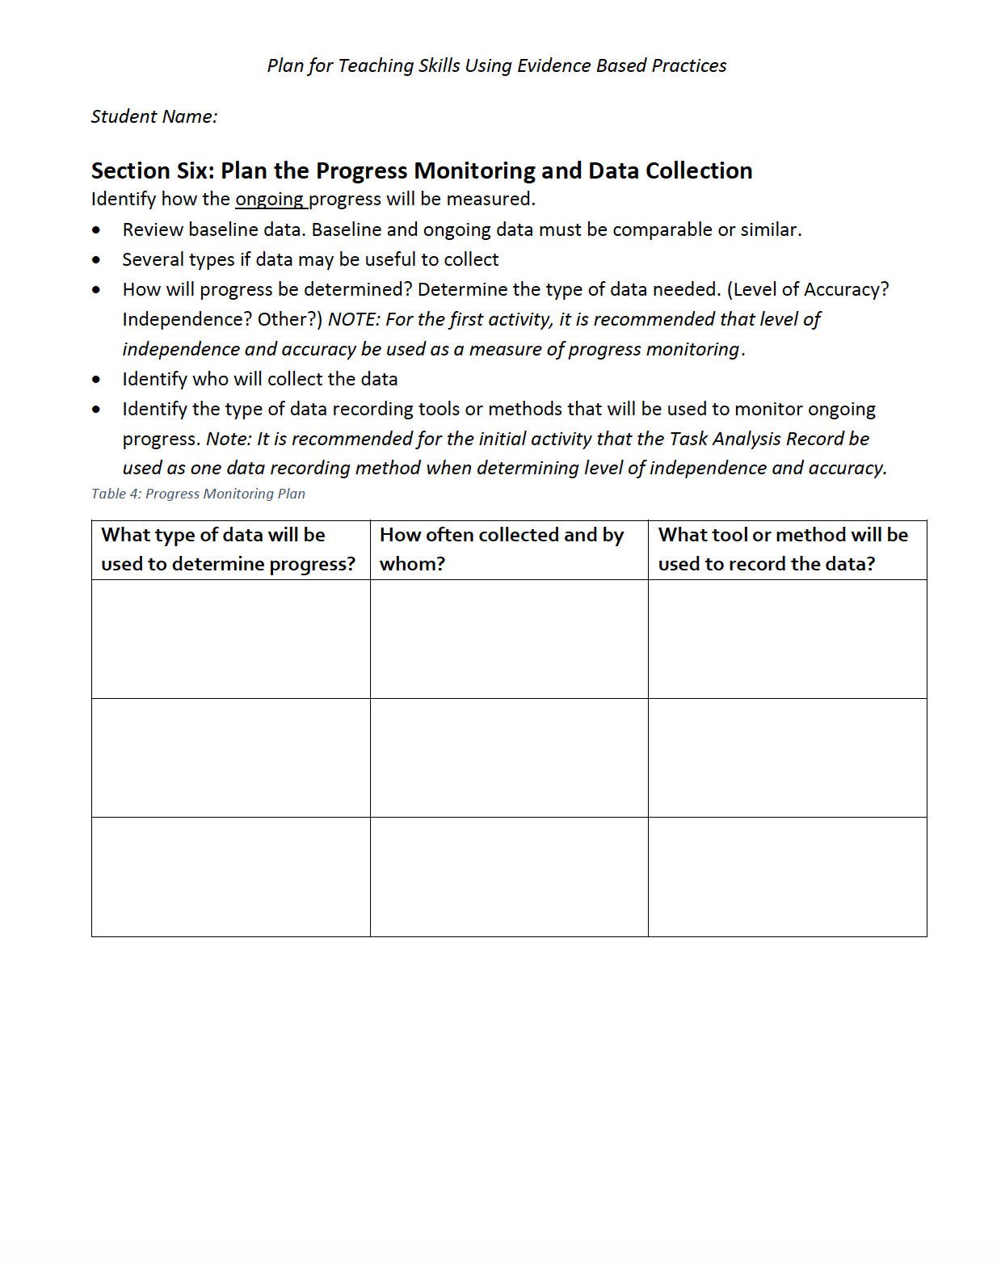
Section Six: Progress Monitoring Data & Tools
Version One
Version Two
Notes:
Section 6 Plan the progress monitoring. How to measure progress, with which tools and who will be responsible.

Slide 34
Progress Monitoring and Data Collection
The focus of Section Six is to define the ongoing progress monitoring
Determine how progress will be measured?
  For the initial plan, it is recommended that both level of independence and accuracy be used as measures of progress monitoring.
Select data recording tools/methods to monitor ongoing progress.
  It is recommended that the Task Analysis Record be used as one data recording method when determining level of independence and accuracy.
  Identify who will collect the data
Remember, baseline data and ongoing data must be comparable

Slide 35
Decisions About Ongoing Data
Progress may be measured in many ways
  Task Analysis will allow teams to follow the level of independence demonstrated when performing the skill accurately.
Multiple tools may be used to gather data
  The Task Analysis record is one tool that can be used to capture progress monitoring data
Other tools will be needed for additional information
Notes:
Teams will use the task analysis record as one tool and method to record progress data. However, in many cases, other types of data will be needed. Use the resources on the next slide to explore additional types of data and data tools/methods.

Slide 36
Resource to Assist Teams in Progress Monitoring
Watch a Video about this data resource
and
Download the document
Notes:
Facilitators should show the brief video as an introduction to the tool. The document may then be downloaded and reviewed by teams. As time permits, allow teams the opportunity to review the document and discuss additional data that may be useful to collect
Video and Document link: https://ohioemploymentfirst.org/view.php?nav_id=469

Slide 37
Plan the Type of Data Needed
Templates from “Employment First Collecting and Analyzing”
Review these data templates
The following two slides identify the types of data and data tools reviewed in the tool
Notes:
If teams need other data collection tools, have them review and download these simple tools from the Ohio EF website.
Employment First Collecting and Analyzing link:
https://ohioemploymentfirst.org/view.php?nav_id=469

Slide 38
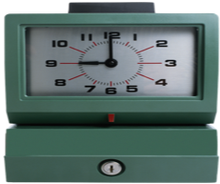


Consider the Type of Data Needed (1)
What Measures Will You Use For Your plan?
Duration
  Time. How long does it take to do the task?
Intensity (of target or issue of concern)
  May need to develop an intensity scale for objective measures
Accuracy
  How accurately is the task performed?
Notes:
Direct participants to use the document provided on slide 36, “Collecting and Analyzing Youth Performance Data” if they need additional information. As time permits, ask groups to give examples of when they may have used each type of data represented.

Slide 39

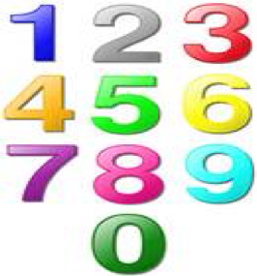
Consider the Type of Data Needed (2)
Level of Independence
  What level of support is needed to perform task?
  It is recommended that independence be one target of the plan
Frequency of target goal
  How often is the task done or how often is assistance needed?
Notes:
Direct participants to use the document provided on slide 36, “Collecting and Analyzing Youth Performance Data” if they need additional information. As time permits, ask groups to give examples of when they may have used each type of data represented.

Slide 40
Review Section Six Example
Use the following slide and the downloaded documents to review how the team determined they would measure progress and collect data for Paul’s plan

Slide 41
Example Section Six
Several types if data may be useful to collect (Ex: Level of Independence and Accuracy)
Identify who will collect the data
Identify the type of data recording tools or methods that will be used to monitor ongoing progress.
What type of data will be used to determine progress? | How often collected and by whom? | What tool or method will be used to record the data?
Independence and Accuracy | Tyrell, Jenkins, Cramer will all need to collect data. Frequency TBD. Initially, we will collect daily | Task Analysis Record Prompts needed with goal of independence Ability to complete each step correctly
After gaining independence, will monitor frequency (%) of success | Tyrell, Jenkins, Cramer will all need to collect data Frequency TBD | Tally Sheets. Number of opportunities available vs. # of successful uses of strategy.
Notes:
This is a completed example of section 6 from Version Two of the example

Slide 42
Team Discussion: Determine the Data Plan
Review the previous slides with examples and resources.
Study the information in the resource provided
Discuss the type of data that would best monitor the target student and choose a data template(s) to be used to collect that type of data.
Complete the remaining information for Section Six, such as, who will collect the data and how often.
Notes:
Time for the team to complete section six. Encourage the team to identify one additional data type (other than accuracy and independence) that would assist in measuring progress of the plan.

Slide 43
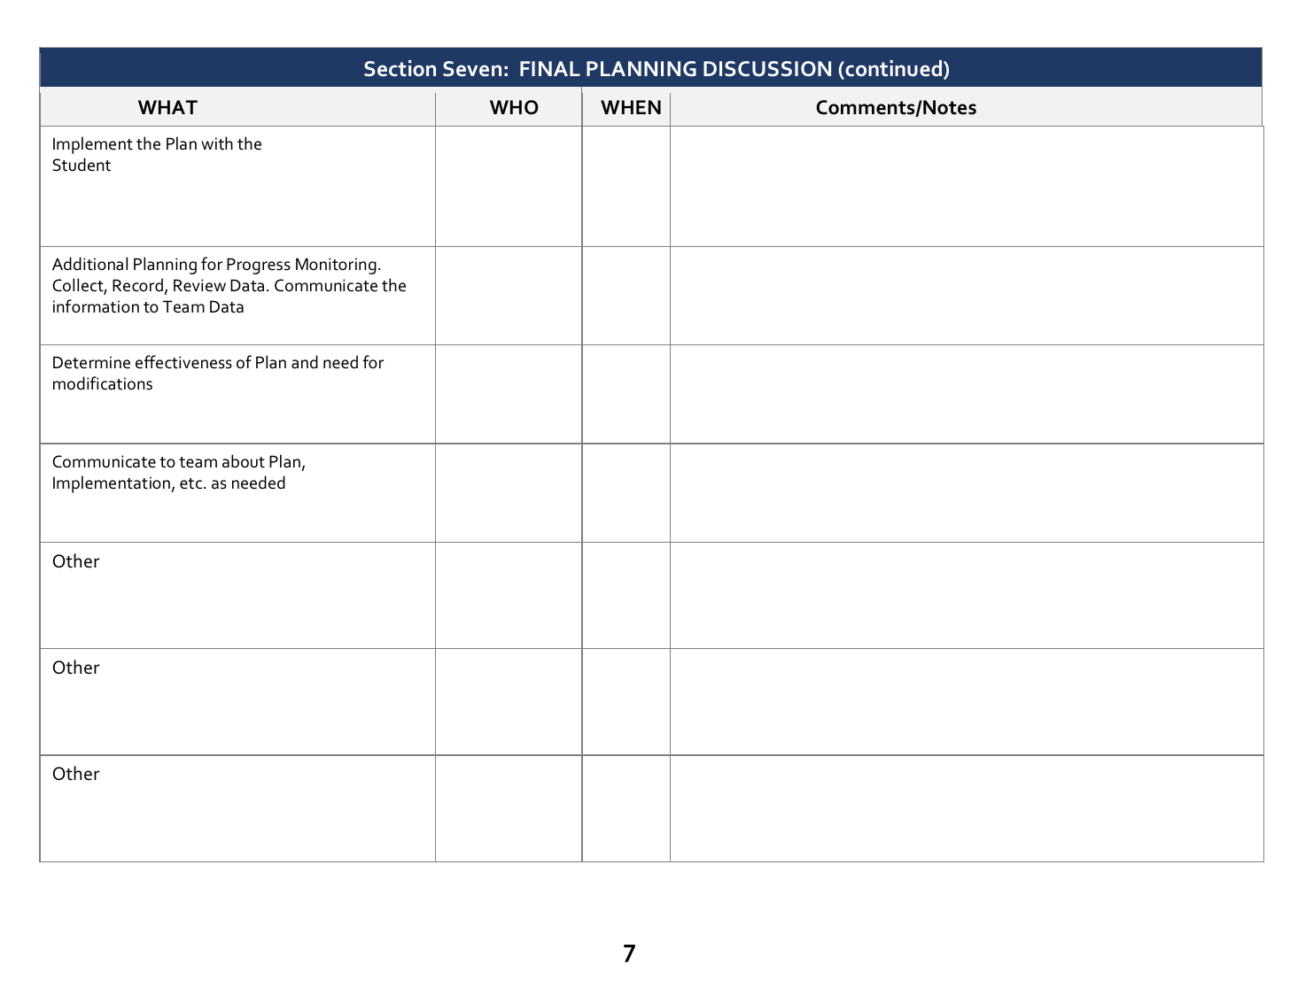
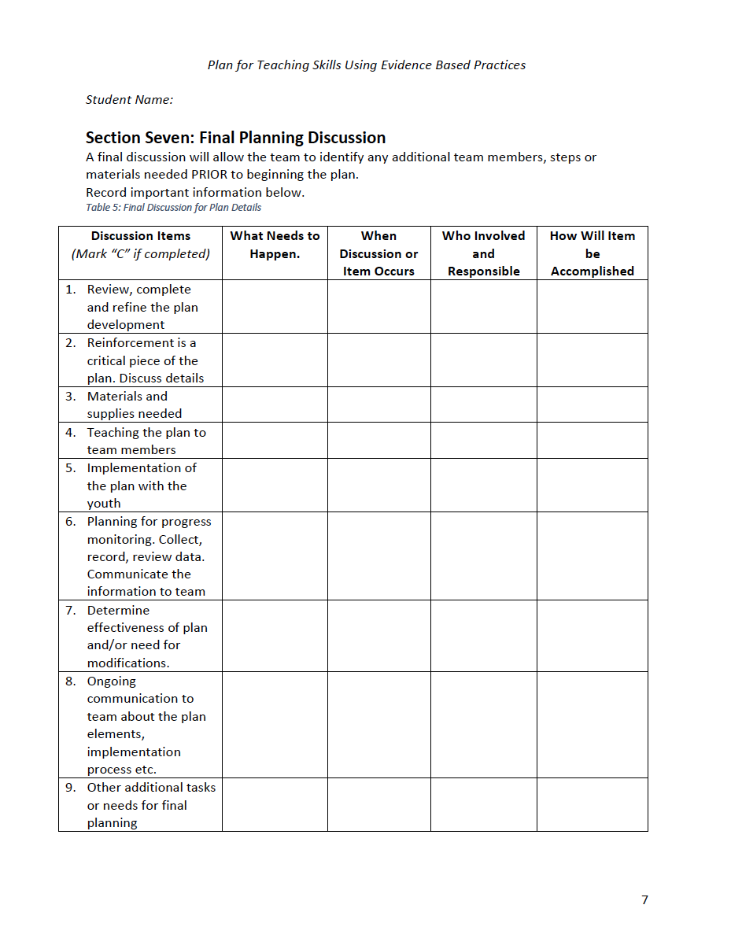
Section Seven: Final Planning
Version One
Version Two
Notes:
This is section seven, final planning discussion with notes on who will have specific roles and any other needed material or comments.

Slide 44
Final Planning?
“The Devil is in the Details!”
Although much has been discussed, it is recommended that the team engage in a final discussion surrounding the plan elements, tools, responsibilities and communication.
Guidance for this discussion is included in the Section Seven questions.

Slide 45
Review Section Seven Example
Locate Section Seven in the plan example and review the items discussed in this section of Paul’s plan.
  Note: While the following slide offers an image of section seven, it is recommended to use one of the example versions as the content may not be easily read from the slide.

Slide 46
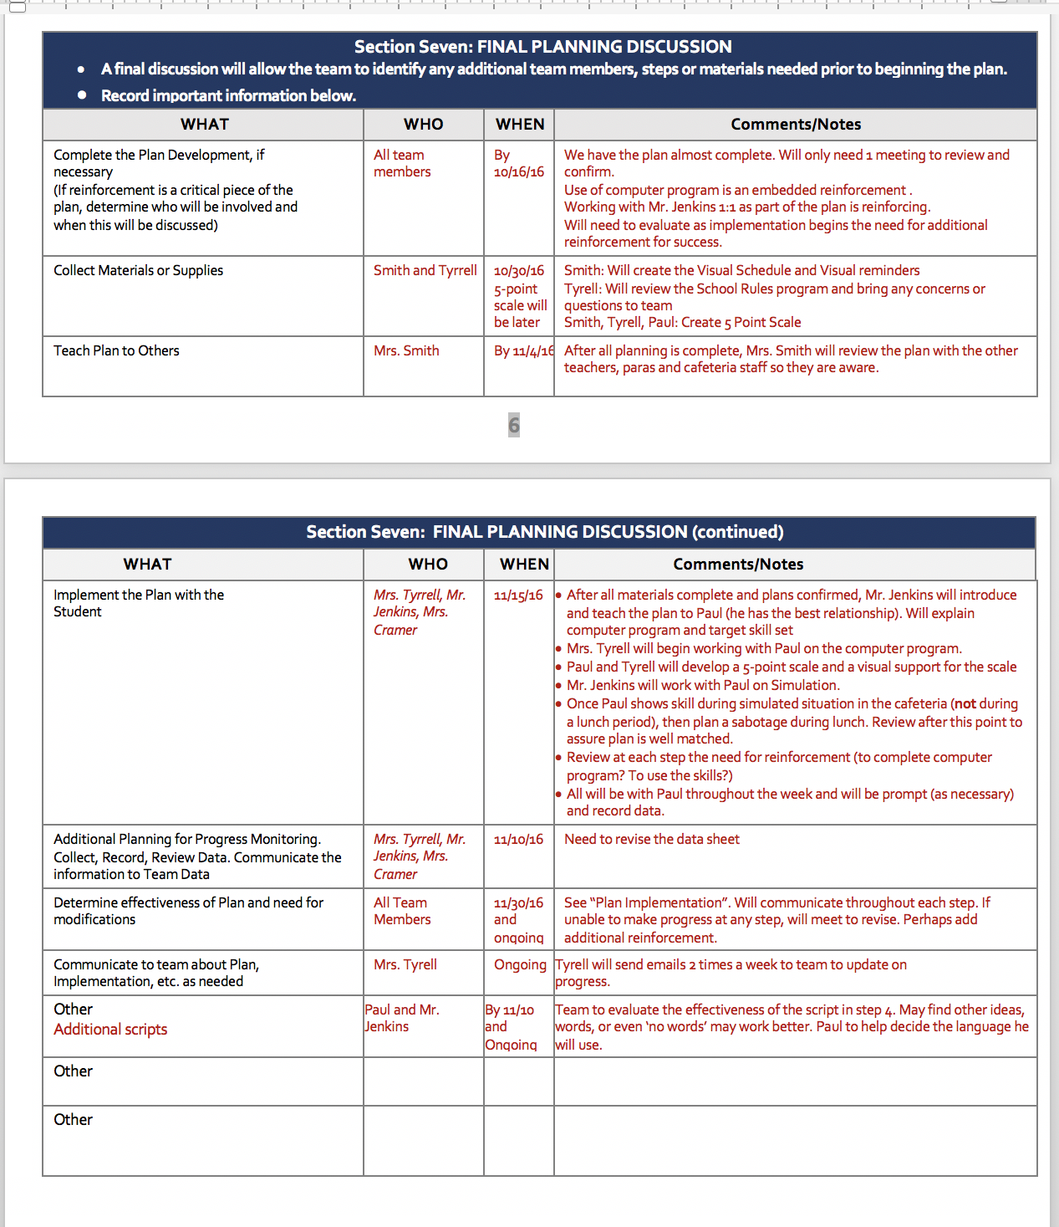
Modify Section Seven to Meet Team Needs
Teams may use this portion of the Planning Template to assure the details of gathering materials, communicating plans, assuring feasibility and confirming follow up are in place.
Although there are labeled columns and prompting questions included, the team should use this space and time in a manner that works best for final team preparations.

Slide 47
Complete Section 7: Final Planning Discussion
After review of the blank and completed example for section 7
Meet with the team to fill in the additional information needed for the plan
Add dates for the start of implementation, progress monitoring
Discuss when and who will review the data collected
Make final changes to the plan. Revise steps, add additional prompts or supports or eliminate steps or prompts based on team input
Notes:
The team can begin the discussion for section seven during the training, however, they will need to review the final details after collecting baseline data and making any final edits to the plan.

Slide 48
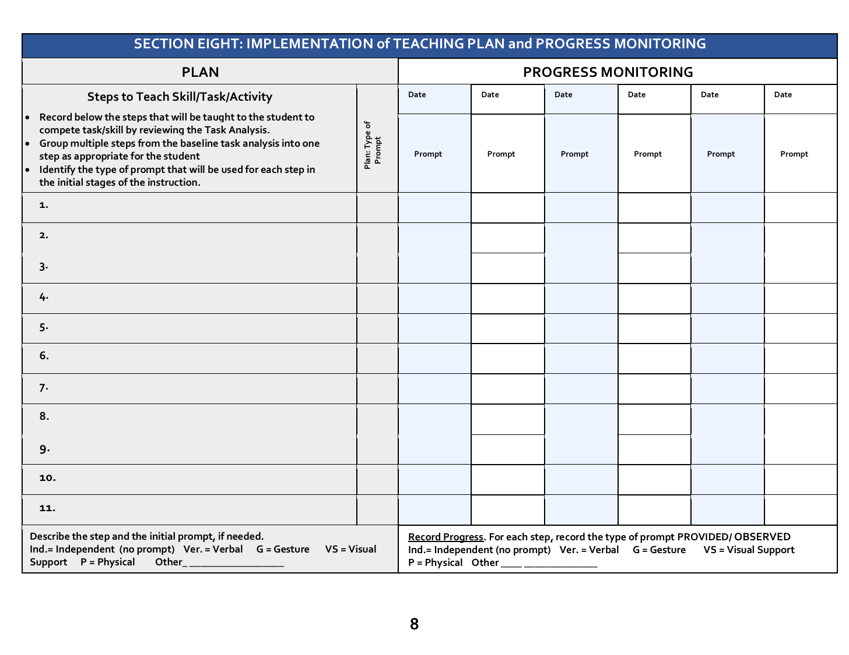
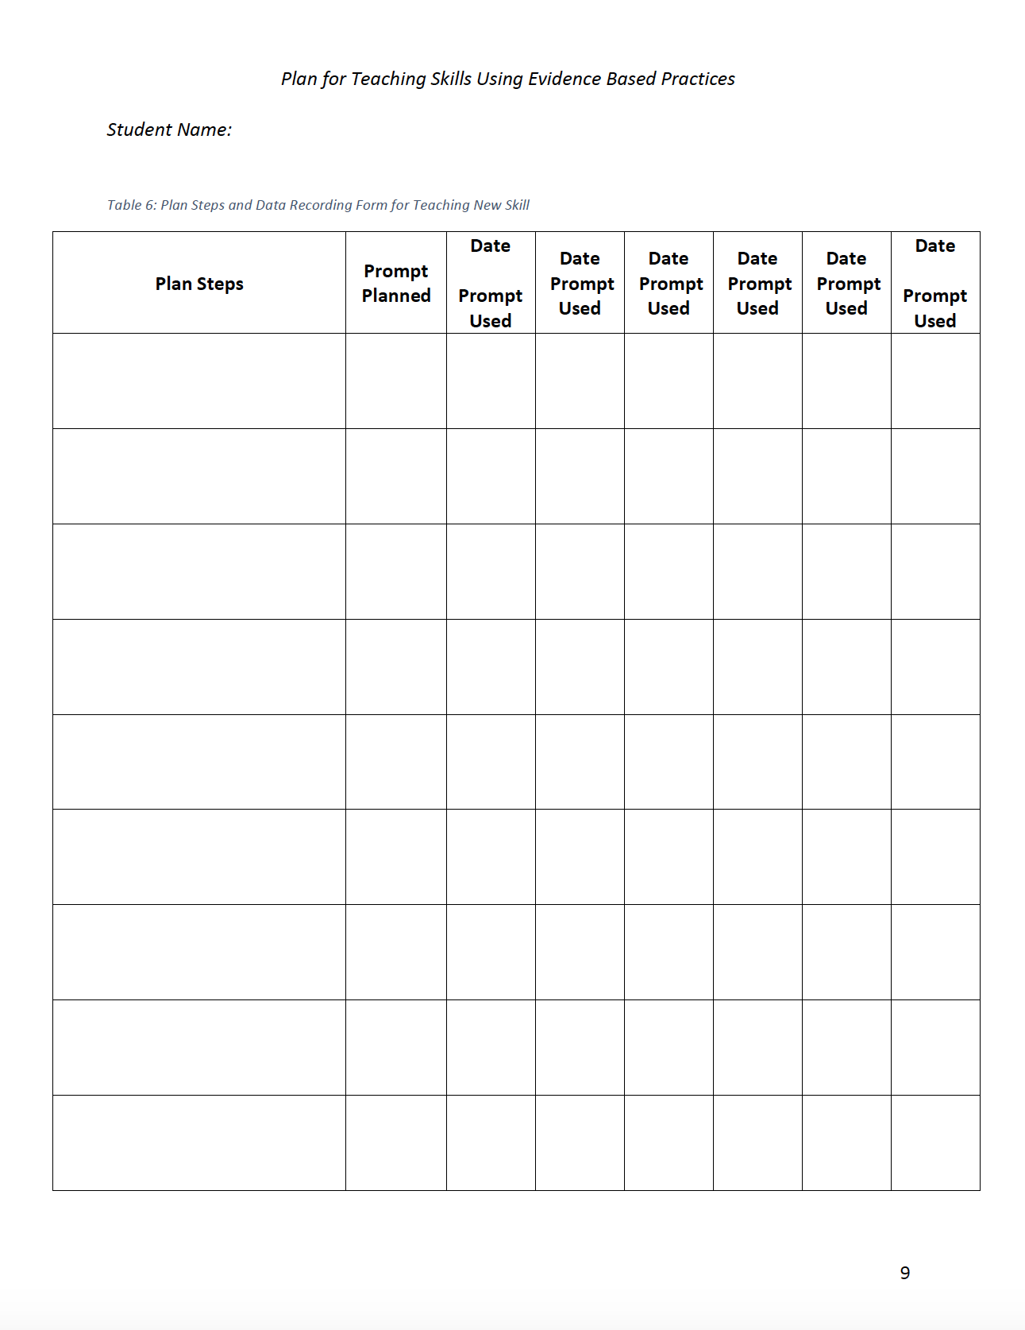
Step Eight: Implementation of Teaching Plan
Version One
Version Two
Notes:
Section Eight, Implementation of the teaching plan and progress monitoring. Since the baseline data has been collected through the three trials you can now begin instruction. Based on the trial data you may need to change, add or eliminate some steps. You should have an idea about the type of prompt you will use for each step (column two) and you are ready for the designated team members to begin instruction and record the results in the progress monitoring section on the right side of the form.

Slide 49
Section Eight Elements
Section Eight captures the steps of implementing the teaching plan for the targeted skill or task.
Section Eight includes several elements:
  Steps to complete skill or task
  Prompts planned to be used for teaching each step
  Space to record the data for each trial or opportunity observed as progress monitoring data
  Key for coding the prompts used
Notes:
This section is very similar to Section Five when the team collected baseline data. They may have made edits to the teaching plan after collecting and reviewing baseline data. Encourage the teams not to simply transfer the information from Section Five and instead discuss the need for changes first.

Slide 50
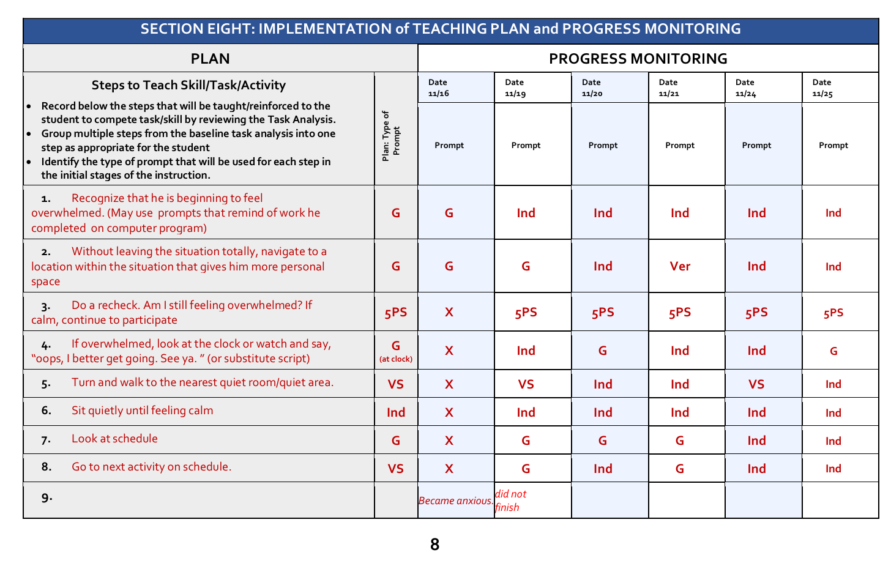
Overview of Section Eight
Use Paul’s completed example of Section Eight to overview the various components and to understand how to develop and use this section
The following slides will provide guidance for Section Eight by utilizing Paul’s example
Notes:
Section Eight, completed example for teaching plan and dated results of data collection.
There is a large amount of valuable information on this slide. The next four slides explain in more detail how to complete the information needed for prompting and progress monitoring and also give examples that will show how the prompts may change over the progress monitoring teaching sessions and how to record the data for each teaching session.

Slide 51
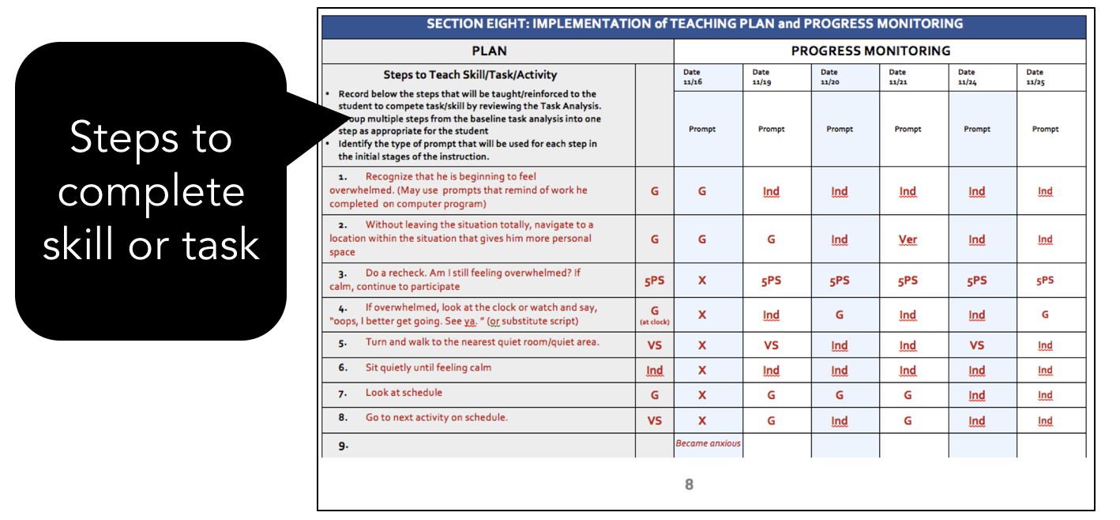
Review: “Steps”

Slide 52
Task Analysis Identifies Steps
Use the steps identified in Section Five task analysis for the baseline.
Document these as the Plan Steps in the Section Eight table to be taught to the youth to complete the task/skill after reviewing the task analysis.
In some cases, several individual steps may be grouped together as one step if appropriate for the youth’s skills (see slide 23).

Slide 53
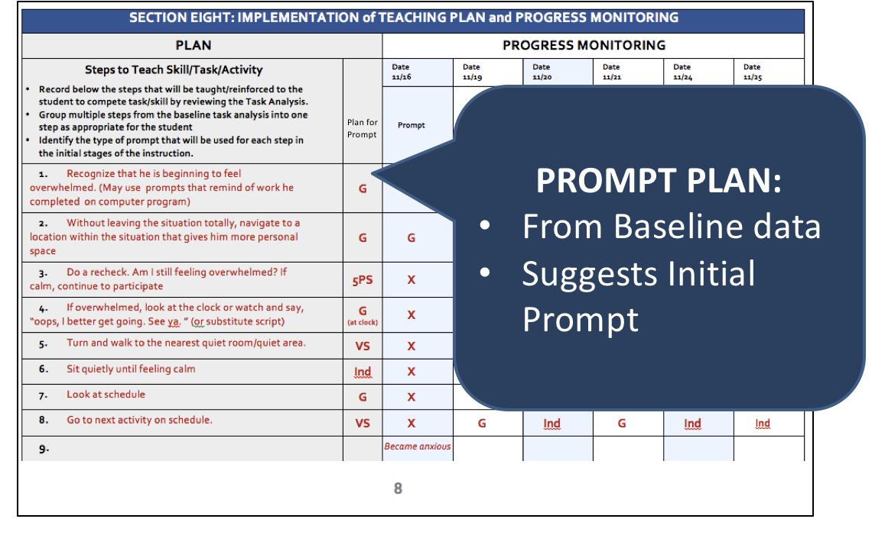
Example: Prompt Plan

Slide 54
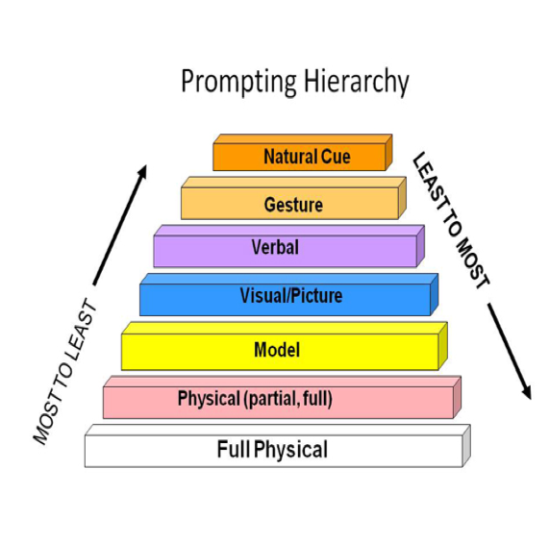
Review:
“Prompt Plan”
Column Two on Section Eight
Using baseline data, develop a prompt plan based on student baseline response
Consider the effectiveness of the prompt used during the baseline data collection
  Did the youth complete the step accurately using the prompt?
Use a prompt hierarchy. Steps that were less accurate during baseline will require “most” prompts and those easily and accurately completed will require “least” or none.
  Example: Increase gesture to a verbal or visual support or decrease prompt to gesture instead of a model
Notes:
If the idea of the prompt hierarchy seems new to some of the participants, encourage the teams to review this information found in the Session on Chaining and Prompting. Another activity could be to have each team to have a 2 minutes discussion to define ‘prompt hierarchy’. Each team can then offer one idea about prompt hierarchy to the entire group, thus building a collective definition.

Slide 55
Prompt Codes
Note the codes used for recoding the prompts
A team may choose to use these or create additional or different codes
Ind= Independent (no prompt)
Ver= Verbal
G= Gesture
VS= Visual Support
P= Physical
O= Other (identify)
X= Did not complete

Slide 56
Prompts to Support Difficult Steps
Some steps Paul was ‘not able’ to do when baseline data was collected as he had had no previous support or instruction in those skills
However, we learned in Section Three that Paul’s plan begins with computer instruction and development of visual supports (5 point scale). Therefore, the team is predicting that Paul will be able to respond to a minimal prompt or perhaps no prompt after this initial instruction.

Slide 57
Review: Progress Monitoring
Record skill development using the Progress Monitoring portion of Section Eight
For each observed opportunity, record the type of prompt provided, no prompt (Ind.), or not completed (NA)
Prompts used in the first opportunities should begin with the planned prompts and gradually move to a different type of prompt as needed.
Notes:
Section Eight is completed following the group session.

Slide 58
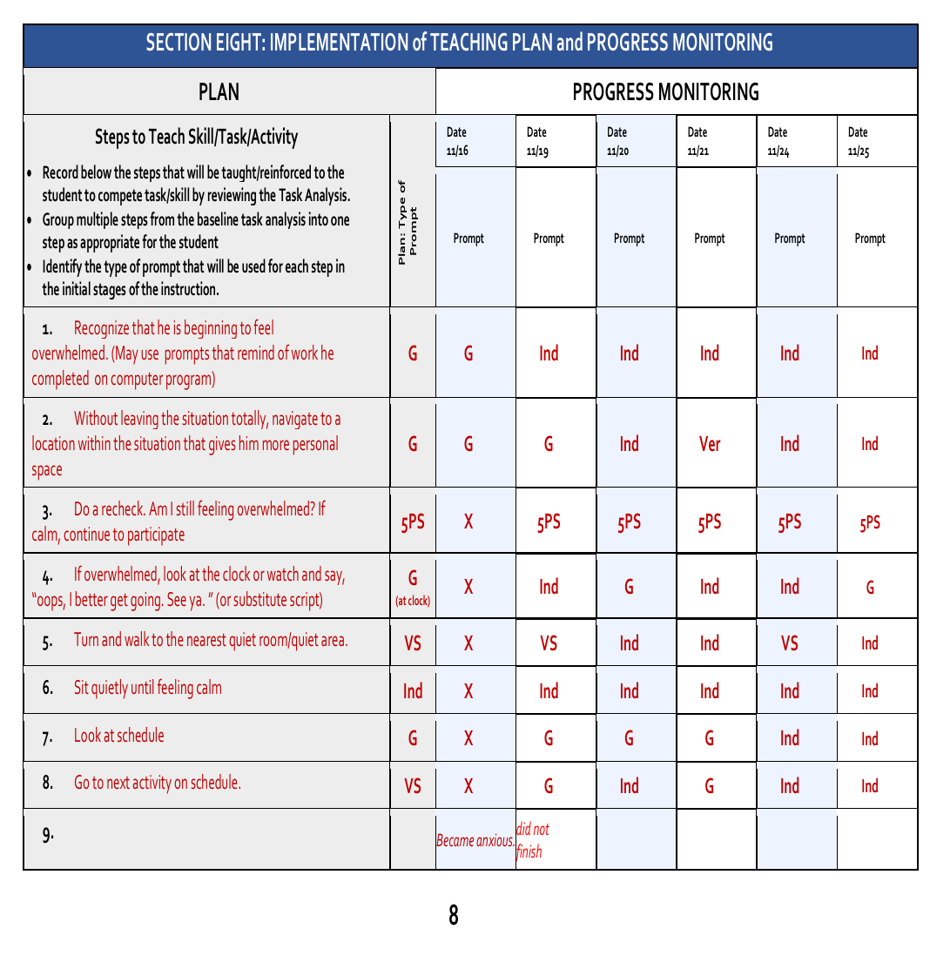
Example: Progress Monitoring
Record the date for each teaching opportunity at the top of the column
In the same column, record the type of prompt used to complete each step and the progress.
Prompts should change as the student receives more instruction and becomes independent or when prompts such as a visual support may become long term support.

Slide 59
Fading Prompts
Remember to think long term about fading prompts
  Review Session on Chaining and Prompting
Consider the use of technology to support the youth
Example: a timer and picture sequence on a phone to move through the steps correctly.
Notes:
This slide is just to remind teams that fading the prompts is part of the goal and is necessary to reach independence. However, when the data indicates that the youth continue to need prompting, discuss how the prompt may be turned into a support that the youth learns to self-manage, thus increasing independence.

Slide 60
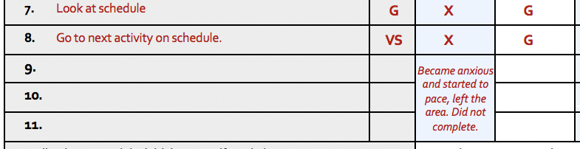
Adding
Brief Notes
Adding a few words to explain the situation can assist in review and modifications.
In Paul’s example he was unable to complete many steps during his first opportunity with the plan.
It is noted that he, “Became anxious and started to pace, left the area. Did not complete.”
Notes:
This is section 8, implementation of teaching plan and progress monitoring. Attention is being directed to the bottom of the form where there is space to write notes that may be helpful when looking at the student’s progress.

Slide 61
Complete Section Eight and Begin Teaching
After the baseline data is reviewed, the plan may require changes, additions or reduction of steps.
Determine the type of initial prompt for each step and record in column two
Designated team members(s) use the plan to begin instruction and record the results in the progress monitoring section on the right side of the form.
Team members confirm meeting date to review progress

Slide 62
Follow Up for Share Out of Teams
Teams now continue to implement the plan, provide instruction using the selected evidence based practices and collect data.
Teams will meet on the following date to share progress on the result of plan implementation:
Notes:
Facilitators should add the date for the follow up session to this slide and assure each team member notes and records the date. Should there be a significant amount of team members with conflicts for the selected date, it is recommended that the group attempt to find an alternate date.

Slide 63
Team Presentation Guidelines
Teams plan a ten minute presentation to share results of plan development and implementation
Develop a 6-slide PowerPoint presentation to share highlights of plan implementation
Presentation to cover the bulleted items.
Identified skill to be developed/goal
Current skill level/baseline
EBP practice(s) used
Steps used/task analysis (section 4)
Progress monitoring, data collection including prompting and reinforcement
Outcomes/results from use of evidence based practice
Revisions to the plan based on your data
Reflections: What would you do differently, how to continue to use plan/EBP
Notes:
This final slide can be used by a facilitator who is working with teams plan to complete and implement the teaching plan and use it with a target student and collect data on the student’s progress. After a reasonable length of time, teams should reconvene for a follow up session (suggest the minimum of a month). Teams should plan to share the team results guided by the bullet points on this slide. Individual users can also use this slide to reflect on their own experience implementing the Plan to Teach Skills using Evidence Base Practices.

Slide 64
Additional Plan Example
An additional completed case study example is available to assist teams through the process of developing a plan
This case study of Kristen reflects a plan to build a specific vocational skill.
The steps of the process are the same, however the content of the plan is very different from Paul’s plan
Download this example from the session webpage
Notes:
The Kristen example may be helpful to those teams that plan to teach a task with specific , distinct steps rather than a social/emotional skill such as the one that is highlighted in the Paul example. The planning process for either is the same however, the EBP used to teach the skills are different.

Slide 65
Certificate of Completion
Please take a few minutes to complete a short eight-question survey.
Response to the survey with 75% accuracy allows the learner to download a certificate of completion for the session.

