Slide 1
“What Works for Work”
Session 4:
Video Modeling
Notes:
This session will focus on the EBP of Video Modeling. This is a newer practice that many are finding is effective to teach new skills using the power and motivation of technology.

Slide 2
Session Preparation
In this session, it is recommended that participants have available technology with a camera and video editing software installed to be able to practice making and editing a video that can be used in video modeling.
Recommend using a tablet if possible, however a smartphone can be used if there are no other alternatives.
If technology is not available, the information and resources in this session can still be beneficial to the learner.

Slide 3
What is Video Modeling?
Video Modeling (VM) is a strategy in which a teacher, parent, or practitioner shows a video of desired behaviors or interactions to an individual student or a small group of students.
Two research studies support the use of video modeling in a variety of teaching settings and video modeling instruction to show students how to imitate behavior or interaction when in a different setting.
  Bellini & Akullian in 2007
  Thull in 2019
Notes:
Three Research study links:
A Meta-Analysis of Video Modeling and Video Self-Modeling Interventions for Children and Adolescents with Autism Spectrum Disorders
Bellini, S., & Akullian, J. (2007). https://journals.sagepub.com/doi/10.1177/001440290707300301
Download Thull in 2019 document #7, PDF research study entitled Chapter 7: Learners with Disabilities and Video-Based Instructional Message Design ,
More recently research by Thomas, DeBar, Vladescu, & Townsend in 2020 put out a research article entitled A Comparison of Video Modeling and Video Prompting by Adolescents with ASD can be found at: https://link.springer.com/article/10.1007/s40617-019-00402-0,
VM is a practical and effective intervention for improving a variety of skills and behaviors. It uses observational learning, making it an efficient and effective intervention. It is a relatively simple, and efficient strategy that can be used to improve or decrease specific target behaviors. Many teams report success using this strategy with individuals with Autism Spectrum Disorders.

Slide 4
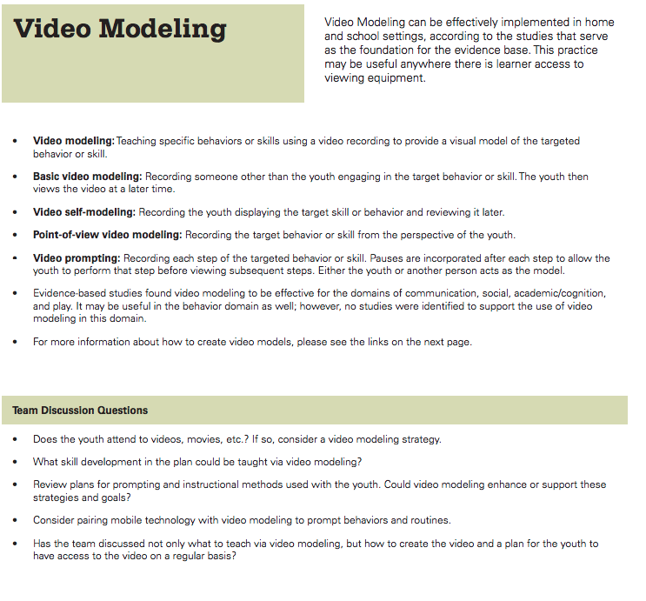
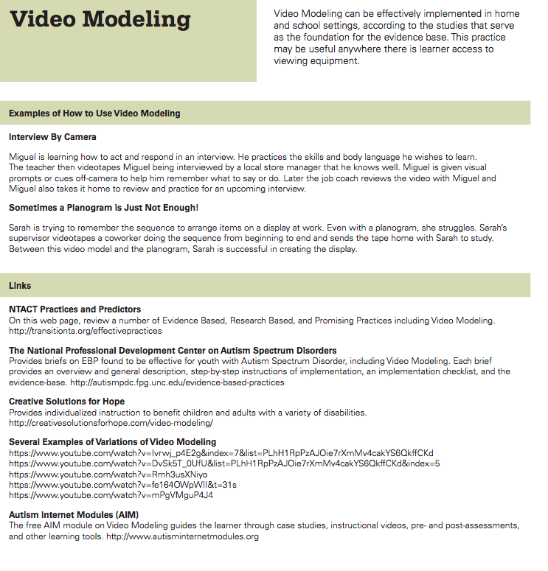
Handout #1:
Evidence Based Transition Practices
Notes:
Review the pages that overview Video Modeling. These are found in the Ohio Employment First document, “Evidence Based Practices for Transition Youth”. This is the document that is being used throughout each of the sessions. It can be downloaded from the What Works for Work web page or at this
link:
www.ocali.org/project/evp-adult-success

Slide 5
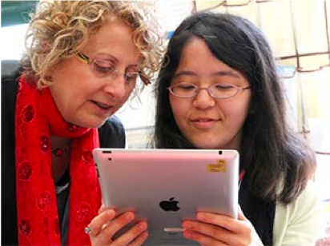
“Wow, it sure helps when I see it being done”
Videos used for modeling are intended to:
  Show positive behavior or activity in the video
  Be shared with the individual as an instructional tool
Create unique videos or find examples online
  Tip: Review the online video completely to assure it is appropriate for the target audience.

Slide 6

Video Modeling Teaches Expectations
Allows person to see and ‘study’ the desired behavior
Integrates video clips of “modeled behavior”
What can be used?
    Phone or Tablet Camera
    YouTube Videos
    An app with Video Modeling, e.g. MeMinder (on next slide)
Notes:
This can be a great way for the student to see the appropriate behavior and expectation in the classroom or work site. Video the student doing a task correctly and then allow a student that is struggling to view the video to understand the expectations and steps of the task. Many students enjoy watching videos that feature themselves. Using videos from the internet such as YouTube or commercial products can also be beneficial. You can also make your own videos using a phone or tablet camera. We will explore these options further in this session.

Slide 7
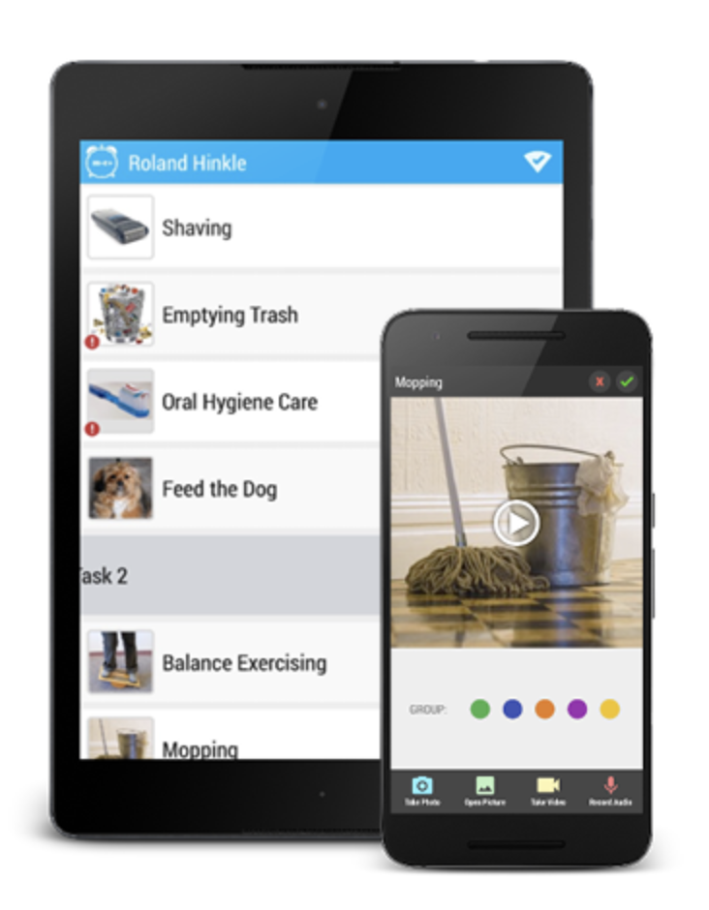
MeMinder
App provides video modeling and task management
Optional function to allow others to monitor what tasks were completed and to modify tasks and schedules
More information available on the CreateAbility website
Notes:
Website for hyperlink: https://www.createabilityinc.com/vocational-assistance/
There are many apps available and new ones being launched everyday that could be used to facilitate video modeling and other strategies. Examples in these sessions are not an endorsement and only serve as an example of what is available.

Slide 8
Steps for Video Modeling
The next slide overviews steps to consider when creating a video modeling strategy.
The steps suggest the use of peers and typical environments
The steps also emphasize the need to review and revise as necessary
This overview was adapted from an article in Teaching Exceptional Children, July/August 2011, vol. 43, no. 6, p. 22

Slide 9
Steps for Video Modeling
Identify the targeted activity
Choose competent peers/relatives to help
Secure permission if the peers are minors
Prep the participants on what activity you want demonstrated
Prepare the environment for filming
Create the video
Show the video to the individual
Go try the activity
Reflect and decide if the video is okay as is or needs changed
Notes:
Review the entire article for more detailed information about each step : Teaching Exceptional Children, July/August 2011, vol. 43, no. 6, p. 22

Slide 10
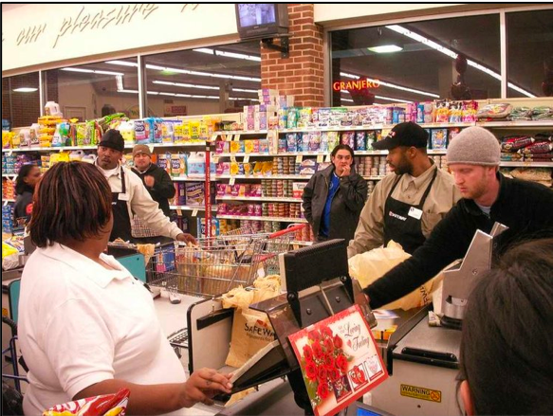
Video Modeling and Job Challenges
Examples of issues that can be tackled using video modeling include:
Difficult relationship with the boss
Isolation or bullying from co-workers
Negative performance evaluations
Inability to complete job duties
(Anderson & Kazantzis, 2008)
Notes:
Social deficits can decrease and limit employment opportunities. Although social narratives are commonly used for teaching social skills, video modeling has proved to be a practical and effective intervention for improving socially related job skills in an employment setting.

Slide 11
Types of Video Modeling (1)
Peer Video modeling – participant is shown a video of a peer performing desired behaviors.
Video Self-modeling – participant is shown a video of themselves performing desired behaviors.
Notes:
There are four variations of video modeling that can be used. Review the types on this slide and the next.

Slide 12
Types of Video Modeling (2)
Point-of-View Video Modeling Example – Video taken from student’s view. Does not have video description on video.
Video prompting - teachers/practitioners stop the video after each step of the task analysis so the target skill can be performed by the learner. (VM Steps for Implementation, NPDC, p.4)
Notes:
Link for Point- of-View Video Modeling Example:
https://www.youtube.com/watch?v=tifNDUG99ms

Slide 13
Selecting a Video Modeling Approach
Considerations to selecting an approach include:
  The skill or situation that the video addresses
  The profile of the person that will use the video model
Situational Example: Navigating a building may best be taught using point-of-view modeling
Learner Example: Some people learn more readily if they see themselves in the video (video self-modeling). Some wish to see others performing the task.
Notes:
When deciding which approach to use, the team should consider the skill or situation that the video addresses as well as the person that will use the video model. After reviewing this slide, discuss additional examples of situations or learner preferences that may influence the type of video modeling that is selected.

Slide 14
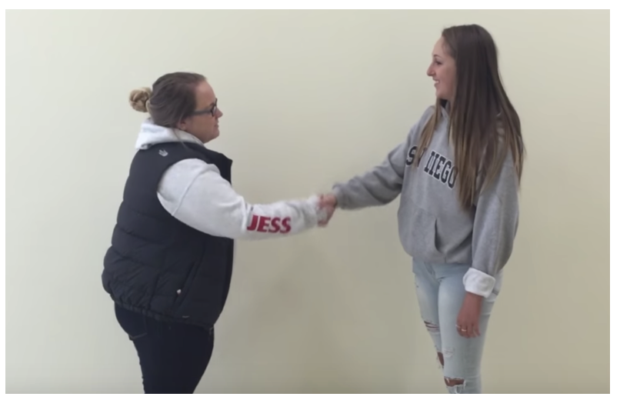
Example: Greeting Others
This Video Model: Greetings (found in slide notes) shows a variety of situations in when which a person might be greeting another person. It also uses a voice over to explain and highlight the nuances of what is in each clip
Notes:
Video link to greeting others
https://www.youtube.com/watch?v=iF5n1LSA1Sg
No audio description.

Slide 15

Example: Self-Modeling
Simple
Phone Camera
Completed on First Take
NOTE: In this video, a visual checklist was used just off camera to prompt steps. This strategy allows the person to view himself on video successfully completing the task or skill.

Slide 16
Video Editing: Steps 1 and 2
Decide what equipment to use, such as phone, tablet or iPad. It can be awkward to video with a laptop but it can be done if that is all that is available.
Determine the video editing software that is available. If needed, software is available free from an app store for a Mac or PC.
  A school district or agency may have a license for software that can be used for creating videos

Slide 17
Video Editing: Step 3
Learn about simple video editing, such as:
  Choosing a theme for the movie.
  Shortening clips
  Adding text to clips and a title for the movie
  Options like slowing the speed for clarity, adding transitions and audio and how to share the movie with others

Slide 18
Video Editing: Step 4
Locate instructions for your video editing software
  Specific resources to assist with editing are mentioned later in this slideshow.
  Options for locating instructions:
    Review the website for the video editing software that will be used
    Search for tutorials on YouTube
    Consult the district or agency technology coordinator or others who know how to edit videos using the selected equipment and software

Slide 19
Video Editing: Steps 5, 6 and 7
Review the video editing basics for the selected device/software
Record a short (less than a minute video)
Practice editing the clip, using some of the basic functions mentioned above like shortening, adding text, using a theme.

Slide 20
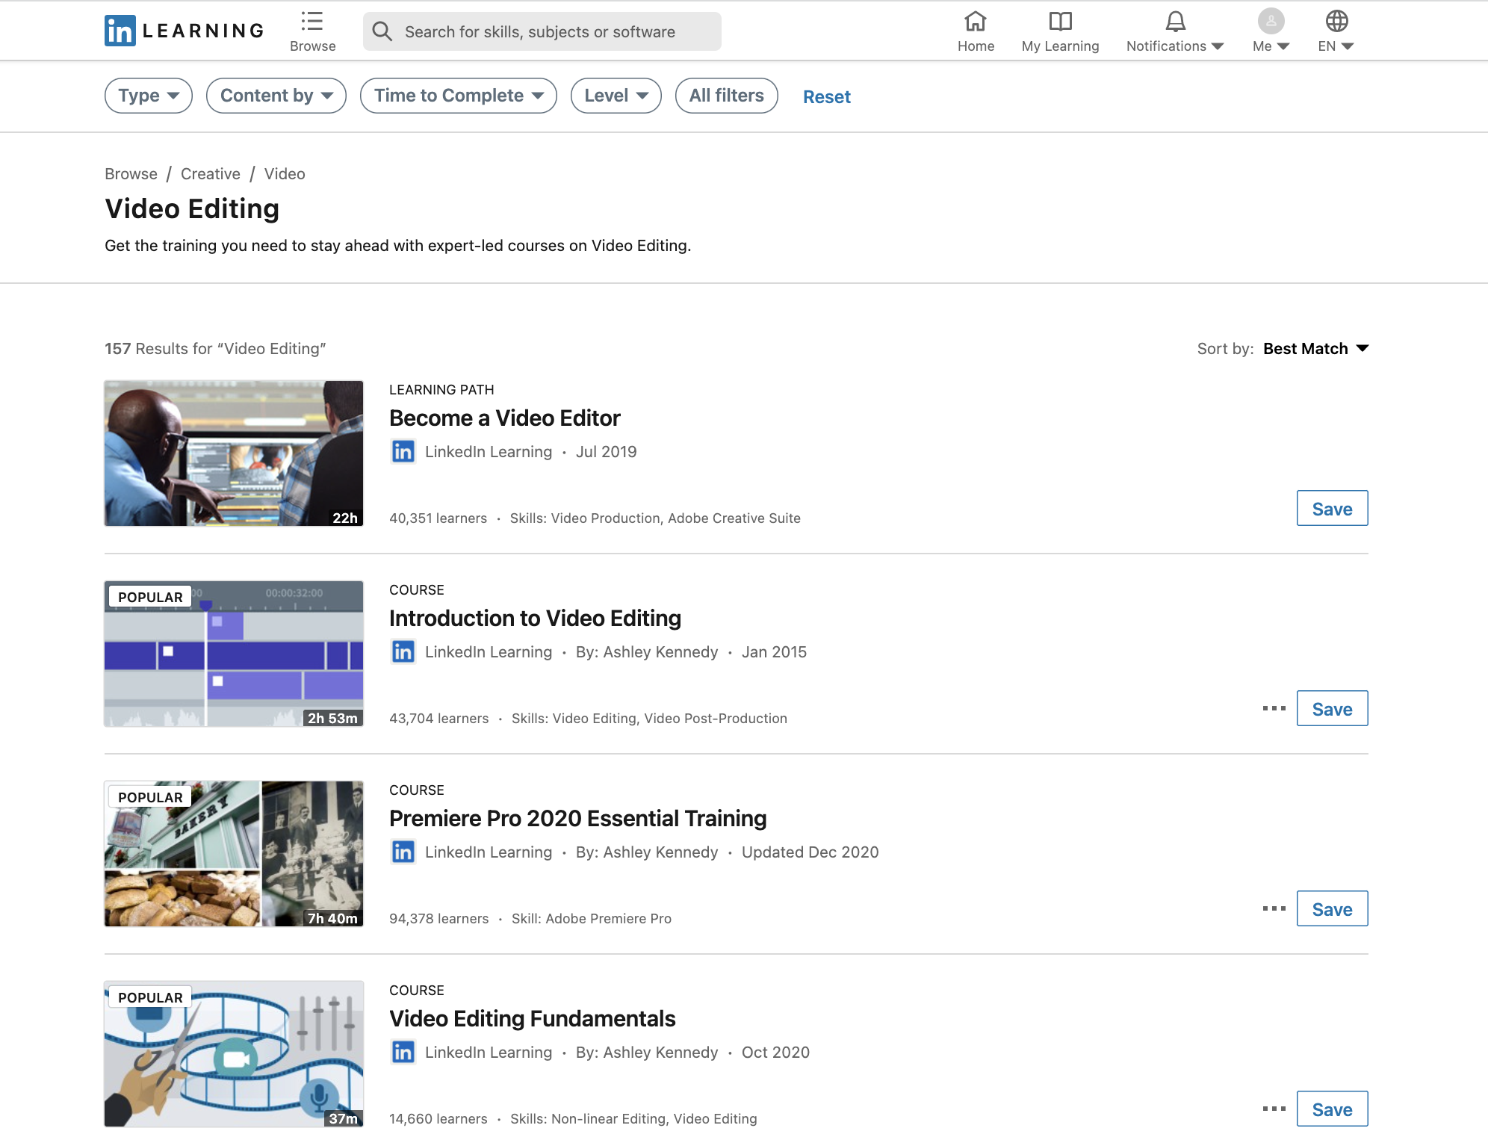
Resource: LinkedIn Learning for Libraries
Many libraries have access to this resource. A library card number and password is needed. The librarian can assist if necessary. The site has many videos on how to use a variety of video editing software or apps.

Slide 21
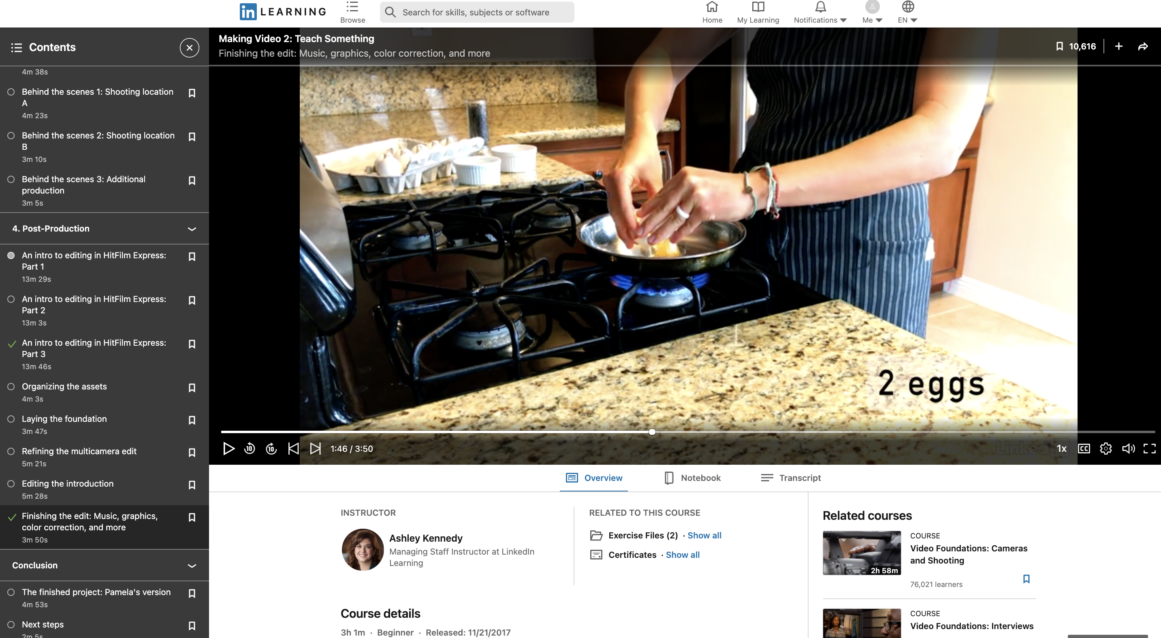
Making Video: Teach Something
Tutorial from LinkedIn Learning for Libraries
Notes:
Facilitators or viewers should determine if LinkedIn Learning for Libraries is available through their local library or their school district and access the site and use one of the online tutorials for learning about the software. The link for the tutorial shown on this page is: https://www.linkedin.com/learning/making-video-2-teach-something/welcome?autoAdvance=true&autoSkip=false&autoplay=true&resume=true&u=76844628
The image on the slide is hyperlinked to this site.

Slide 22
Find a Tutorial on YouTube
Use video modeling to assist in video modeling!
Search and locate video tutorials that demonstrate video editing.
Example:
  iMovie Tutorial for Beginners
Notes:
Link address for the hyperlink in this slide is: https://www.youtube.com/watch?v=4WlXYrStaIY

Slide 23
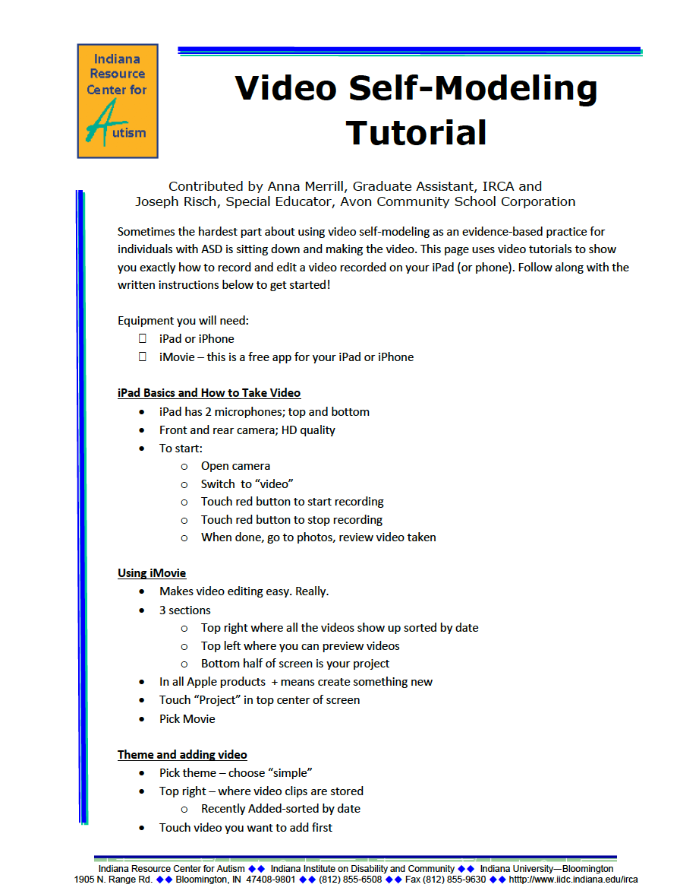
iMovie Video Modeling Tutorial
Handout #3: Video Modeling Tutorial from IRCA
YouTube: How to Create a Video Self-Modeling Video on your iPad: Shoe Tying
  This is an older version of iMovie, but the principles remain the same).
Notes:
Link address for self-modeling video for shoe tying: https://www.youtube.com/watch?v=2qROk1ZEOSg

Slide 24
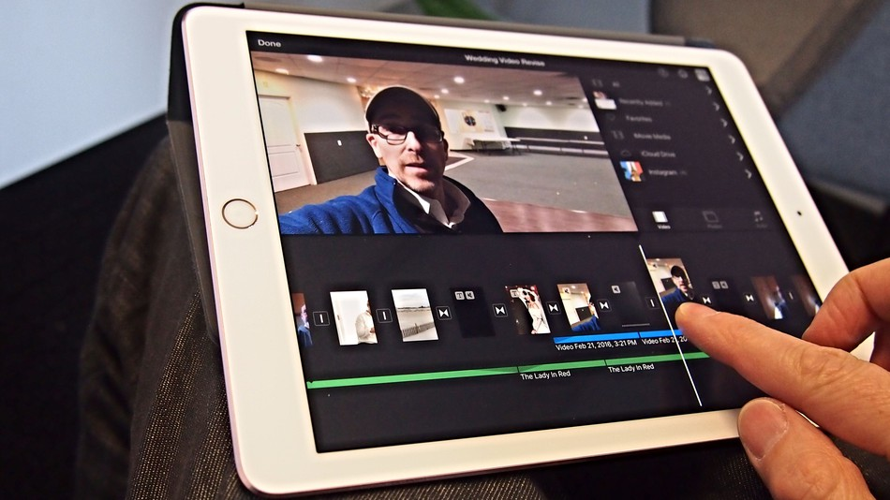
Your Turn to Make a Video!

Slide 25
Practice Video Modeling
  Allow 30 minutes for this activity
  Use a scenario such as:
    Finding the bathroom in the building - start from the current location
    Cooking in the kitchen using a microwave - make a cup of tea
    Social skills- greeting using eye contact and conversational exchange
    Opening a door for someone, pleasantries (hello, let me get the door, thank you, you’re welcome)
Notes:
If this is being done in a group presentations break into teams for the video shoot and editing. If doing this alone you can also use other people who know the software as resources to edit the video and to show the completed product.

Slide 26
Practice: Plan, Shoot and Edit
Do a task analysis of the steps to be taught (Tip: Limit the number of targeted steps in order to complete a one minute video in the 30 minute time period allowed.)
Each team or single participant will video their scenario using one of the video modeling perspectives: self-modeling, peer modeling, point of view, video prompting. (See slides #11-#13)
Edit using a video modeling tutorial for assistance
Share your completed video to gather feedback

Slide 27
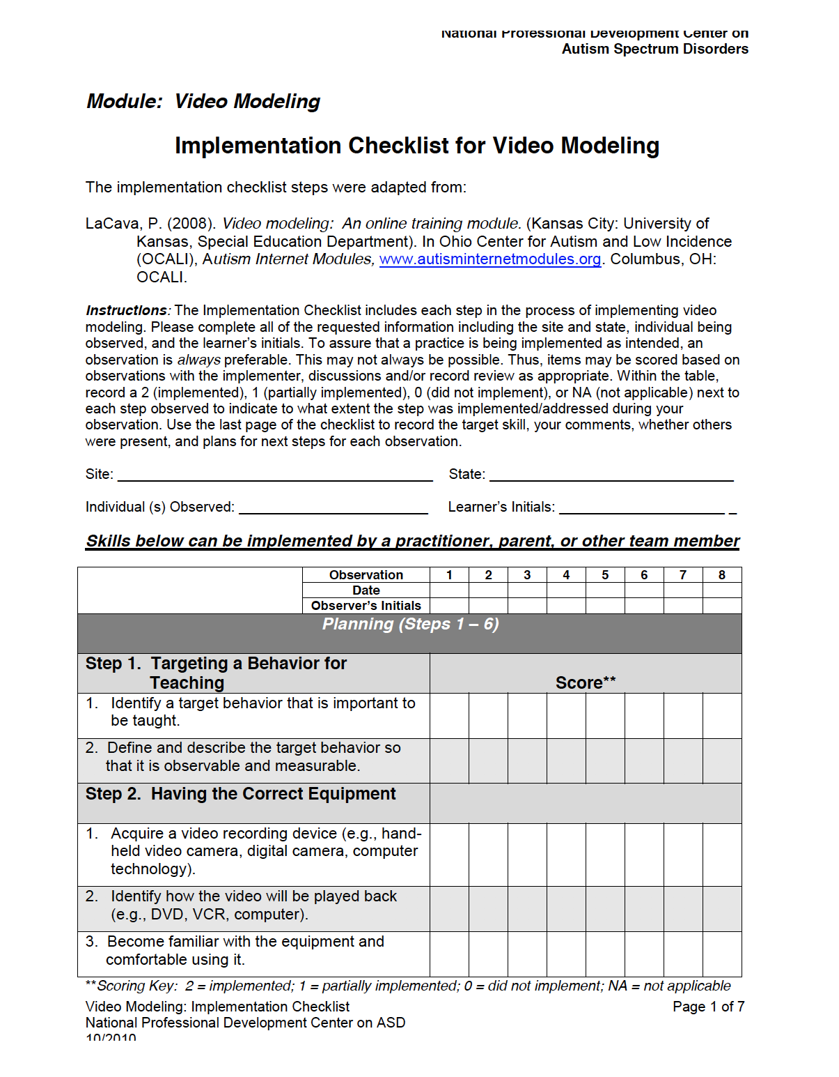
Video Modeling Module and Implementation Checklist
From the National Professional Development Center on Autism Spectrum Disorders (NPDC)
Review the video modeling process including troubleshooting
Complete document can be downloaded from NPDC on autism.
Notes:
Worksheet for module can be found here
http://autismpdc.fpg.unc.edu/sites/autismpdc.fpg.unc.edu/files/imce/documents/VideoModeling_Complete.pdf

Slide 28
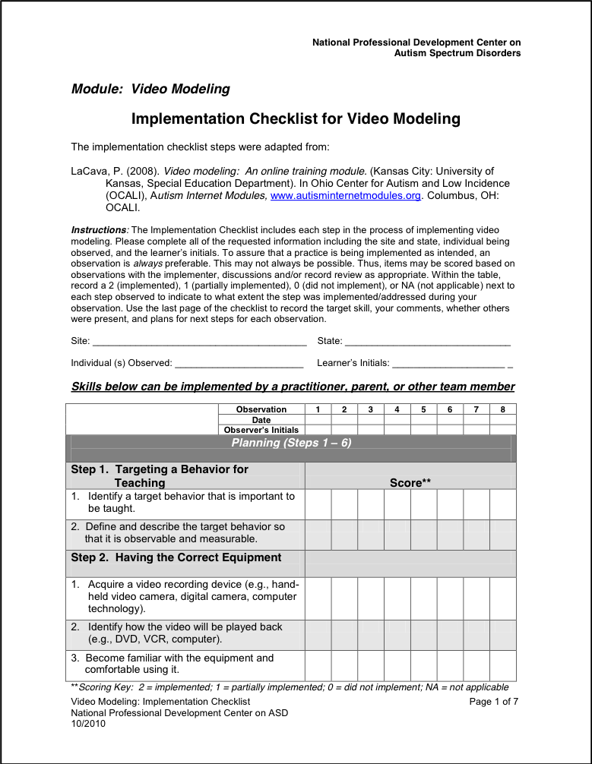
Module: Video Modeling Worksheet Cover Page
Review the pages of the Implementation Checklist on the following slides

Slide 29
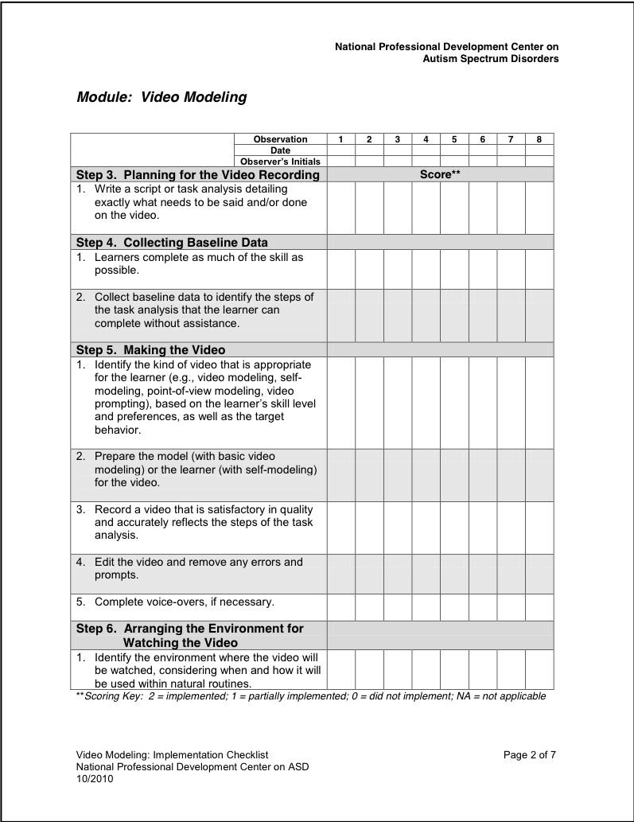
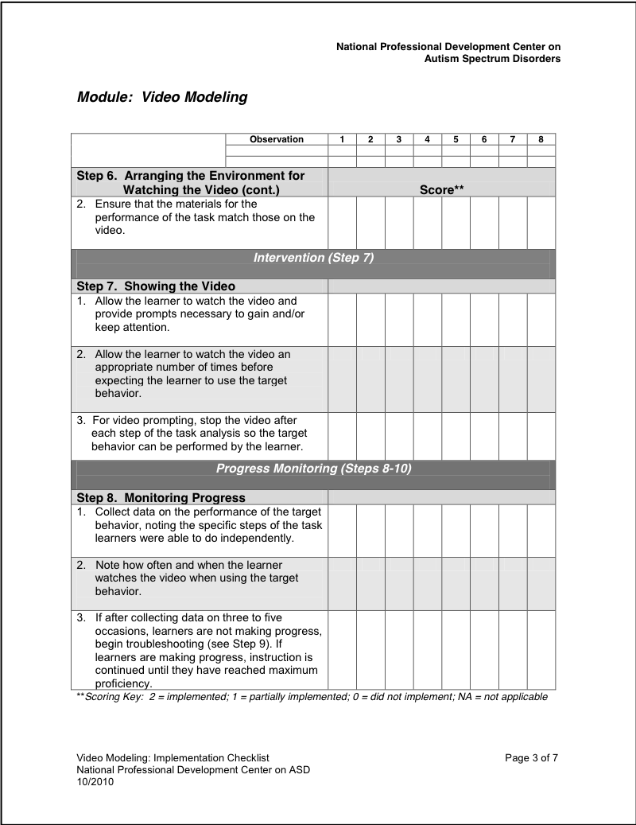
Module: Video Modeling Worksheet Page 2 & 3

Slide 30
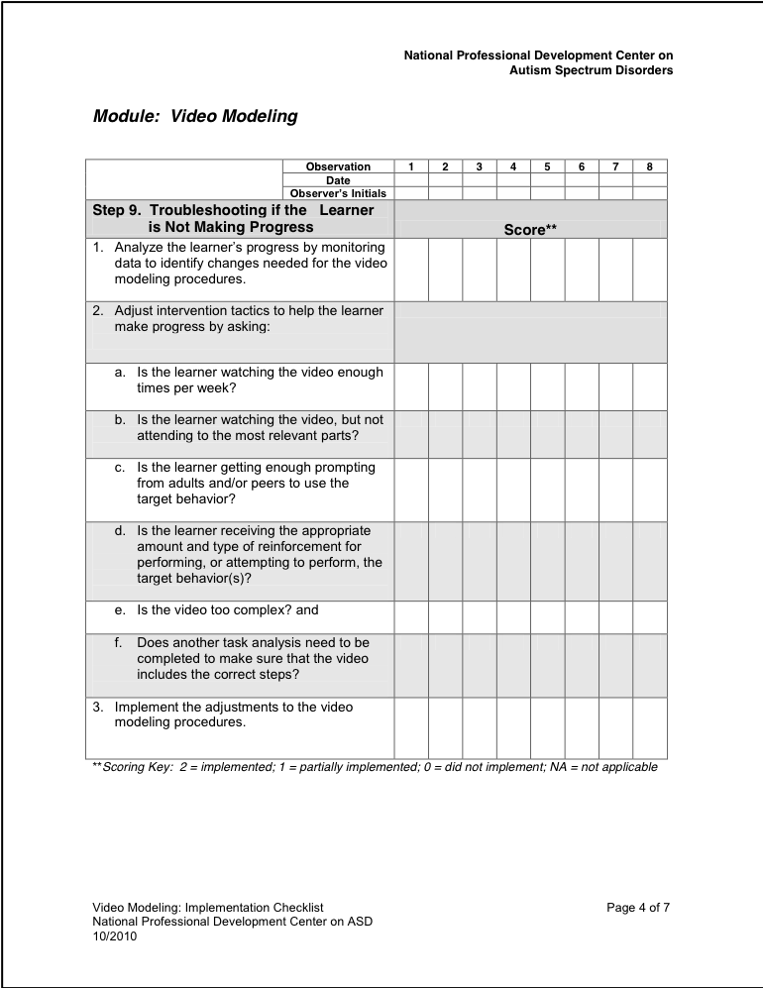
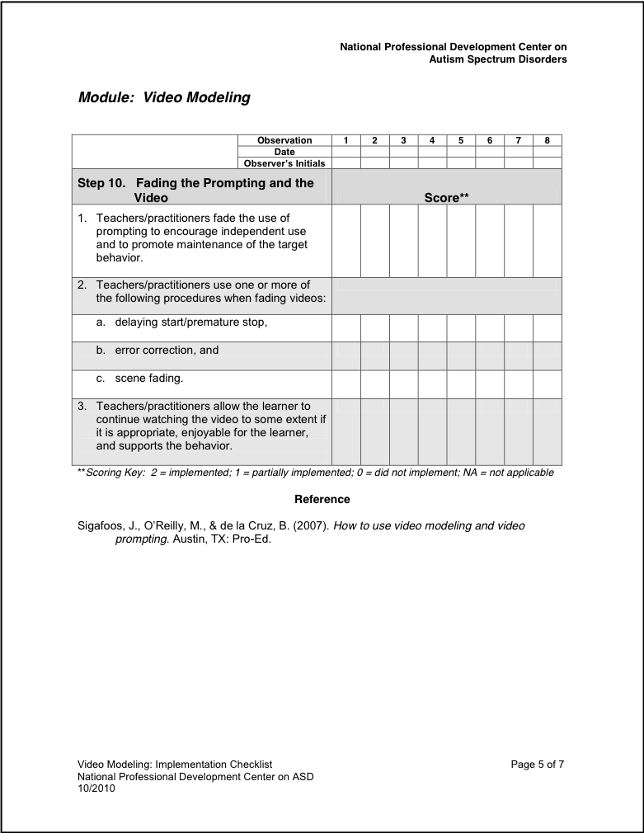
Module: Video Modeling Worksheet Page 4 & 5

Slide 31
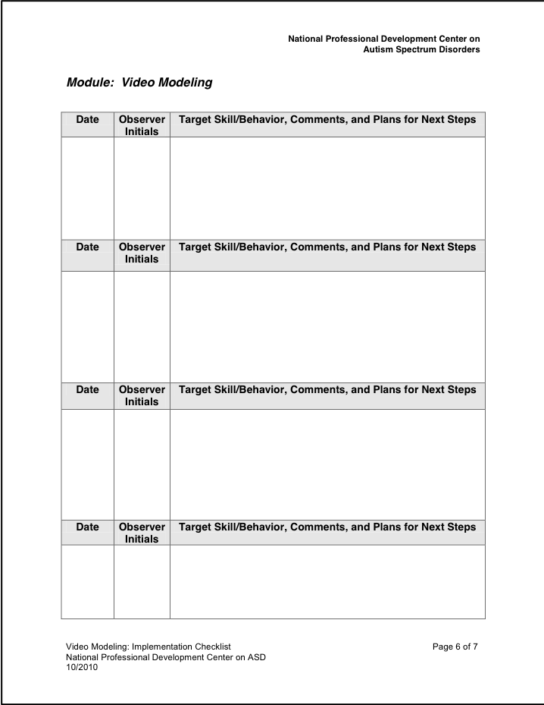
Collect & Review Data with Checklist
The checklist also includes a tool to collect and review data to determine effectiveness of strategy and plans for next steps

Slide 32
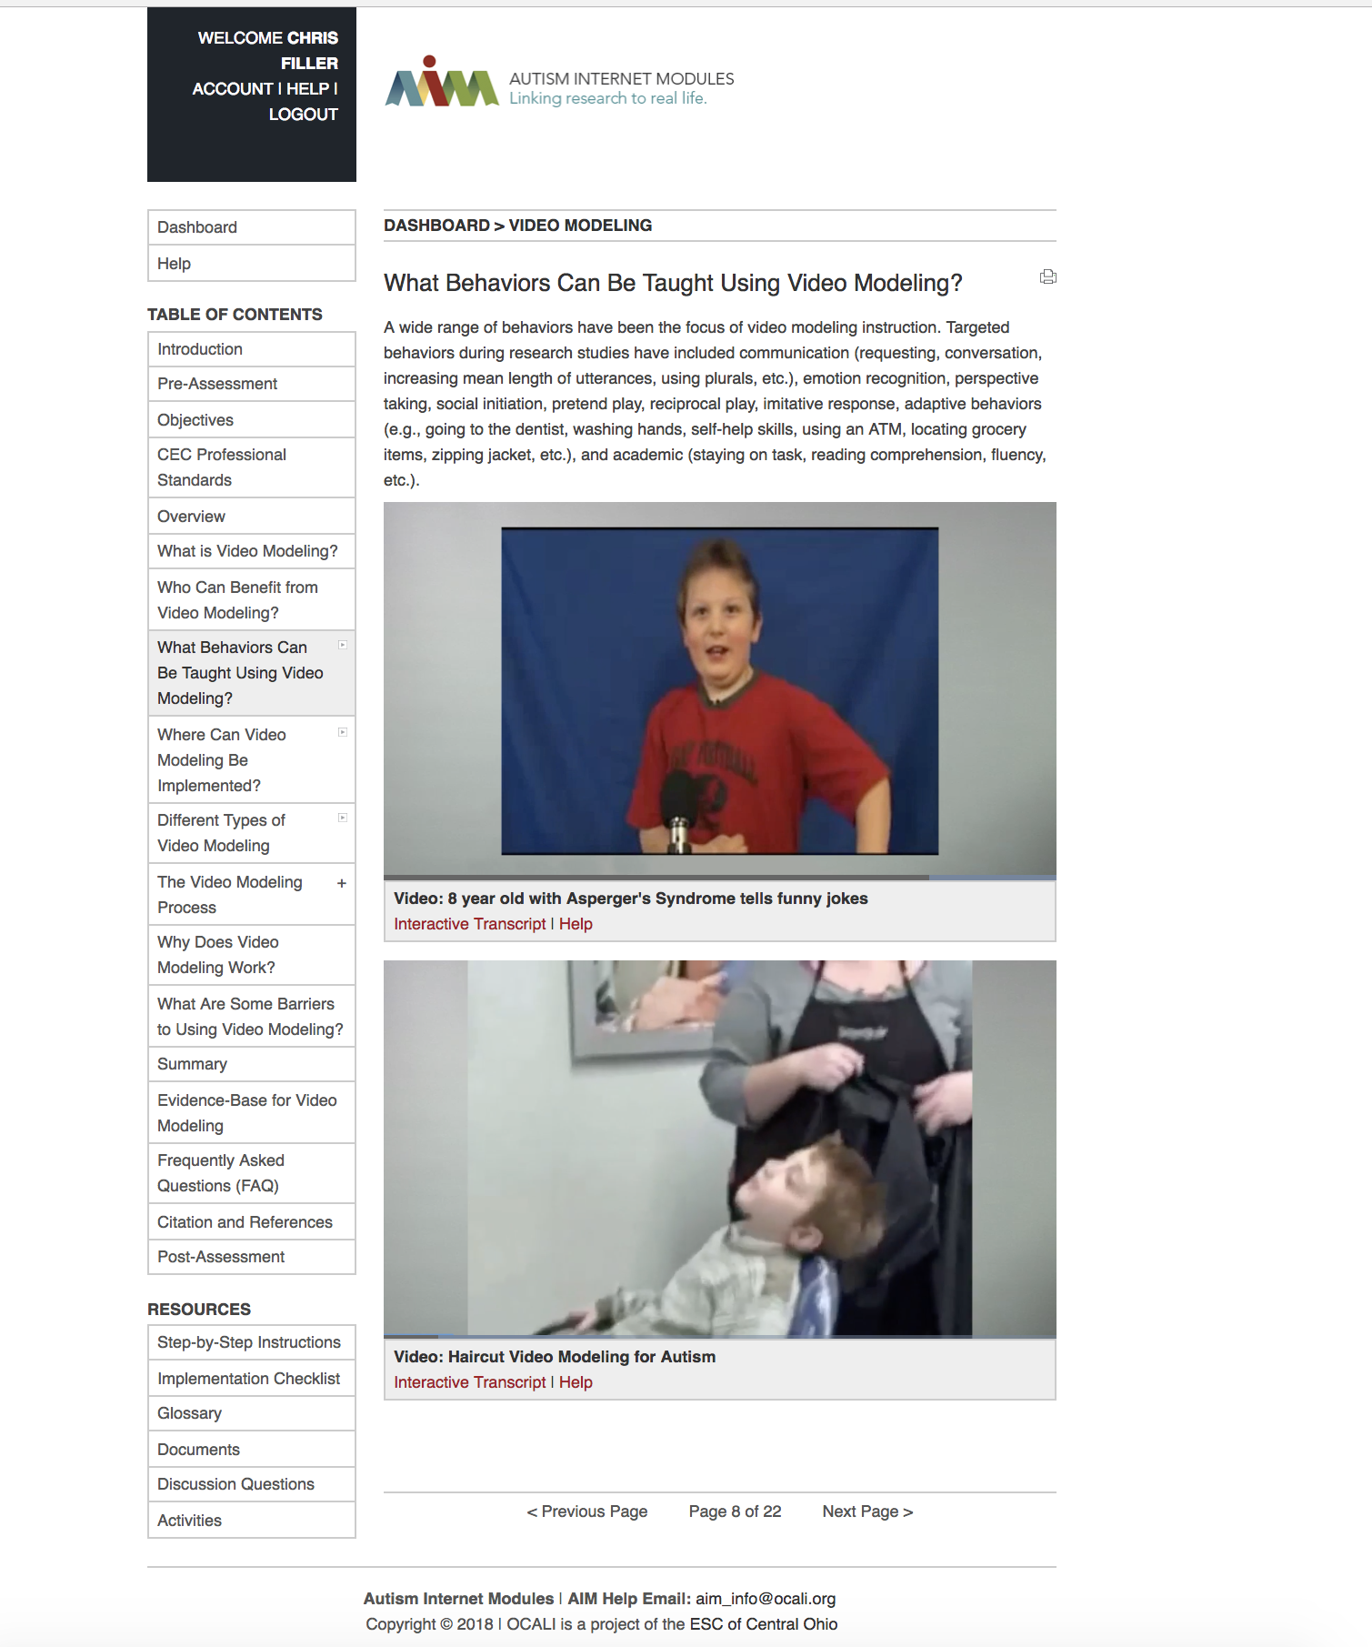
Autism Internet Modules (AIM)
AIM also offers free web- based modules
  Create a free account
  Locate the AIM module on Video Modeling –under Autism in the Workplace or Community
  An interactive version of the video modeling checklist is located within the module
Notes:
Main website for Autism Internet Modules (AIM)
https://autisminternetmodules.org/
The link to creating an account that is in the hyperlink on the slide is : http://www.autisminternetmodules.org/mod_intro.php?mod_id=30
The link to the interactive version of the checklist that is in the hyperlink on the slide is : http://www.autisminternetmodules.org/up_doc/VideoModelingChecklist1.pdf

Slide 33
Video Modeling Take-Aways
Benefits of video modeling (VM):
Step by step visual support for completing tasks.
Opportunity for student/worker to see self as successful.
Can prepare for new tasks and transitions.
Self-modeling can be motivating.
Can be used for self-instruction.
Quick start for video modeling:
Plan ahead (slide 9) and use video camera on your phone for an unedited take.
Use an app that incorporates video (e.g. MeMinder).
Search YouTube for an existing video.

Slide 34
Training Certificate
After completing the session activities and content, please complete a brief survey with 75% accuracy to receive a certificate of completion
Notes:
Survey Link: https://www.surveymonkey.com/r/M3ZZKKN

