Slide 1
“What Works for Work”
Session Ten:
Self-Advocacy & Self-Determination

Slide 2
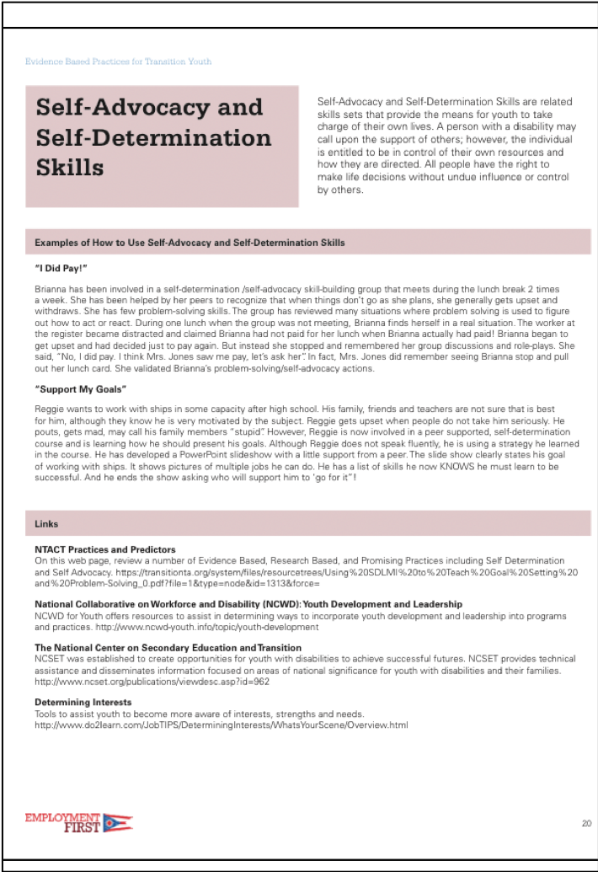
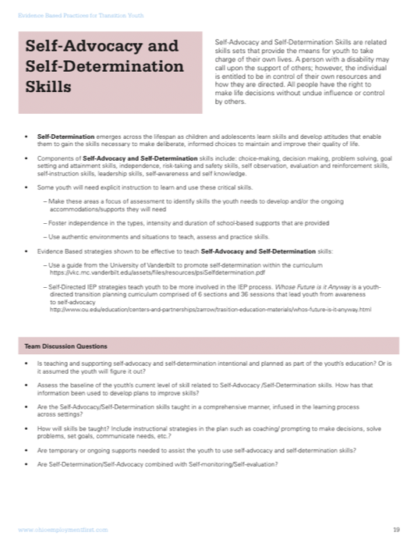
Evidence Based Practices
Self-Advocacy & Self-Determination
Notes:
04: Evidence Based Practices (Handout). Facilitators, ask participants to locate these pages in the document and briefly review.

Slide 3
Words Can Be Confusing
How Do You Define These Words?
Self-Determination
Self-Advocacy
  A Feature, Quality, Attribute
  A Skill Set
  A Process
  A Characteristic of Adult Success
  A Curriculum
  A Civil Rights Movement
  A Foundational Belief
  A Feature, Quality, Attribute
  A Group of Skills
  An Action
Notes:
Facilitators: Before showing all the text on the slide, have a brief discussion on what these terms mean.
Ask participants: What comes to mind when you hear these words?
The point of the discussion and sharing the associated words on the slide is to show that these words have been used in many different contexts and have different references. The next several slides lays the foundation for the focus of these terms when discussing them in relation to Evidence Based Practices.

Slide 4

Understanding The Terms
Self-Advocacy
Self-Determination
Foundational Belief. All people have the right to make life decisions without undue influence or control by others.
The ability to effectively and successfully take charge of one’s life.
Requires a set of interrelated skills, including self-advocacy skills.
Person may call upon support from others; however, is in control of his own resources and how they are directed.
Notes:
This slide provides the descriptions of these two related terms that will be used for this session. Facilitators: please be sure to point out that self-advocacy in this sense is the foundational belief that supports an individual to be self-determined. In turn, the set of skills associated with self-determination includes self–advocacy skills.

Slide 5
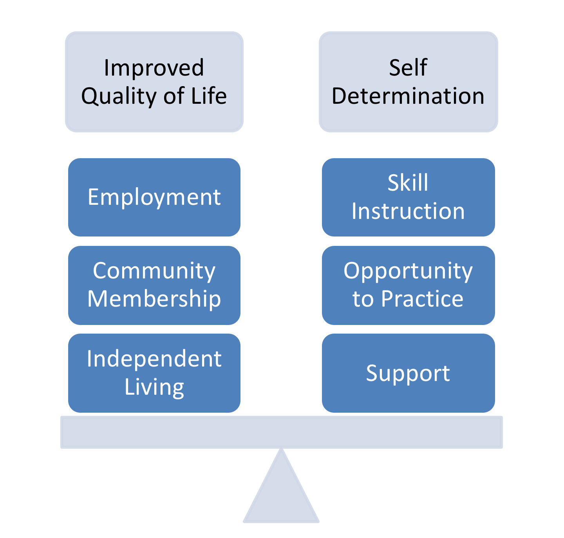
Self-Determination Is Associated With
Better Adult Life Outcomes
Youth have improved adult life outcomes and higher quality of life when they learn and use the skills associated with self-determination
Notes:
“Associated” or “correlated” is used here rather than implying that self-determination WILL lead to a better adult life or WILL cause a better adult life to happen. There is evidence that the 2 are related and connected, however, in some cases, the influences in a person’s life may change the impact of self-determination on the adult outcomes for that person. However, the potential positive impact of becoming self-determined is clear making it a priority goal as youth move towards adulthood.

Slide 6
What Does Self-Advocacy Include?
Speaking up for yourself
Making decisions about your own life
Getting information so that you can understand
Finding out who will support you in your journey
Identifying your rights and responsibilities
Problem-solving
Reaching out to others when you need help and friendship (and how to ask..)
Standing up for and defending the rights of oneself and/or others
Notes:
Facilitator: After reviewing the slide, ask the participants to reflect and comment on the opportunities that exist in their programs that support the development of these skills. Example: Are there discussions about behavior and consequences, citizenship, civil rights, and sexuality?

Slide 7

What Does Self-Determination Include?
Setting goals
Knowing what is needed to reach goals
The ability to make choices and decisions based on own preferences and interests
Accepting the consequences of the decisions made
Monitoring and regulating one’s own actions and to be goal-oriented and self-directed
Using Self-Advocacy Skills

Slide 8
Components of Self-Determination Includes Many Skill Sets
Choice-making
Decision making
Problem solving
Goal setting and attainment
Independence
Risk-taking and safety
Self- observation
Evaluation and reinforcement
Self-instruction
Leadership
Self-awareness and self knowledge
Self- advocacy
Notes:
These skills become ‘targets of intervention’ to build effective self-determination. Intervention plan goals should reflect the specific skills being taught and not simply a general reference to self- determination. Slide #9 goes further to reflect on examples of how these skills might be addressed.

Slide 9
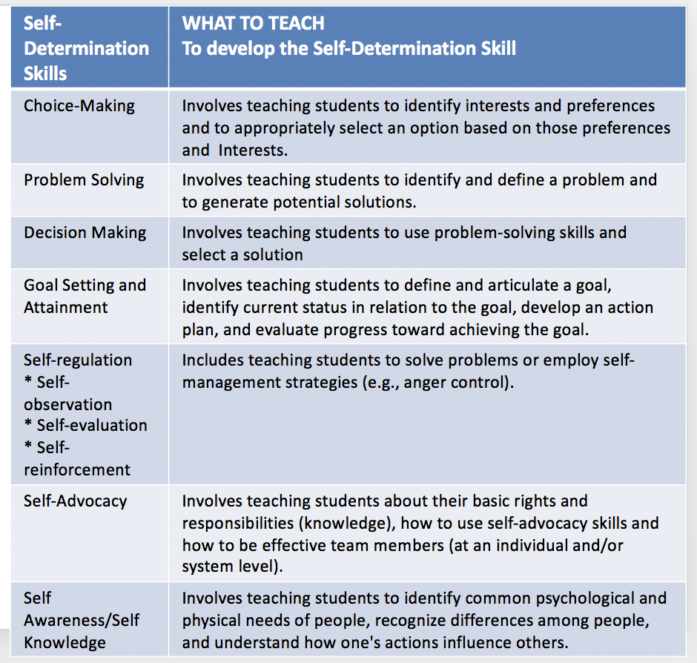
Developing Self- Determination Skills Requires Targeted Teaching Strategies
Notes:
This table in Word format can be read by a screen reader and is available as 05: Development of SD Skills (Handout), “Definition of SD Skills”.
Ask for comments from participants. Have they had the opportunity to address some of these skills within their current programs?
This table is adapted from Promoting Student Self Determination Skills in IEP Planning by Wood, Karvonen, Test, Browder, Algozzine

Slide 10
People with Disabilities Show Less
Self-Determination
  Youth with disabilities are often found to be less self-determined than their non-disabled peers and have less opportunity to make choices and express preferences
Do NOT assume they are incapable of self–determination
Do ASSUME they are in need of:
  Frequent, planned OPPORTUNITY
  In addition to Instruction and Support
Notes:
Research shows that youth/adults with disabilities are less self-determined than their non-disabled peers. It is important, however, not to assume that this in any way reflects the capacity of people with disabilities to become self-determined. Research clearly shows that people with disabilities have fewer opportunities to make choices and express preferences across their daily lives

Slide 11
What Do You Think?
When asked, most professionals agree to the importance of self-determination
However, research has consistently found that explicit instruction to promote self-determination is limited. Often not reflected in youth goals.
What are reasons educators and other professionals may not focus on teaching self- determination?
Notes:
Facilitate a discussion.
Do you agree with the first 2 statements on the slide?
Small group or whole group discussion and identification of barriers. No specific right or wrong answer.
Next slide will provide several reasons that studies have found to be barriers to educating and promoting self-determination.

Slide 12
Barriers to Promoting Self-Determination (SD)
Educator lacks belief that the student can benefit from instruction in SD
Insufficient time
Insufficient training to, and knowledge about, promoting self- determination
Lack of use of EBP in instructional plans
Notes:
Facilitators: After the discussion on the previous slide, review the bulleted items on this slide.
Assure participants these barriers are not true of all professionals working with youth with disabilities. However, studies have found these to be the responses of many educators. Acknowledge that addressing self-determination can take time and planning, thus requiring a team. Targeting specific components and working systematically can make the process manageable and produce results. The next slide provides a resource to begin gathering ideas and strategies.

Slide 13
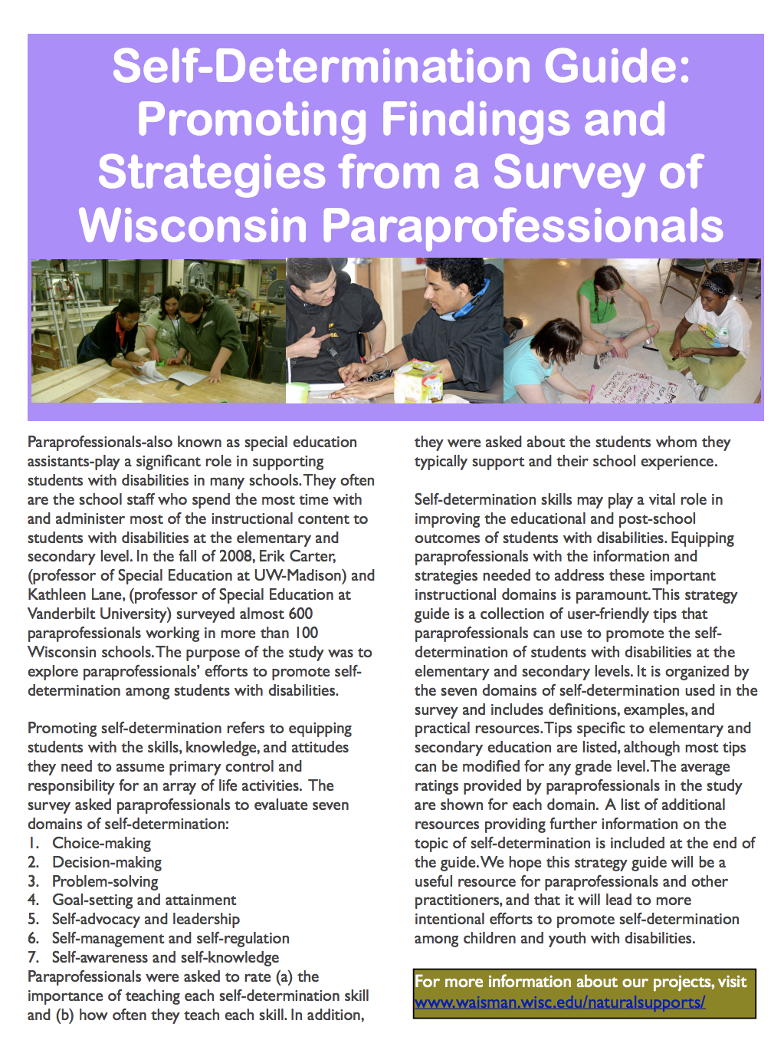
Strategies to Address Self-Determination Across Ages and Domains
Review the article for ideas of how to embed strategies to promote self- determination daily and starting at a young age.
Self-Determination Guide: Results and Strategies from a Survey of Wisconsin Paraprofessionals
  Authors: Martha Walter, Ashleigh Johnson, and Samantha Schomberg
Notes:
A resource to address some barriers listed in previous slide.
This article reviews the results of a study that surveyed almost 600 paraprofessionals working in more than 100 Wisconsin schools. The purpose of the study was to explore paraprofessionals’ efforts to promote self-determination among students with disabilities. Promoting self-determination refers to equipping students with the skills, knowledge, and attitudes they need to assume primary control and responsibility for an array of life activities. The survey asked paraprofessionals to evaluate seven domains of self-determination: 1. Choice-making 2. Decision-making 3. Problem-solving 4. Goal-setting and attainment 5. Self-advocacy and leadership 6. Self-management and self-regulation 7. Self-awareness and self-knowledge Paraprofessionals were asked to rate (a) the importance of teaching each self-determination skill and (b) how often they teach each skill. In addition, they were asked about the students whom they typically support and their school experience.
Self- Determination Guide: Results and Strategies from a survey of Wisconsin Paraprofessionals link:
https://www2.waisman.wisc.edu/naturalsupports/pdfs/Self-Determination.pdf

Slide 14
ACTIVITY:
Skills Area for Self- Determination & Current Opportunities
Skills Areas Associated with SD | Where Can Youth Learn About, Practice and Develop Skills in Current Course of Study?
choice-making
decision making
problem solving
goal setting and attainment
independence
risk-taking and safety
evaluation and reinforcement
self-instruction
leadership
self observation, self-awareness and self-knowledge
Identify as many opportunities currently available in the curriculum or course of study where students may learn about, receive instruction and/or access an opportunity to practice SD skills. Use 06: Skill Areas Associated with SD (Handout).
Notes:
Activity: Consider the skill areas or components of self- determination listed on the handout. Using partners or small groups, select (or facilitator assign to obtain more variety) one or two components. Identify as many opportunities currently available in the curriculum or course of study where students may learn about, receive instruction and/or access an opportunity to practice skills related to the specific component.
Each group will share 1-2 of their most innovative ideas.

Slide 15
ACTIVITY:
Skills Area for Self- Determination & Current Opportunities
Skills Areas Associated with SD | Where Can Youth Learn About, Practice and Develop Skills in Current Course of Study?
choice-making
decision making
problem solving
goal setting and attainment
independence
risk-taking and safety
evaluation and reinforcement
self-instruction
leadership
self observation, self-awareness and self-knowledge
Each Group Share Out Your Most Innovative Ideas.
Notes:
Each group will share 1-2 of their most innovative ideas.

Slide 16
Evidence Based Practices for
Self-Determination
Evidence Based Practices that are effective to promote self-determination include:
  Teaching the component elements of self-determined behavior (choice-making, problem-solving, goal setting skills, etc.)
  Providing opportunities to use and practice these skills
  Providing supports and accommodations as needed
Notes:
Youth need to be exposed to and systematically taught the skills that will allow them to be self-determined. They must also be given opportunity to use these skills. And finally, youth must have access to supports and accommodations when needed. This triad of elements should be the filter by which self-determination programs or curriculums are viewed. Approaches that do not completely address all three elements can add additional strategies, resources and opportunities to allow for a more comprehensive program that aligns with the description of evidence based practices for self-determination.

Slide 17
Materials and Resources for Teaching
Self-Determination
The resources, materials, and products highlighted in this session include several structured programs as well as useful resources
These materials may be used as part of a comprehensive approach to teaching self-determination
Support and accommodation may be needed for some youth
Notes:
The EBP that are discussed not only expose youth to the needed skills, but they also teach and highlight practice of the skills. Many of the resources discussed can be used as a support for any instructional program.

Slide 18
Review of Selected Resources for Self- Determination
The following slides review web-based resources for self-determination. Make note of 2 or 3 resources that you wish to explore further after the slide review.
Note: All images are hyperlinked to the resource website
Discuss the question:
  “How might you use the selected resources to develop SD skills for your students”
Notes:
Facilitators can pace the review of the materials and resources based on time and group interest. As facilitator, make a few comments about each resource that may highlight a unique aspect, an idea for use or a strength of the resource.
Remind the participants to select 2 or 3 that they will look at further after the review of all the resources. Prompt them to be ready to discuss the question:
“How might you use the selected resources to develop SD skills for your students”

Slide 19
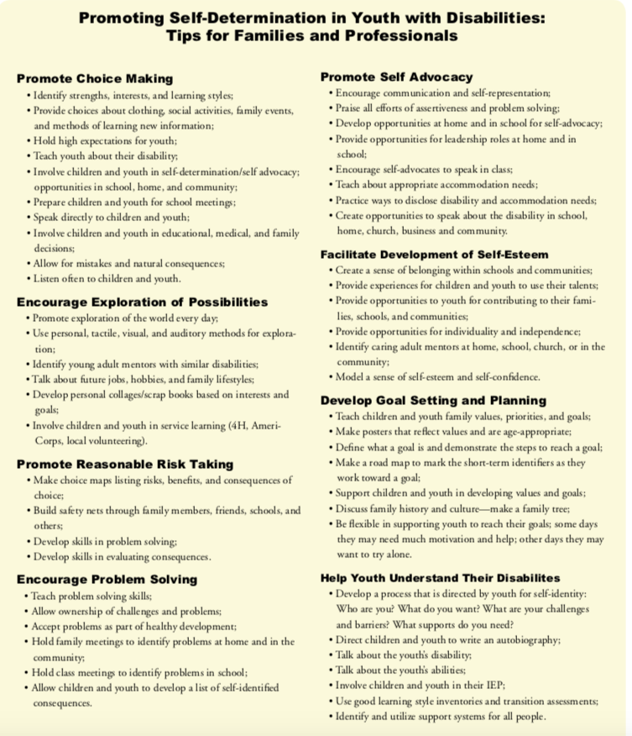
National Center for Secondary Education and Transition
Self Determination: Supporting Successful Transition Tips for Parents and Professionals
Brief Highlights:
Evidence Based Research supports the Strong Positive connection between self- determination and preferred adult outcomes.
Notes:
Self Determination: Supporting Successful Transition Tips for Parents and Professionals
and image link:
http://www.ncset.org/publications/viewdesc.asp?id=962

Slide 20

Childhood meets Adulthood at
Youthhood.org
Highlights:
Survey for students to think about future options after high school
Builds on choice making, self- awareness, and responsibilities as a teenager
Notes:
Image of Youthhood website link:
https://www.youthhood.org

Slide 21

Opening Doors to Self- Determination Skills
Highlights:
Timeline for self- determination skills by grade level (9-12)
Questionnaires for students
Community connections to consider while in high school
Person Centered Planning
Goal mapping
Notes:
Book cover link screenshot:
https://dpi.wi.gov/sites/default/files/imce/sped/pdf/tranopndrs-self-determination.pdf

Slide 22

Job Decisions for the Future
Highlights:
Determining Interest
  Social Skills Assessment
Finding a job
Getting a job
Keeping a job
Notes:
Determining Interest link:
http://do2learn.com/JobTIPS/DeterminingInterests/SocialSkillsAssessments/Assessments.html
Web image link:
http://do2learn.com/JobTIPS/

Slide 23

OhioMeansJobs.com
Highlights:
Student career interest survey
Budget calculator
Mock interview with self-record option
Online training
Resume and Cover letter guidance
Notes:
Ohio Means Job website image-link:
https://ohiomeansjobs.ohio.gov/wps/portal/gov/omj/for-students/explore-careers

Slide 24
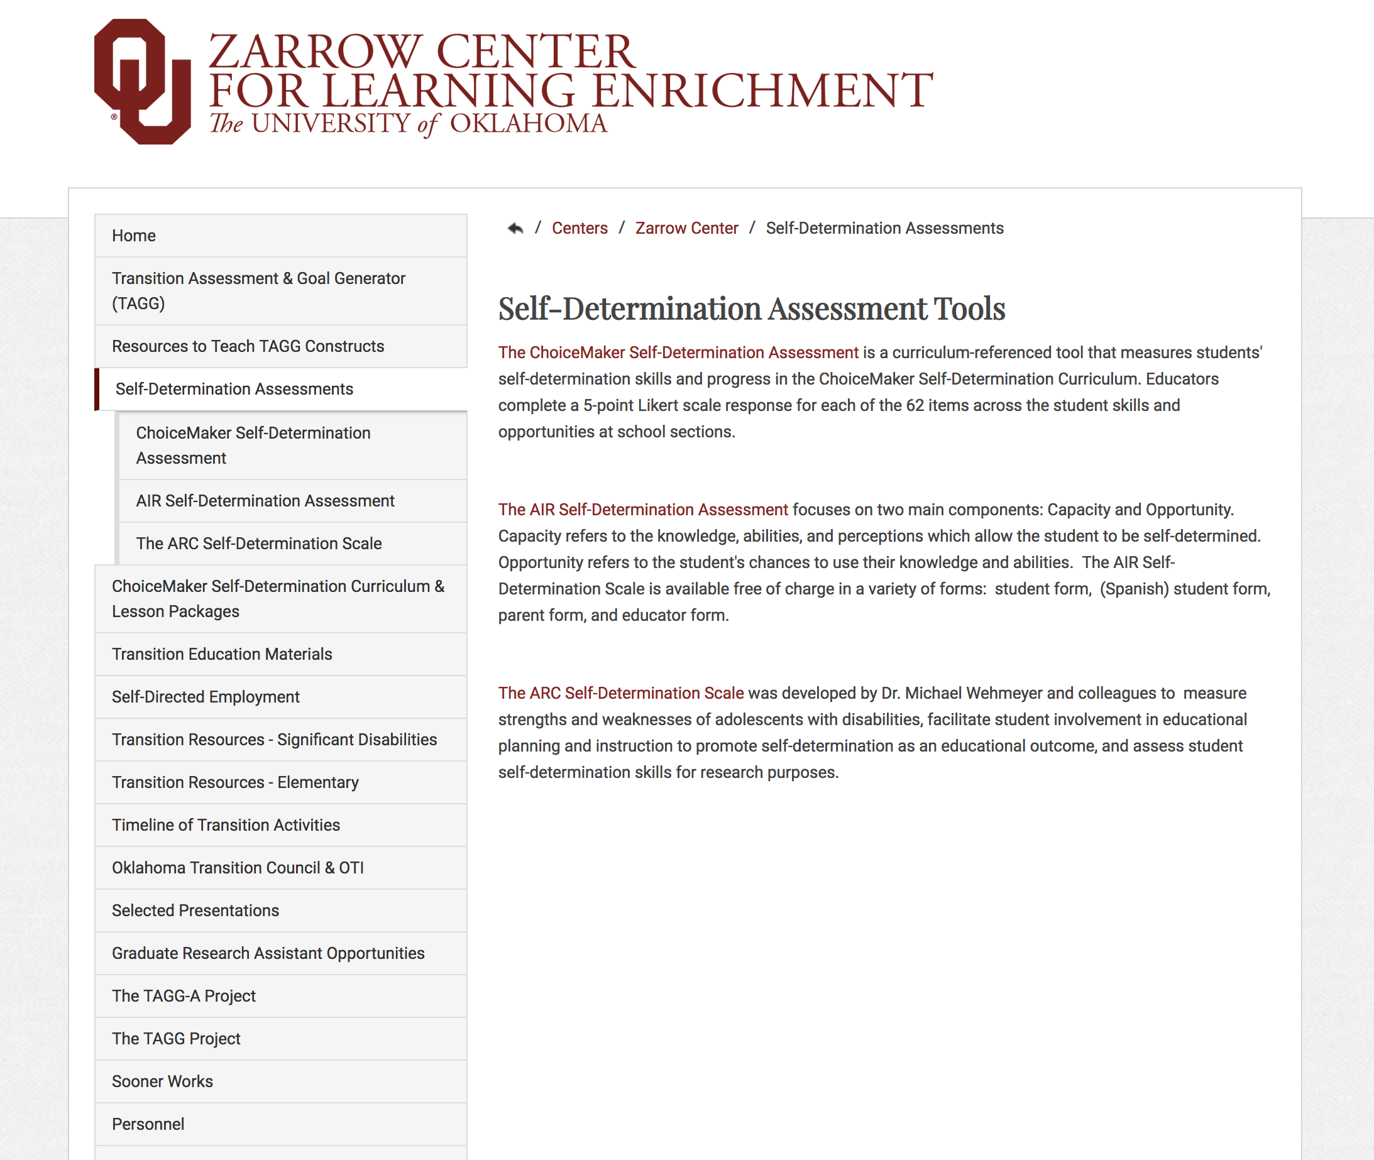
Zarrow Center Self- Determination
Highlights:
Whose Future Is It Anyway?
Self- determination curriculum
Lesson plans
Zarrow Center: Self-Determination Assessment Materials
Notes:
Whose Future Is It Anyway link:
http://www.ou.edu/education/centers-and-partnerships/zarrow/transition-education-materials/whos-future-is-it-anyway
Screenshot image link:
http://www.ou.edu/education/centers-and-partnerships/zarrow/self-determination-assessment-tools

Slide 25
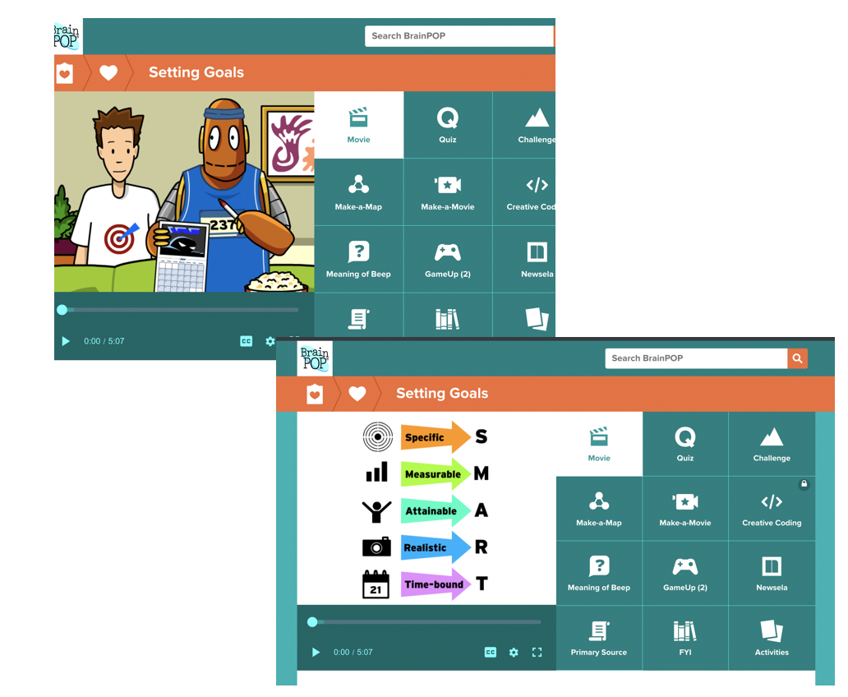
BrainPop Decision Making Topics
Highlights:
Short Interactive videos and simulations with lesson activities already created
Setting Goals
Conflict Resolution
Personal Hygiene
Notes:
Setting Goals: link https://www.brainpop.com/health/settinggoals/settinggoals/
Conflict Resolution & Personal Hygiene & Screenshot BrainPop Images link:
https://www.brainpop.com/health/freemovies/

Slide 26

FoolProof- Financial Education
Highlights:
Large Video Library- Short video covering topics from saving to budgeting
Modules cover financial responsibilities for teens.
Notes:
Modules link:
https://foolproof.directionscu.org/academy/high-schools
Screenshot of image link:
https://foolproof.directionscu.org/academy

Slide 27
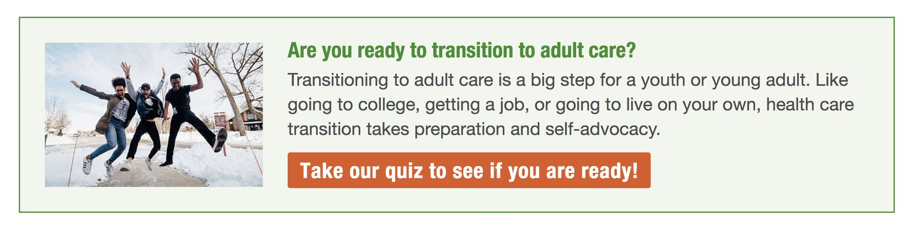
Got Transition
Highlights:
Got Transition aims to improve transition from pediatric to adult health care through the use of new and innovative strategies for health professionals and youth and families.
Youth and Families webpage promotes actions for youth to makes decisions about their own health care.
Notes:
Got Transition: https://www.gottransition.org/youth-and-young-adults/
Take our quiz:
https://www.gottransition.org/youth-and-young-adults/hct-quiz.cfm

Slide 28
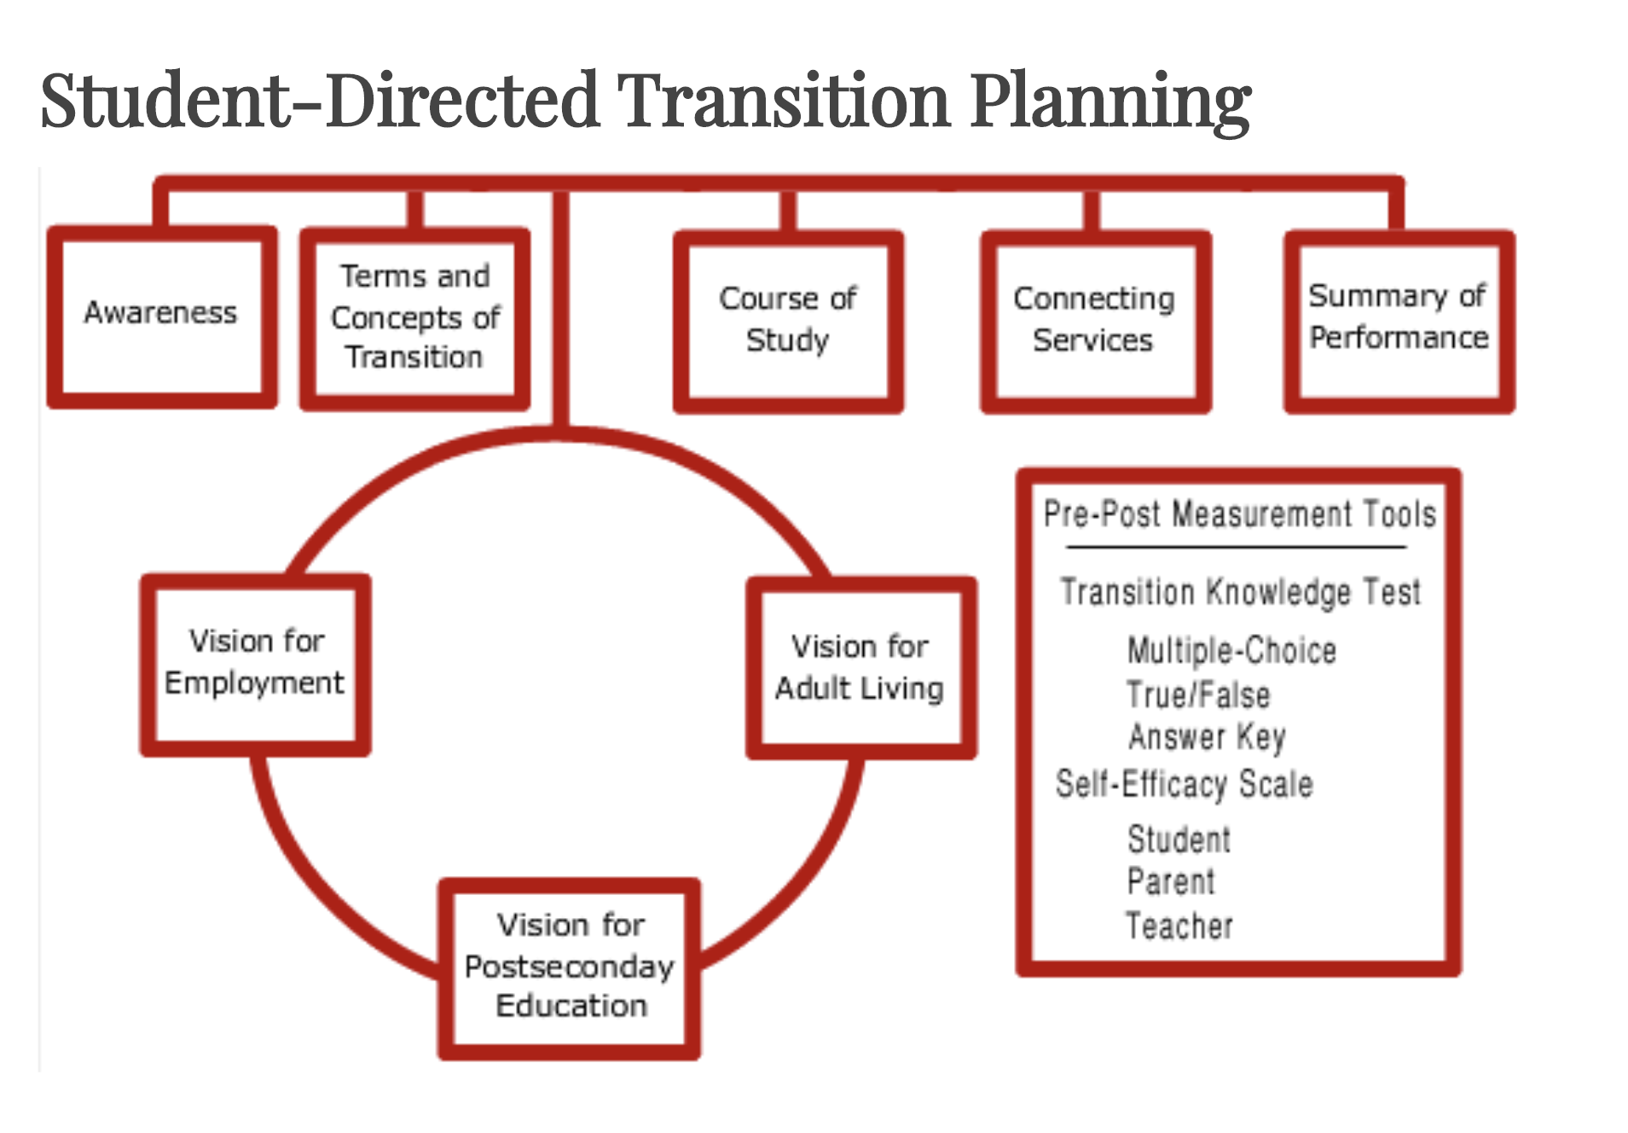
Student-Directed Transition Planning
Highlights
The eight Student-Directed Transition Planning (SDTP) lessons facilitate high school to adult life planning partnerships between students, their families, and educators.
SDTP uses the Student-Directed Summary of Performance as a means for students to learn, organize and present transition information.
Notes:
The hyperlinks in the slide link to:
http://www.ou.edu/education/centers-and-partnerships/zarrow/transition-education-materials/student-directed-transition-planning

Slide 29
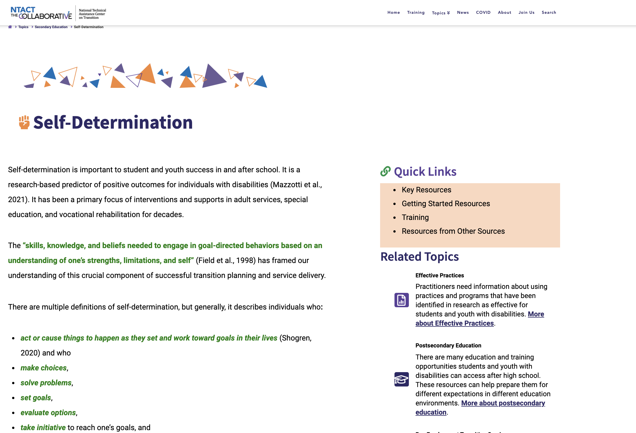
Self- Determination Resources
NTACT- Self- determination lesson plans. Set- up a free account.
Notes:
NTACT link:
https://transitionta.org/topics/secondary-education/self-determination/

Slide 30
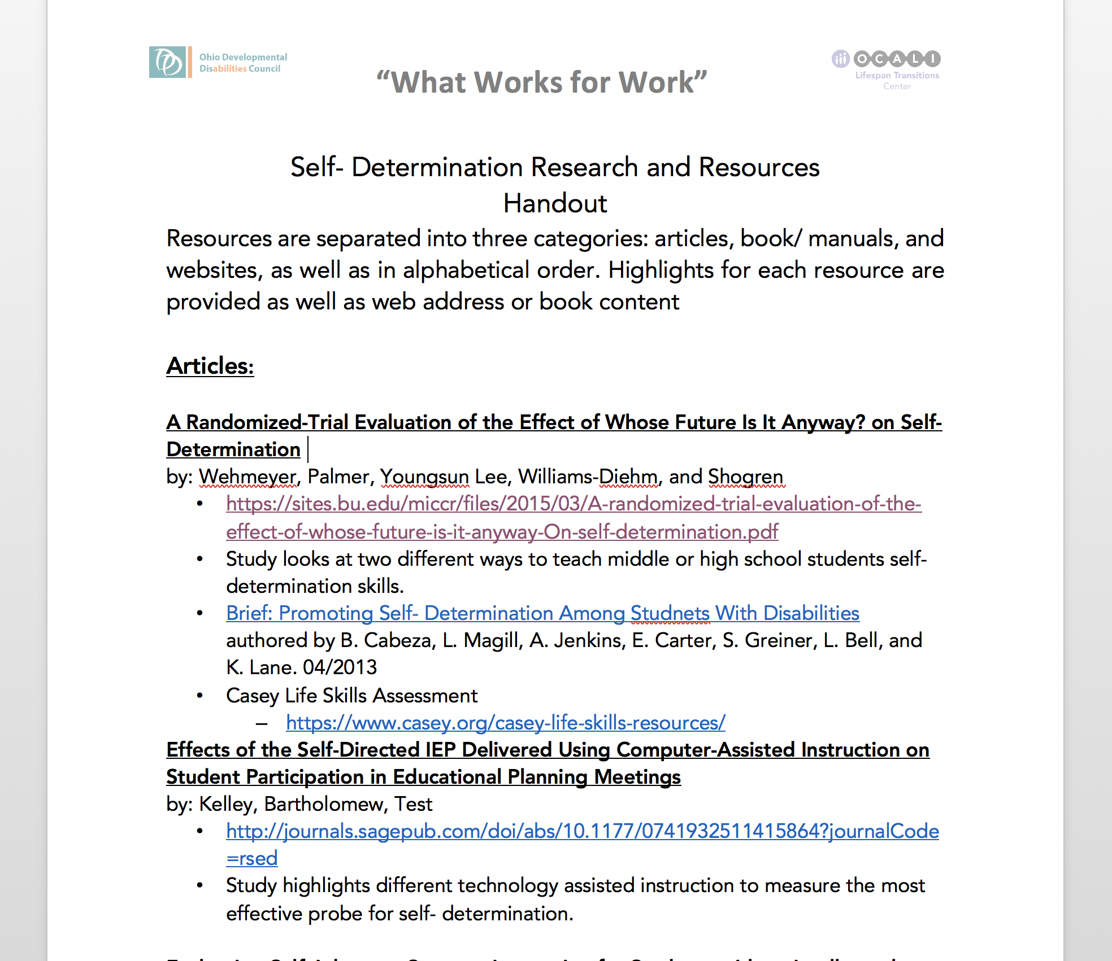
Self- Determination Research and Resources
Download the document of additional Self-Determination resources from the session 10 website.
This document includes those highlighted on the previous slides as well as others.
Notes:
Call out the Research and Resources for Self-Determination document on the Session 10 website. Explain that this document is a resource sheet that includes all the resources review on the slides as well as others that have been found to be helpful. The document contains active hyperlinks for each resource.
Download & Image and of Self- Determination Research and Resources link:
https://www.ocali.org/project/session_ten_self-advocacy_self_determination

Slide 31
Time for Further Review of Resources
Explore your selected resources (2 or 3).
Make notes of interesting aspects and uses
Be ready to offer ideas of “How you might use the selected resources to develop SD skills for your students”
Notes:
Prompt the participants to explore the selected 2 or 3 resources. Prompt them to be ready to discuss the question: “How might you use the selected resources to develop SD skills for your students”.
Provide 15 minutes if possible.

Slide 32
Group Discussion
“How you might use the selected resources you reviewed to develop SD skills for your students”
Notes:
As time allows, ask for participants to quickly discuss what they reviewed.
Have each offer ideas for use. If they found they would not use the resource, could they recommend the type of situation where the resource would be helpful

Slide 33
Take Away
Self-Determination has been associated with better Quality of Life and improved adult life outcomes
Developing Self-Determination (SD) requires:
  Instruction in targeted SD skills throughout the education years (and often beyond)
  Frequent, systematic, planned opportunities to use the skills
  Individualized support and accommodations as necessary

Slide 34
Survey
Please take a few minutes to complete a short survey and provide feedback on the What Works for Work session information and resources.
Need CEUs? Complete an eight-question survey with 75% accuracy to receive a certificate of attendance.

