Slide 1
ALL In… Co-Planning That Includes ALL Learners and ALL Professionals

Slide 2
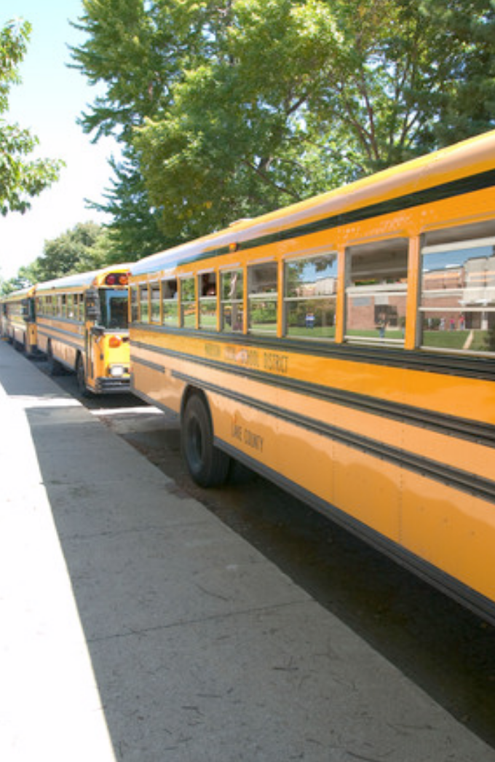
ALL in - Focus on inclusive district practices (non-negotiables)

Slide 3
When the doors of our district's open every day...
has pre-planning prepared ALL professionals to reach and teach are ALL learners?
Notes:
Will start with some questions

Slide 4
Is team-designed, Tier I instruction tried BEFORE inclusive placements are ruled out - especially for learners with significant disabilities?

Slide 5
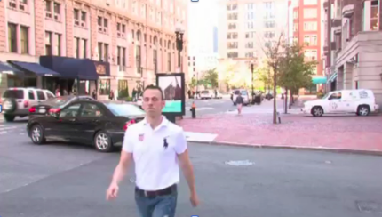
Word on the street… Think College
https://www.youtube.com/watch?v=U6M8FpIFCnw
Notes:
Play first clip up to :44
At what point does your team, school, district, etc. pause because they are unsure about the inclusive potential even after they have just said EVERYONE should have the opportunity to go to college?
http://www.thinkcollege.net

Slide 6
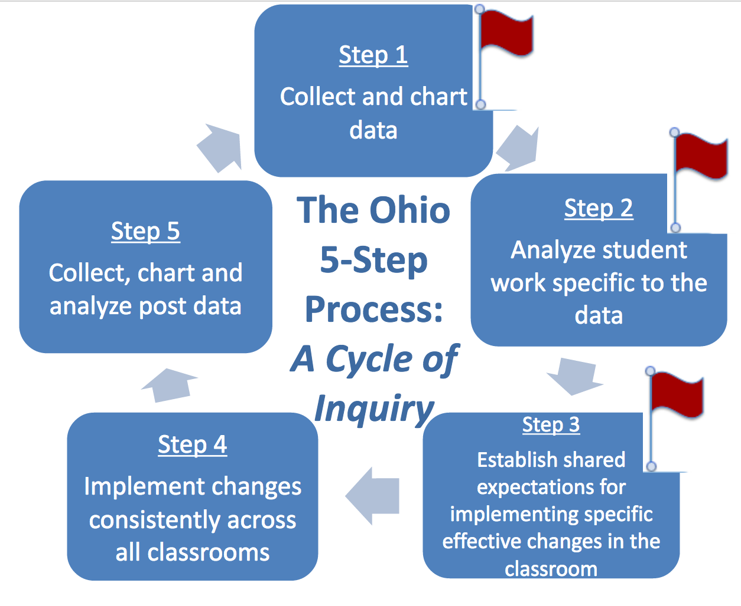
Realities From The Field
Step 0 ?
Notes:
Inclusive practices are not always in place during the 5-step process. Where are there red flags in your practice?

Slide 7
Questions for teams to ponder:
Who are we planning for? (who is this ALL you speak of)
Who is needed to support their learning?
Who is the primary planner?
Where in the template do content specialists have a voice?
Where in the template do intervention specialists have a voice?
Where in the template do other specialists have a voice?
Are there sections missing to capture the planning for ALL learners?
Notes:
Activity 1

Slide 8
Notes:
“By the student by the skill”
TBT data driven discussions from tip-to-tip

Slide 9
https://www.youtube.com/watch?v=RYtUlU8MjlY
Notes:
Curved Planning Design - we begin our planning by thinking about and preparing for earners who are the hardest to reach.

Slide 10
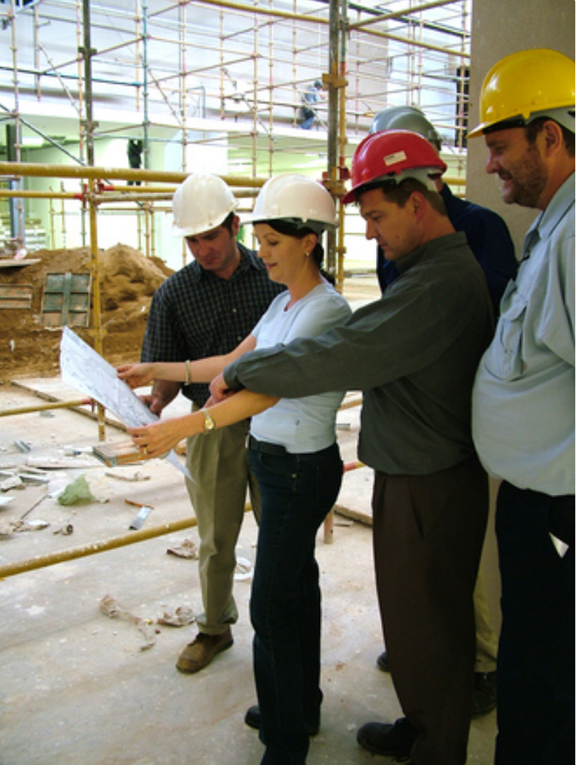
When did planning become uncool? Ok, so maybe it was never considered cool….BUT we need find value in the planning process.

Slide 11
What is co-planning to co-serve?
Teacher Based Teams co-plan and co-serve through PROACTIVE PRACTICES that meet the needs of each and every learner from tip-to-tip across grade-levels.

Slide 12
What is co-planning to co-serve?
Curriculum is selected and designed for all learners in preparation for first teach, rather than developed for a normed-group of students and then adapted after-the-fact

Slide 13
What is co-planning to co-serve?
Personalized learning needs are integrated into a collaborative planning tools which assist educators in determining appropriate instructional practices and documenting progress toward goals and learning targets.

Slide 14
ALL in - Focus on How do we ensure that “Everyone’s In”?
Notes:
As you watch be on the look-out for common language across the district and pro-active planning practices.
What is the disposition help by every professional within this district?

Slide 15
As you watched the video what were some of the traits ALL buildings across the district embedded that contributed to barrier free learning and high achievement.
Champions of Change

Slide 16
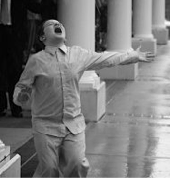
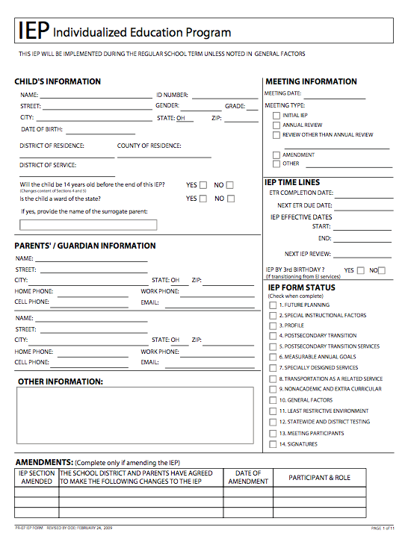
ALL in - Focus on inclusive language
People First Language
Don’t Say
A handicapped child
He is wheelchair bound
She’s a spec. ed. kid
I have a blind girl in my class.
He is one of my IEP kids.
When describing assessment capable learners we say:
Jenny is a 3rd grader
He uses a wheelchair for mobility.
She receives special education supports and services.
I have a student in my class who uses visual supports
He communicates with specific behaviors
IEP
Notes:
Non-Negotiable #1

Slide 17
ALL in - Focus on team development
Notes:
Non-Negotiable #2

Slide 18
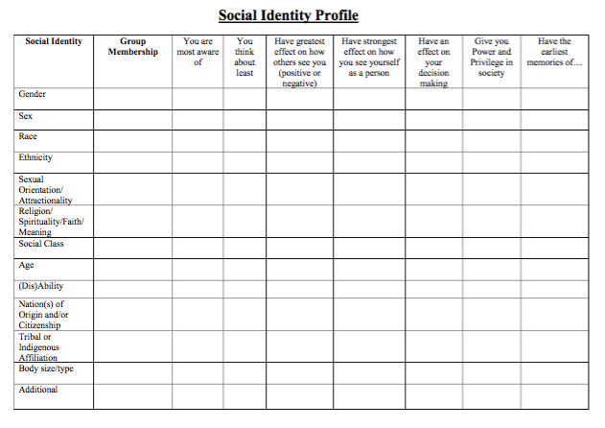
What is Your Social Identity Profile?
Chavez-Korell, S.
Notes:
Did you know that our identity characteristics drive how we view others? How do our profile, history and upbringing contribute to our decision making and interaction with others?
15-20 minutes
Ah ha’s based on your own profile - discussion
How does your profile represent learners?
Do you express (knowingly or unknowingly) MICROAGGRESSIONS in your daily interactions with others?

Slide 19
Professionals involved in the planning process must mirror learners receiving instruction. If learners do not have representation
FIND SOMEONE!
Notes:
Doesn’t mean they have to be face to face at every meeting, but they need a voice at the beginning of the planning process and periodically during follow-up and follow-along.

Slide 20
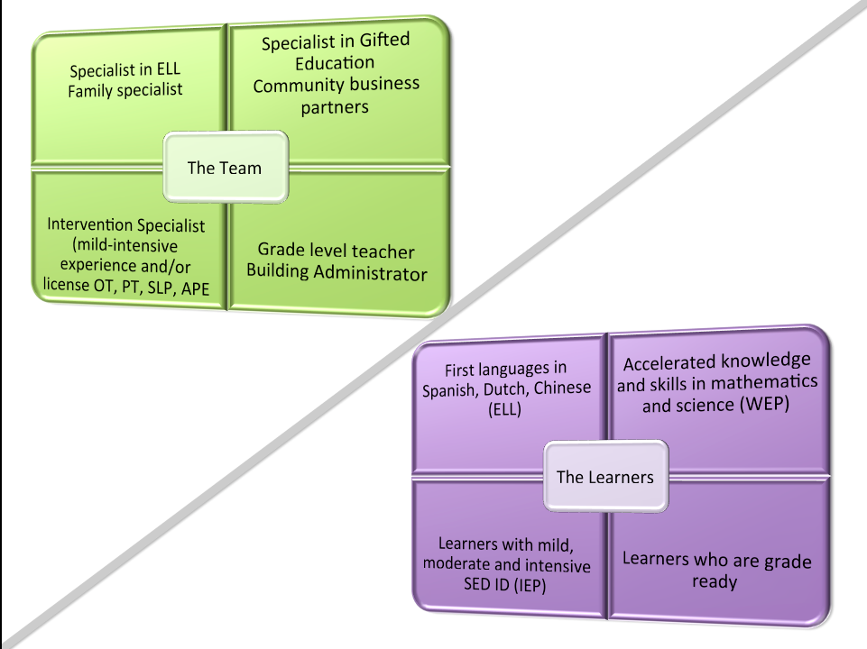
Notes:
Your planning team should be made up of professionals who mirror your learners to ensure that all learner needs will be met by using evidence based instruction strategies, methods and materials as detailed in special learning plans and be provided during first time instruction and assessment within Tier I by ALL professionals.
Students should never have to wait to fail or go to a certain location or professional to get what they need. Remember, learning occurs all day every day and all professionals on the grade level team must be “in the know” about how to best reach and teach ALL learners at that grade level.

Slide 21
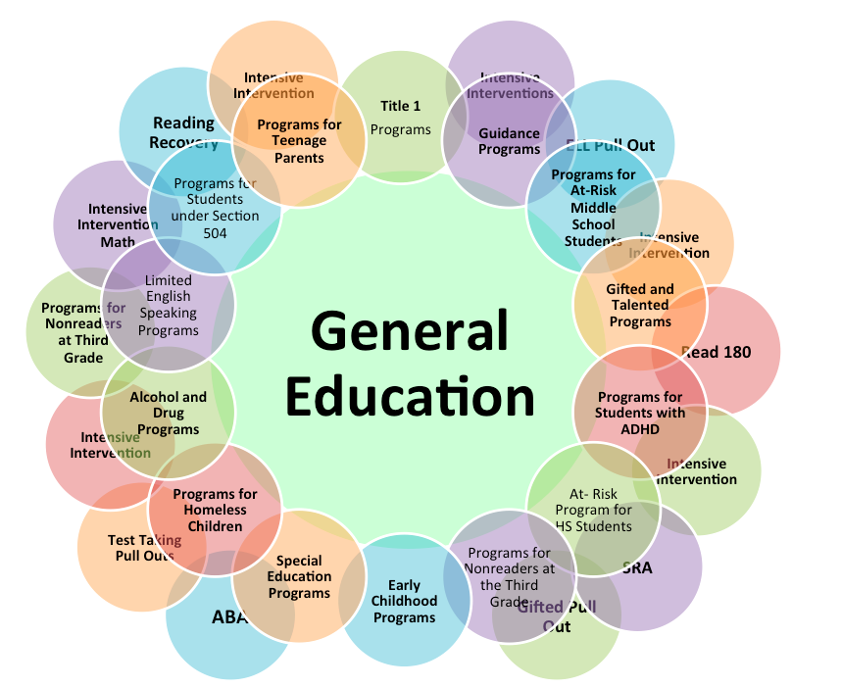
WITHOUT KNOWLEDGE schools have a culture of marginalization
By:
ability
race
disability
language
social class
social emotional wellness
Frattura, E. , 2012

Slide 22
Perspectives from the field
Investigating Root Causes of LRE Choices
Content Specialist Perspective:
“I was not trained to meet the very specialized needs of learners with disabilities, so I rely on the intervention specialist to meet their needs.”
What does this look like?
“Usually, we begin the class together
and then the IS takes those with
IEP’s out to re-teach and
complete the lesson”
“I don’t want the pace of some to
slow down the pace for others”
Intervention Specialist Perspective:
“I am worried that my students will not have access to their IEP specified accommodations so I will just keep them in my room”
“I am usually not sure what we'll be covering in each class from day to day. I just try to walk around and help my kids”
“I feel like my job is to create materials on the fly
when I see that my students are struggling
with the lesson.”
“The IEP says direct instruction and 60 mins. of intervention so I pull them to provide both”
“Jimmy goes to inclusion class for science and has all other classes in the resource room”
Frattura, E. , 2012
Notes:
Barb

Slide 23
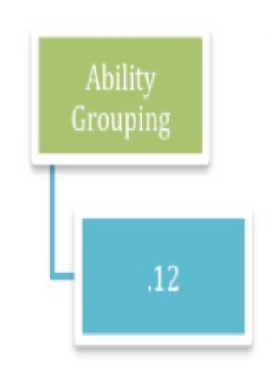
How do we move away from ability grouping and pull-out instruction?
Notes:
Teamwork, coaching, modeling, co-planning can promote integration and less pull-out.

Slide 24
ALL in - Focus on co-planning BEFORE co-teaching
Does current planning include these non-negotiables:
All team member expertise is shared in the planning to support learners in Tier I participation and engagement
Co-planning frame focuses work and conversations
Co-planning is captured in writing
Co-plan is housed in a shared virtual hub for all team member to access any time
Integrates flexible layers of support, service, accommodation, universal design and differentiation as provided in specialized learning plans
Notes:
Non-Negotiable #3

Slide 25
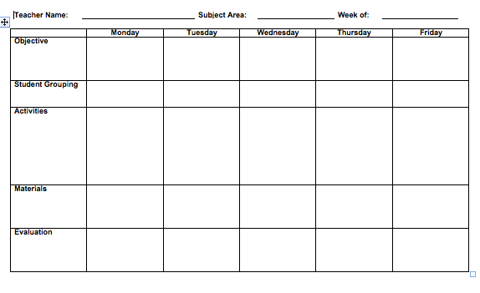
Traditional Planning Structures Do they capture all voices at the planning table?
Do they represent all learner needs?
Notes:
tell about calls from the field from team members who are just in the room but not heard
having a voice at the table for all members

Slide 26
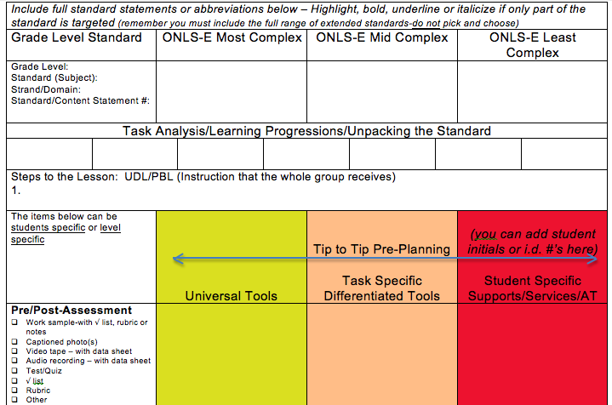
Sample Planning That Includes ALL (Regardless of LRE)

Slide 27
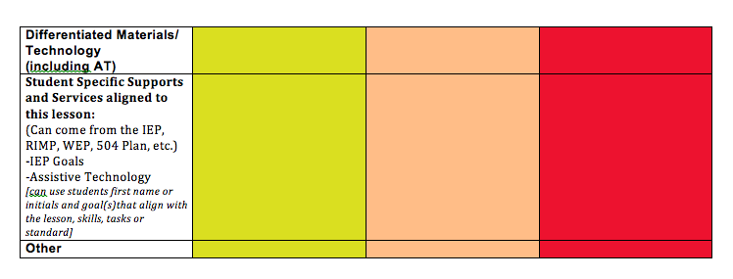
A Missing Link
Integrate UDL/DI/AT into co-planning
Notes:
Planning can take many forms. This is an example of leveled planning for diverse groups of learners. After pre-assessments are given student level of support and specific instruction based on pre-knowledge data can be determined.

Slide 28
Activity
Supports and services list and sort:
Make a list of supports and services from one class or grade level – across all learners that adults would provide during instruction (RIMP, WEP, IEP, 504, ELL, etc.)
Cluster like supports and services into groups
Which should become UDL features?
Which will be included in differentiated design features?
Which will remain student specific? (AT)
Notes:
WHAT ELSE DO YOU NEED TO KNOW???? This is what teachers struggle with. They have the basics, but need to know more to be able to plan accordingly. Have the right people and the right information at the table.
Roles assignrd
Admins recorder

Slide 29
IEP/RtI Supports and their effect on LRE
All of these layers can be offered in a single environment with flexible staffing and flexible grouping throughout the day
Tier 3
Specially designed instruction unique to the student’s career path, learning target(s), IEP’s and or adaptive skills
Tier 2
Targeted re-instruction based on assessment data
Priming of content and/or materials prior to instruction
Tier 1
Natural use of IEP recommended supports, services, personnel, AT, accommodations and scaffolds
Redesign of instructional tools, methods and materials, as needed
**Each and every student starts here**

Slide 30
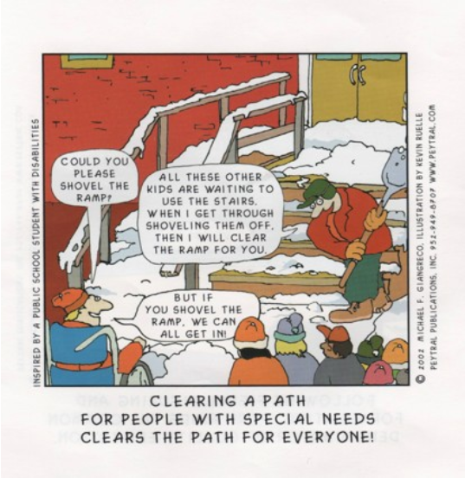
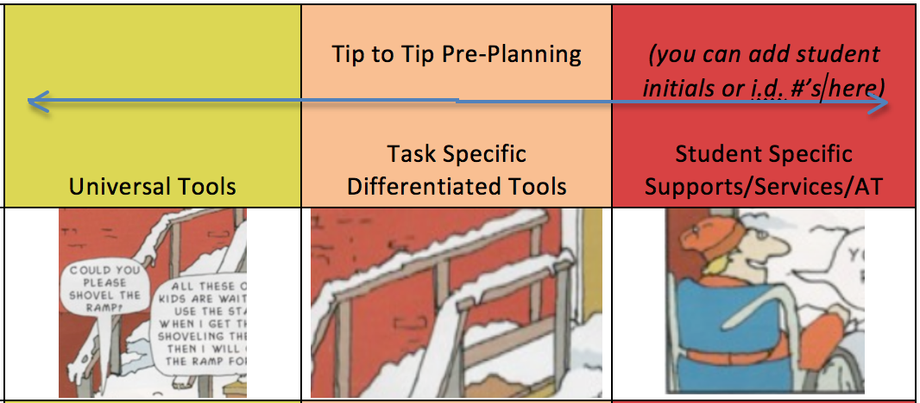
Do you remember this cartoon?
Let’s look at it once again more closely.
Notes:
What part of this image represents UDL - (planful design that is accessible and usable by all people all of the time)
What part of this image represents multiple means or differentiation - (planful design that is available to all people by flexible choice)
What part of this image represents Specially Designed Instruction/Assistive Technology - (planful design that aligns a specific learner to feature matched tools, methods or materials that are unique to a specific learner’s needs)

Slide 31
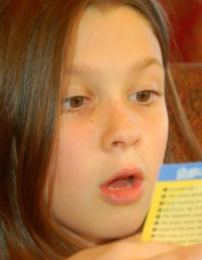
RtII
Notes:
All of these supports and services should be planned into Tier I instruction first and added to the other tiers as needed later.

Slide 32
Time for a perspective shift
What happens when we neglect to pre-plan with all layers of support?

Slide 33
When I was presented with text I couldn’t read I…
Asked to use the pass
Got into trouble so you would ask me to leave
Pretended to read while you watched
Listened to the comments of my classmates and added a comment or two to piggyback on to what they said
Felt dumb
Shut down
Gave up
Made excuses
Asked someone for help
Went home and used my computer to scan in the text and had the computer read it to me

Slide 34
When I attend classes with my peers but I am not provided my AT tools that I have access to in therapy or intervention I…
Feel like a fool just sitting there
Get frustrated and angry
I don’t ask for help
I ask for help every 5 seconds
Crack jokes about how dumb this lesson is
I group myself with a peer who will do the work
Entertain myself usually resulting in some type of reprimand
Try me best but can’t show half of what I really know or can do

Slide 35
When I was presented with a writing task about content I know but can’t spell the words I…
Waited to go home to complete the writing because my mom, friend or sibling will type what I tell them
Used my cell phone texting app that lets me speak and it writes my words into the text box and I just copied those
Broke my pencil
Gave up and didn’t turn in the assignment
Write a few words on a page that didn’t make sense
Wrote using words I can spell but not what I was thinking
Saved the work for my intervention period were I knew I could get help

Slide 36
When people talk to me with no expectation that I will respond because I am not traditionally verbal I…
Discredit what you say to me
Feel frustrated, mad and stupid
Gag when you use that baby sing-song voice
Roll my eyes
Look away
Stare back at you intently, thinking if I say the words in my mind you might hear my answer
Wish I had a way to communicate so you know I am “in here”

Slide 37
When you provide assistance without asking (including touching me and my stuff) I…
Want to scream or lash out
Feel like you think I can’t do this myself
Think you must be frustrated with me
Feel violated
Give you a mean look
Eventually give up and just wait for you to come along because I know you will do it for me
Think I am doing something wrong
Shut down

Slide 38
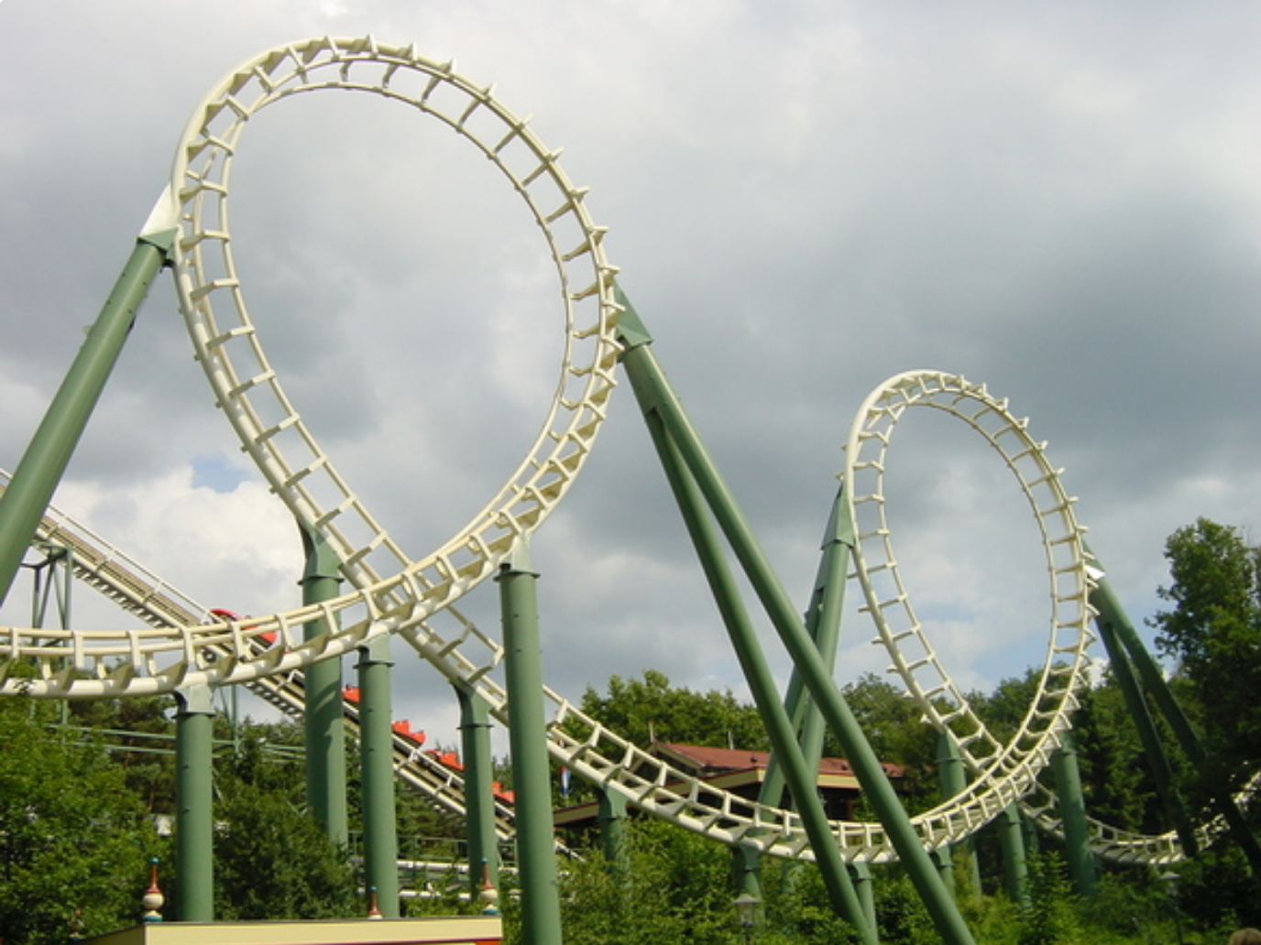
ALL in - STOP the rollercoaster ride
Gr. 1 BEST teacher ever! Learning is fun and engaging.
Gr. 4 I finally learned to read.
Gr. 2 Horrible year - no access to IEP supports in inclusion class.
K Learning the ropes.
Gr. 3 My teacher thinks I am dumb.

Slide 39
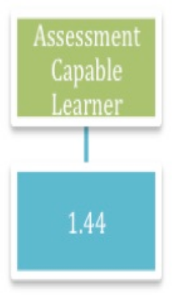
ALL in - Focus on inclusive assessment design and data collection
Notes:
Non-Negotiable #4

Slide 40
Unpacking the Standards
Identify the grade level standard
Identify the noun(s) in the standard – What students will learn
Identify the verb(s) in the standard – How students will demonstrate learning – if provided (or this could be flexible)
Identify the context – if provided (or this could be flexible)

Slide 41
Unpacking Standards Template
Standard | What would students need to DO (verbs)… Lower Order (Remembering, Knowledge, Understanding, Comprehension) | What would students need to DO (verbs)… Higher Order (Analyzing, Evaluating, Creating, Synthesis) | Learning Targets/Goals
Target Type
__Knowledge __Reasoning __Skill __Products
Key Knowledge What would students need to KNOW (nouns)… (Key vocabulary to define, discuss, and model for students) |  |  | Assessment How will you know that students have MASTERED the content?
***Remember if it is not stated in the standard it remains flexible for design***

Slide 42
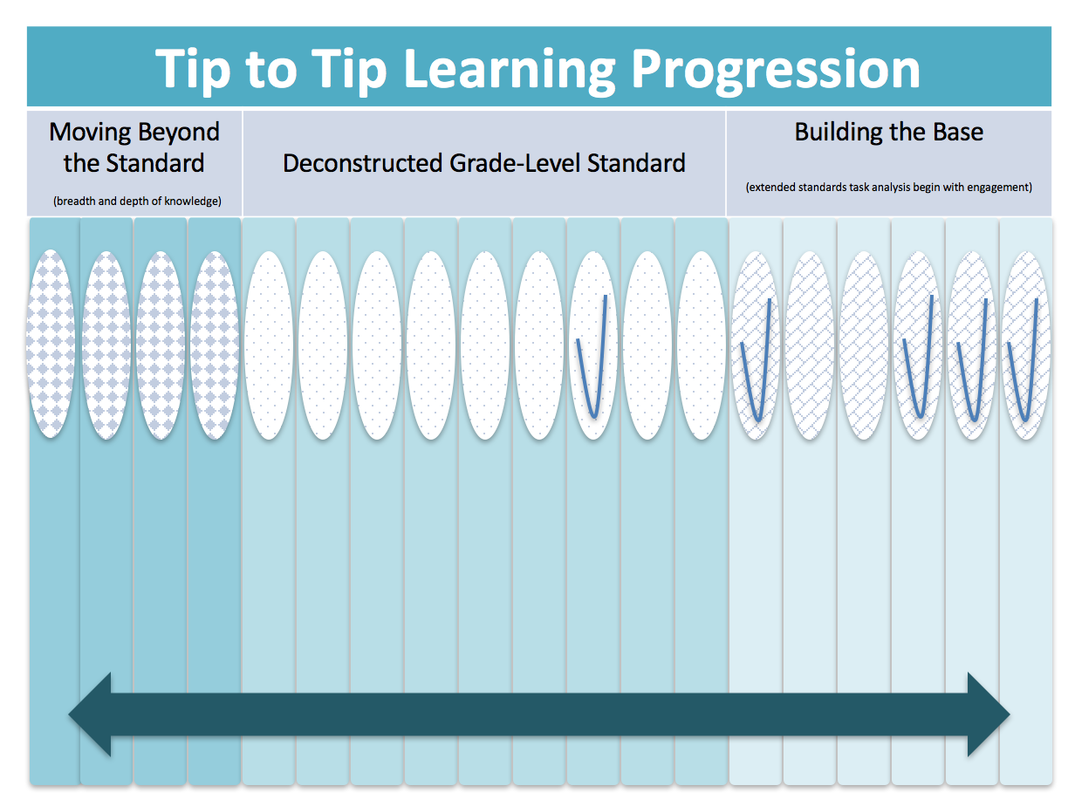

Slide 43
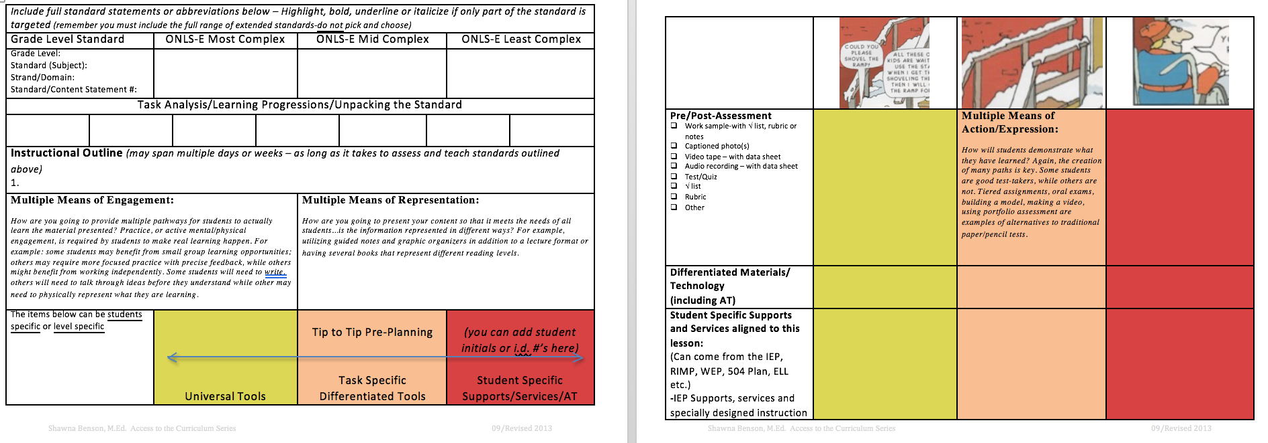
Co-Planning
Bridging the gap between standards and learners

Slide 44
Select a grade-level standard
Identify the noun(s) (what) and the verb (how) in the selected standard
Unpack the standard by writing each skill or bit of knowledge essential to completing the whole standard
Sequence deconstructed skills and knowledge into sequential order
Add 3 extended standards into the Building the Base section deconstruct these skills further with a beginning point of engagement in standard skill or concept
Copy and paste learning progression, planning tools and assessment design

Slide 45
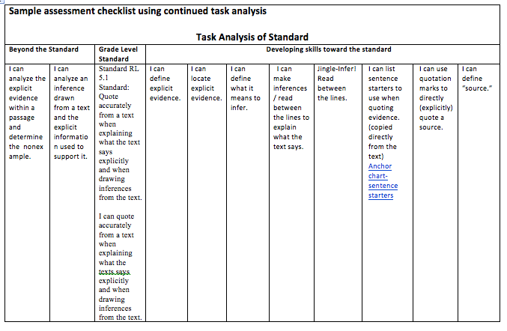
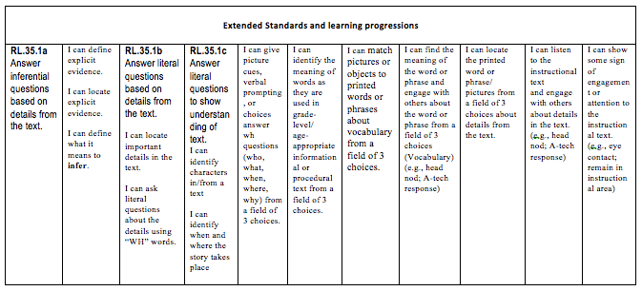
Sample Tip-to-Tip Learning Progression
Notes:
Standards should be deconstructed to detail learning progressions, entry points and learning targets for ALL learners.

Slide 46
Sample Grade Card/Progress Report Using Learning Progressions

Slide 47
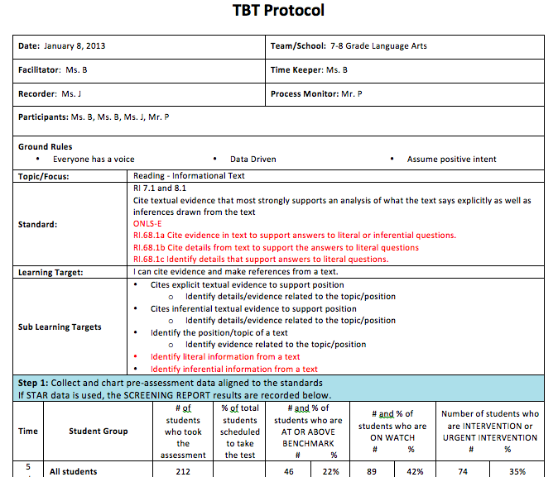
Embedding Learning Progressions into the TBT Process

Slide 48
Ponder this: Current Systems Barriers
Examine the systems we put in place that set up barriers to co-planning and co-serving learners.
What are some structures that present barriers?
How are learners and professionals organized?
How are ALL professional talents utilized and shared?
Take a critical look at learners in data based subgroups (SWD’s, race/ethnicity, socio-eco.)
…Are your current practices conducive to or in opposition to your goals in redesigning roles and improving learning outcomes?

Slide 49
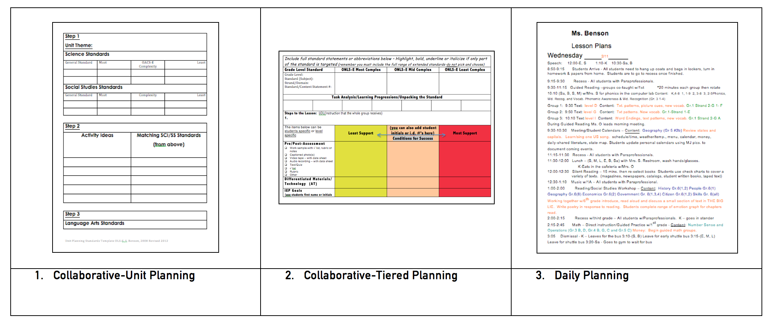
Layers of Planning *we’ve got a template for that*

Slide 50
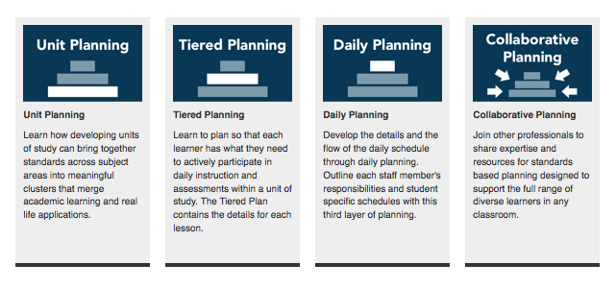
http://www.ocali.org/project/TDL_planning

Slide 53
Please feel free to contact me:
Shawna Benson
Program Director -Teaching Diverse Learners Center at OCALI
330-464-4294
shawna_benson@ocali.org

