Slide 1
Behavior: Optional Forms

Slide 2
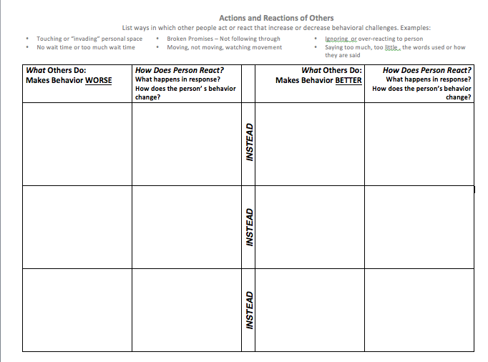

Slide 3
5
What REPLACEMENT skill needs to be taught to and used by the Individual?
This skill will serve the same FUNCTION as the behavior of concern (Step 2 and 4)
6
Interventions to Address Behavior
Plan to Teach and Reinforce REPLACEMENT Skills
INTERVENTION. Will a specific intervention(s) be used to teach teach the new skill? (EBP)
LEARNING STYLE. What strategies or methods will be used to improve learning and skill development that match the individul’s learning style and need (Step 3)
ENVIRONMENTAL MODIFICATIONS. What modifications to the environment (Step 1 and 3) will be necessary to achieve an environment that is supportive of learning new skills and may also reduce setting events or triggers (Step 2)? Modifications include modifications in the way others act and react.
SENSORY. Will the person require sensory/biological adaptations or interventions (Step 1&3) to promote learning and using the new skill or to reduce setting events and triggers (Step 2) ?
SOCIAL AND COMMUNICATION. What social-emotional and communication supports (Step 1 and 3) will be needed? How will instruction in these areas be provided to promote learning the replacement skill or to reduce setting events and triggers (Step 2)? Interventions and Supports include modifications in the way others communicate to the person.
REINFORCE. Ways to add Motivation and Reinforcement (Step 3)
DATA. How will progress towards the new skill be measured (Data worksheet)?

Slide 4
What RELATED Skills should be taught to improve the individual’s access to and
participation in LRE? (Step 4)
5
6
Interventions to Address Behavior
Plan to Teach and Reinforce RELATED Skills
INTERVENTION. Will a specific intervention(s) be used to teach teach the new skill? (EBP)
LEARNING STYLE. What strategies or methods will be used to improve learning and skill development that match the individual’s learning style and need (Step 3)
ENVIRONMENTAL MODIFICATIONS. What modifications to the environment (Step 1 and 3) will be necessary to achieve an environment that is supportive of learning new skills and may also reduce setting events or triggers (Step 2)? Modifications include modifications in the way others act and react.
SENSORY. Will the person require sensory/biological adaptations or interventions (Step 1&3) to promote learning and using the new skill or to reduce setting events and triggers (Step 2) ?
SOCIAL AND COMMUNICATION. What social-emotional and communication supports (Step 1 and 3) will be needed? How will instruction in these areas be provided to promote learning the replacement skill or to reduce setting events and triggers (Step 2)? Interventions and Supports include modifications in the way others communicate to theindividual.
REINFORCE. Ways to add Motivation and Reinforcement (Step 3)
DATA. How will progress towards the new skill be measured (Data worksheet)?

Slide 5
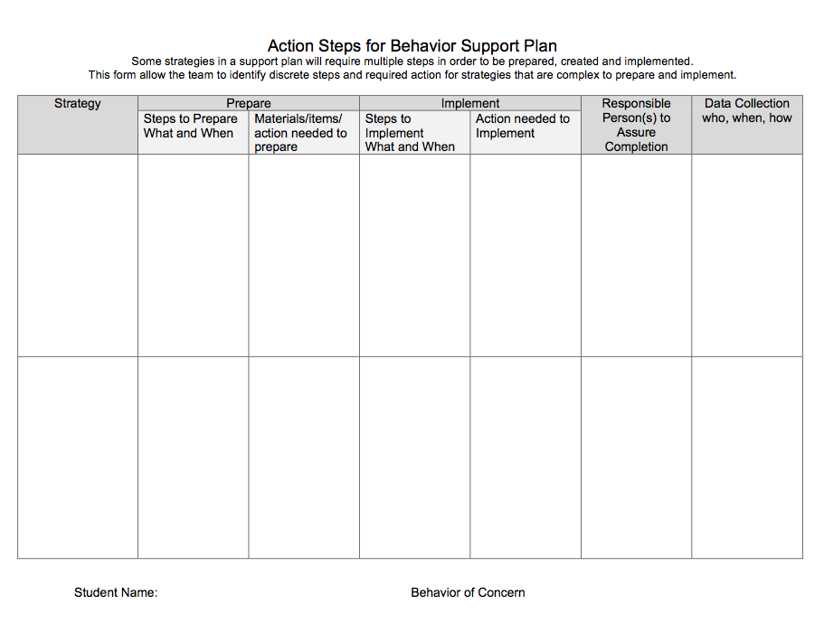

Slide 6
