Slide 1
Behavior: Process Forms (to be Completed by Team)

Slide 2
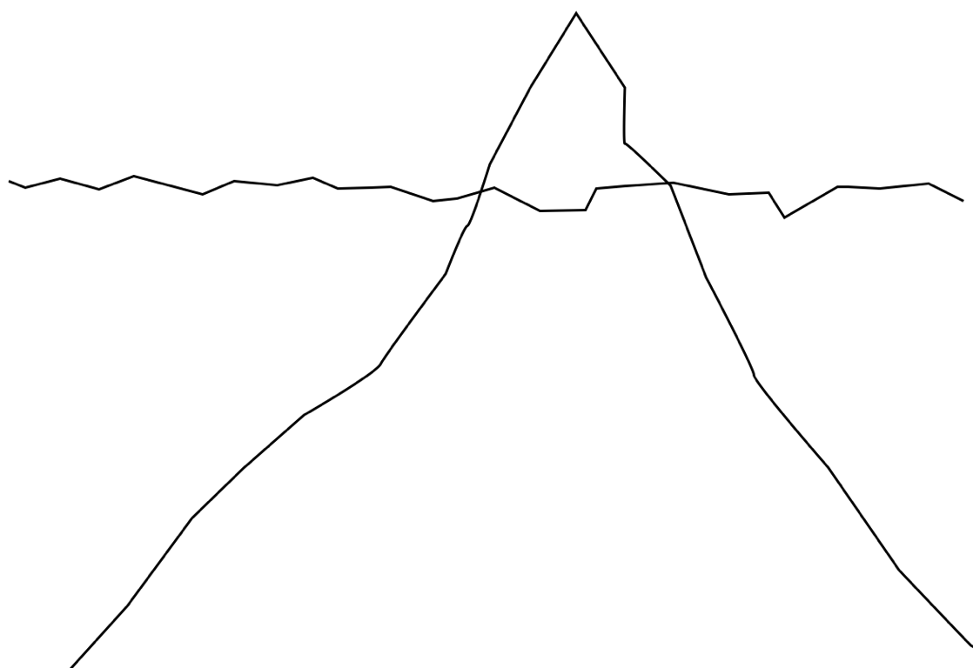
Antecedents
BEHAVIOR OF CONCERN
Consequences
Setting Events
Triggers
Factors that Increase the Behavior (Reinforcement)
Notes:
Given the behavior, pull out some antecedent, setting events, and triggers. Then some consequences and reinforcements. Then, make a hypothesis about what is increasing or decreasing the targeted behavior.

Slide 3
Data and Your Individual
Behavior
What are you going to measure? And when?
What would be the best way to measure?
Who is going to create the data sheet?
Who will be responsible to track the data? Graph the data?
When will the team meet to review data?
Notes:
Give 10 minutes to consider these questions for own student

Slide 4
Social, Emotional and Communication Challenges | Social, Emotional and Communication Challenges | Social, Emotional and Communication Challenges | Sensory/Biological Sensitivities and Preferences Impact of Medical Concerns | Learning Challenges and Uneven Skill Development | Difficult to Motivate Narrow Areas of Interest | Environmental Mismatch and Change

Slide 5
Individual Challenges Related to Behavior
(To Help Identify Antecedents and Consequences)
Individual Strengths Related to Behavior
(To Help Identify Strategies)
3
1
Learning Challenges and Uneven Skill Development
Environmental Mismatch and Change
Sensory/Biological Sensitivities and Preferences Impact of Medical Concerns
Social, Emotional &Communication Challenges
Difficult to Motivate & Narrow Interests
 | Learning and Skill Development
 | Environmental Matches
 | Sensory/Biological Preferences
 | Successful Social, & Communication
 | Motivation & Interests
2
4
What are the Underlying Contributors to and Function of the Behavior (THE “WHY WORKSHEET”)
When ___________ is faced with the stressors of these setting events ______________________________________
_______________________________________________________________________________________________
and these immediate triggers _______________________________________________________________________
he/she engages in the identified behavior (above) which results in this type of reinforcing consequence ______________________________________________________________________________________________.
These identified factors result in the behavior serving the following function(s) or benefit(s) for the individual (1 or more):
A Sensory Experience or Physiologic Benefit : __________________________________________
A Desired Object , Person, Activity or Experience: ______________________________
An Escape from an undesirable Task, Activity, Person, etc.: ___________________
A Way to Communicate: _______________________________________________________________
Other Functions:
WHAT’S MISSING?
Behaviors are indications of a missing or needed skill that will address issues identified in Step 2.
What skills does the individual need (that were NOT identified in Step 3) in order to change the behavior of concern?
(Example: Social, Communication, Academic, Coping, Emotional Regulation, Self Help, etc.)
Notes:
List on flip chart/give each table one section

Slide 6
THE WHY WORKHEET: What is Causing the Behavior? Why Does it Continue?
Review what you have discovered
When _____________ is faced with these Setting Events……
And these Immediate Triggers…
S/he engages in this Behavior:
Which results in these Reinforcing Consequences
Function of the Behavior. Based on the information of the above setting events, triggers and consequences, _______________ receives the following benefit(s) or function(s) from the behavior (select one or more):
Obtains a Desired Object , Person, Activity or Experience | What is Obtained?
 | Why does s/he want this?
Sensory Experience or Physiologic Benefit | What is the sensory experience/benefit?
Escapes an undesirable Task, Activity, Person or experience: | What is escaped?
 | Why does s/he wish to escape this?
Provides Communication | What is he/she communicating?
Other
Worksheet for Step 2

Slide 7
Begin with Success: Recognize the Individual’s Strengths, Preferences, Interests
Your individual
Communication
Physical Attributes
COPING SKILLS
Academically related areas
Functional Skills
Work Habits
Self Monitoring and Self Regulation of Sensory Needs
Personality
Motivators and Reinforcers
Self Determination Skills
Social Competencies
Notes:
Give 15 minutes to work on own student’s strengths

Slide 8
What REPLACEMENT skill needs to be taught to and used by the Individual? This skill will serve the
same FUNCTION as the behavior of concern (Step 2 and 4)
5
What RELATED Skills should be taught
to improve the Individual’s access to and
participation in LRE? (Step 4)
5
Interventions to Address Behavior
Plan to Teach and Reinforce REPLACEMENT Skills
INTERVENTION. Will a specific intervention(s) be used to teach the new skill? (EBP)
LEARNING STYLE. What strategies or methods will be used to improve learning and skill development that match the person’s learning style and need (Step 3)
ENVIRONMENTAL MODIFICATIONS. What modifications to the environment (Step 1 and 3) will be necessary to achieve an environment that is supportive of learning new skills and may also reduce setting events or triggers (Step 2)? Modifications include modifications in the way others act and react.
SENSORY. Will the individual require sensory/biological adaptations or interventions (Step 1&3) to promote learning and using the new skill or to reduce setting events and triggers (Step 2) ?
SOCIAL AND COMMUNICATION. What social-emotional and communication supports (Step 1 and 3) will be needed? How will instruction in these areas be provided to promote learning the replacement skill or to reduce setting events and triggers (Step 2)? Interventions and Supports include modifications in the way others communicate to the person.
REINFORCE. Ways to add Motivation and Reinforcement (Step 3)
DATA. How will progress towards the new skill be measured (Data worksheet)?
6
Plan to Teach and Reinforce RELATED Skills
INTERVENTION. Will a specific intervention(s) be used to teach teach the new skill? (EBP)
LEARNING STYLE. What strategies or methods will be used to improve learning and skill development that match the person’s learning style and need (Step 3)
ENVIRONMENTAL MODIFICATIONS. What modifications to the environment (Step 1 and 3) will be necessary to achieve an environment that is supportive of learning new skills and may also reduce setting events or triggers (Step 2)? Modifications include modifications in the way others act/ react.
SENSORY. Will the individual require sensory/biological adaptations or interventions (Step 1&3) to promote learning and using the new skill or to reduce setting events and triggers (Step 2) ?
SOCIAL AND COMMUNICATION. What social-emotional and communication supports (Step 1 and 3) will be needed? How will instruction in these areas be provided to promote learning the replacement skill or to reduce setting events and triggers (Step 2)? Interventions and Supports include modifications in the way others communicate to the perosn.
REINFORCE. Ways to add Motivation and Reinforcement (Step 3)
DATA. How will progress towards the new skill be measured (Data worksheet)?

Slide 9
Reinforcement and Your Individual
List what is reinforcing to your individual. If you aren’t sure, what are you going to do to find out?
What type of reinforcement would work best for the individual and targeted skills? Consider intrinsic/extrinsic motivators.
What will be the schedules of reinforcement: -how often -how much -who is giving -how will you record data about it -when/how will you review, update, revise
Notes:
Give 10 minutes to consider for own student

