Slide 1
What is New at PRC?
Presented by
Elyse Pycraft, M.S., CCC-SLP
Jennifer Monahan, M.S., CCC-SLP
Monica Stevens, M.S., CCC-SLP, M.A., CCC-A

Slide 2
What is New at PRC?
Welcome! My name is Jennifer Monahan, MA, CCC/SLP I am a salaried, regional consultant of the Prentke Romich Company and am also one of more than 100 employee owners.
If you have questions about this information, feel free to ask me or call PRC at 1-800-262-1984.

Slide 3
What is New at PRC? Devices
The new Accent 1400 device
New 2.01 Software update (mid May)
The NuPoint unit – Head pointing with an integrated look
Continue to offer the Accent 1000, and Accent 800 devices
Touch Guides
Keyguards
Bluetooth Switch
IR Chip in the 1400 for device commands

Slide 4
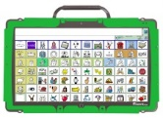
What is New at PRC? Devices
Dimensions: 14.1"w × 8.9"h × 1.8"d
Weight: 5.9 lbs.
Display Size: LCD IPS 14"
Synthesized Speech with unlimited Digitized Speech Capacity
Battery Life: 18-20 hours standard battery
Battery Life with NuEye: 10-12 hours
Language Activity Monitoring (LAM)
3 - 2.0 USB Ports; 1 - 3.0 USB Port
2 - Switch Scanning Ports
Full SD card slot
HDMI port
4GB RAM
128GB of storage

Slide 5
What is New at PRC? Devices
Built for durability with a high impact case and magnesium frame
Integrated device with synthesized voices
Built in Wi-Fi™ connectivity for PRC software updates and remote services
Context-Sensitive Help built right into the device for fast answers that are easy to access
Smooth, high-definition, 14” touch-screen display with wide viewing angle
Daylight readable display
Easy to clean and sealed for protection from moisture and spills
Carry handle for portability
Mounting bracket for wheelchair and table stands
Enhanced audio provides superior sound and clarity
Front and rear cameras

Slide 6
What is New at PRC? Devices
Integrated Bluetooth® connectivity
Expanded Bluetooth for phone interface
Enhanced IR controls give the user freedom to control their environment
Windows® 8.1 operating system powered by Intel Haswell processor
Built-in user manual
Accessibility: Direct Selection, Single- or Dual-switch Scanning, Eyegaze using NuEye Tracking System, Headtracking using NuPoint Tracking System, USB Connectivity Allows use of Mouse, Joystick and Mouse Emulation Access Products
Voices: Nuance, Microsoft®, Ivona American English, Ivona American Spanish

Slide 7
What is new at PRC? Language Options
Unity®
CoreScanner™
Lamp WFL™
Essence™
Word Power™
Other options

Slide 8
What is New with PRC? Language Options
Unity®
Software dedicated to the dynamic display of the MinSpeak© designed by Bruce Baker
Many different home MAPs (MinSpeak Application Programs) to support any person’s needs
28, 36, 45, 60, 84, 144
Very adaptable for personal needs
Vocabulary builder to allow for gradual learning of set language communication board

Slide 9
What is New at PRC? Language Options
CoreScanner™
CoreScanner™ is a progressive language program specifically designed for individuals with physical disabilities, who best access augmentative communication technology through the use of a switch.
Set up with feedback menu features that aid in tracking and provide definitive background to foreground clarity
Based on access to most commonly used core words used by all languages at all ages

Slide 10
What is New at PRC? Language Options
LAMP WFL™
Language Acquisition through Motor Planning
Available in 84 key location on all devices and App for iPad
Available in 3 learning levels, One-hit, Transition, and Full
Designed to have only one set of hits to get to any word

Slide 11
What is New at PRC? Language Options
Essence
Program is for those with a fluent use and understanding of the English Language
Designed for access to a preferred Keyboard, word prediction, save utterances, and other technical devices desired

Slide 12
What is New at PRC? Language Options
WordPower™
Language developed by Nancy Inman
Available in 45, 60, and 84 location boards
Now available without additional charge
Uses Unity® symbols for icons
Can purchase PCS symbols for an additional charge

Slide 13
What is New at PRC? Language Options
Other Options
Symbol Stix are now available on all devices
Can purchase PCS
Unity available in English or Spanish
Make your own- From 1 key to 144

Slide 14
What is New at PRC? Support
Support is open Monday through Friday from 8:00 am to 7:30 pm
1-800-262-1990
Quick Reference Guides available online to support all devices
Access to the AAC Language Lab is available on the Home Page of our Website
PASS Demo Software is available for each device
Our Online newsletter is available to anyone who registers with us to receive email

Slide 15
What is New at PRC? Education
Training is available in numerous formats
Face to Face
Online
Self Study

Slide 16
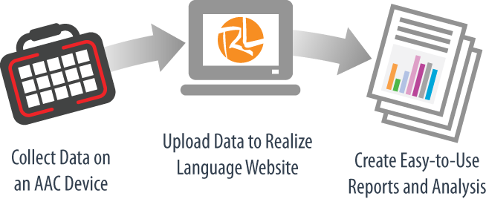
What is New at PRC? Support for Language Planning
Realize Language
Available to use with many communication devices, including PRC devices.
Will be wifi capable with PRC devices upon the 2.01 software release

Slide 17
What is New at PRC? Apps
LAMP WFL™
Language Learning Apps
Unity Connect
To search fro PRC products in the App Store, put Prentke Romich Company in your search bar

Slide 18
PRC Social Media Connections Learn about our latest AAC solutions and training opportunities. Connect with other AAC device users.
https://www.facebook.com/PrentkeRomichCompany.
http://twitter.com//PrentkeRomich
https://www.YouTube.com/PRCAccess

Slide 19
What is New at PRC?
If you have any questions, feel free to visit our booth today or you may contact me at the following options:
Jem.cons@prentromcom
1-800-262-1984 Ext.463
614-563-1410

