Slide 1
Assistive Technology: Enhancing greater independence, participation, and access in environments with remote supports.
Shawn Henry, Executive Director, OCALI
Jan Rogers, AT&AEM Center Program Director
Notes:
Jan Start 1-10

Slide 2
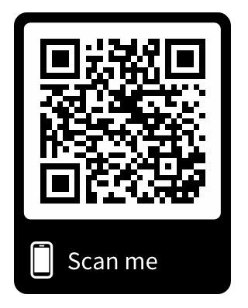
https://www.ocali.org/project/document_archive
TechnologyFirst_OCALI_Aug2018
Notes:
Accessible PPT

Slide 3
Federal Definition of AT Device and Services
AT Device - "any item, piece of equipment, or product system, whether acquired commercially off the shelf, modified, or customized, that is used to increase, maintain, or improve functional capabilities of individuals with disabilities.
AT Service-“any service that directly assists an individual with a disability in selection, acquisition or use of an assistive technology device.”
Technology Related Assistance to Individuals with Disabilities Act of 1988 (Tech Act)

Slide 4
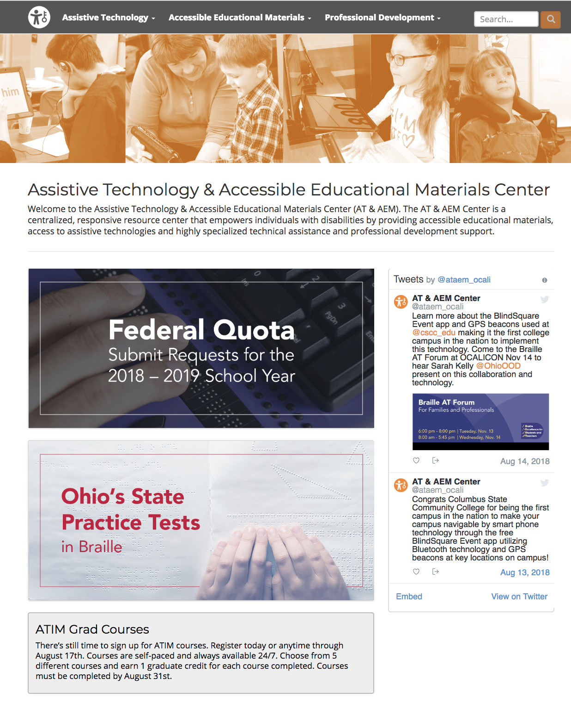
AT & AEM Center Website
https://ataem.org

Slide 5
AT Assessment
https://ataem.org/at-assessment

Slide 6
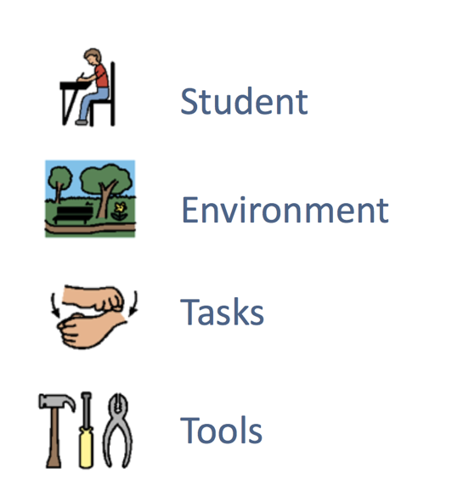
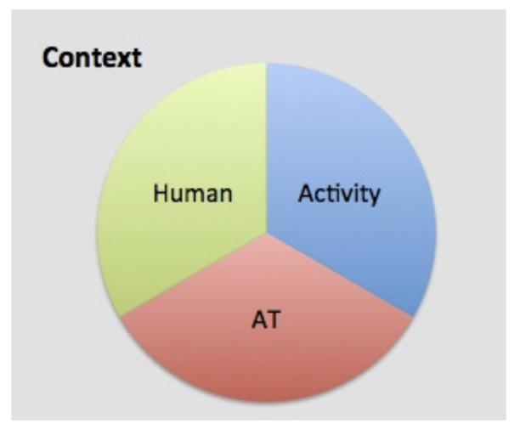
SETT Framework
HAAT
www.joyzabala.com
Cook & Hussey
Notes:
Add to the assessment area

Slide 7
AT Assessment
https://ataem.org/at-assessment

Slide 8
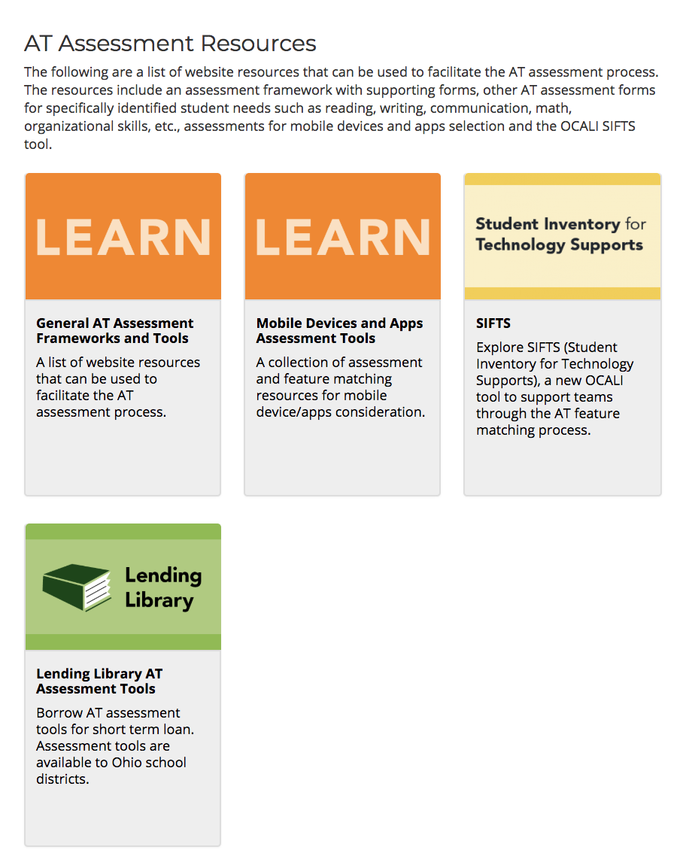
AT Assessment - AT Assessment Resources
https://ataem.org/at-assessment

Slide 9
AT Assessment - Frameworks and Tools
https://ataem.org/general-at-assessment-frameworks-and-tools

Slide 10
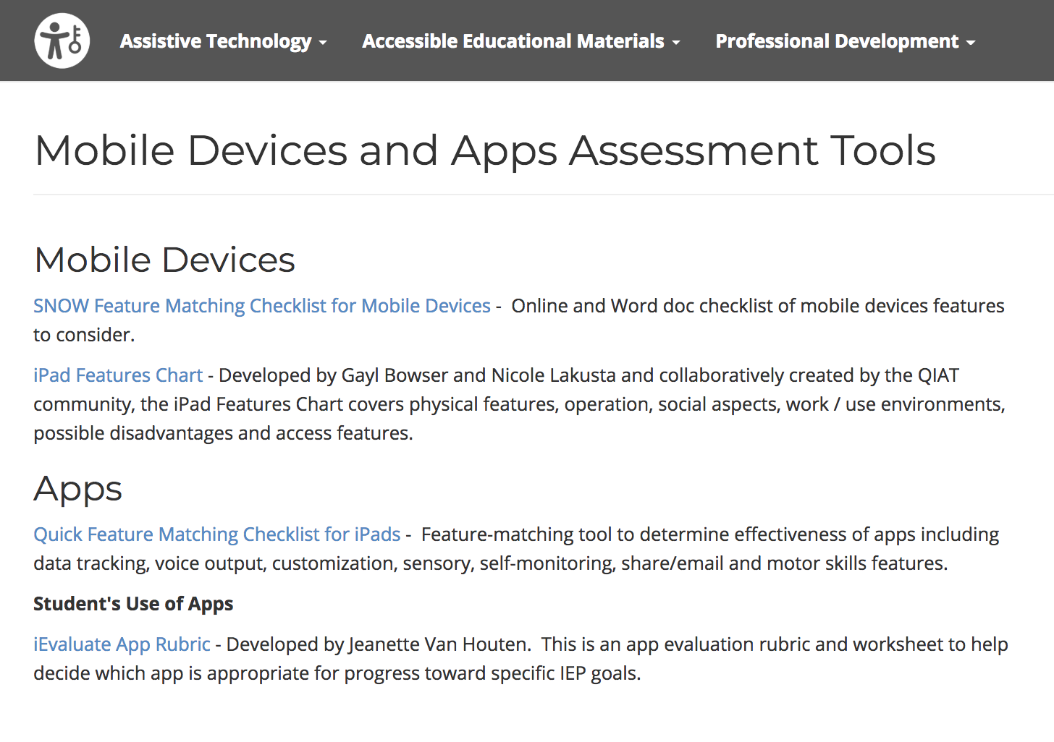
AT Assessment - Mobile Device and Apps Assessment Tools
https://ataem.org/at-assessment

Slide 11
Student Inventory for Technology Supports SIFTS
www.atfeaturematching.org

Slide 12
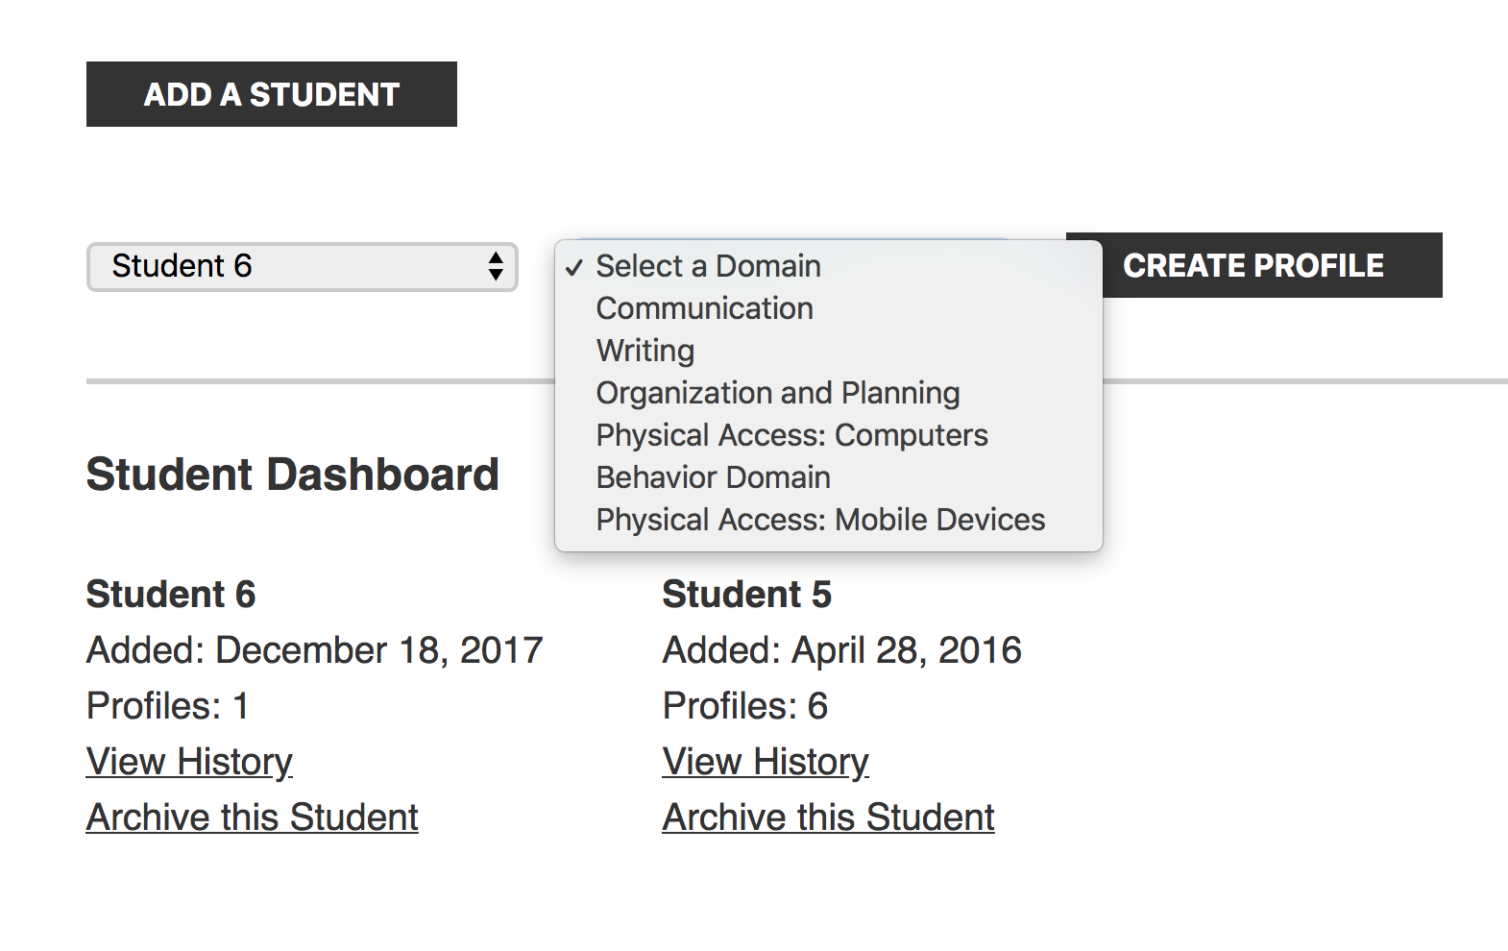
SIFTS Student Dashboard
www.atfeaturematching.org
Notes:
Emphasis that it can be used for anyone (lifespan)

Slide 13
SIFTS
Survey Questions
www.atfeaturematching.org

Slide 14
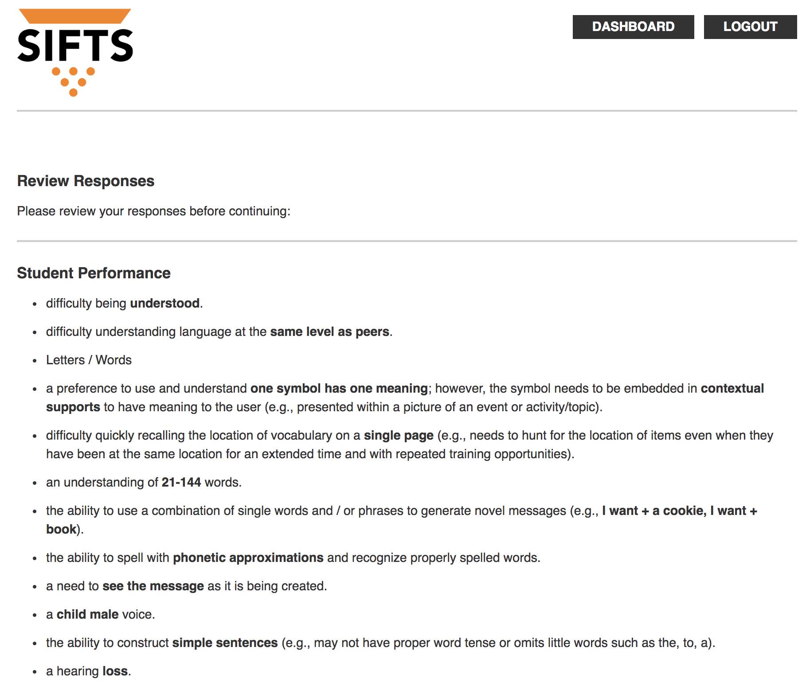
SIFTS
Student Performance
www.atfeaturematching.org

Slide 15
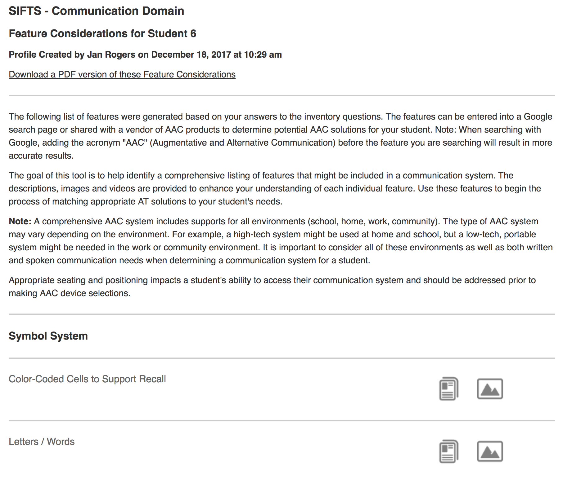
SIFTS
Feature Considerations
www.atfeaturematching.org

Slide 16
SIFTS
Features with
text descriptions, pictures, and video
www.atfeaturematching.org

Slide 17
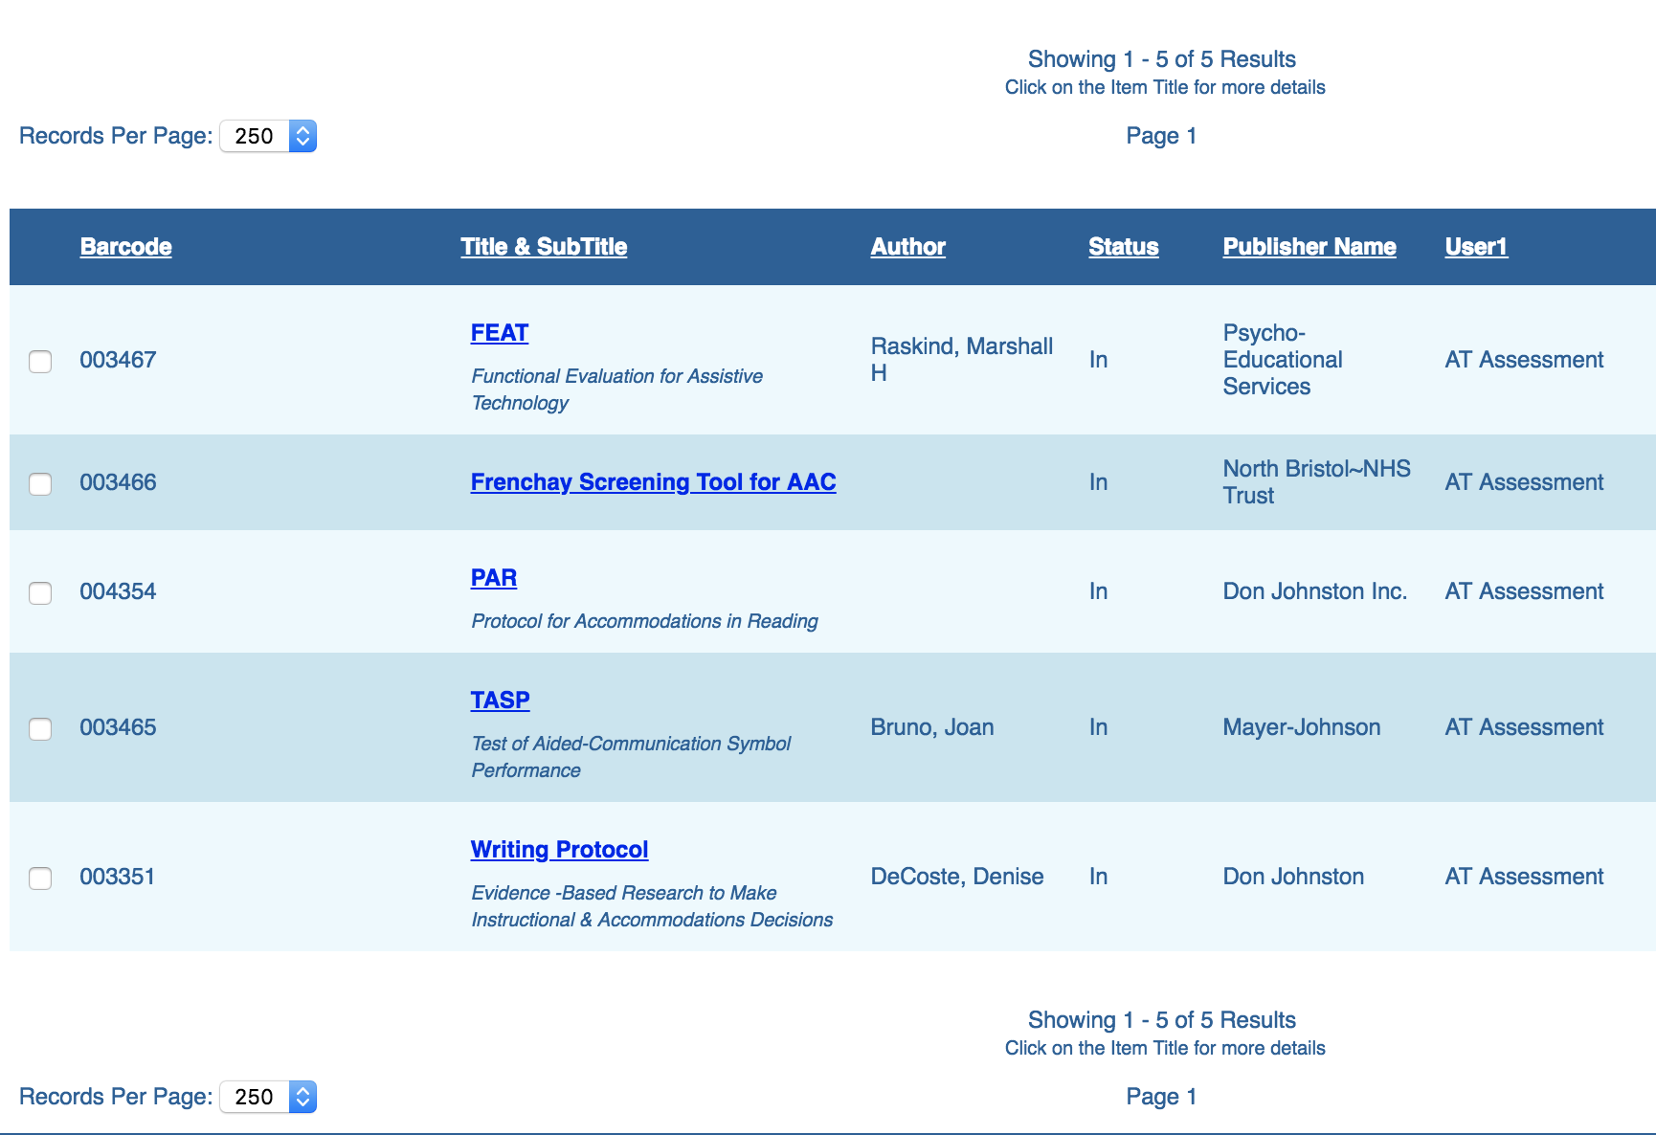
OCALI Lending Library - Assessment Tools
https://ataem.org/at-assessment

Slide 18
AT Tools
https://ataem.org/at-tools

Slide 19
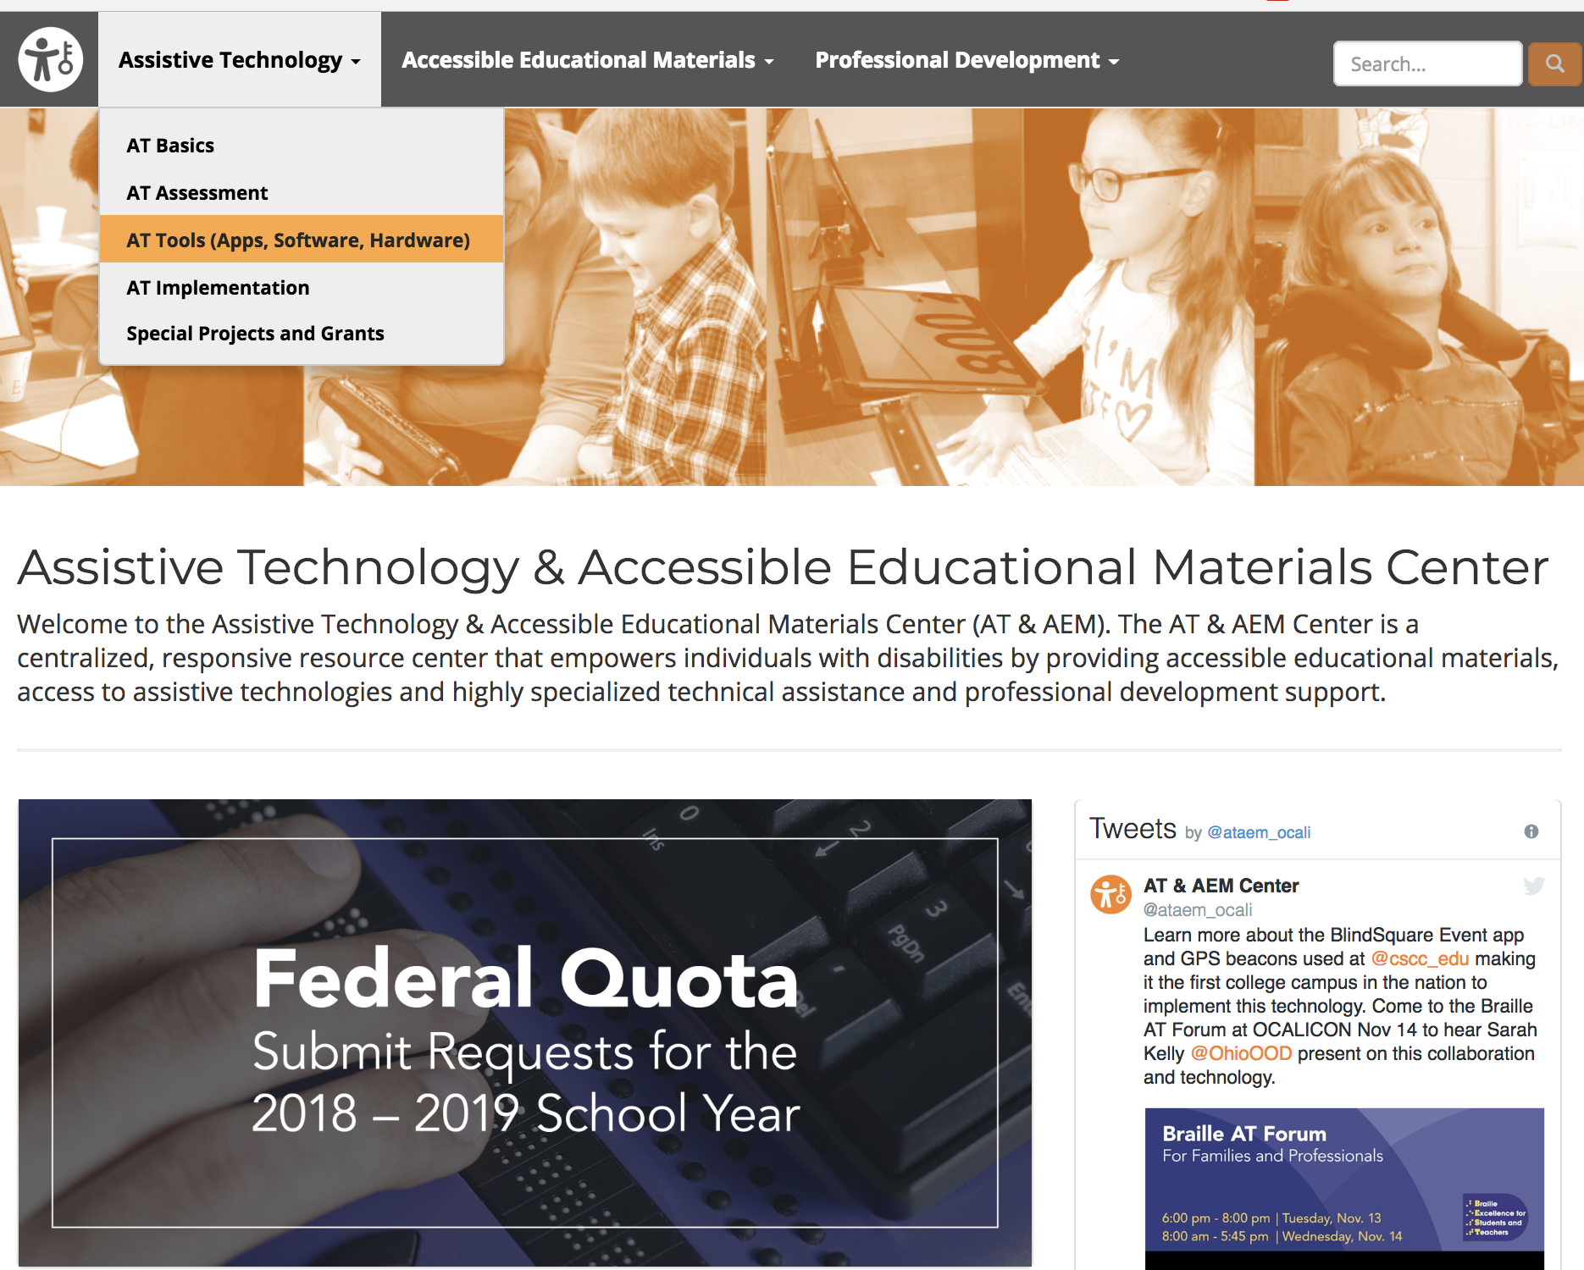
AT Tools
https://ataem.org/at-tools

Slide 20
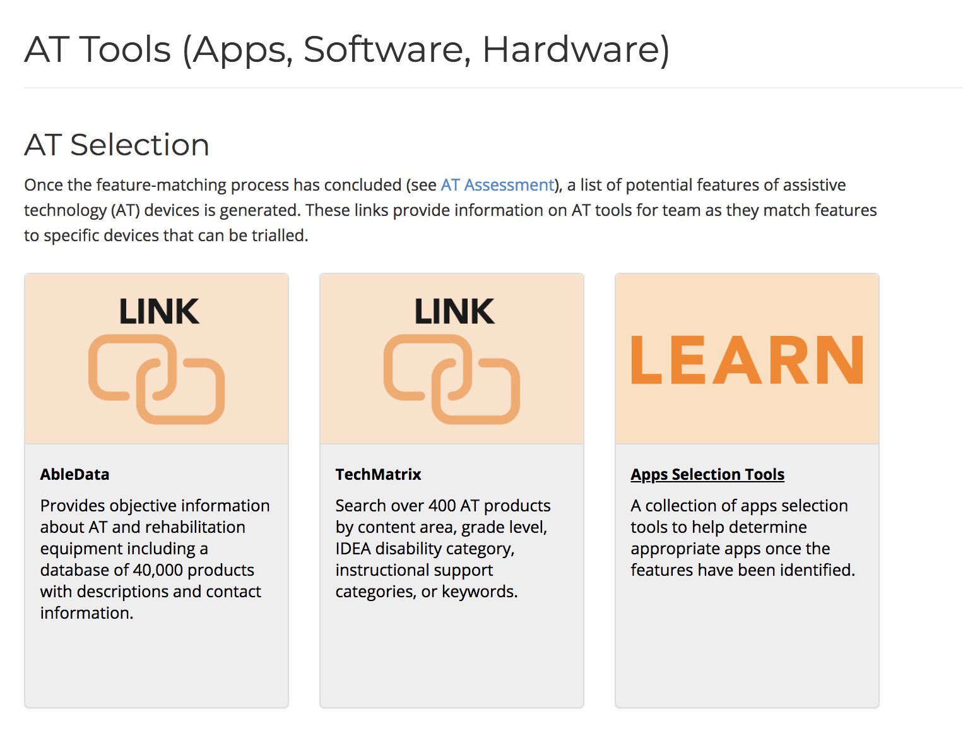
AT Selection
https://ataem.org/at-tools

Slide 21
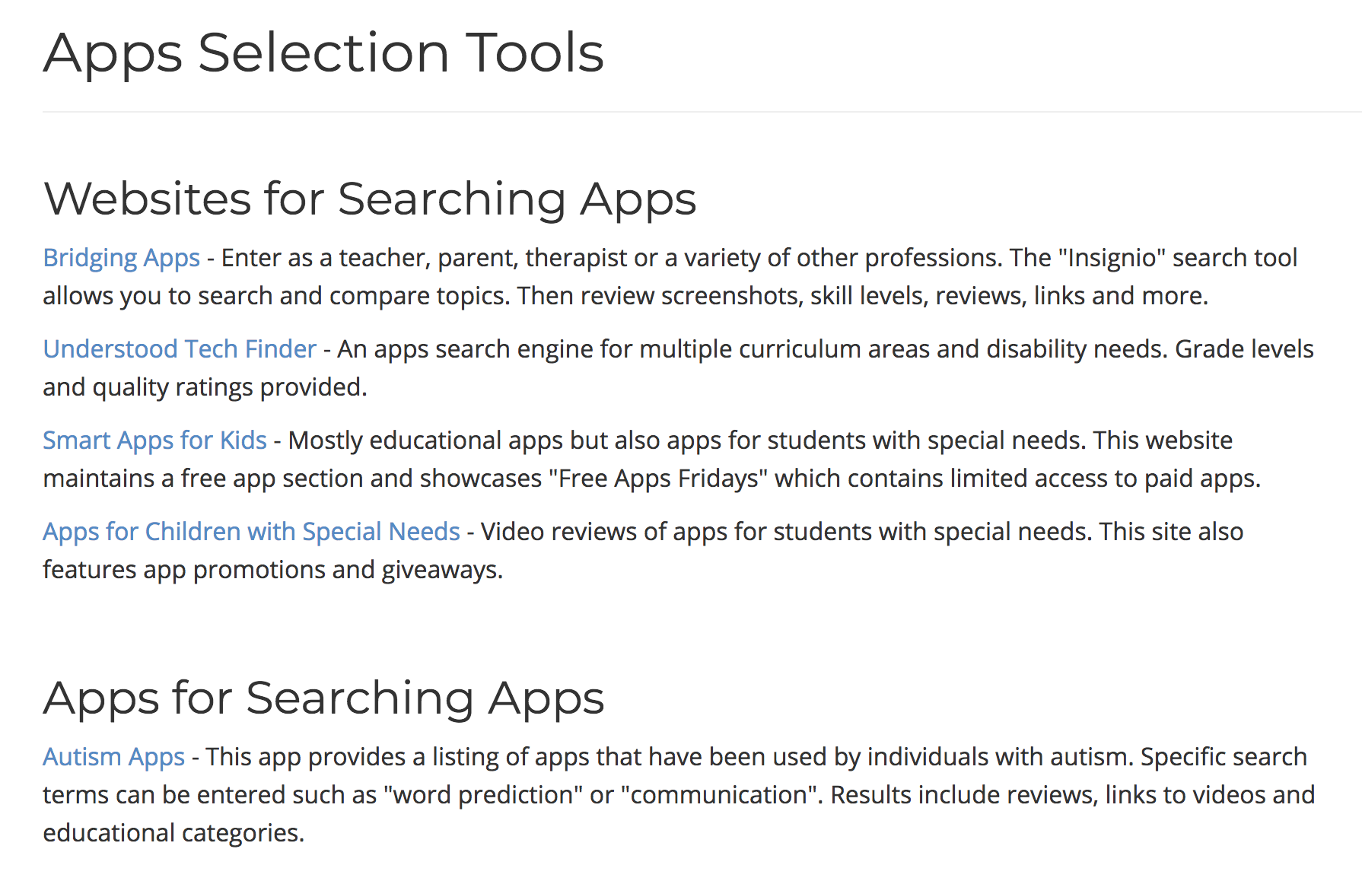
App Selection Tools
https://ataem.org/at-tools
Notes:
Bring a couple of kits (organization, switch access of iPad)

Slide 22
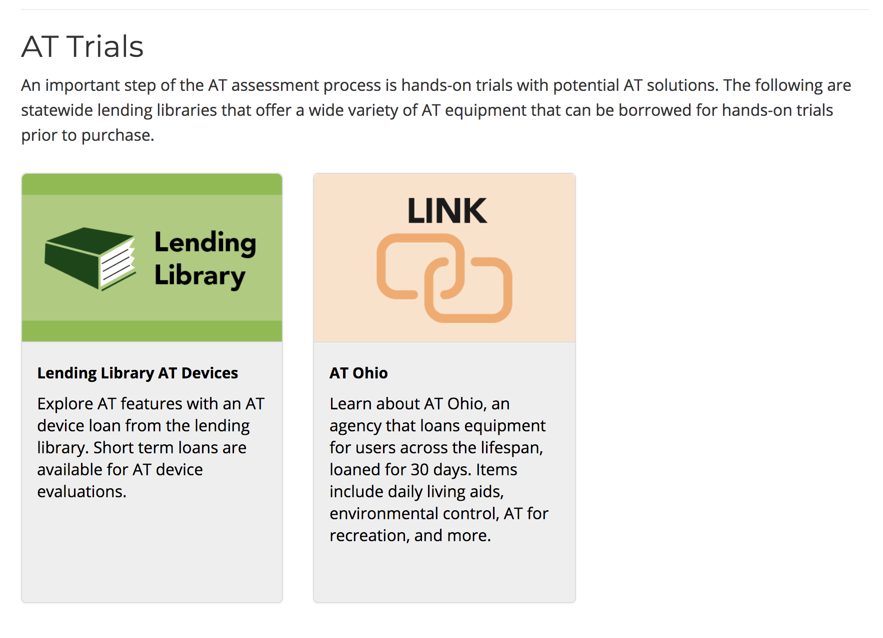
AT Trials
https://ataem.org/at-tools
Notes:
133 items,
33 kits with a focus on specific areas of support (organization, reading, writing, math, low vision, blind, communication iPads, hearing, positioning, sensory, etc)

Slide 23
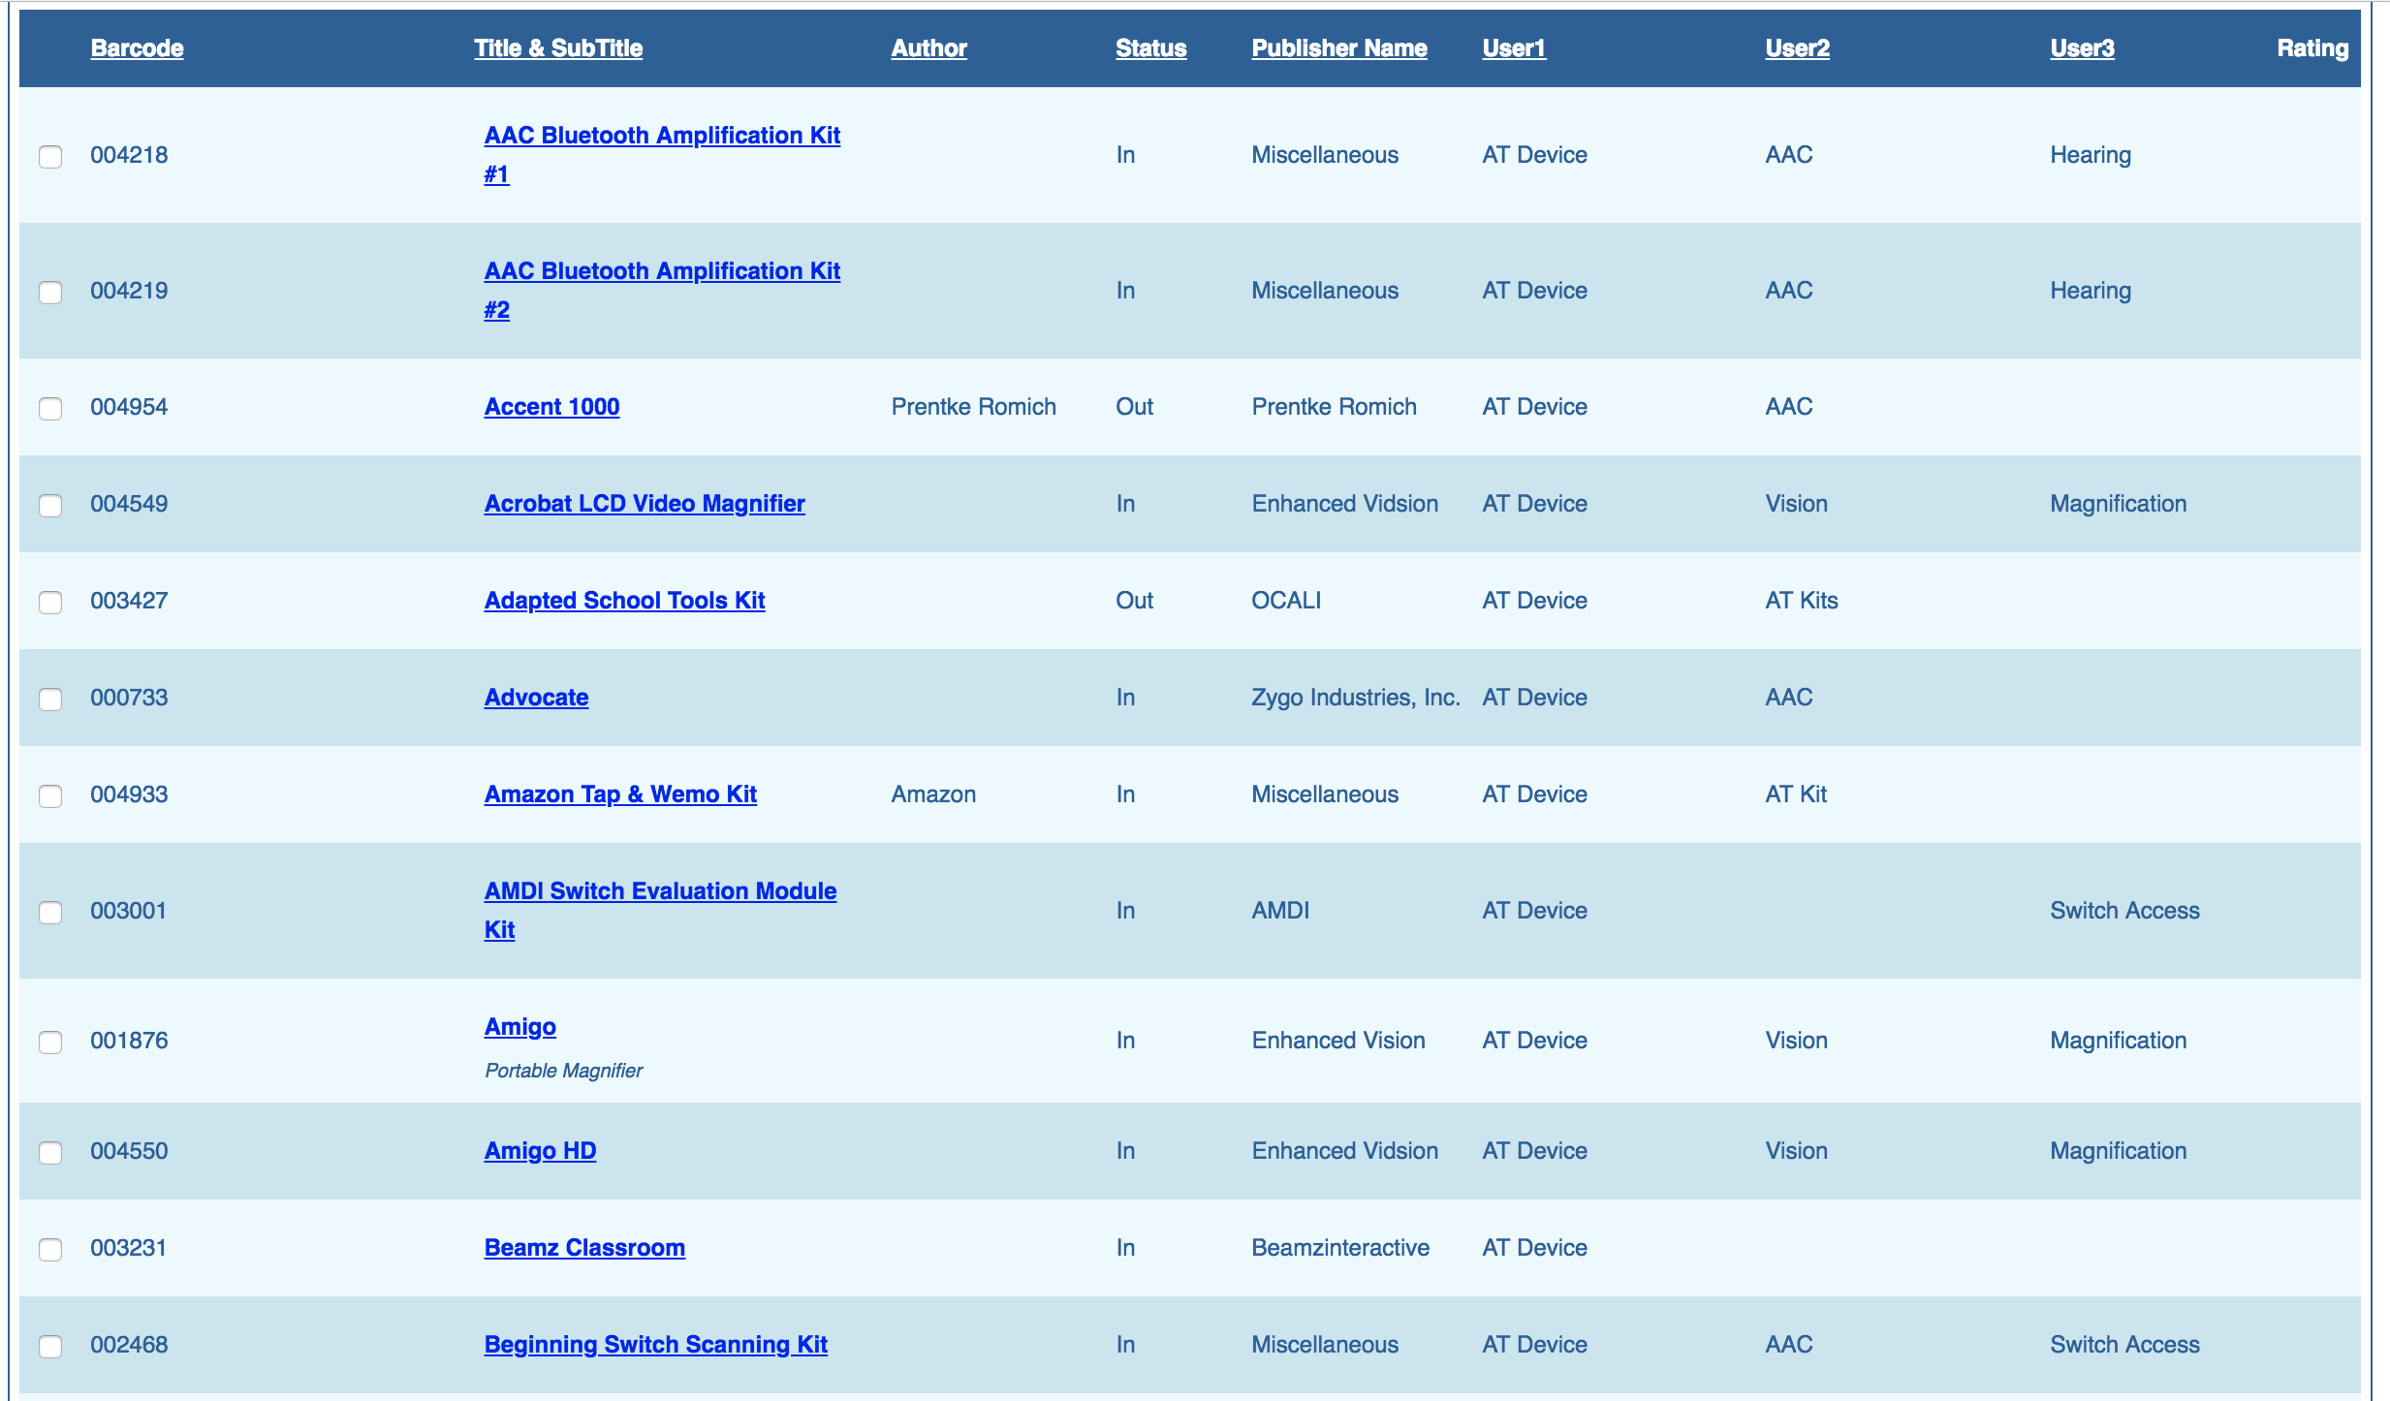
AT Trials
https://ataem
.org/at-tools

Slide 24
AT Professional Development
https://ataem.org/at-assessment

Slide 25
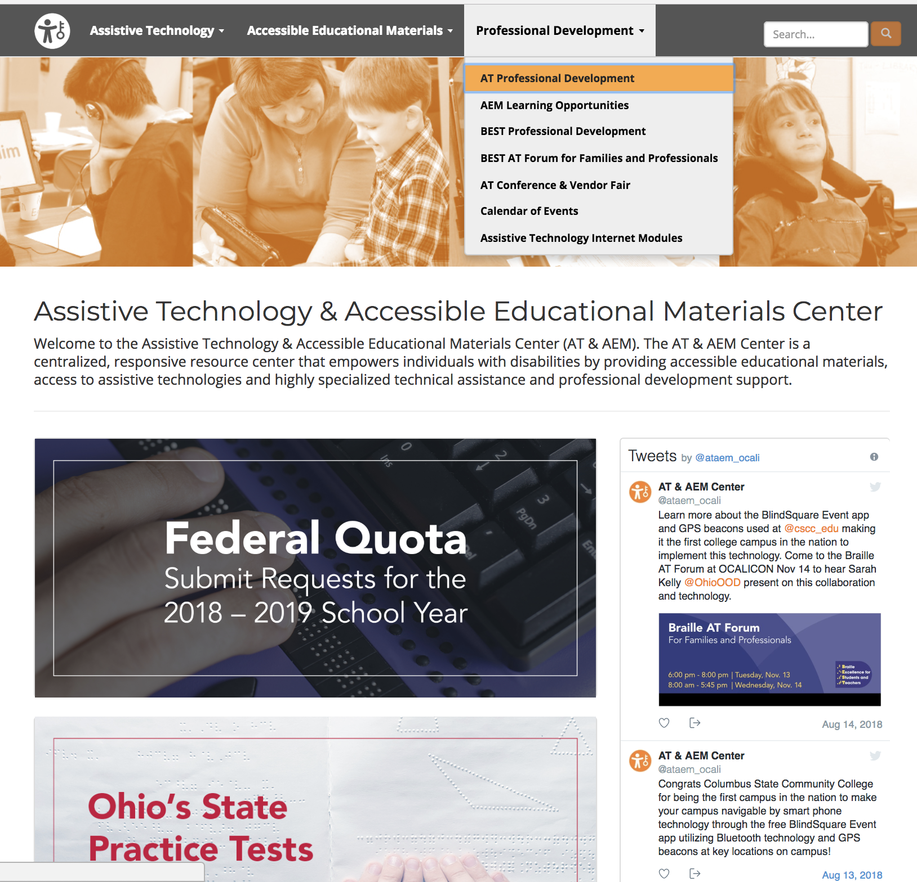
Professional Development
https://ataem.org/professional-development

Slide 26
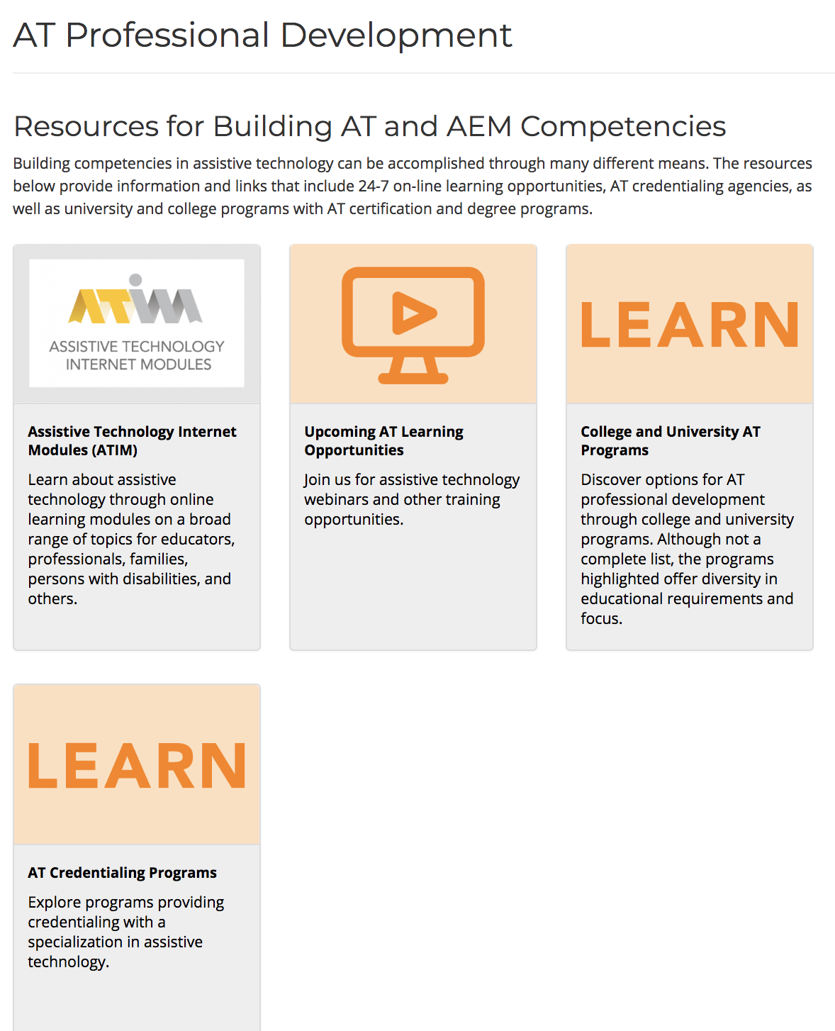
AT Professional Development
https://ataem.org/professional-development

Slide 27
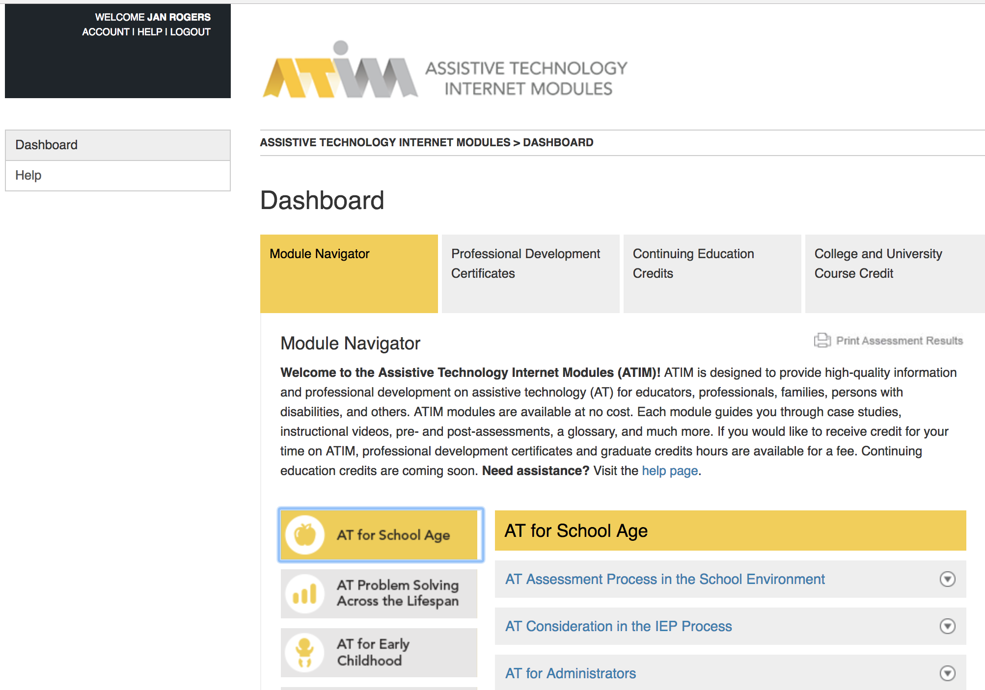
Assistive Technology Internet Modules (ATIM)
https://atinternetmodules.org/
Notes:
16,600 + users
All 50 states
All 88 counties
Used currently most by university faculty and students followed by intervention specialists

Slide 28
Free registration available. Lunch included. Door prizes!
October 2, 2018: Rootstown – NEOMED
October 3, 2018: Lima – Rhodes State College
October 4, 2018: Chauncey – SST 16
October 5, 2018: Dayton – Hilton Garden Inn, Austin Landing
https://ohioatvendorfair.org

Slide 29
Thank you AT&AEM Center Powered by OCALI

