Slide 1
OCALI AT&AEM Center! What can we do for you?
Jan Rogers, AT&AEM Center Program Director
jan_rogers@ocali.org

Slide 2
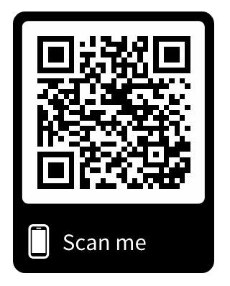
https://www.ocali.org/project/document_archive
TechFest_ATAEM_Mar2019
Notes:
Accessible PPT

Slide 3
Federal Definition of AT Device and Services
AT Device - "any item, piece of equipment, or product system, whether acquired commercially off the shelf, modified, or customized, that is used to increase, maintain, or improve functional capabilities of individuals with disabilities.
AT Service-“any service that directly assists an individual with a disability in selection, acquisition or use of an assistive technology device.”
Technology Related Assistance to Individuals with Disabilities Act of 1988 (Tech Act)

Slide 4
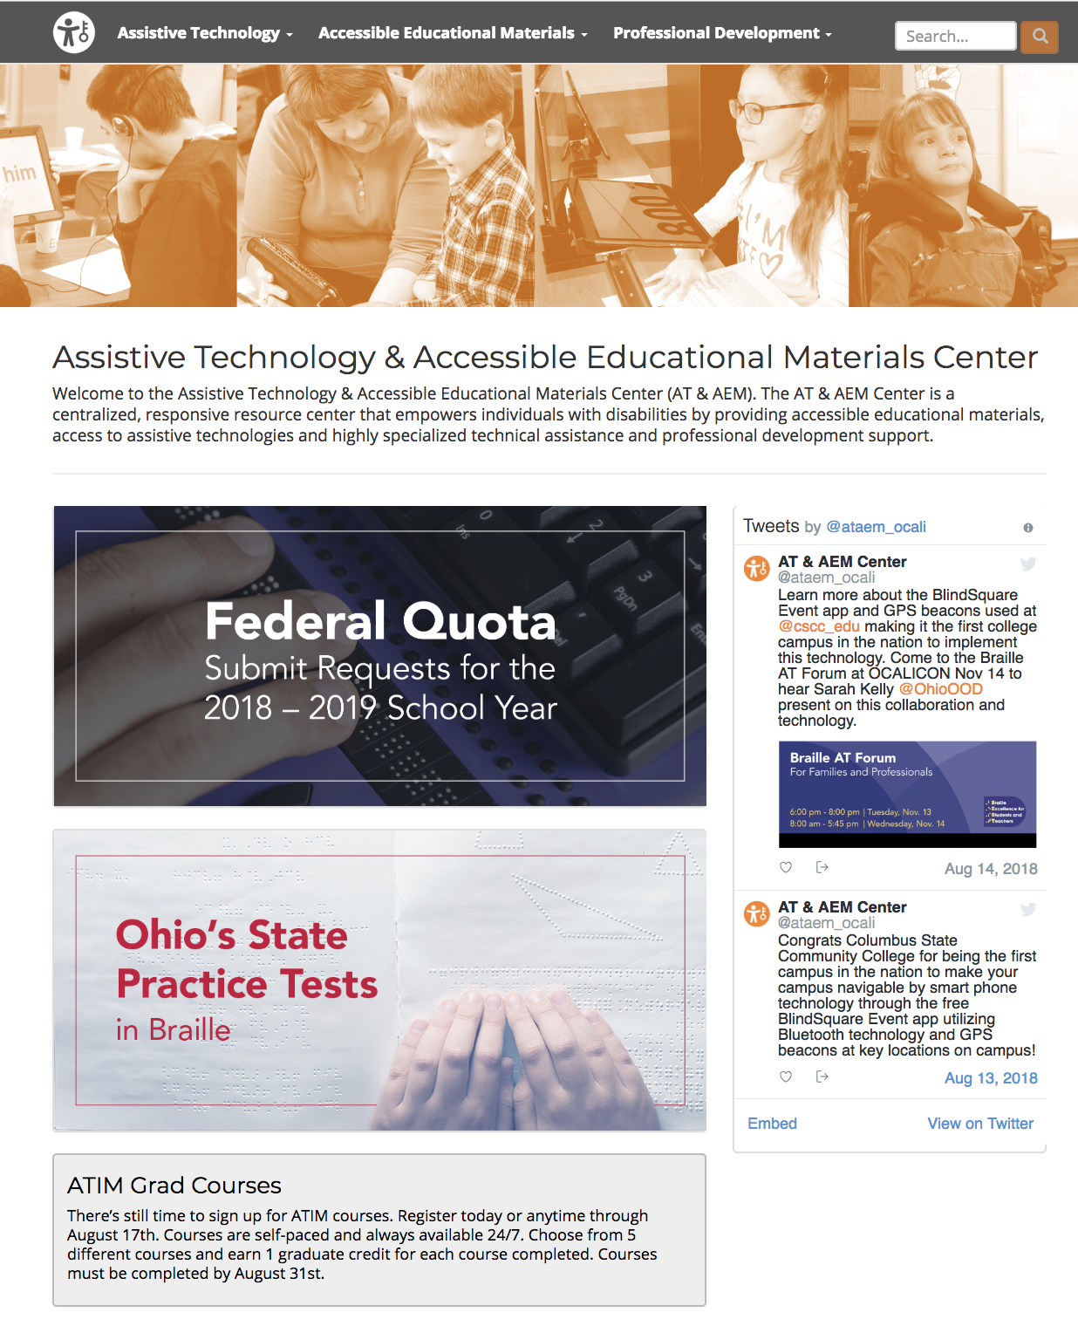
AT & AEM Center Website
https://ataem.org

Slide 5
AT Assessment

Slide 6
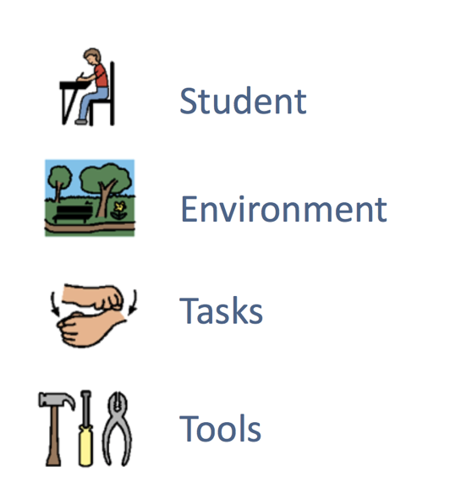
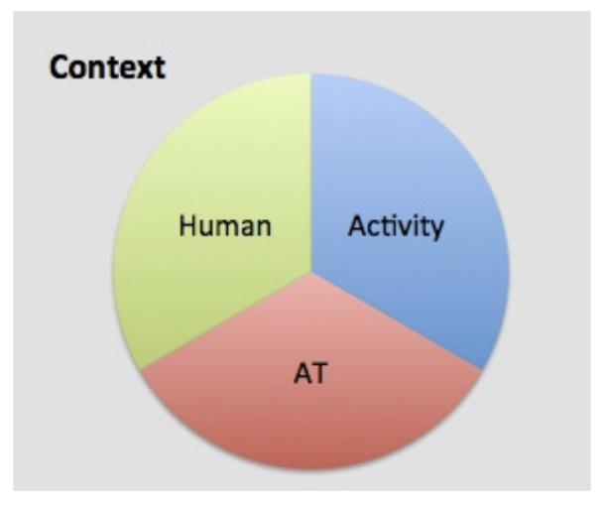
SETT Framework
HAAT
www.joyzabala.com
Cook & Hussey

Slide 7
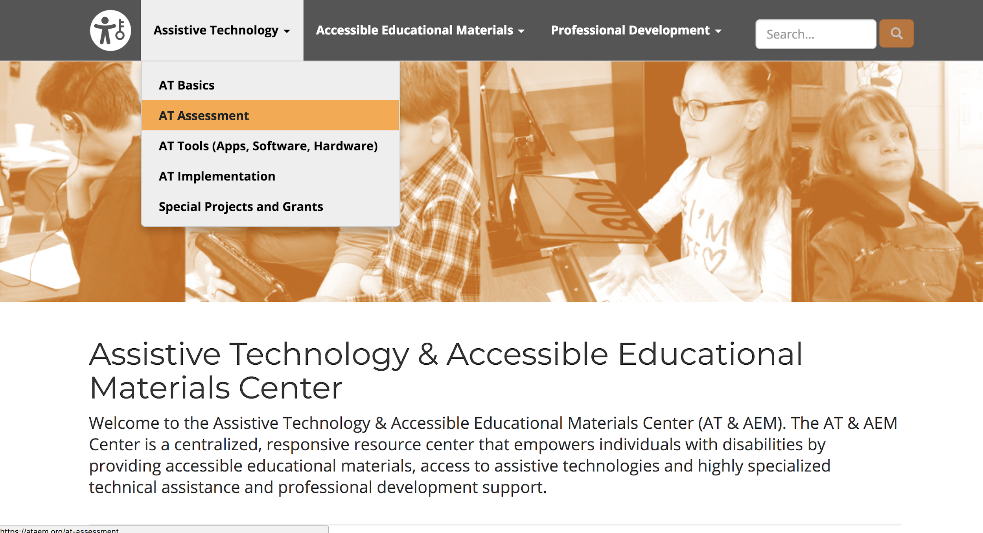
AT Assessment
https://ataem.org

Slide 8
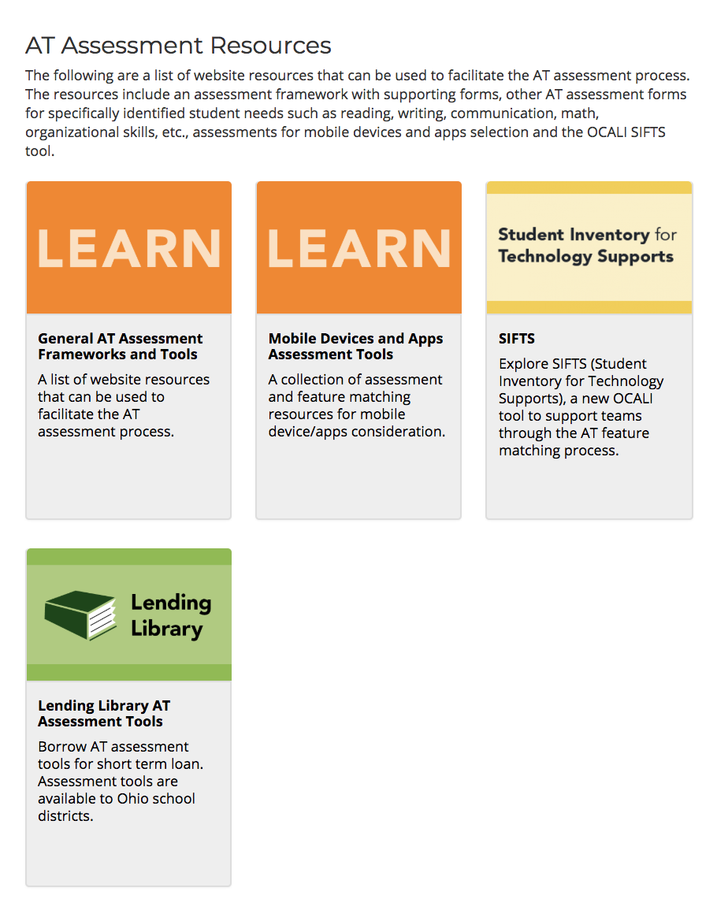
AT Assessment - AT Assessment Resources
https://ataem.org/at assessment

Slide 9
AT Assessment - Frameworks and Tools
https://ataem.org/general-at-assessment-frameworks-and-tools

Slide 10
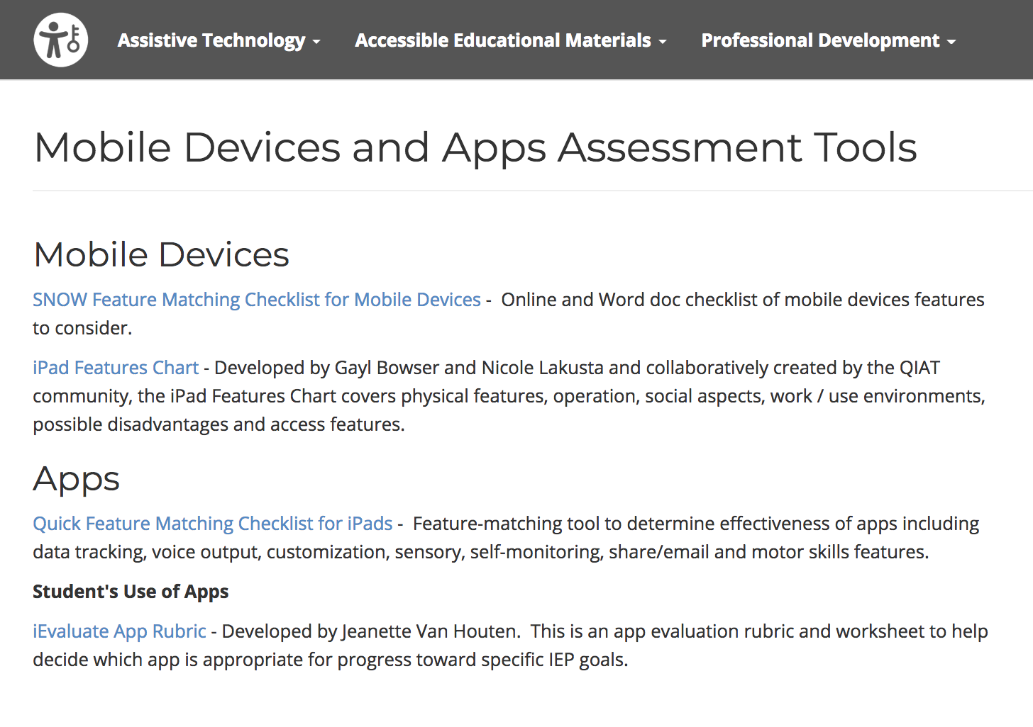
AT Assessment - Mobile Device and Apps Assessment Tools
https://ataem.org/mobile-devices-and-apps-assessment-tools

Slide 11
Student Inventory for Technology Supports SIFTS
www.atfeaturematching.org

Slide 12
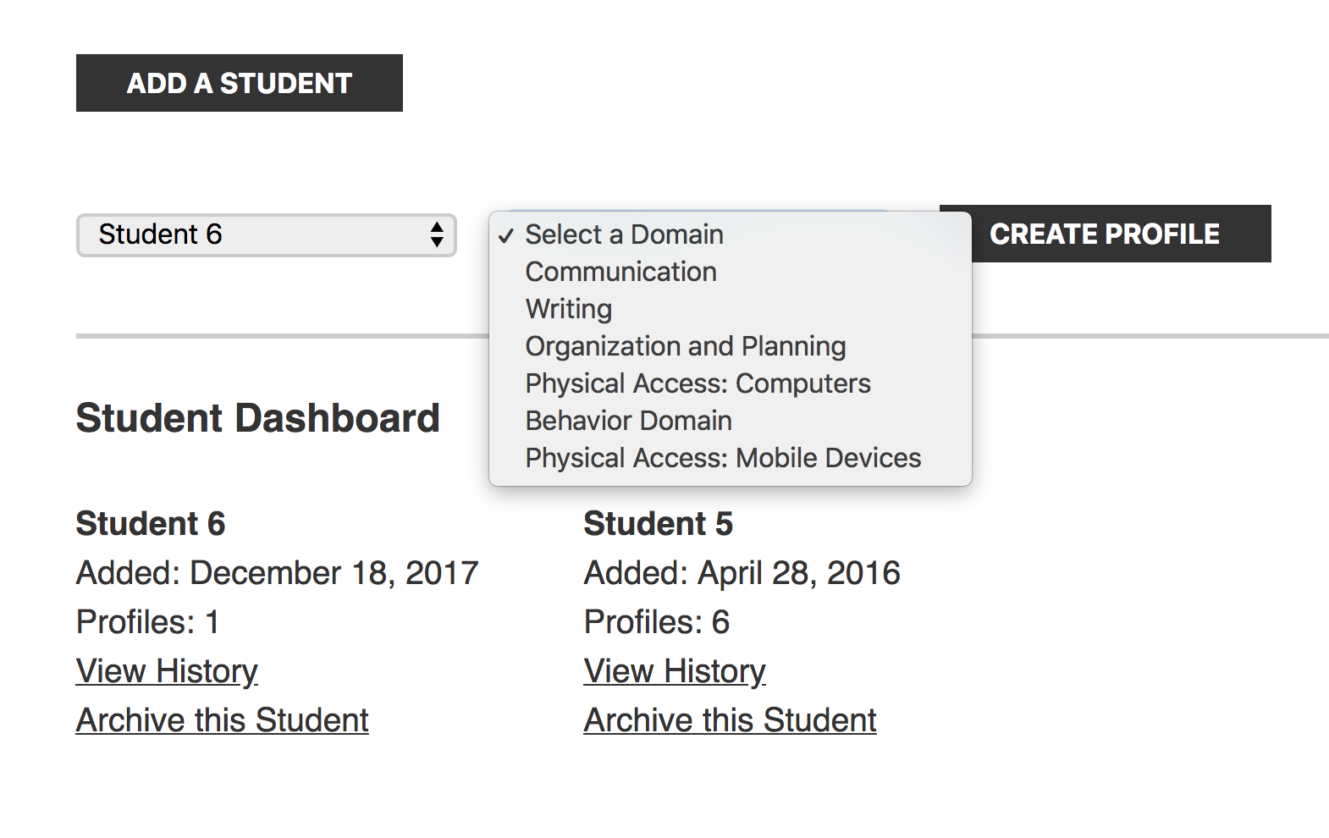
SIFTS Student Dashboard

Slide 13
SIFTS
Survey Questions

Slide 14
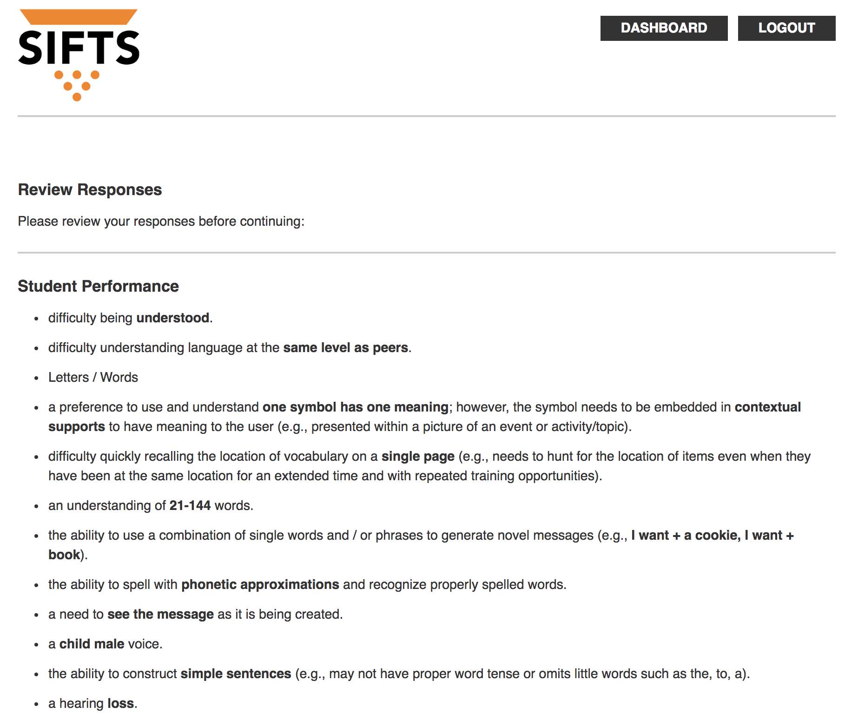
SIFTS
Student Performance

Slide 15
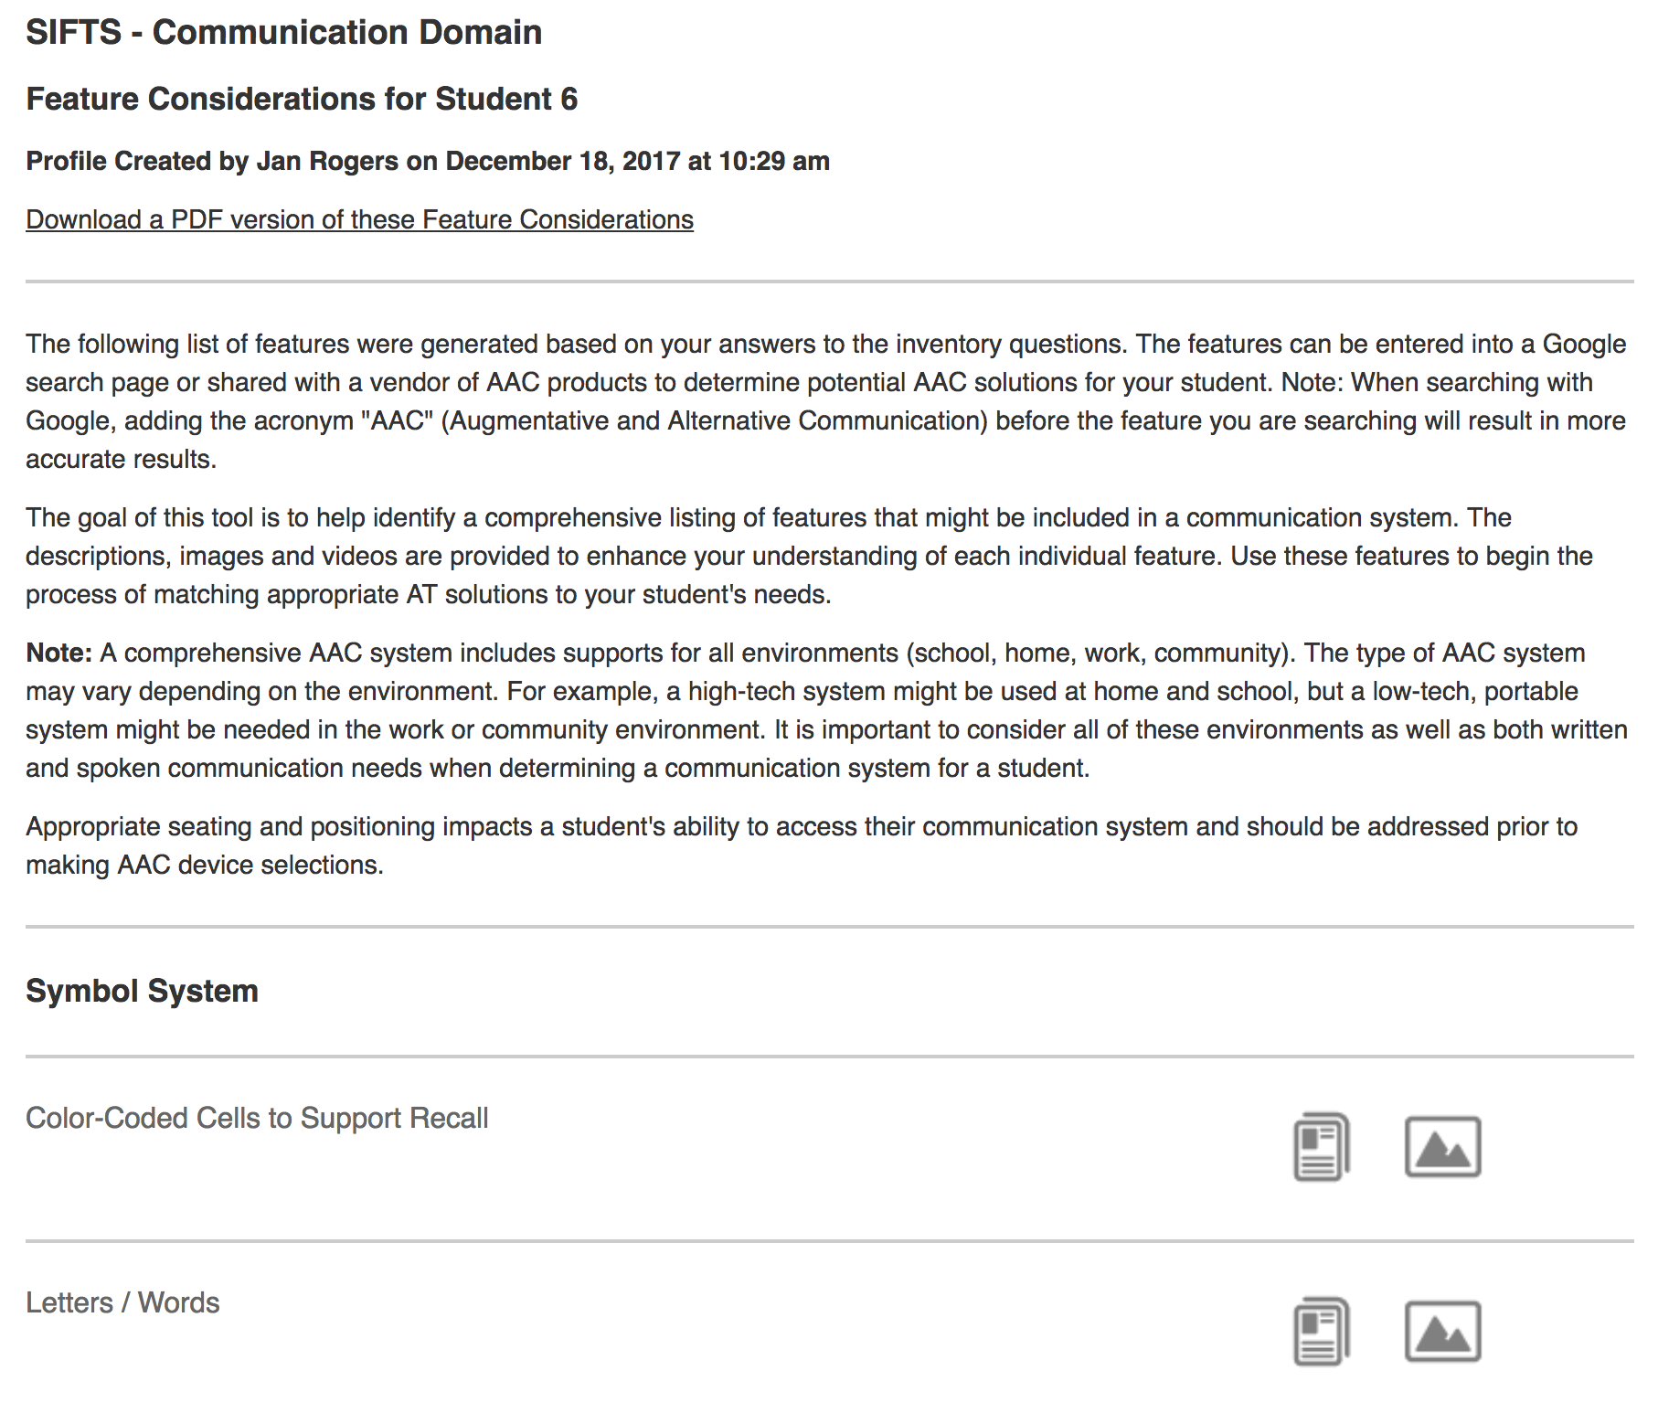
SIFTS
Feature Considerations

Slide 16
SIFTS
Features
(text descriptions, pictures, and video)

Slide 17
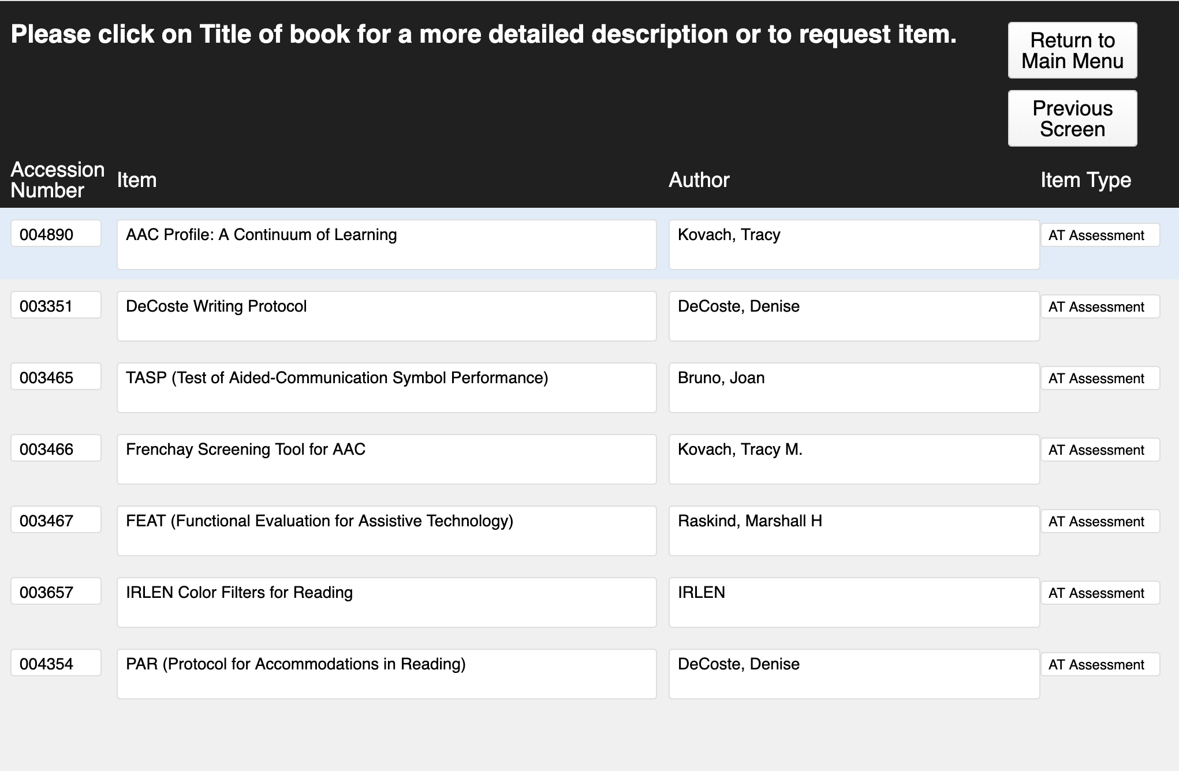
Assessment Tools - OCALI Lending Library
www.ocali.org/lending-library

Slide 18
AT Tools (Apps, Software, Hardware)

Slide 19
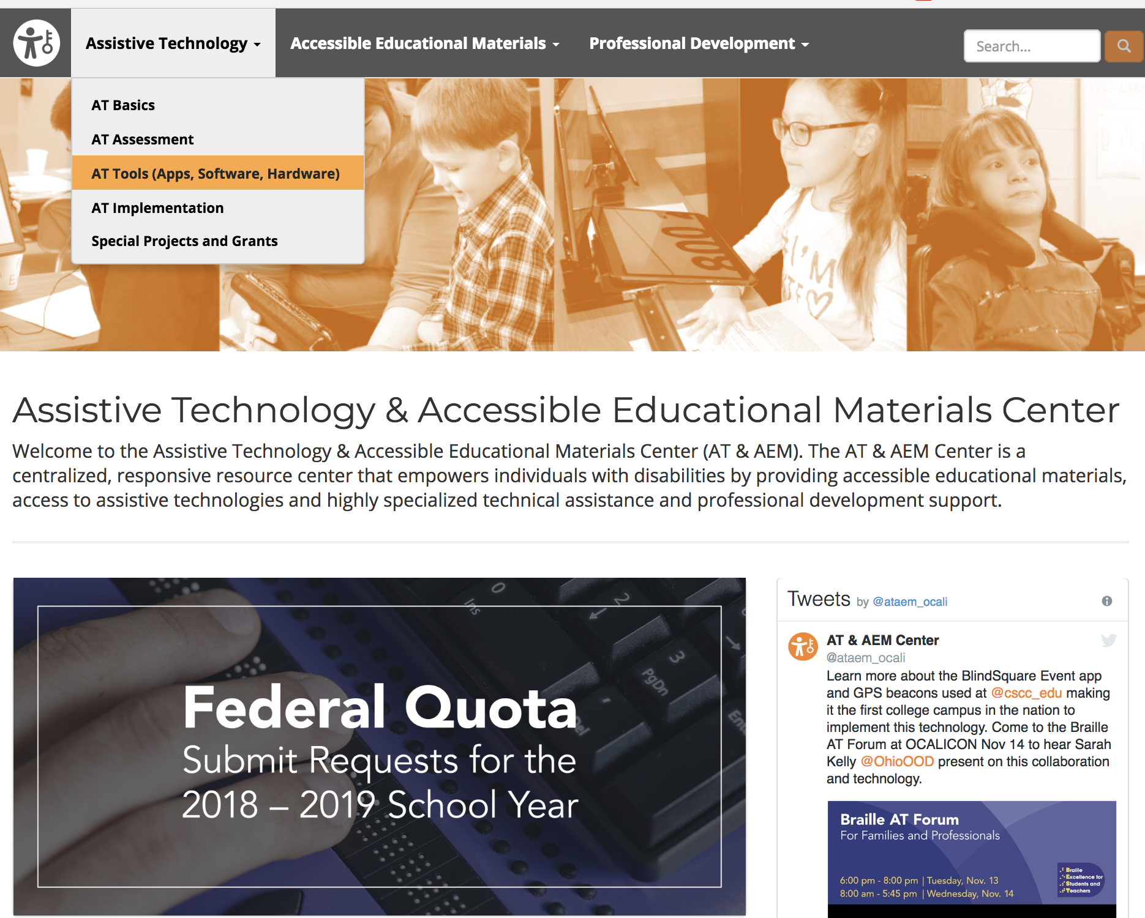
AT Tools
https://ataem.org

Slide 20
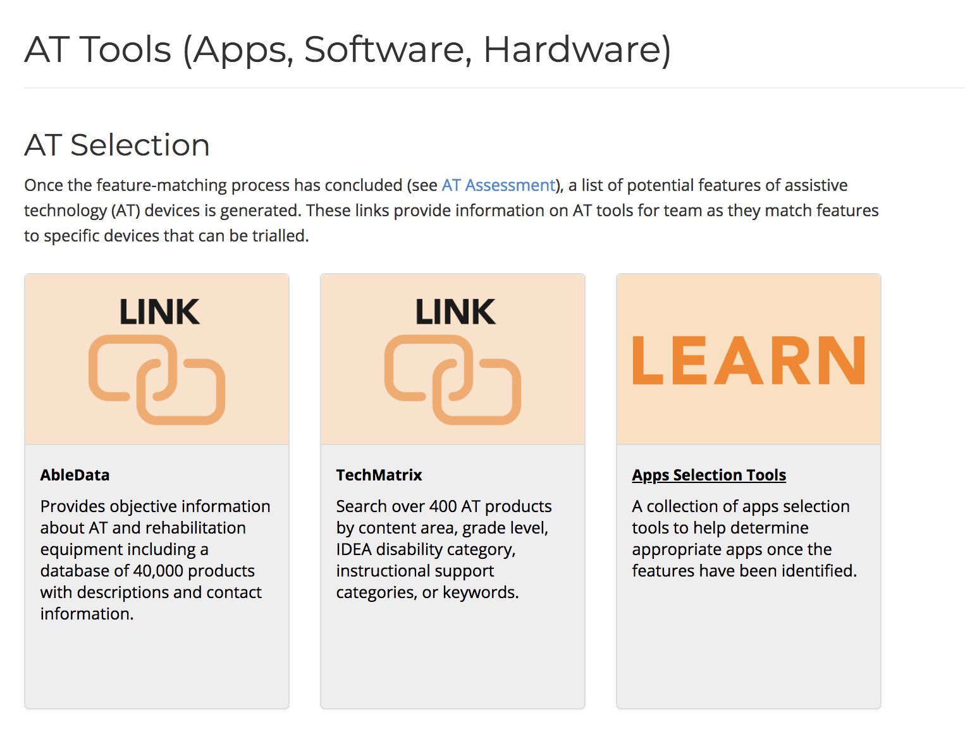
AT Tools - Selection
https://ataem.org/at-tools

Slide 21
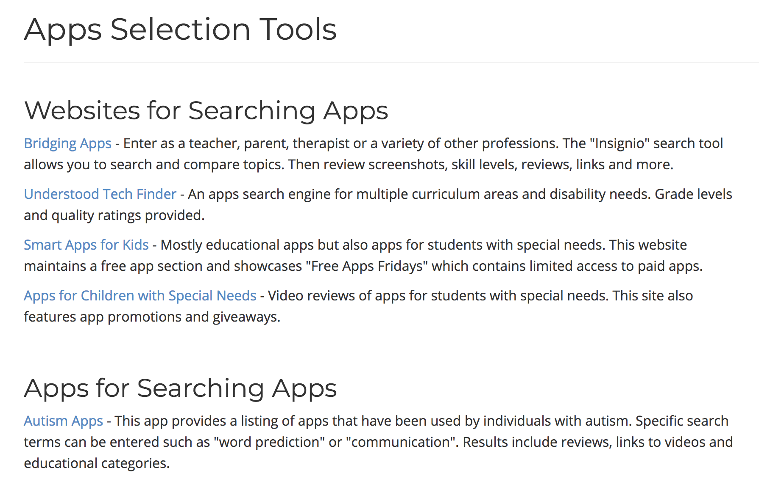
App Selection Tools
https://ataem.org/apps-selection-tools

Slide 22
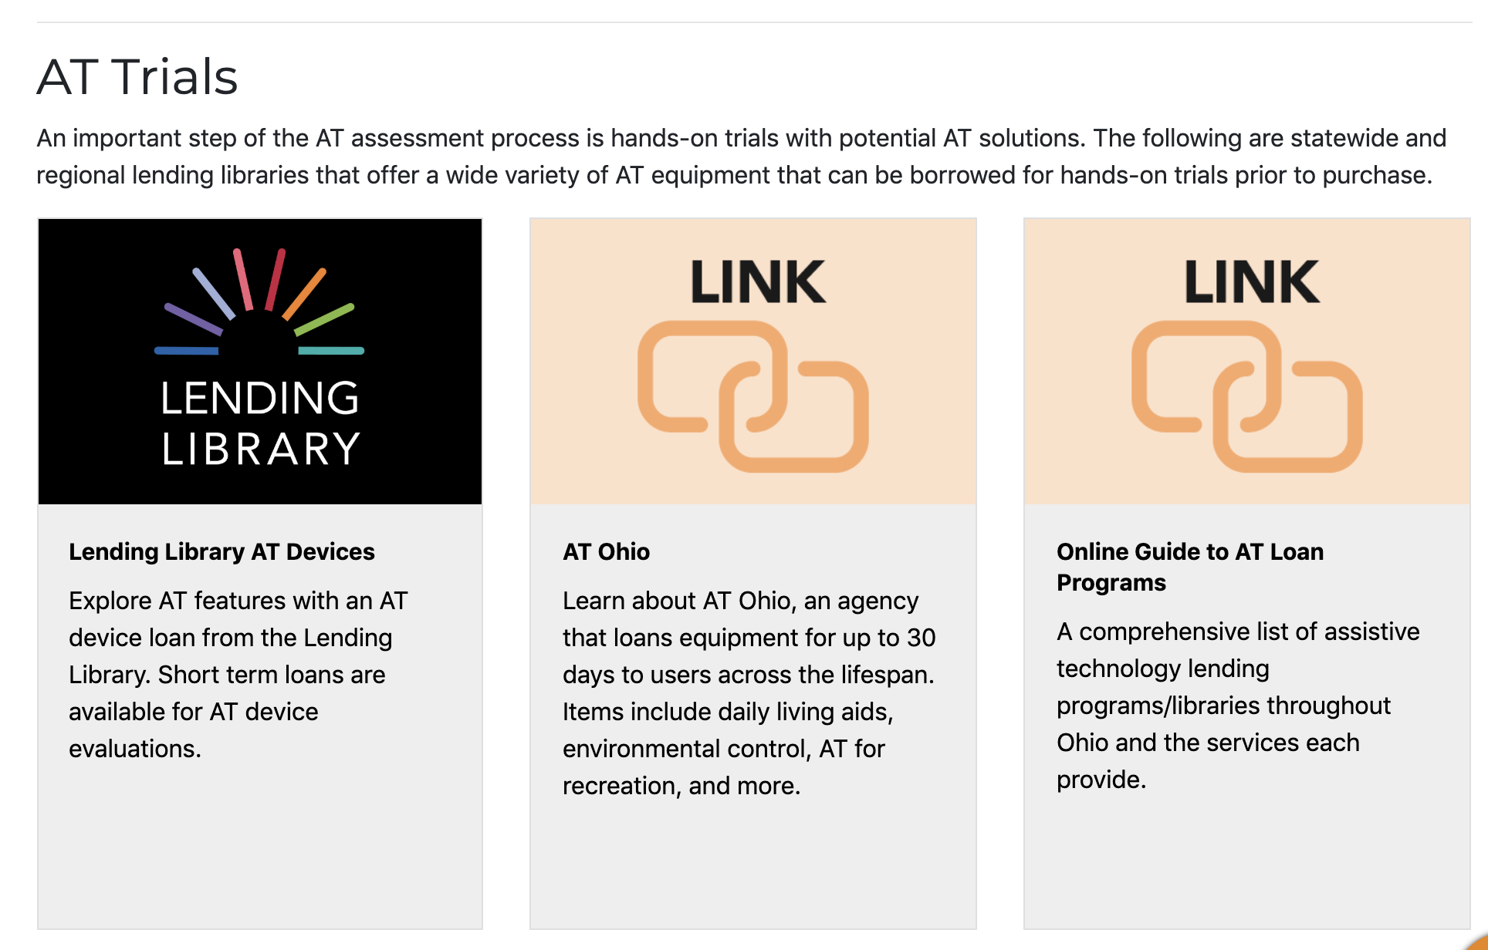
AT Trials
Notes:
200+ items,
33 kits with a focus on specific areas of support (organization, reading, writing, math, low vision, blind, communication iPads, hearing, positioning, sensory, etc)

Slide 23
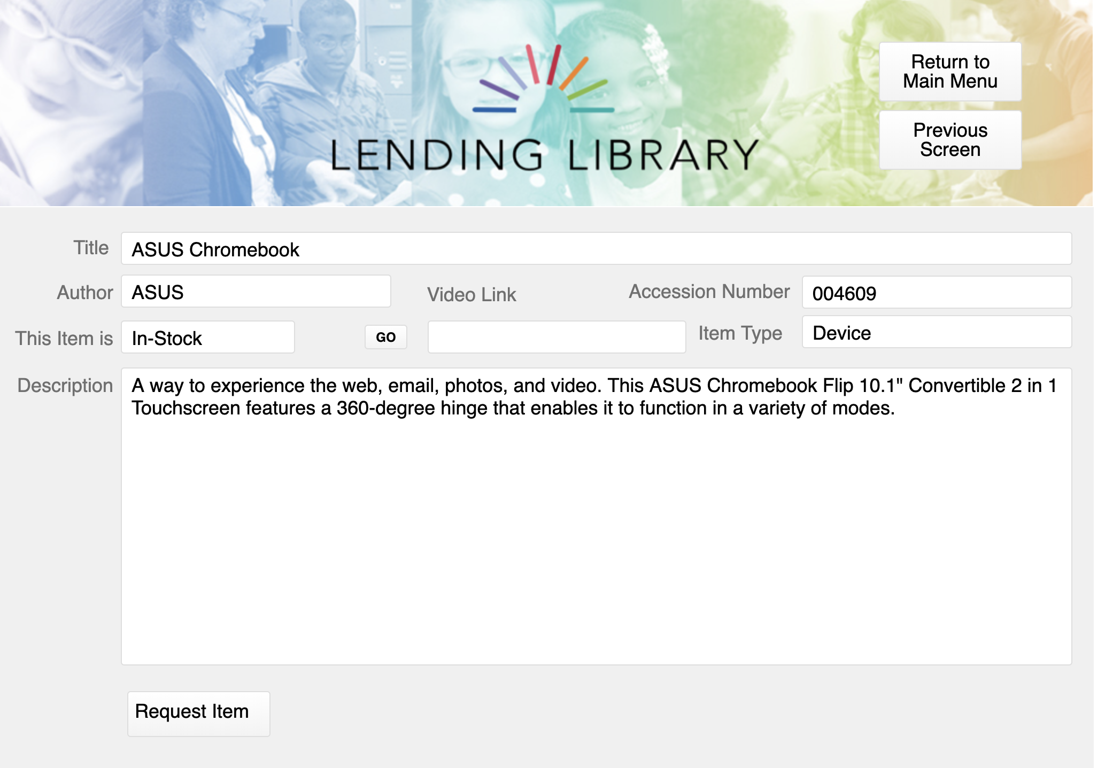
AT Trials – OCALI Lending Library
www.ocali.org/lending-library

Slide 24
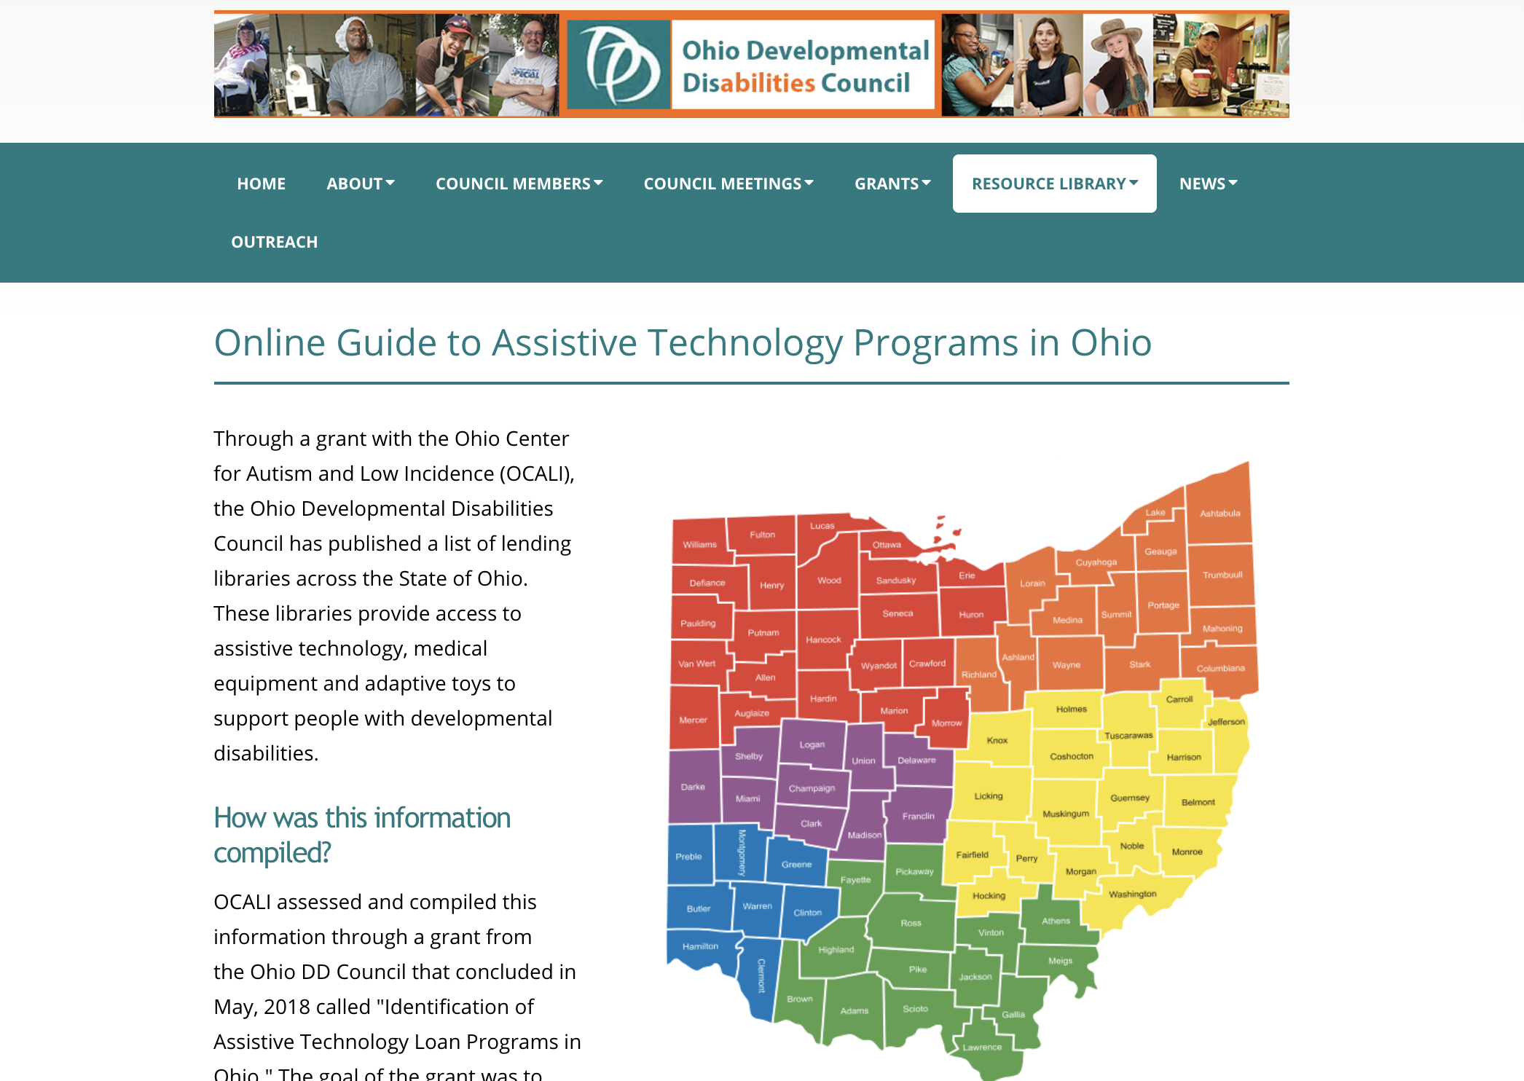
AT Trials – Regional and Statewide Lending Libraries
https://ddc.ohio.gov/ohio-at-lending-libraries

Slide 25
AT Professional Development

Slide 26
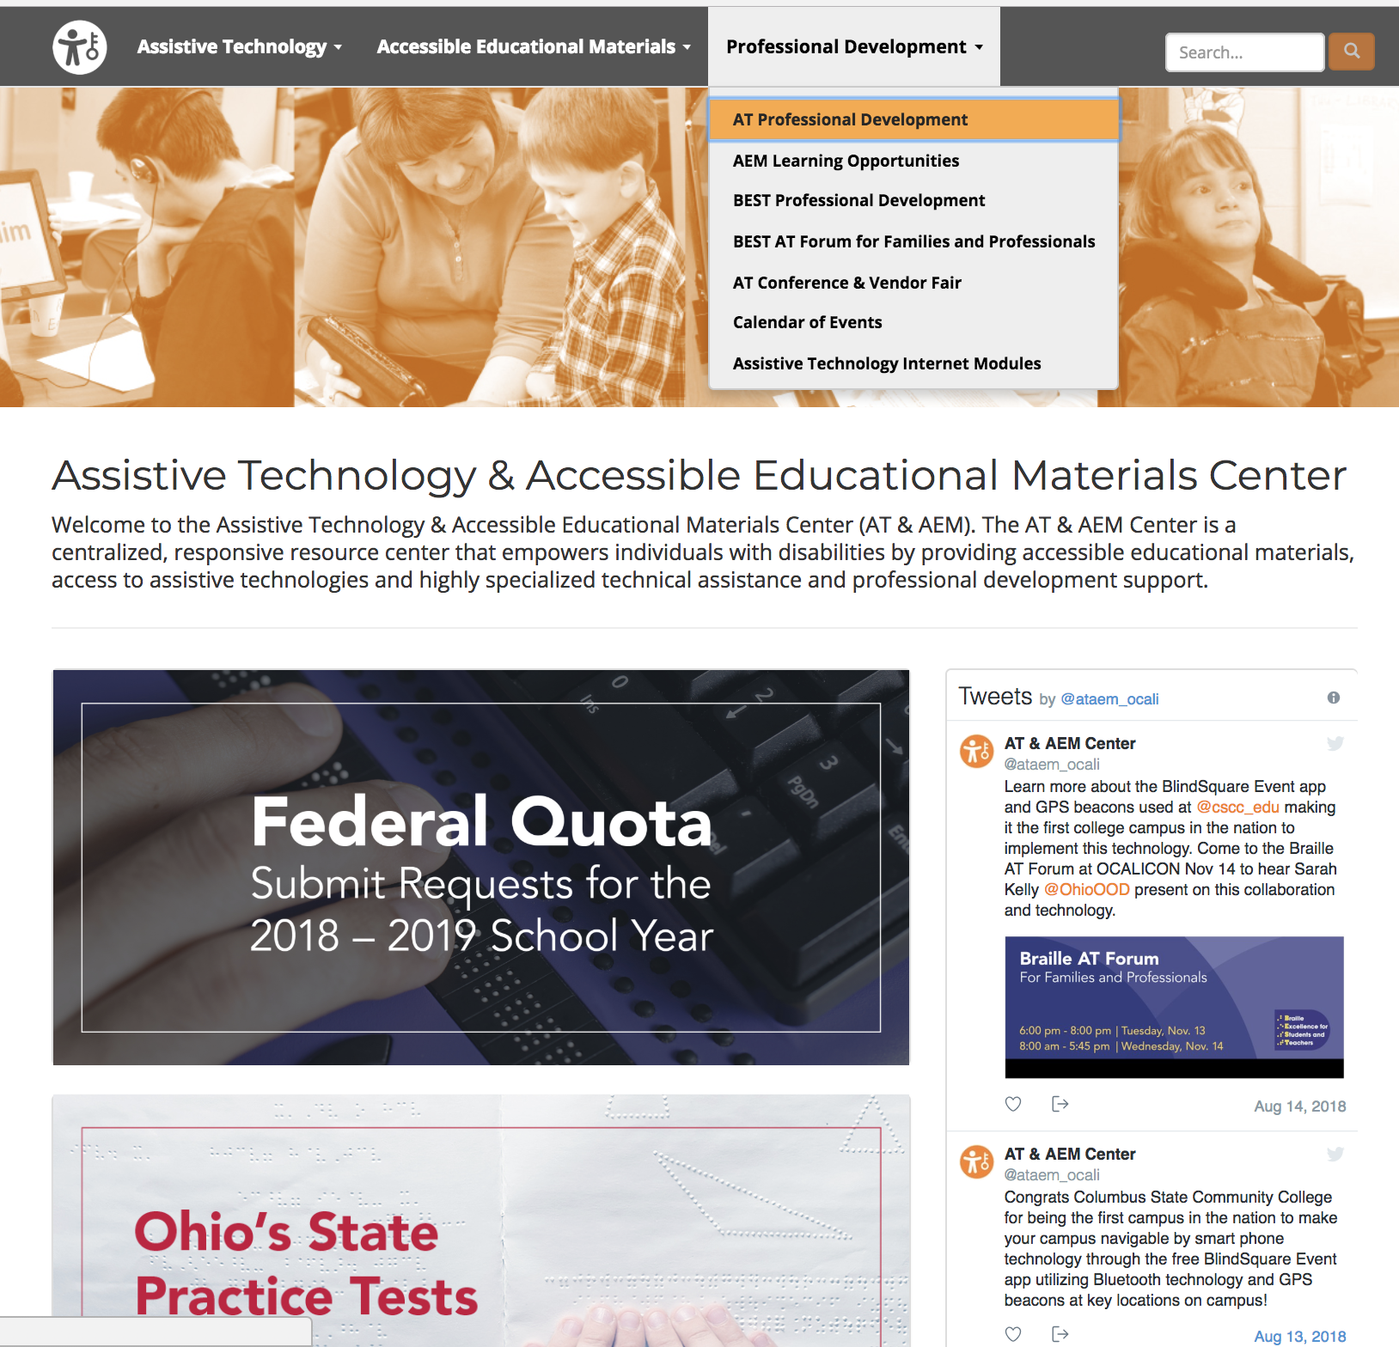
AT Professional Development
https://ataem.org

Slide 27
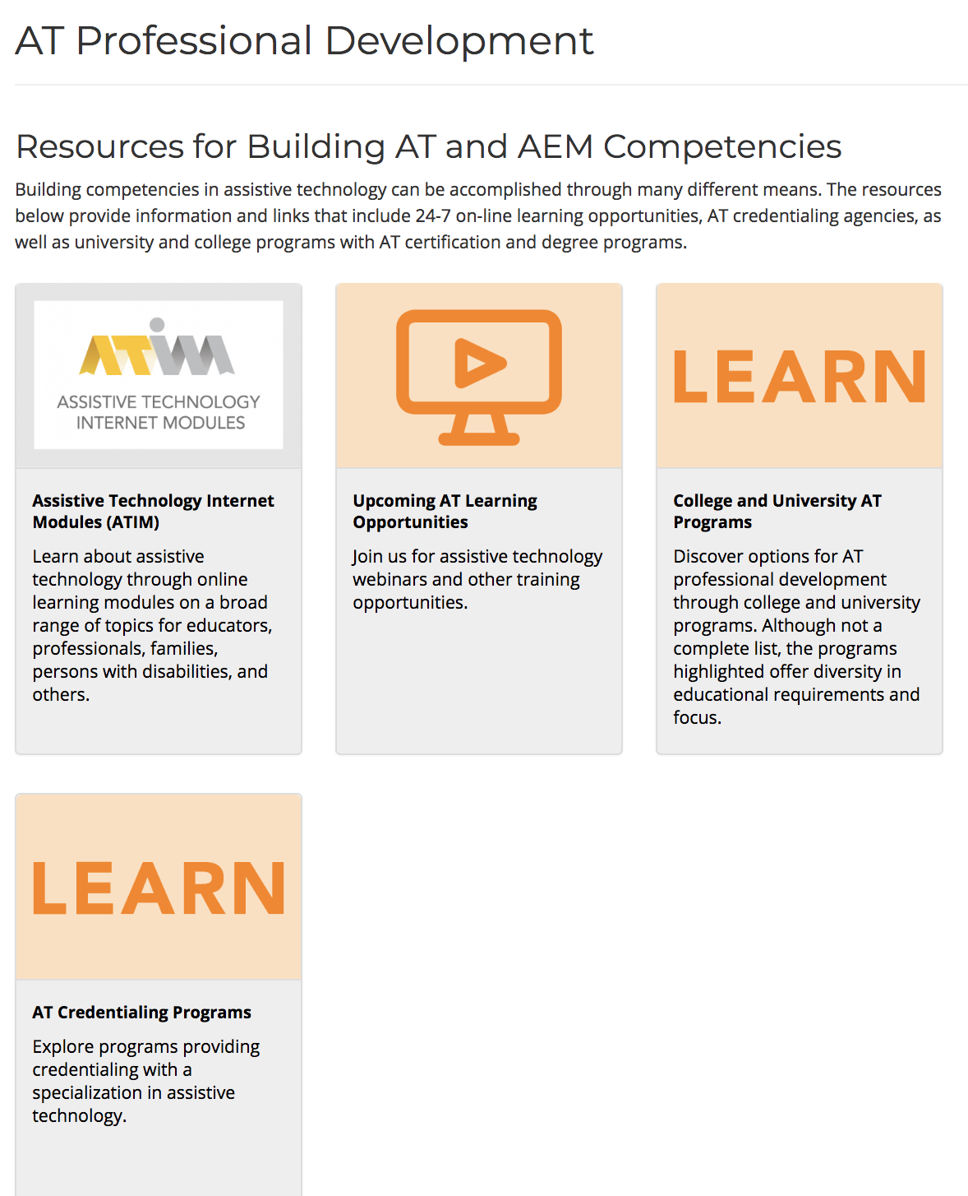
AT Professional Development - Resources
https://ataem.org/professional-development

Slide 28
AT Professional Development - Archived Webinars

Slide 29
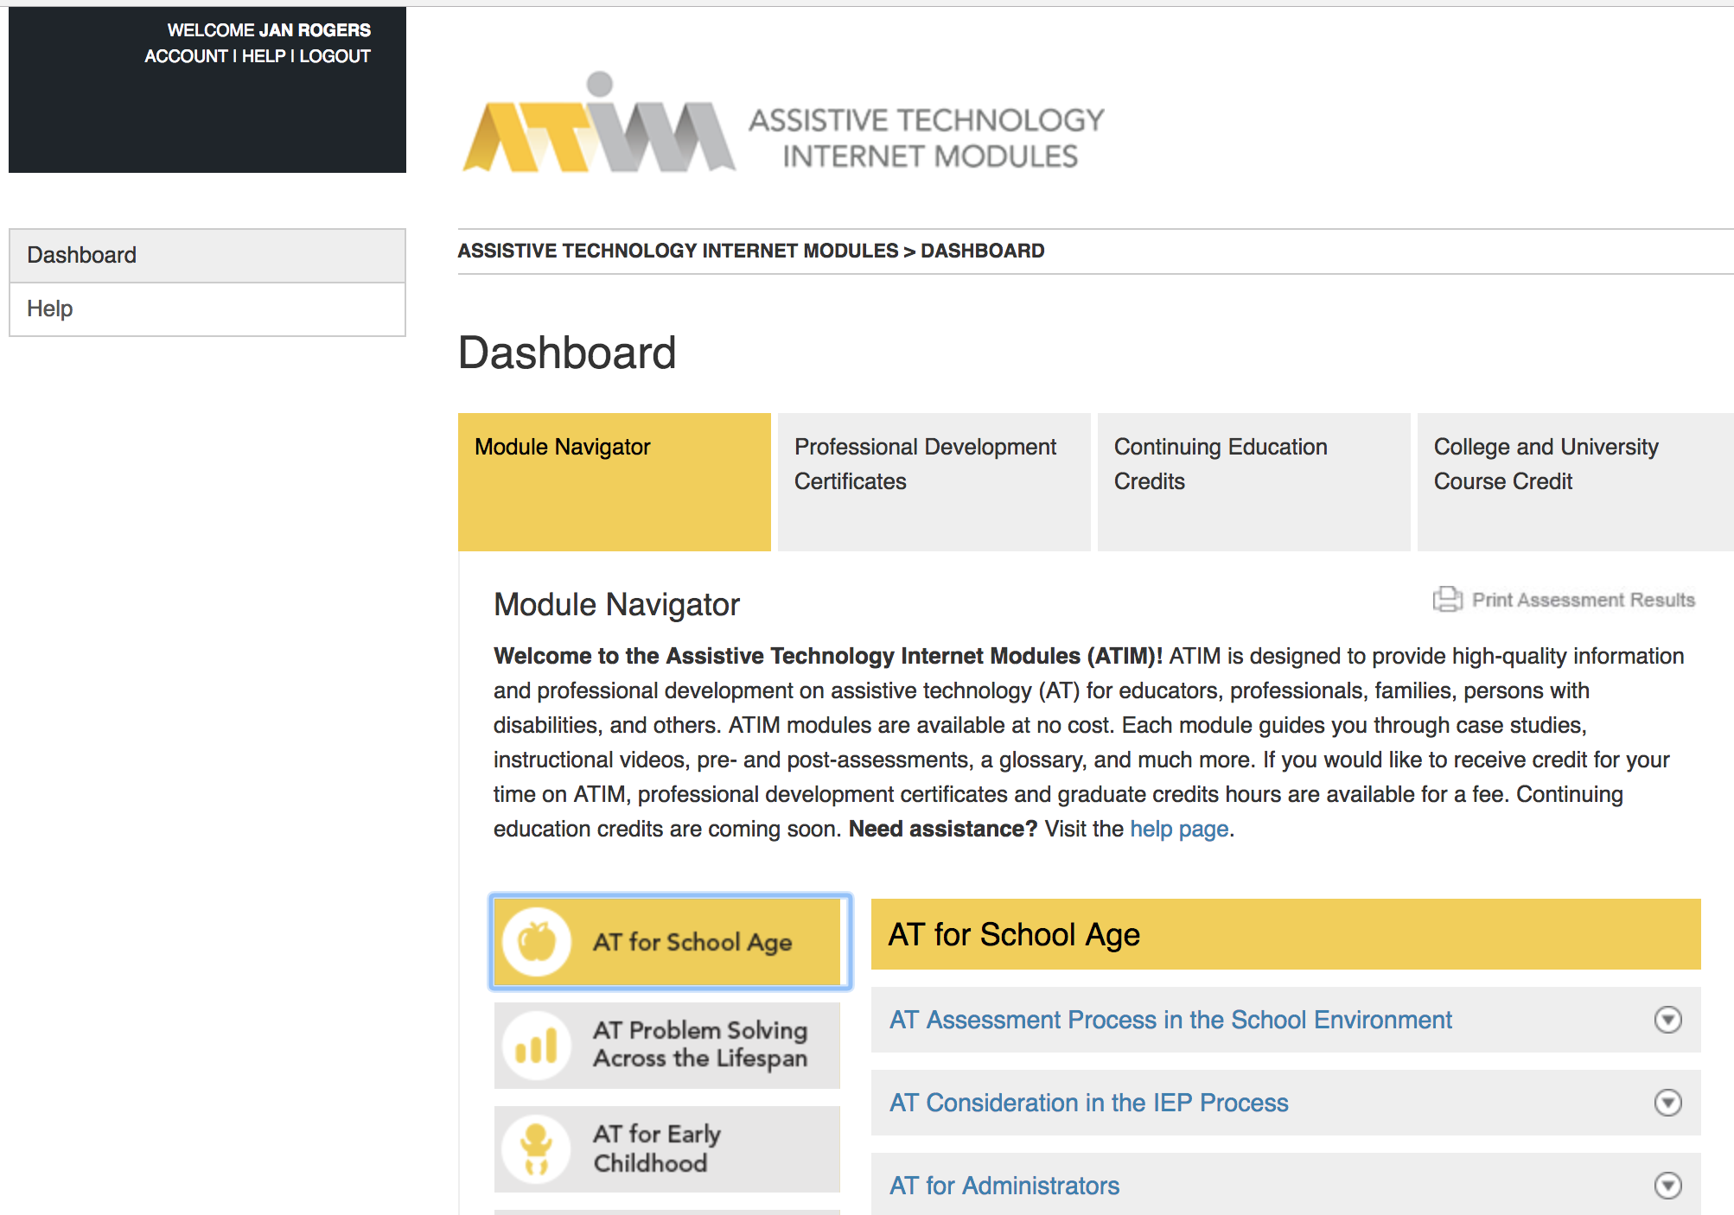
Assistive Technology Internet Modules (ATIM)
https://atinternetmodules.org/
Notes:
19,000 users
All 50 states
All 88 counties
70 countries (Canada, Austraila, Puerto Rico, UK, China, New Zealand)
Used currently most by university faculty and students and intervention specialists

Slide 30
AT Conference and Vendor Fair
Free registration available. Lunch included. Door prizes!
October 2, 2018: Rootstown – NEOMED
October 3, 2018: Lima – Rhodes State College
October 4, 2018: Chauncey – SST 16
October 5, 2018: Dayton – Hilton Garden Inn, Austin Landing
https://ohioatvendorfair.org

Slide 31
OCALICON 2019
https://conference.ocali.org/

Slide 32
Thank you AT&AEM Center Powered by OCALI

