Slide 4
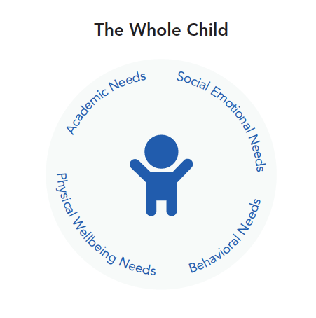
The Whole Child

Slide 5
Students in Your Building
Defined By...
Student Background
Scenario Story
What Did You Notice?
Barriers to Access
Strategies
Continued Understanding

Slide 6
Common Challenges, Universal Strategies
Dyslexia
Deaf or Hard of Hearing
Executive Function Challenges

Slide 7
Group Exercise Focus on Autism Spectrum Disorder (ASD)
What are characteristics?
What barriers will the student face in the classroom? In the lunchroom? At community events or extracurricular activities?
How might these barriers impact the student across the day? What might you notice?
What might you notice about teachers and other school staff in their interactions with this student?
What strategies might support the student?
How could these strategies also support your other students?

Slide 8
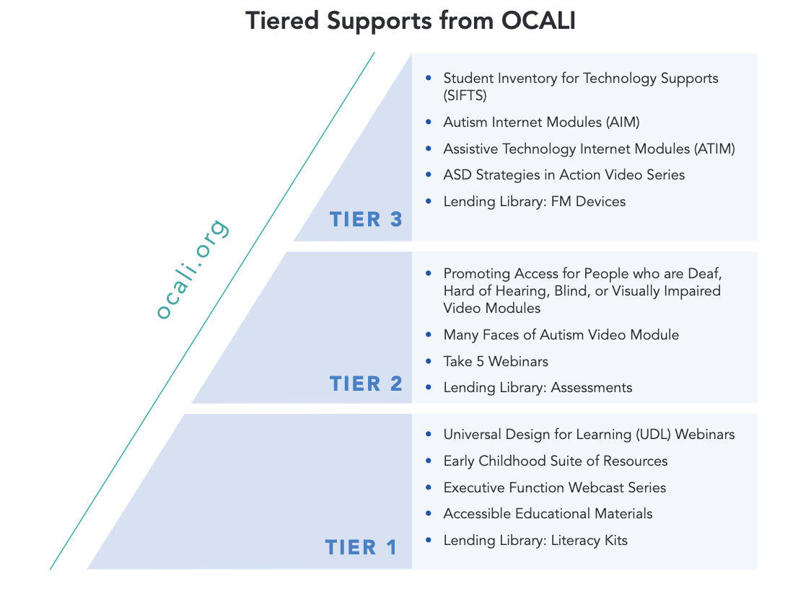
Tiered Supports from OCALI

Slide 9
UDL Webinar

Slide 10
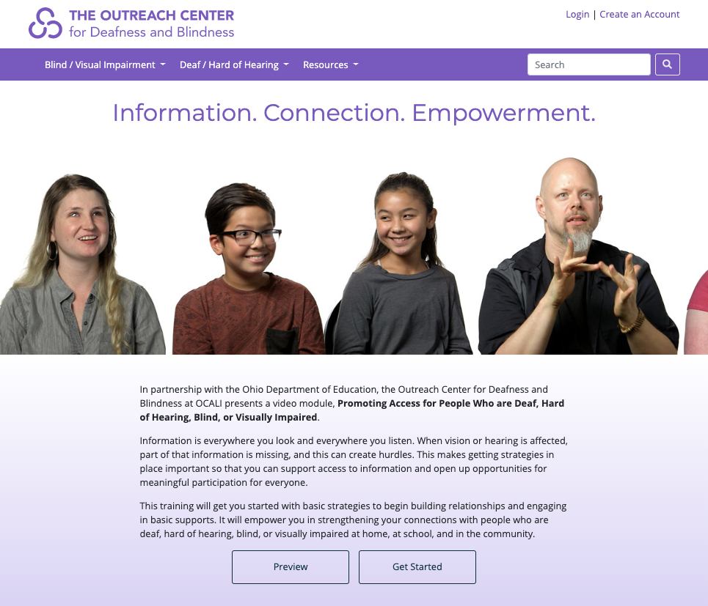
Promoting Access

Slide 11
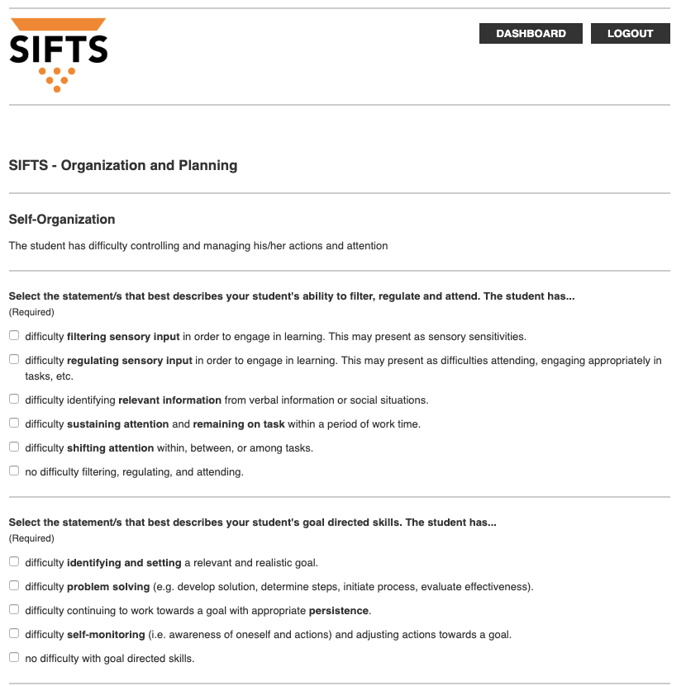
SIFTS

Slide 12
Post-It Feedback
+ One thing you learned or enjoyed from today's session
+ One additional thing you would like to learn and didn't hear about today

