Slide 1
App Smackdown
for Curriculum and School Access
Jan Rogers, MS, OTR/L, ATP
Heather Bridgman, MS, ATP
Mary Jo Wendling, OTR/L

Slide 2
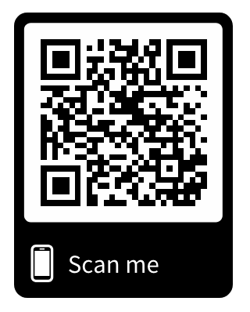
https://www.ocali.org/project/document_archive

Slide 3
Learning Objectives
Identify apps and/or exts to support curriculum access and school participation
Identify features of the various apps/exts presented that could be matched to student needs
Develop a better understanding of how to select apps/exts to meet the needs of students with disabilities
Understand the difference between educational, therapeutic and assistive technologies

Slide 4
General AT Assessment Process

Slide 5
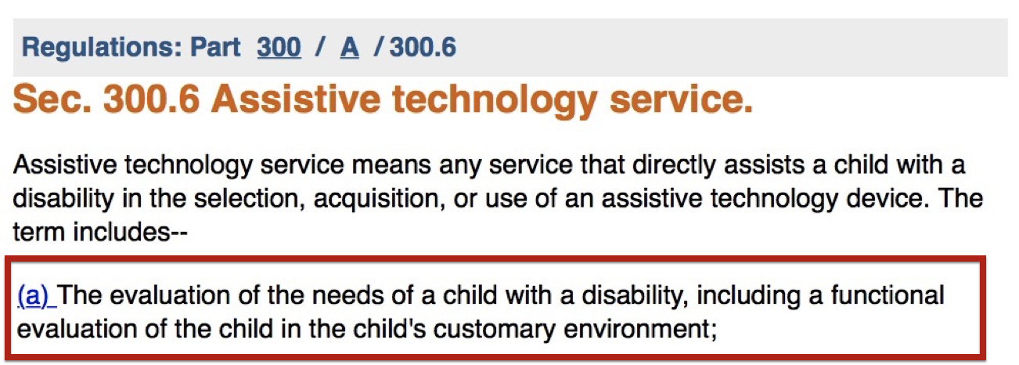
AT Services in IDEA
IDEA 2004 - Definition of AT Service

Slide 6
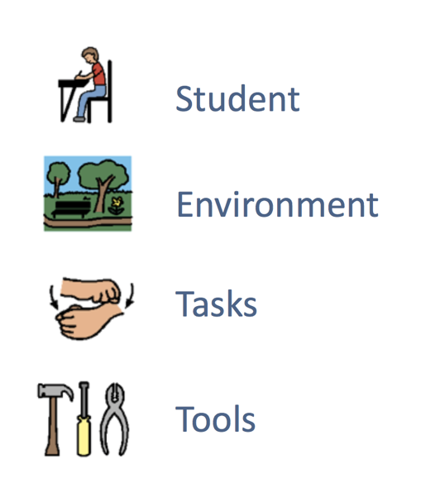
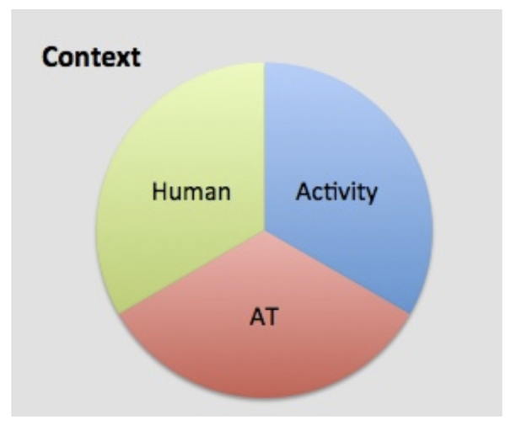
SETT Framework
HAAT
www.joyzabala.com
Cook & Hussey

Slide 7
Steps of the AT Assessment Process
Initiate the AT decision-making process
Identify the team
Gather information: Identify student needs and abilities, environments and tasks

Slide 8
Steps of the AT Assessment Process (Cont.)
Solution generation & selection: Feature-matching
Equipment trials & acquisition
Implementation & ongoing assessment

Slide 9
Assistive Technology Internet Modules (ATIM)
AT Assessment Process in the School Environment
AT Assessment Tools
An Overview of Using the WATI Assessment Process
http://atinternetmodules.org
Notes:
ATIM Assessment in the Schools
ATIM Assessment Tools
ATIM WATI Assessment Process

Slide 10
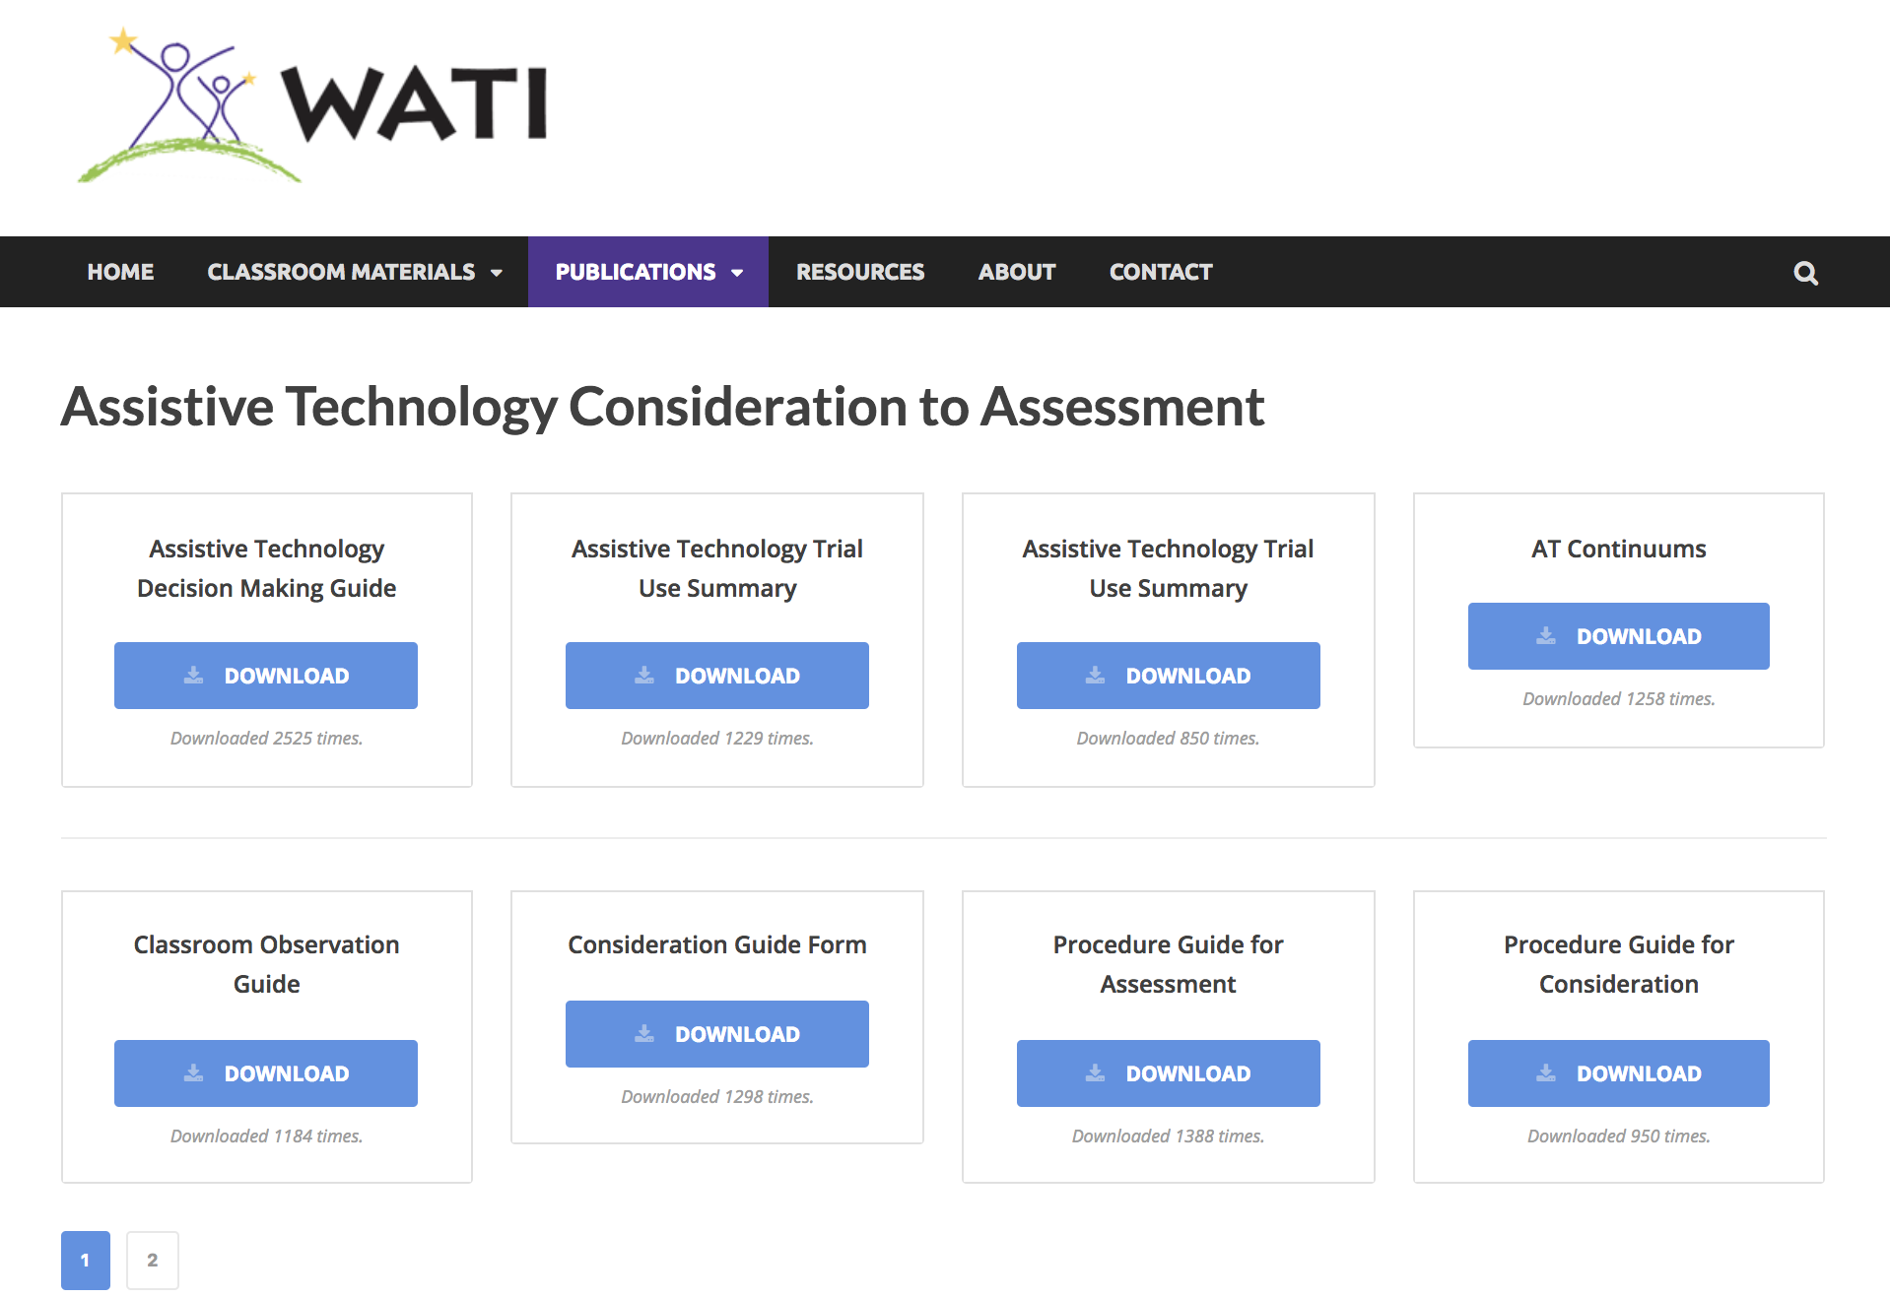
WATI Updated Documents
http://www.wati.org/free-publications/assistive-technology-consideration-to-assessment/

Slide 11
Device Specific AT Assessment Resources

Slide 12

Assistive Technology Internet Modules (ATIM)
Computer Access - WATI - Part 1
Computer Access - WATI - Part 2
Mobile Device Access - WATI - Part 1
Mobile Device Access - WATI - Part 2
http://atinternetmodules.org

Slide 13

Feature-Matching
Student Inventory for Technology Supports
www.atfeaturematching.org
Notes:
Add feature matching video

Slide 14
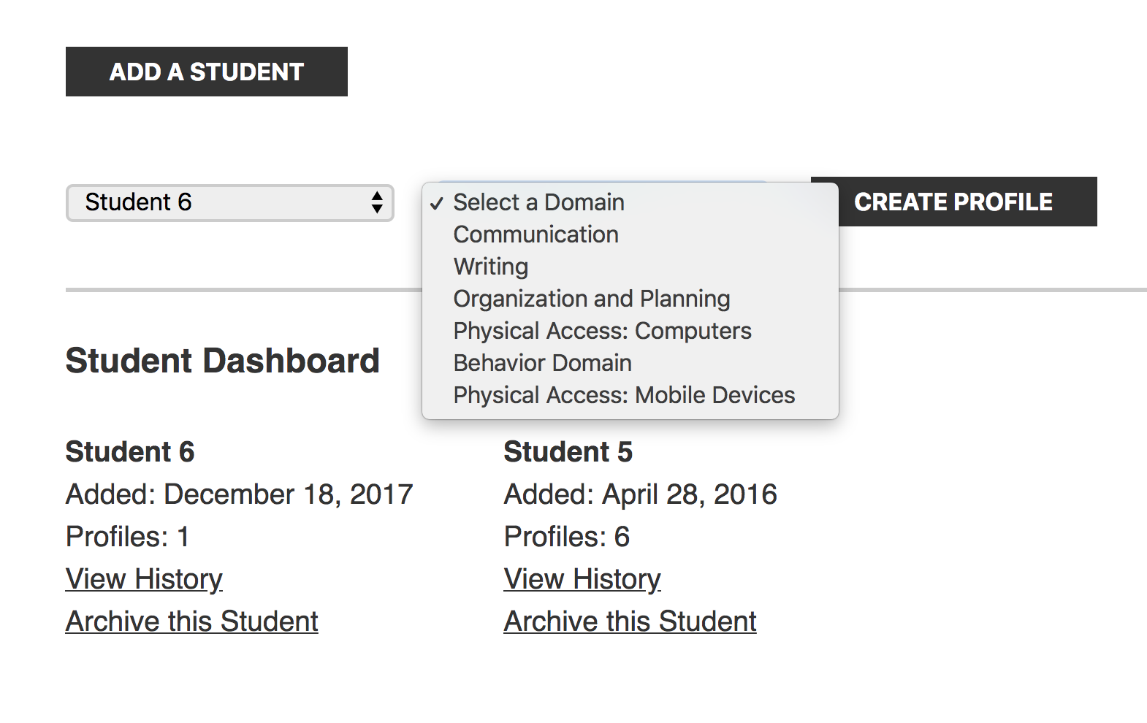
SIFTS
www.atfeaturematching.org

Slide 15
Device Selection Resources

Slide 16
Devices & Operating Systems

Slide 17
Apple iOS
Created and developed by Apple Inc. in 2007
Powers iPhone, iPad, and iPod Touch
2nd most popular mobile OS globally after Android
2.2 million iOS apps, 1 million native for iPads
Known for extensive built in accessibility features

Slide 18
Android
Developed by Google, modified Linux Kernel
Primarily for touchscreen mobile devices
Variants for game consoles, digital cameras, PCs and other electronics
Open source so OS features may be slightly different in various devices

Slide 19
Chrome OS
Google designed based on the Linux Kernel.
Google Chrome web browser is the principal user interface.
Primarily supports web applications
Connection to other devices via cloud or in some cases Bluetooth (e.g. Keyboards, Mice, Speakers, Headphones, Headsets (audio only)).
File sharing through cloud only
Notes:
Chrome - Chrome OS is an operating system designed by Google that is based on the Linux kernel and uses the Google Chrome web browser as its principal user interface. As a result, Chrome OS primarily supports web applications. Chromebook can’t load printer drivers or connect no ports??? External devices can’t be hardwired. They may be connected via cloud printing for printers or bluetooth for certain other devices (Keyboards, Mice, Speakers, Headphones, Headsets (audio only). Bluetooth cannot be used for file sharing.

Slide 20
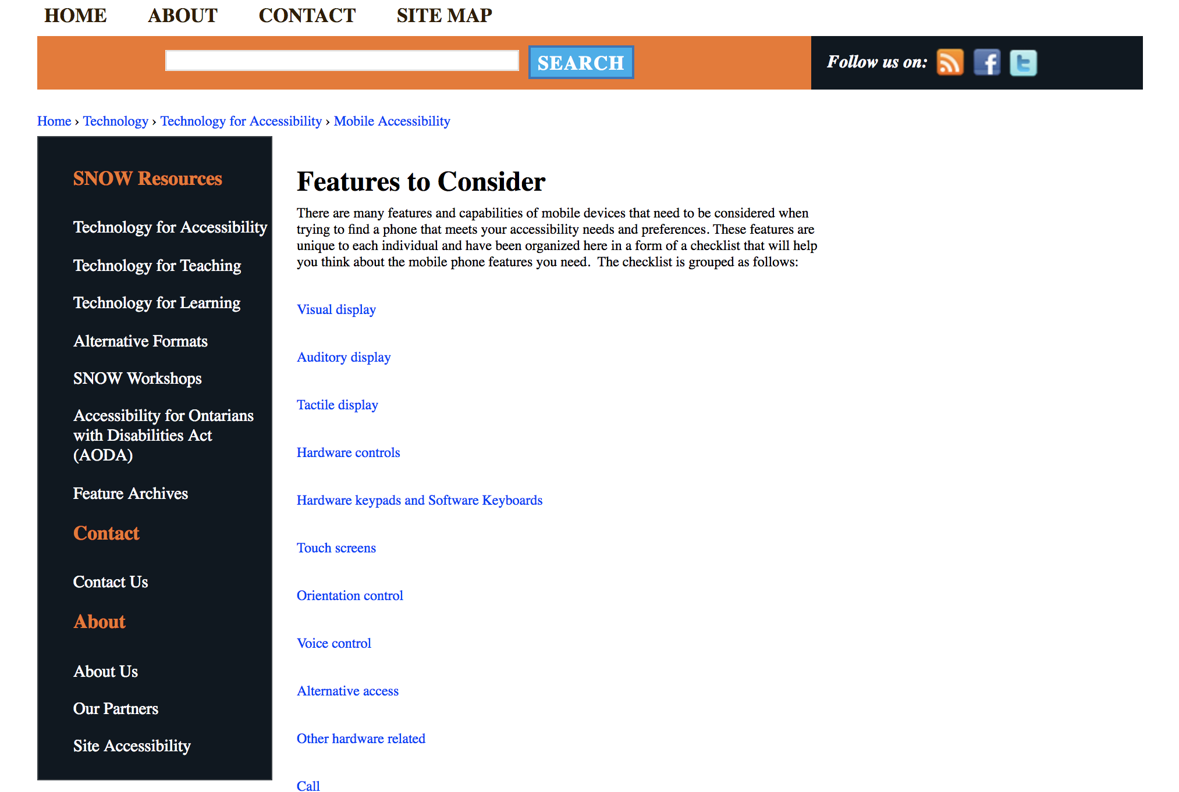
SNOW: Features to Consider for Mobile Devices
https://snow.idrc.ocadu.ca/node/190

Slide 21
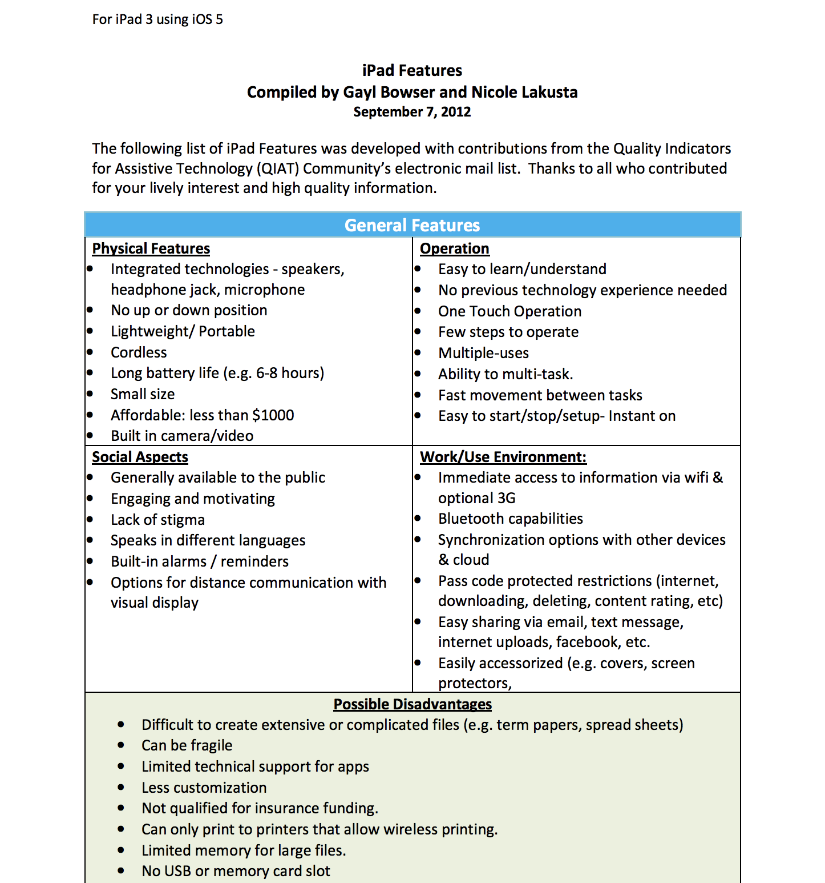
iPad Feature Chart
http://www.qiat.org/docs/resourcebank/QIAT-iPad%20FeaturesChart-9-7-12.pdf

Slide 22
App/Ext Assessment Resources

Slide 23
Assistive Technology Internet Modules (ATIM)
Using the WATI AT Assessment Process (a few examples)
Reading
Writing
Organization
Math
http://atinternetmodules.org

Slide 24
Feature Matching
Student Inventory for Technology Supports
www.atfeaturematching.org
Notes:
Add feature matching video

Slide 25
SIFTS
www.atfeaturematching.org

Slide 26
App/Ext Selection Resources

Slide 27
What’s the difference between plugins, extensions, and apps?

Slide 28
Plugins
provide some additional functionality to a web browser
phased out due to development of apps and extensions
function of some plugins being incorporated into the settings of browsers.

Slide 29
Extensions
Little or no user interface (UI) component.
Extends the functionality of browsers and the websites
  Adds a new button to the address bar (e.g. ever-present currency converter, pinterest button)
  Adds buttons on any web page viewed within the browser (e.g. “Mail It” or “BrowseAloud”)
Notes:
Show Browse Aloud example

Slide 30
Apps
work within a browser or stand alone within an operating system (Chrome vs Apple & Android)
typically have a dedicated user interface and, rich user interaction
more rich and interactive than a website
less cumbersome than a desktop application on a computer operating system but less feature rich

Slide 31
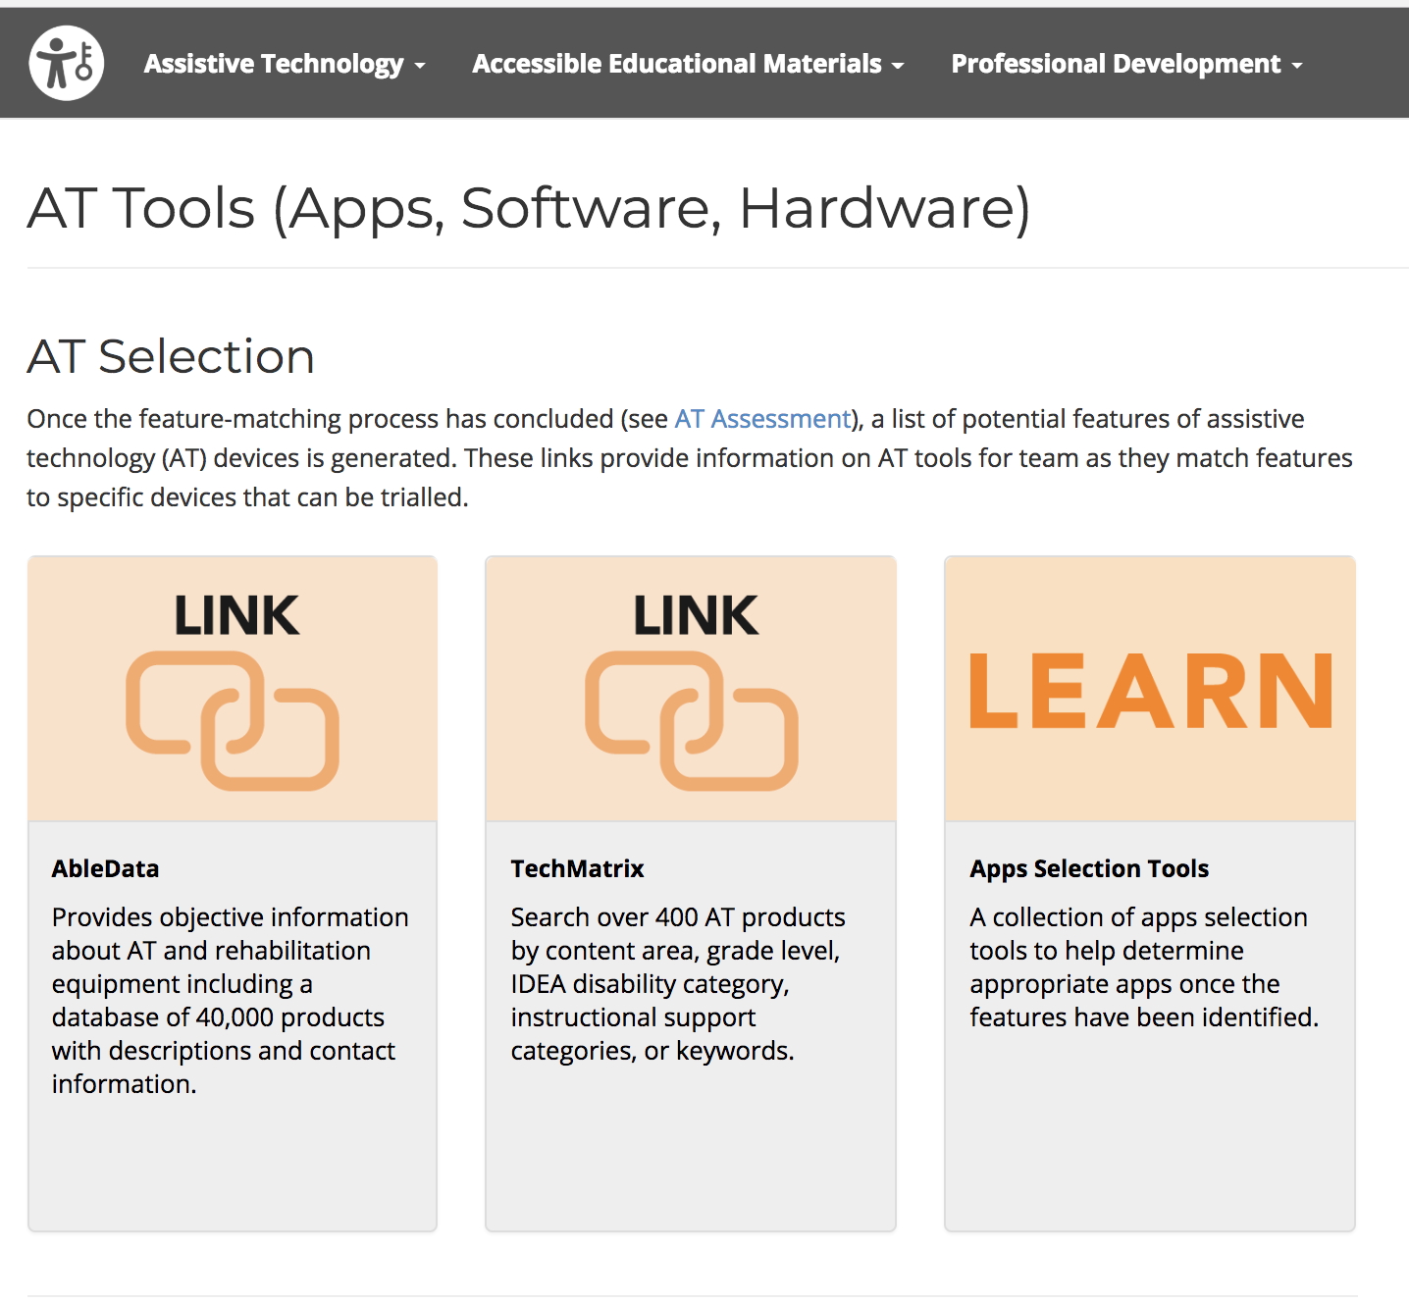
App Search Tools
https://ataem.org/at-tools

Slide 32
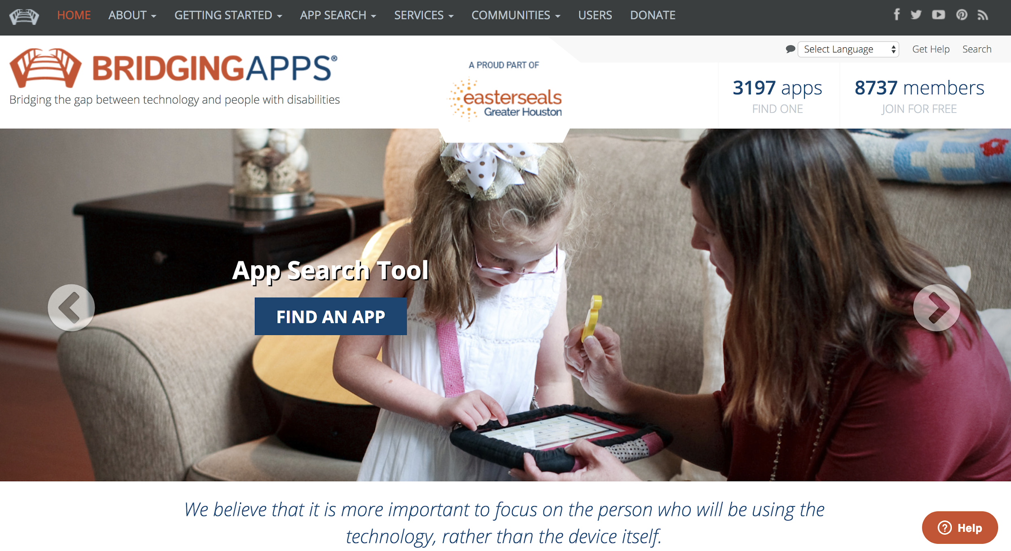
Bridging Apps
http://bridgingapps.org/
Notes:
Bridging Apps - Enter as a teacher, parent, therapist or a variety of other professions. The "Insignio" search tool allows you to search and compare topics. Then review screenshots, skill levels, reviews, links and more.

Slide 33
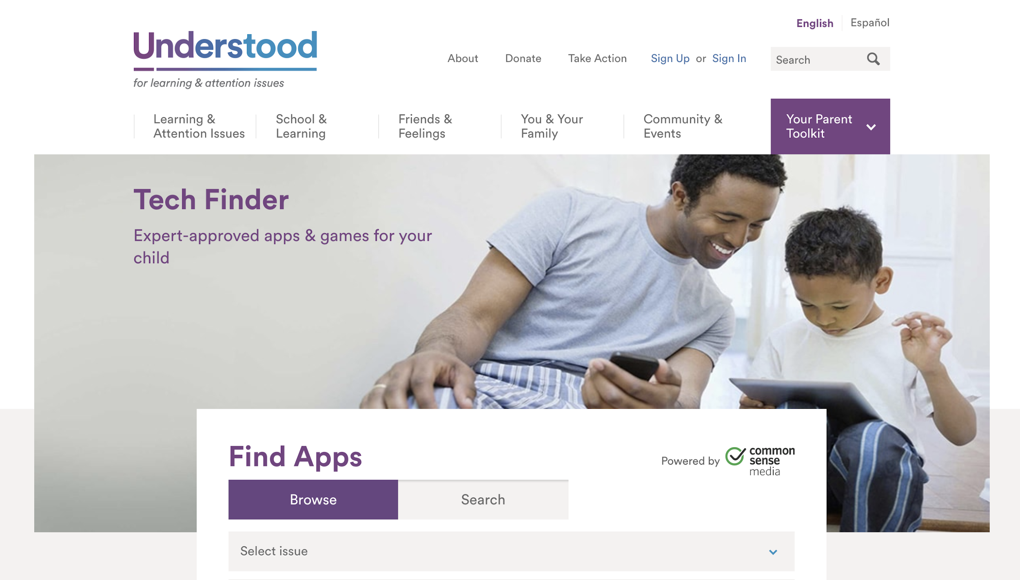
Understood Tech Finder
https://www.understood.org/en/tools/tech-finder
Notes:
Understood Tech Finder - An apps search engine for multiple curriculum areas and disability needs. Grade levels and quality ratings provided.

Slide 34
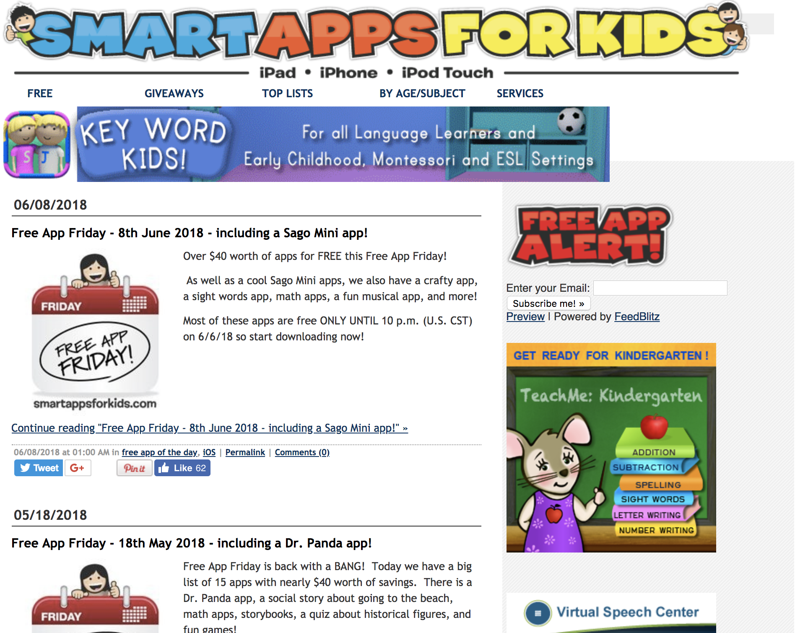
Smart Apps for Kids
http://www.smartappsforkids.com/
Notes:
Smart Apps for Kids - Mostly educational apps but also apps for students with special needs. This website maintains a free app section and showcases "Free Apps Fridays" which contains limited access to paid apps.

Slide 35
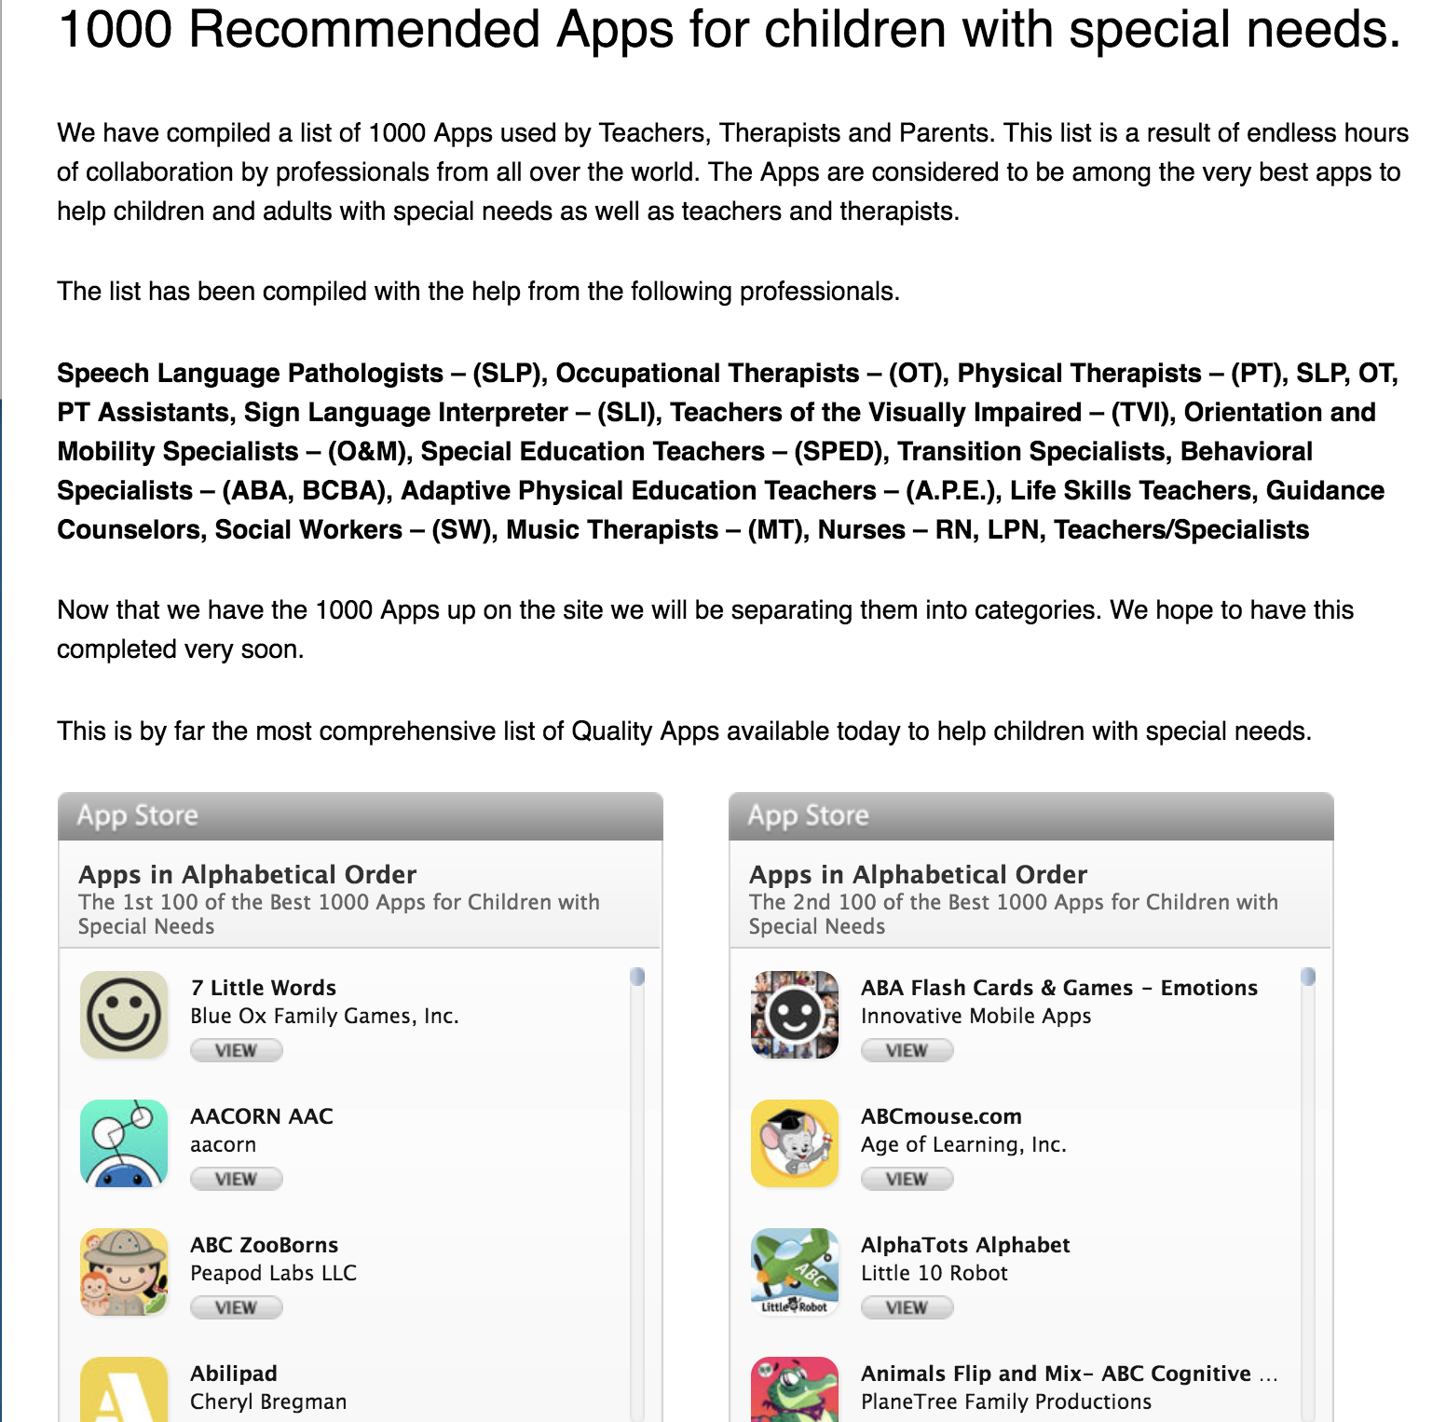
Apps for Children with Special Needs
http://a4cwsn.com/
Notes:
Apps for Children with Special Needs - Video reviews of apps for students with special needs. This site also features app promotions and giveaways.

Slide 36
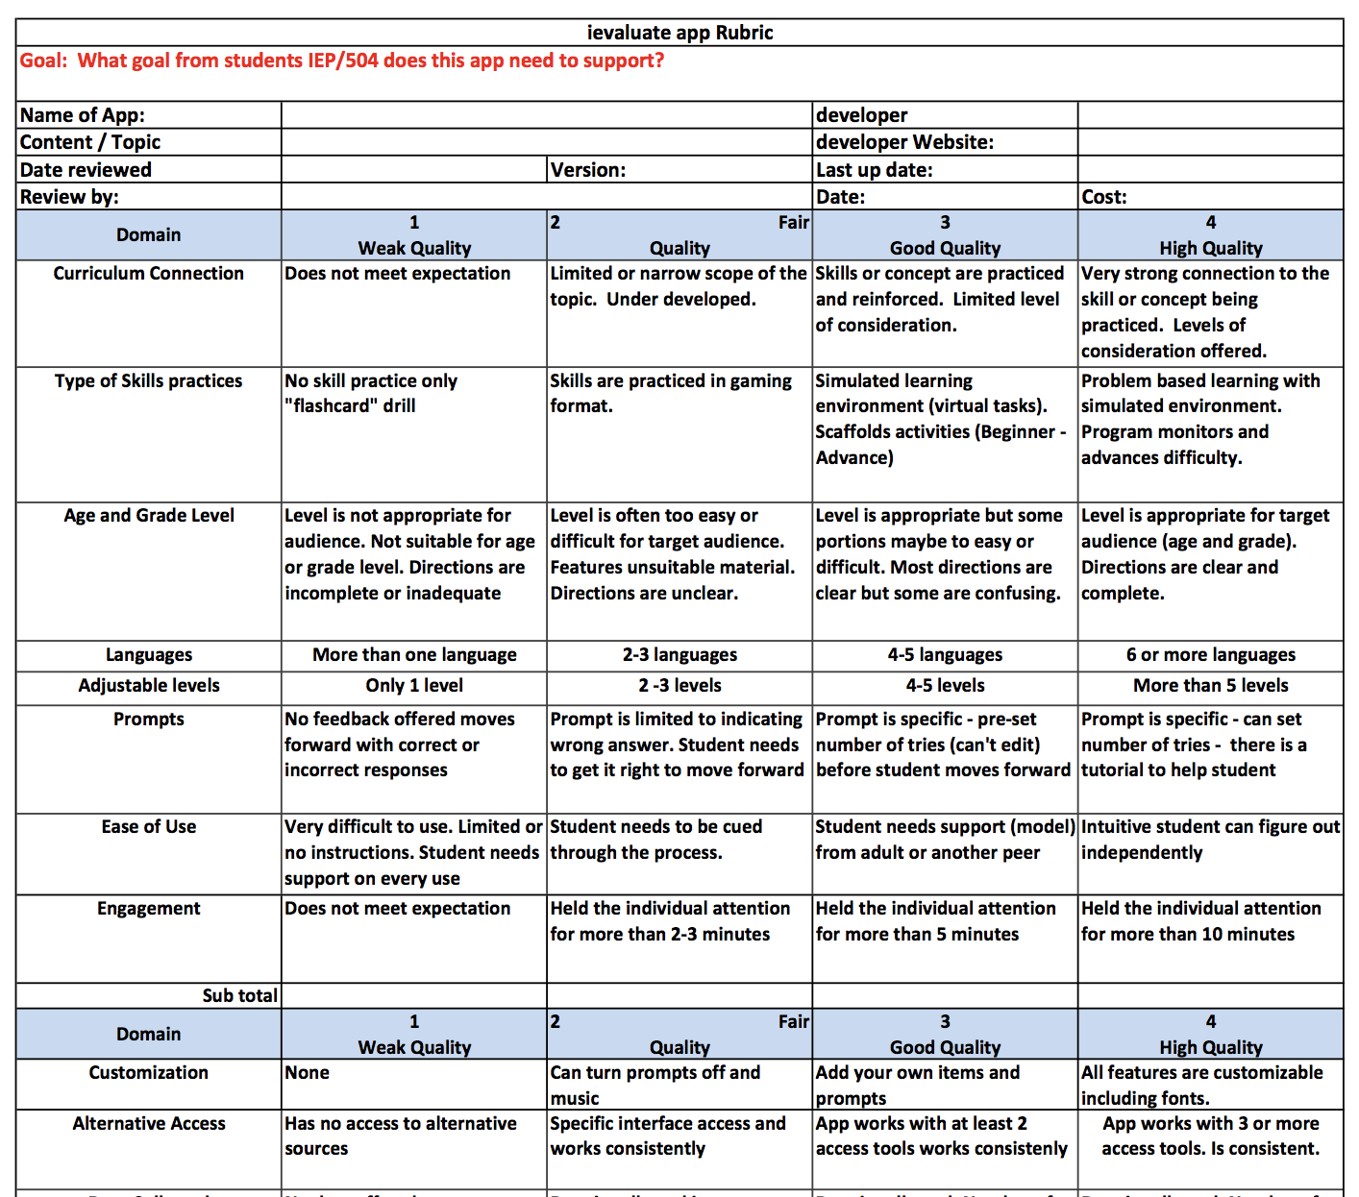
iEvaluate App Rubric
https://static.squarespace.com/static/50eca855e4b0939ae8bb12d9/50ecb58ee4b0b16f176a9e7d/50ecb593e4b0b16f176aa97b/1330388174777/JeanetteVanHoutenRubric.pdf

Slide 37
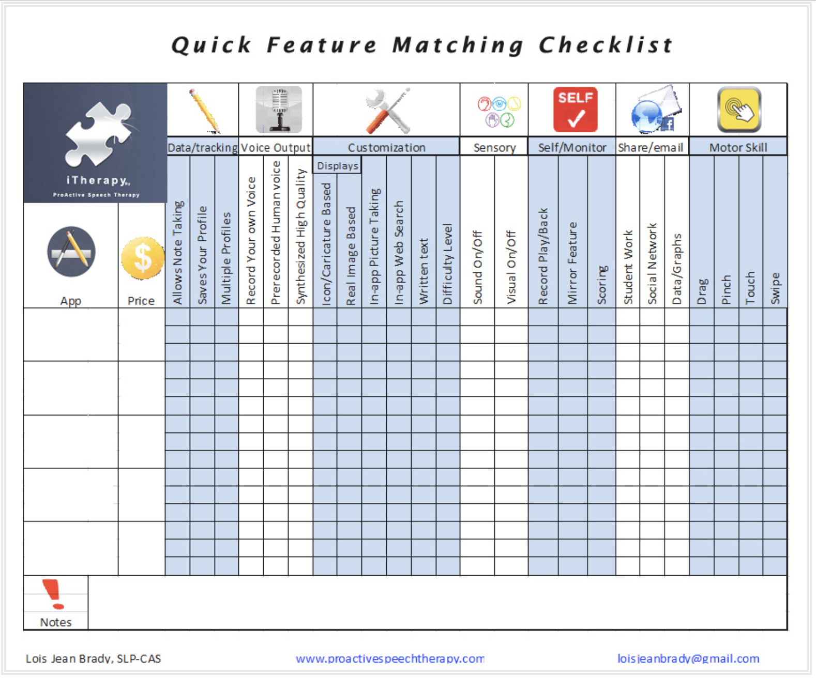
Quick Feature Matching Checklist
https://proactivespeech.wordpress.com/2012/07/24/quick-feature-matching-checklist-for-ipad-apps/

Slide 38
App/Ext Smackdown
Notes:
One app at a time per person
Provide name of app
Description of the app with features
Who would benefit from the features provided in the app
Cost
Link
App or Extension
Platform

Slide 39

http://bit.ly/AppSmackSPS2018
Notes:
Editing turned on so feel free to add to the document

Slide 40
Rules of Engagement
Showcase no more than 3 apps/exts at a time
Provide name of app/ext
Describe the app/ext and features
Describe the app/ext use (AT, educational, therapeutic)

Slide 41
Rules of Engagement
Indicate who benefits from the app/ext
Provide the app/ext cost
Provide app/ext link
Indicate the app/ext platform/s

Slide 42
App/Ext Use - Educational
Technology used to support learning and teaching.
Sometimes educational technology can be assistive technology if it is needed by a student to perform in the education setting

Slide 43
App/Ext Use - Therapeutic
Used to develop the skills needed to improve, increase, maintain, the functional capabilities of an individual

Slide 44
App/Ext Use - Assistive Technology
Used to increase, maintain, or improve the functional capabilities of an individual.
Often times provides access during skill development.
Is defined by need.

Slide 45
Let the fun begin!!!!!

Slide 46
Learning Objectives
Identify apps and/or exts. to support curriculum access and school participation
Identify features of the various apps/exts. presented that could be matched to student needs
Develop a better understanding of how to select apps to meet the needs of students with disabilities
Understand the difference between educational/therapuetic and assistive technologies

Slide 47
Thank you for learning with the
AT&AEM Center Powered by OCALI

