Slide 1
Tobii + Dynavox = Great Options to Help Students Communicate
Dan Lipka. M.Ed, OTL
dan.lipka@tobiidynavox.com 330-620-1040

Slide 2
Tobii merges with Dynavox: May 2014
Dynavox
Brand name recognition
Struggled after going public, but now back and on the right track
Best for lightweight portable SGD’s
New Companion software
New T Series SGD’s
New Boardmaker Online
Tobii
World leader for high tech, especially eye gaze access
Smaller but large engineering team
Research and analysis
Non SGD uses of eye gaze (gaming)
Adaptive computer access in addition to SGD
Very active with regulatory changes in public policy
tobiidynavox is the largest AAC/SGD manufacturer in the world!

Slide 3
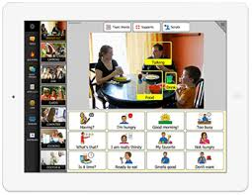
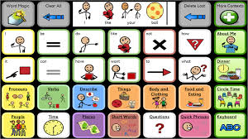
Software: Communication (vocabulary) Options
Compass
Collaborative or cohort based communication solutions
Cross platform compitability
Multiple page set options for different needs
Some by Dynavox content group
Others by well known language experts
One size does not fit all
5 levels within most page sets
Tobii Communicator 4
More intuitive windows based model
Great for customizing
Pagesetcentral.com for more content
14 different languages
Sono Suite novel approach to language development

Slide 4
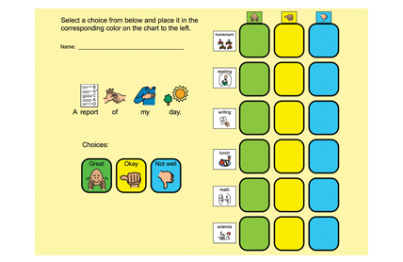
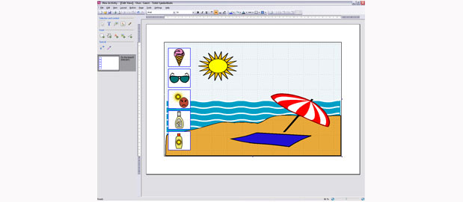
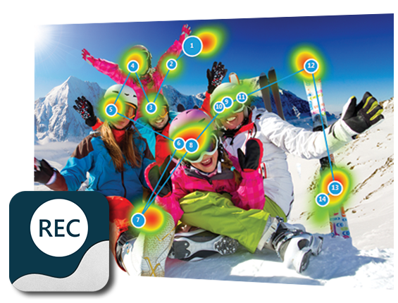
Software: Education and Support
Boardmaker Family
Boardmaker
Boardmaker Studio
Boardmaker Online
Boardmaker Curriculum
Boardmaker student app
Symbolmate
Symbol stix icons
Measurement
Tobii gaze viewer

Slide 5
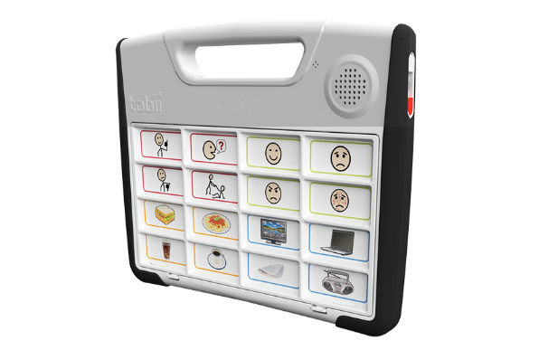
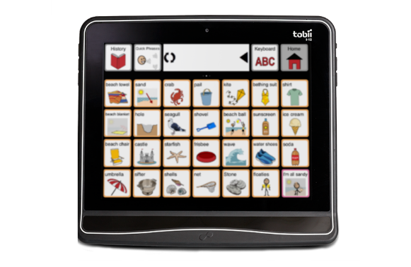
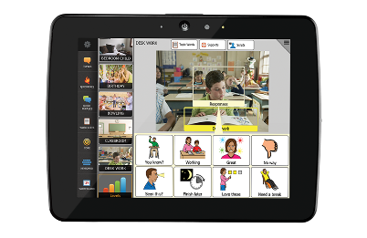
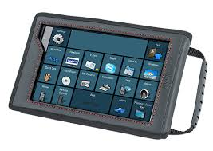
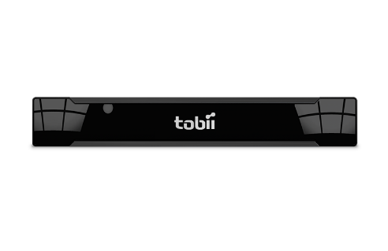
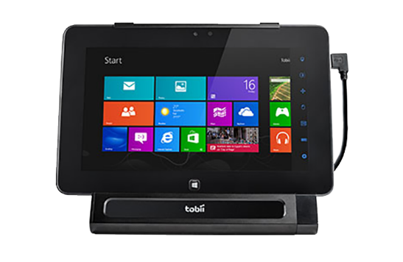
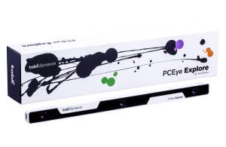
Tobiidynavox SGD Hardware
Static display
S32 Touch
S32 Scan
Text to Speech
Lightwriter SL40*
Dynamic Display
M8
T Series
T7
T10
T15
I Series
I12
I15
Computer options
PC Eye Go
PC Eye Mobile
PC Eye Explore
*Toby Churchill product

Slide 6
Compass Content Team
5 SLPs
2 Technical Content Developers
1 UI designer
This team works directly with the software team to build content and define features
Notes:
First, I think it’s important to understand who makes up the content development team. It’s comprised of 5 SLPs, 2 Technical Content Developers, and 1 UI designer.
UI stands for user interface, meaning creating a look and operation of the software that is user friendly for the consumer.
The Speech Language Pathologists on this team have over 50 years of combined experience in the field of AAC, with many of them coming from top therapy and research institutes like Rehab Institute of Chicago.
This team works directly with the software team to build content and define features for improved communication. So this alone is fairly unique, to have such an extensive team involved in the software development.
This is a piece of software built by a group of individuals that have a long history of developing AAC software and content.

Slide 7
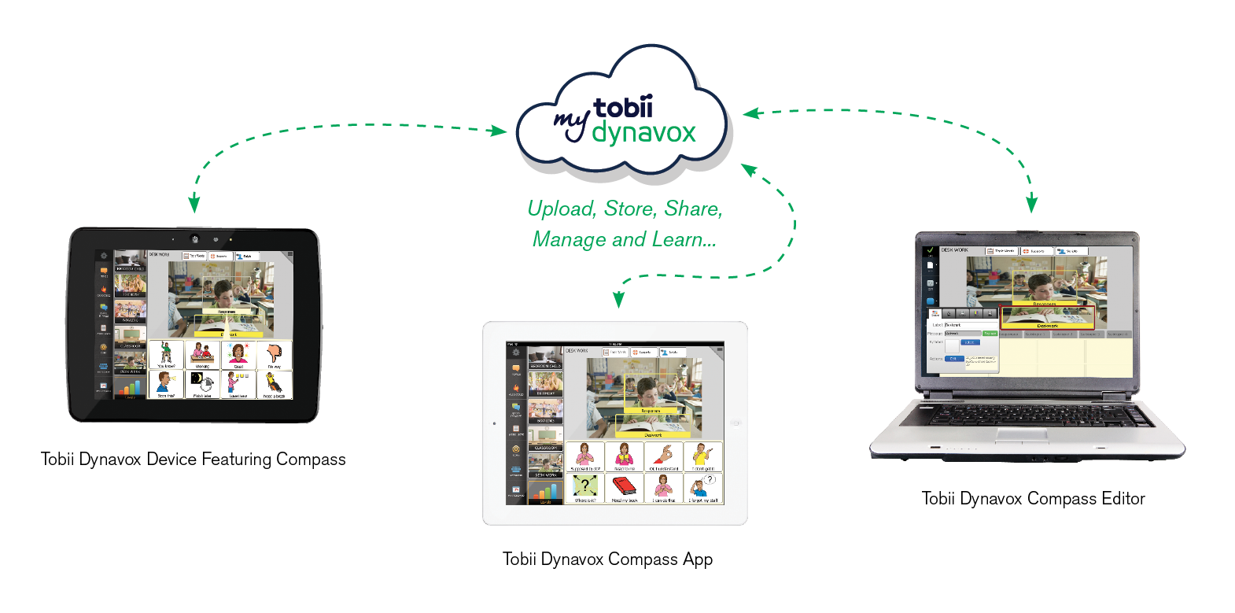
Compass: Communication Environment

Slide 8
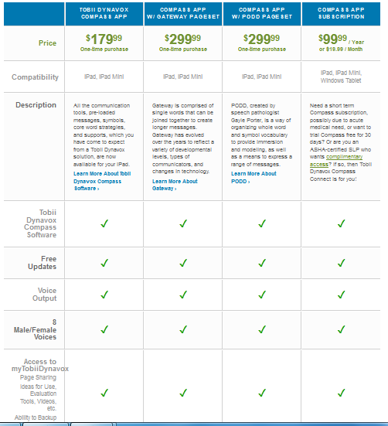
Compass Connect I Pad app
Options
Compass for Professionals
FREE!!
http://www.tobiidynavox.com/compass-app-overview/

Slide 9
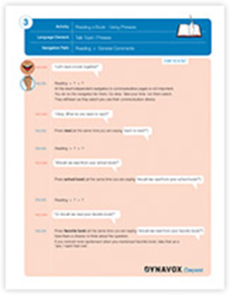
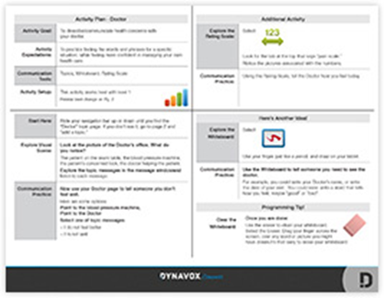
Mytobiidynavox.com
30 day free trial for anyone
6 month renewable trial for SLP’s using ASHA number
Includes Standard and Premium Page sets
Includes free Compass Connect I Pad app
Additional support resources
Videos
Evaluation tools
Sample lesson plans
Sample therapy plans
Research
Community

Slide 10
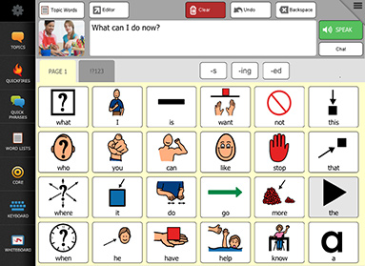
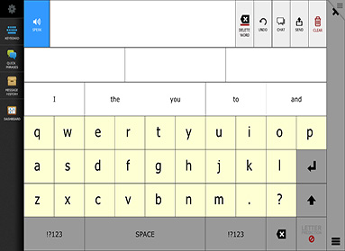
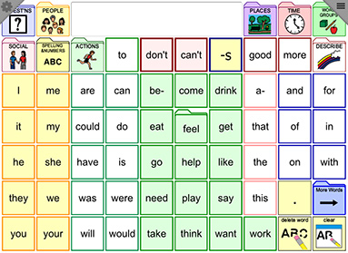
Compass: Standard Page Sets
All Access
Master Page sets
Nav Bar
Navigator
Text based
Stroke and Brain Injury
Word Power*
Nancy Inman developer
http://www.tobiidynavox.com/pagesets/

Slide 11
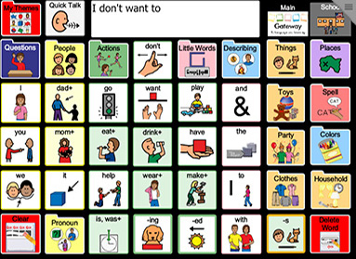
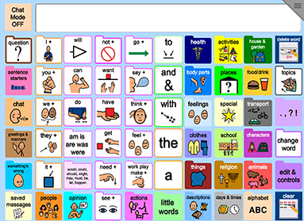
Compass: Premium Page Sets
Gateway
Joan Bruno
Learning
Language Impaired
Linguistically Compotent
PODD
Gayle Porter
15 and 60 location
http://www.tobiidynavox.com/premium-pagesets/

Slide 12
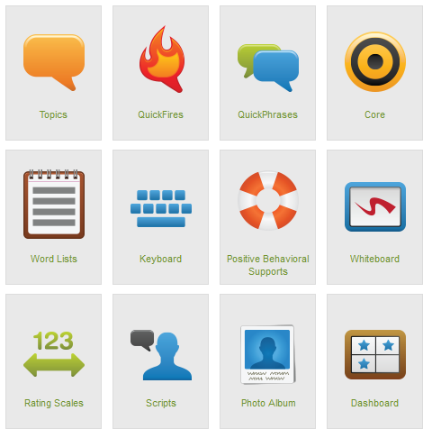
Compass: Communication Tools
Tools for different uses and needs
Topics
Quick Fires
Quick Phrases
Core Vocabulary
Word Lists (category)
Keyboard
BehaviorSupports
Whiteboard
Rating scale
Scripts
Dashboard
http://www.tobiidynavox.com/communication-tools/

Slide 13
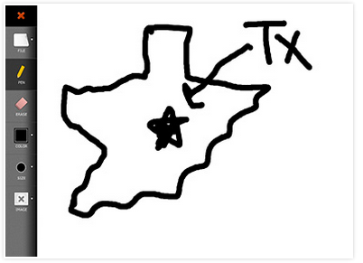
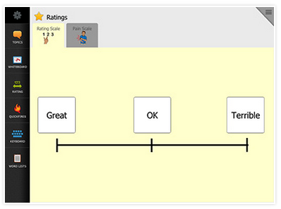
Compass: Communication Supports
Notes:
Another example is the Whiteboard – This was a low-tech tool that was found in every Aphasia therapy group, in hospitals and acute care settings, and in most any therapy settings when working with adults.
The dry erase board was found in all communication environments as a quick way to share an idea or thought.
And it was once again the goal of the development team, to take that communication support and make it an integrated tool in the Compass software.
We see that same type of development for supports like rating scales and use of scripts.
Solutions created for this communication cohort but are finding use with other individuals as well.

Slide 14
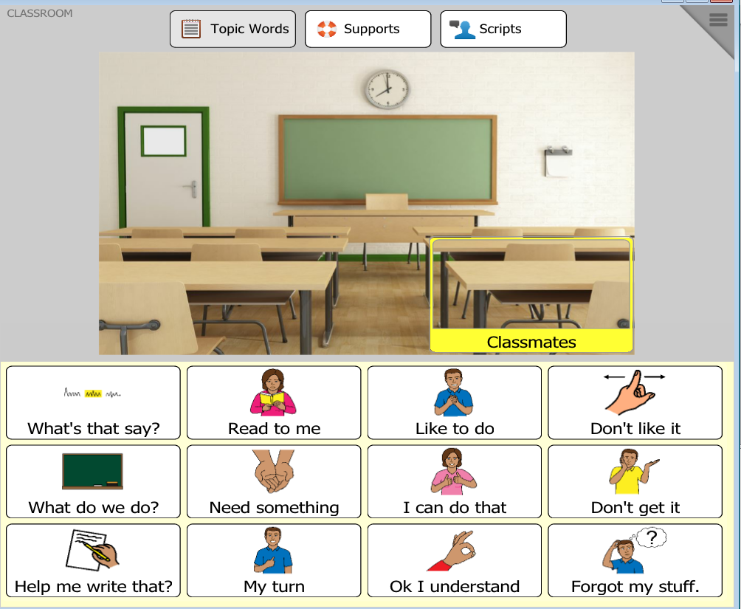
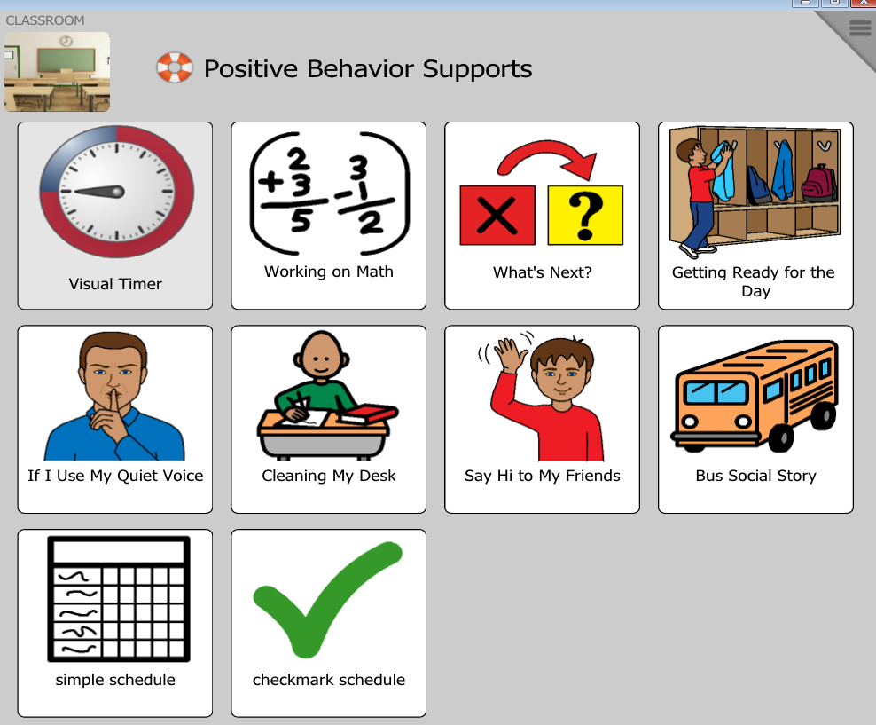
Compass: Communication Behavior Supports
Notes:
The Supports Tab provides the opportunity for the seamless integration of behavior supports in that individual’s communication program. It is no longer an additional support but a true integrated support.

Slide 15
Questions? Now lets talk eye gaze!

Slide 16
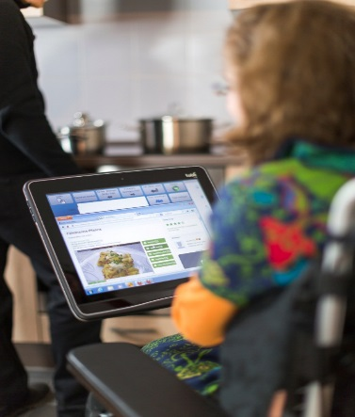
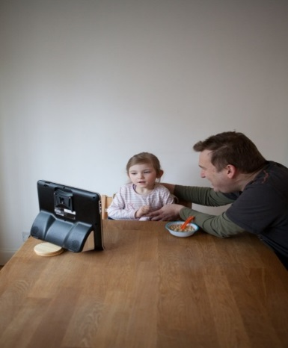
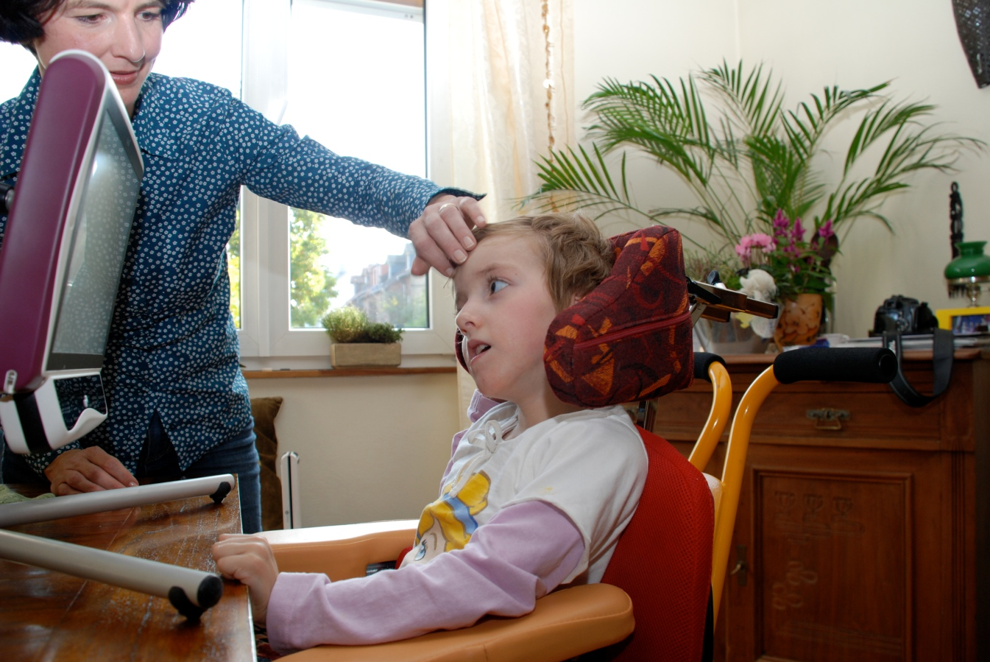
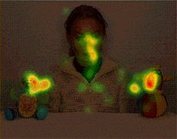
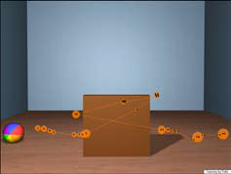
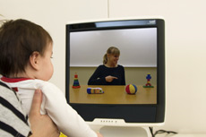
Eye Tracking vs. Eye Control & Gaze Interaction
Eye Tracking is when the device “maps” or “tracks” the eyes and a person’s gaze point on an area (where they are looking).
Eye Control/ Gaze Interaction is what is used when a user is “controlling” a device with their eye movements and gaze direction; selecting and “clicking” objects and navigating computer interfaces hands free.

Slide 17
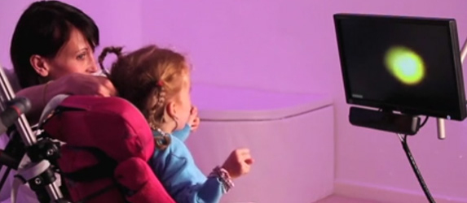
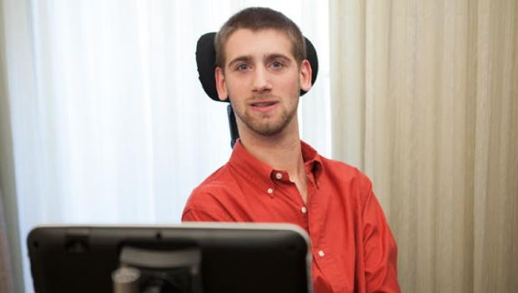
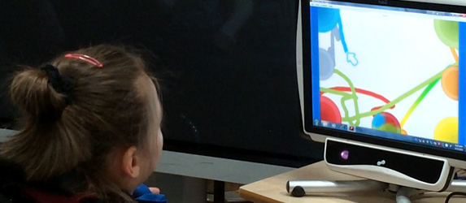
Eye Control
Eye Tracking is like no other access
Looking v Controlling
Learning Curve
Sensory
Early eye Tracking
Exploration
Choosing and turn taking
Communication
Computer access

Slide 18
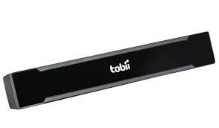
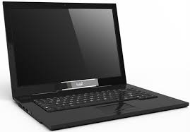
Eye Control
Computer Access

Slide 19
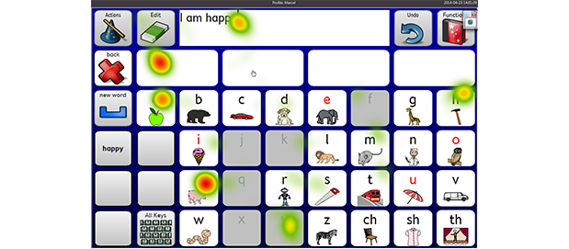
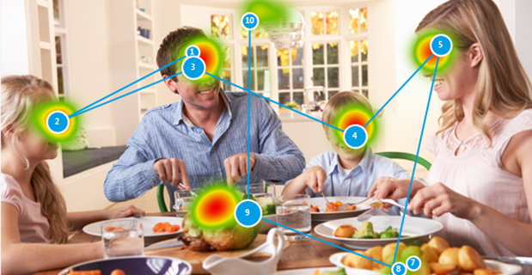
Eye Tracking
Tobii Gaze Viewer
Records where a person looks on the screen
ANY screen content
Heat map
Gaze plots
Play back video or screen shot

Slide 20
How eye tracking works
Not all eye tracers are the same!

Slide 21
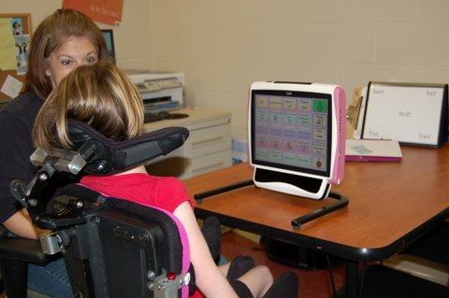
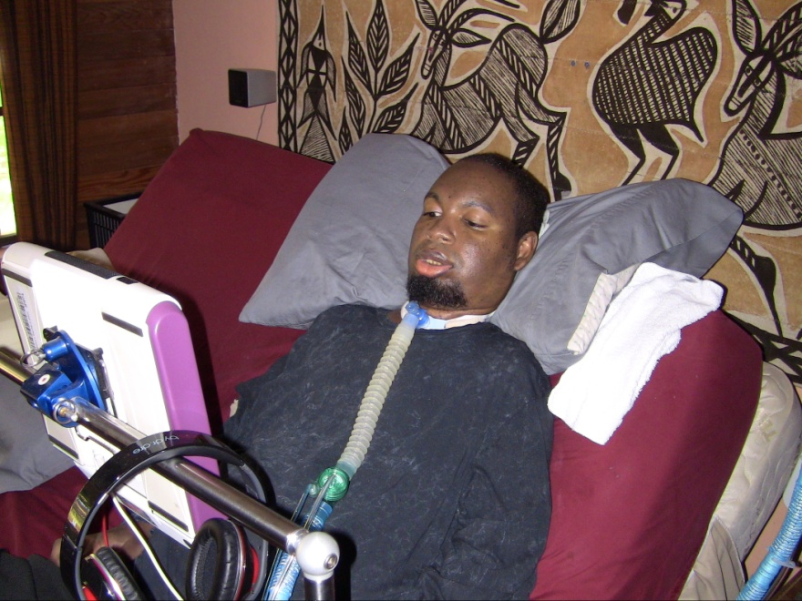
Eye control is “just” an access method. Questions to ask:
Does eye control require less effort than other access methods?
Is the individual in a more comfortable and better position physically using eye control than other access methods?
Is the individual more independent in using eye control than other access methods?
Is eye control significantly faster than other access methods?

Slide 22
Positioning is everything!

Slide 23
Practice!
Eye Control practice can take minutes, hours, or days…it depends on the individual.
Typically, with practice, Dwell time with Mouse Emulation will decrease…especially when the person becomes familiar with the page set.
For Communicators, practice should occur on the primary communication page set to decrease the cognitive load of gathering information….
….but periodic breaks to games to work on eye control will increase eye control skills as well.

Slide 24
Thank You!

